Slide 1
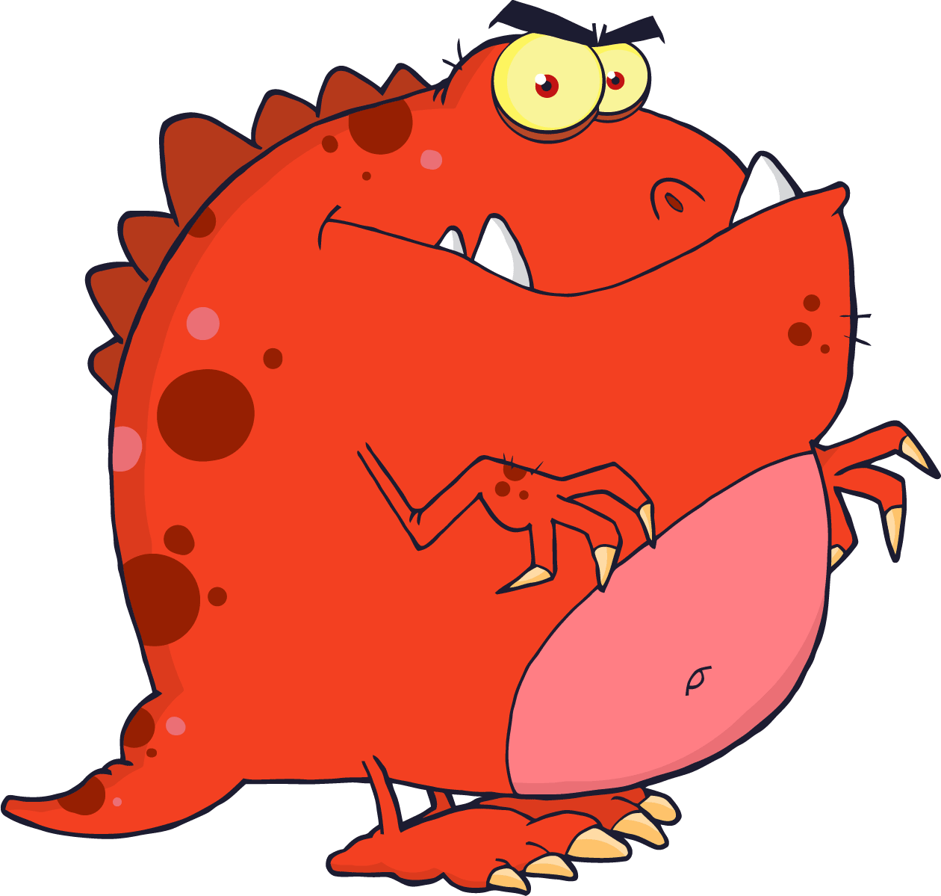
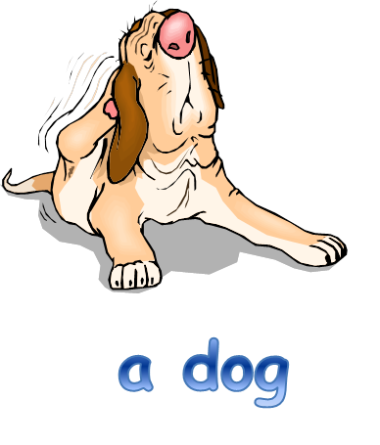
Noun phrases
Using words to describe and specify

Slide 2
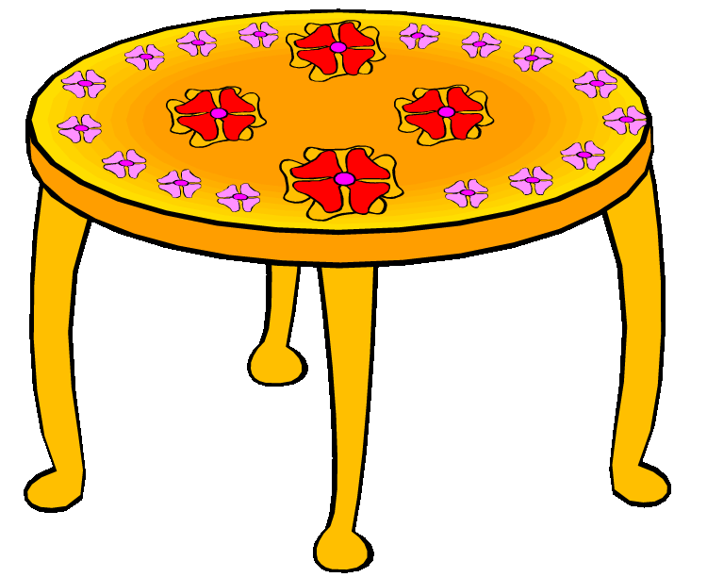
Noun phrase
A noun phrase is a group of two or more words that contains a noun but no verb to tell us what the noun is doing or feeling.
a table
the flowers

Slide 3
Expanded noun phrase
An expanded noun phrase is a noun phrase with extra details added.
Adjectives can be added to add more information:
a patterned table
the red flowers

Slide 4
Look at the pictures on the following pages and see if you can think of ways to expand the noun phrase by adding adjectives.

Slide 5
a tree

Slide 6
a dog

Slide 7
the man

Slide 8
the lady

Slide 9

the octopus

Slide 10
a butterfly

Slide 11
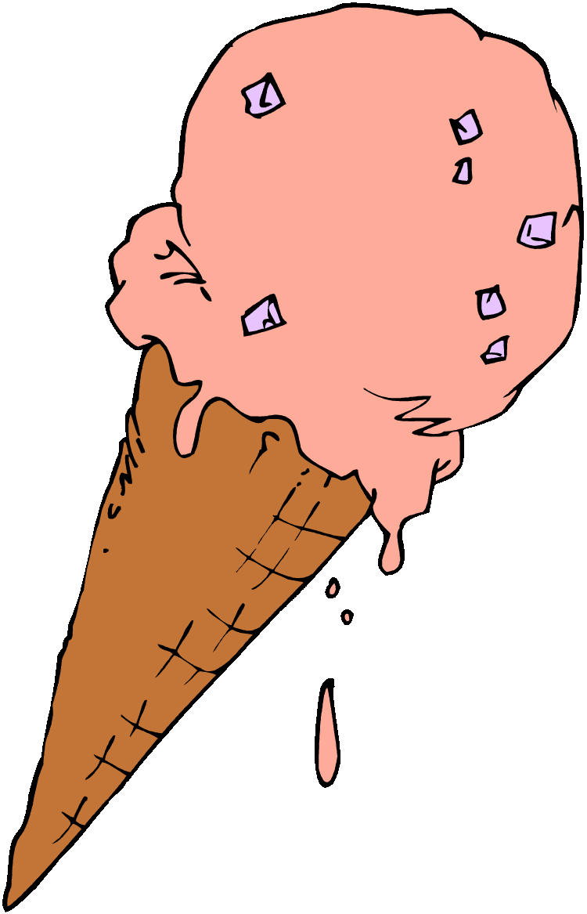
the ice-cream

Slide 12
the baby

Slide 13
the storm

Slide 14

How did you do?
Do you think you will be able to write more interesting sentences using expanded noun phrases?

