Slide 1

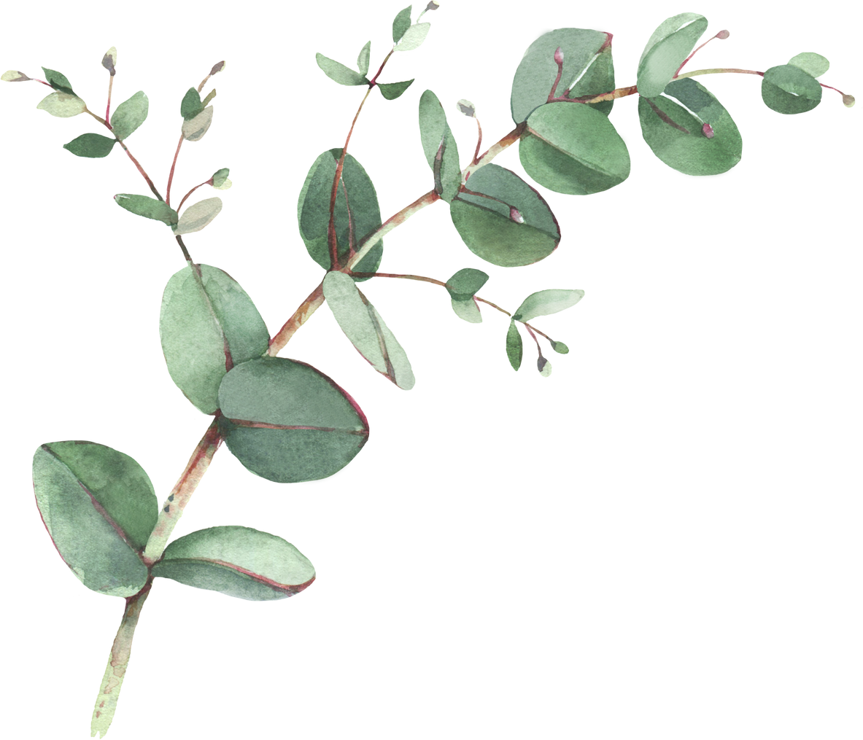
Year 2 Spellings- Summer 2
Week 1- WB 7th June 2027 | Week 2- WB 14th June 2027 | Week 3 – WB 21st June 2027
Animals Laughed Because Different Another Before Everyone Liked | Measure Exposure Television Casual Occasion Visual Invasion Division | Signature Furniture Sketcher Snatcher Dispatcher Catcher Creature Fixture
Week 4 – WB 28th June 2027 | Week 5 – WB 5th July 2027 | Week 6 – WB 12th July 2027
Wonderful Thirstily Beautiful Pleasure Exciting Their There They’re | Quiet Remember Manage Seaside Happiness Umbrella Towards Scene | Graceful Refused Cabbages Strapped Little Hedgehogs Skating Gerbils

