Slide 1

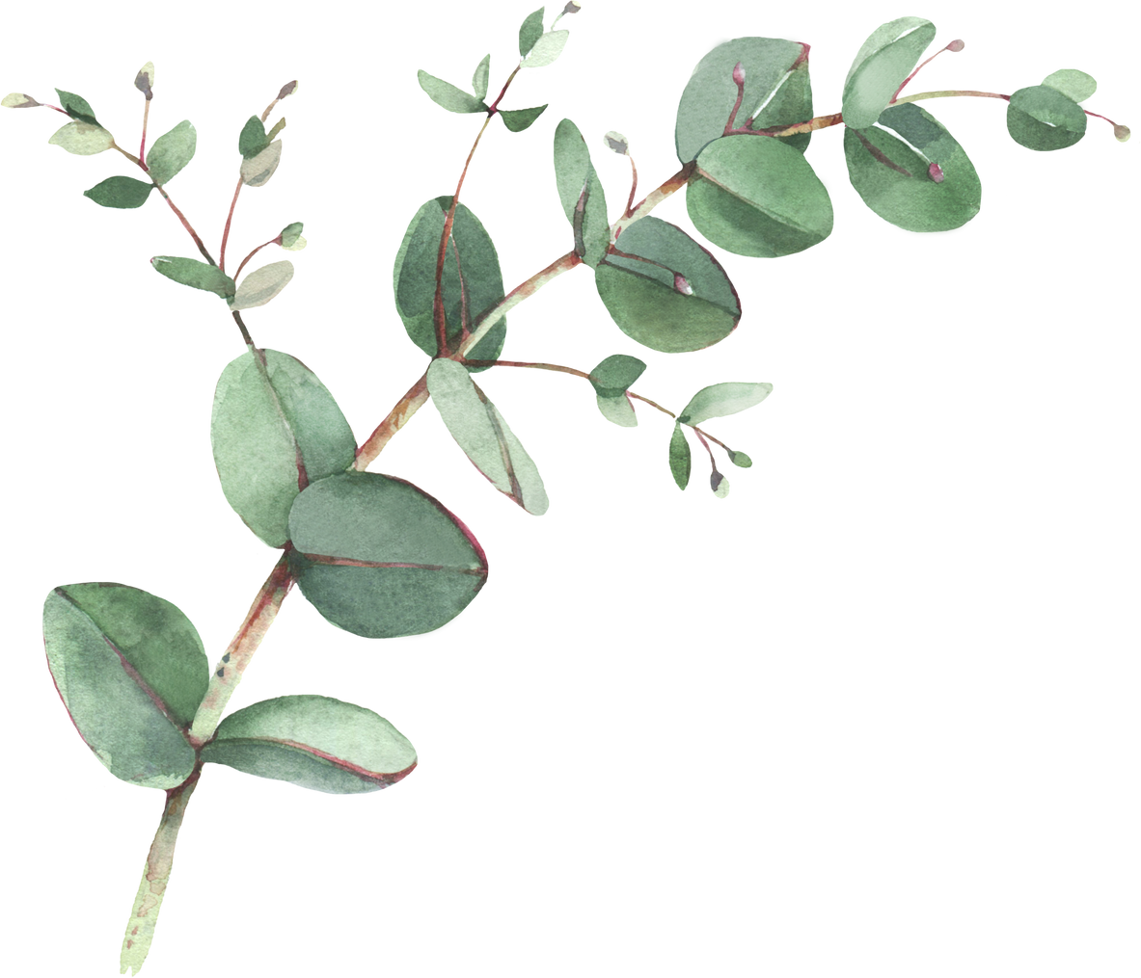
Year 2 Spellings- Summer 1
Week 1- WB 12th April 2027 | Week 2- WB 19th April 2027 | Week 3 – WB 26th April 2027
Half Mr Any Clothes People Again Money Mrs | Urgent Fringe Great Taller Alright Giant Calling Subject | Mother Brother Glove Watch Halt Month Another Quarrel
Week 4- WB 4th May 2027 | Week 5 – WB 10th May 2027 | Week 6 – WB 17th May 2027
Word Worm Worse Worthless World Warden Swarm Forwards | Knew Knife Knock Knit Gnash Gnome Design Gnarl | Payment Government Judgement Weakness Sickness Agreement Improvement Illness

