Slide 1

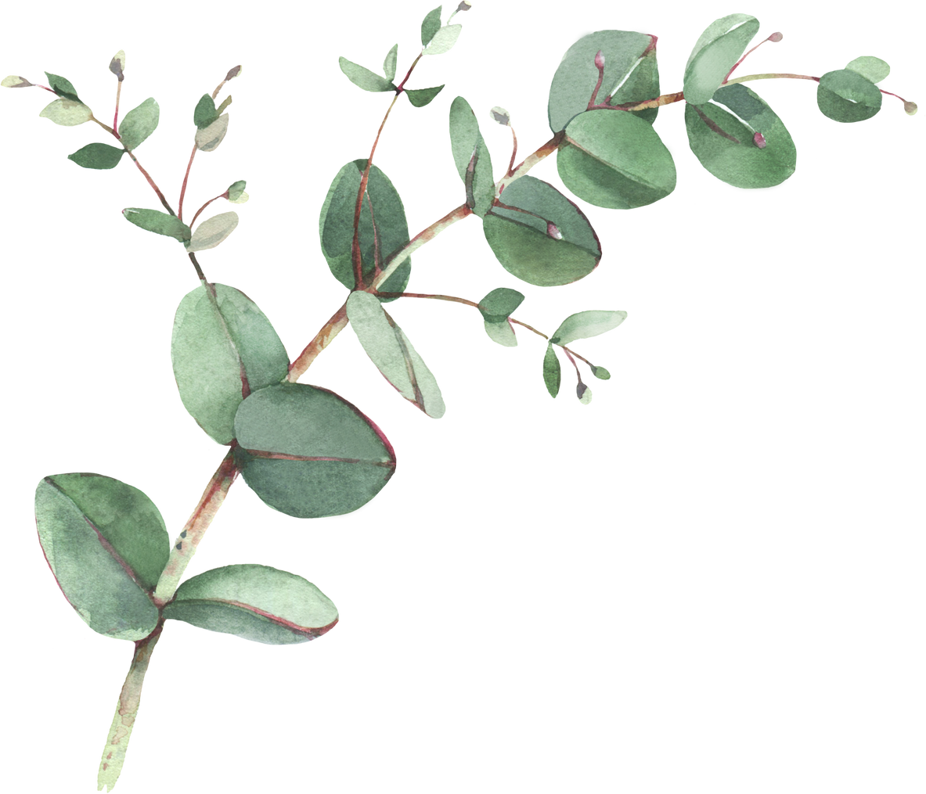
Year 2 Spellings- Spring 2
Week 1- WB 22nd February 2027 | Week 2- WB 1st March 2027 | Week 3- WB 8th March 2027
Vein Thief Fright Mould Perfume Toast Extreme Choose | Lonely Gladly Safely Quickly Bravely Sensibly Really Cheerfully | Pears Buses Tomatoes Foxes Benches Apples Boxes Bananas
Week 4- WB 15th March 2027 | Week 5- WB 22nd March 2026
Cabbage Jumper Energy Magic Jacket Village Hinge Garage | Centre Place Once Graceful Geese Price Expect Since

