Slide 1

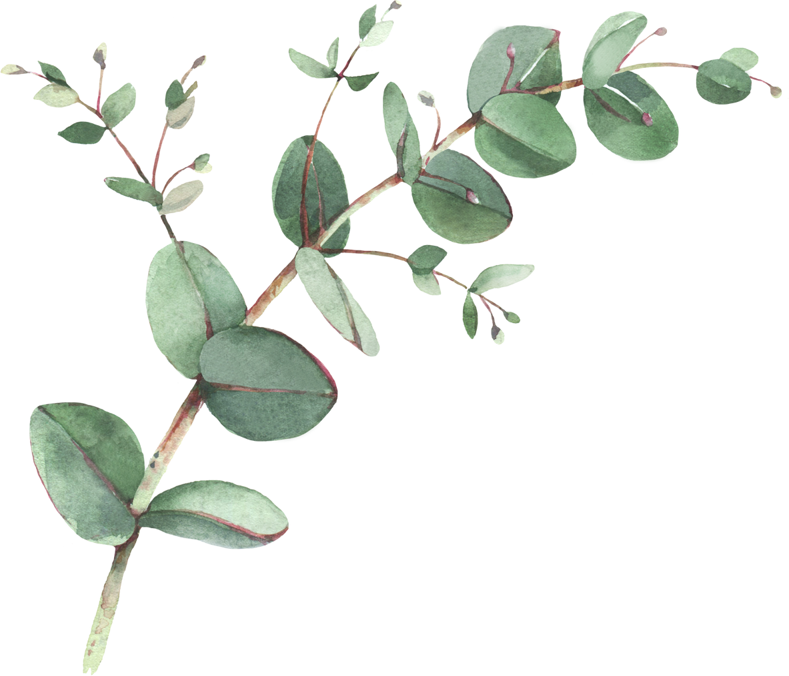
Year 2 Spellings- Spring 1
Week 1- WB 5th January 2027 | Week 2- WB 11th January 2027 | Week 3 – WB 18th January 2027
Great Seaside Stay Cake Careful After Eating Holding | Painless Fearless Hopeless Mindless Years Steer Software Downstairs | Bottle Ripple Travel Bubble Camel Flannel Towel Terrible
Week 4 – WB 27th January 2027 | Week 5 – WB 1st February 2027 | Week 6 – 8th February 2027
Petal Devil Herbal Evil Local Daffodil Until Royal | Nosiest Furrier Studying Carries Hurried Heavier Easier Jellies | Spies Trying Fries Driest Replied Supplies Flying Shyest

