Slide 1

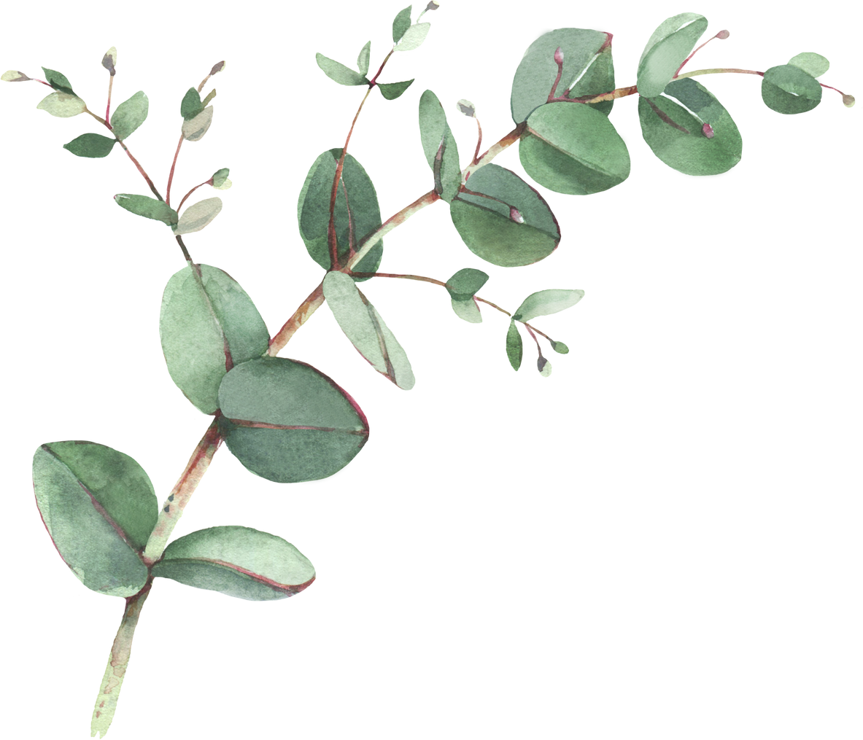
Year 2 Spellings- Autumn 2
Week 1- WB 3rd November 2026 | Week 2- WB 9th November 2026 | Week 3 – WB 16th November 2026
Soap Explode Throat Pillow Stroking Stony Toast Grown | Writes Wrecks Wrong Wrenched Wriggle Wrapped Wren Wrinkle | Nurse First Turning Serve Farmer Thursday Perfect Squirm
Week 4- WB 23rd November 2026 | Week 5- WB 30th November 2026 | Week 6 – 7th December 2026
Town Crown Tower Proud About Shouting Scowled Mountain | Author Astronaut Bored Wore Crawled Haunted Before Snore | Years Smear Downstairs Software Clear Steer Dearest Hearing

