Slide 1
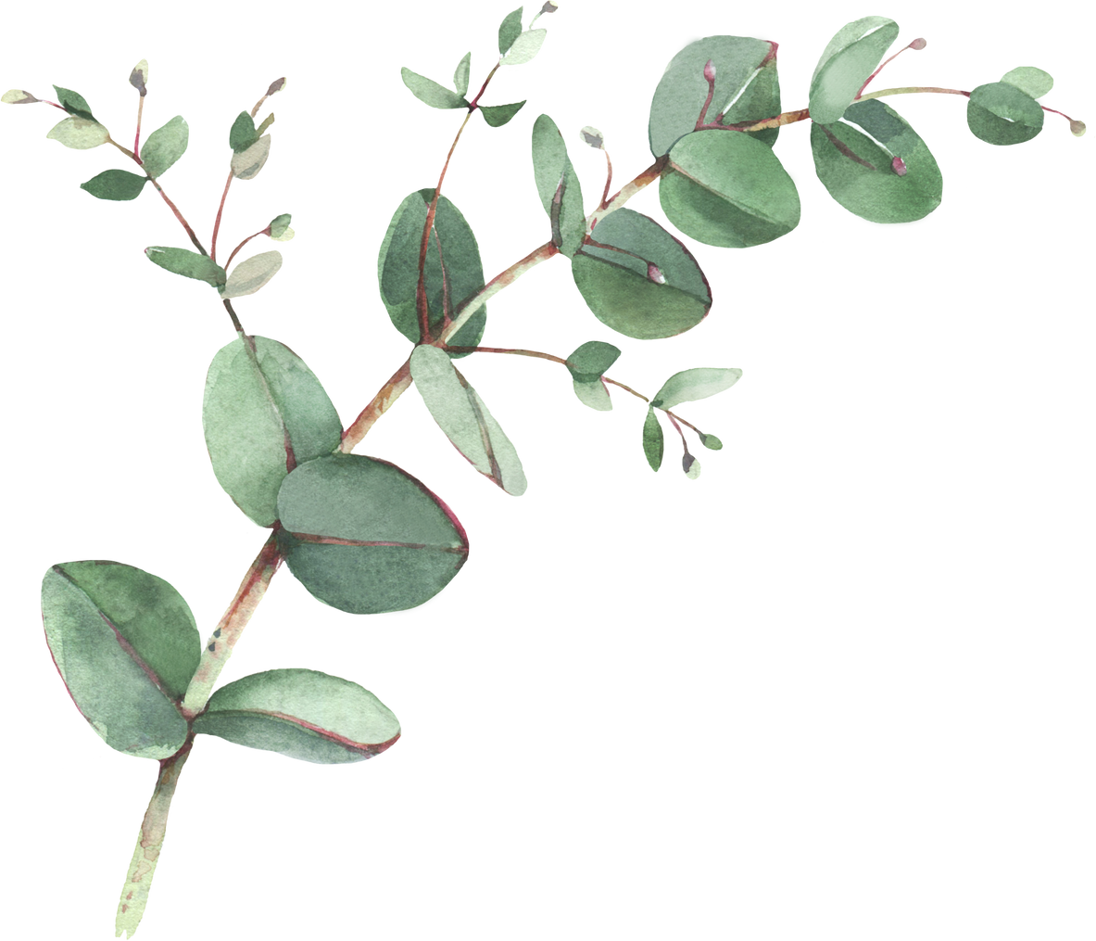

Year 2 Spellings- Autumn 1
Week 1- WB 7th September 2026 | Week 2- WB 14th September 2026 | Week 3 – WB 21st September 2026
They Friend Came People Said Children Called When | Taken Amazed Flaky Chasing Mistaken Skater Can’t Didn’t | Grating Baking Shaver Chased Named Sleepy See Sea
Week 4 – WB 28th September 2026 | Week 5 – WB 5th October 2026 | Week 6 – WB 12th October 2026
Thief Completed These Shriek Pleased Giving Bee Be | Delight Untied Glide Flight Alike Crying Typed Replying | With Could House Asked About Here Little Very

