Slide 1
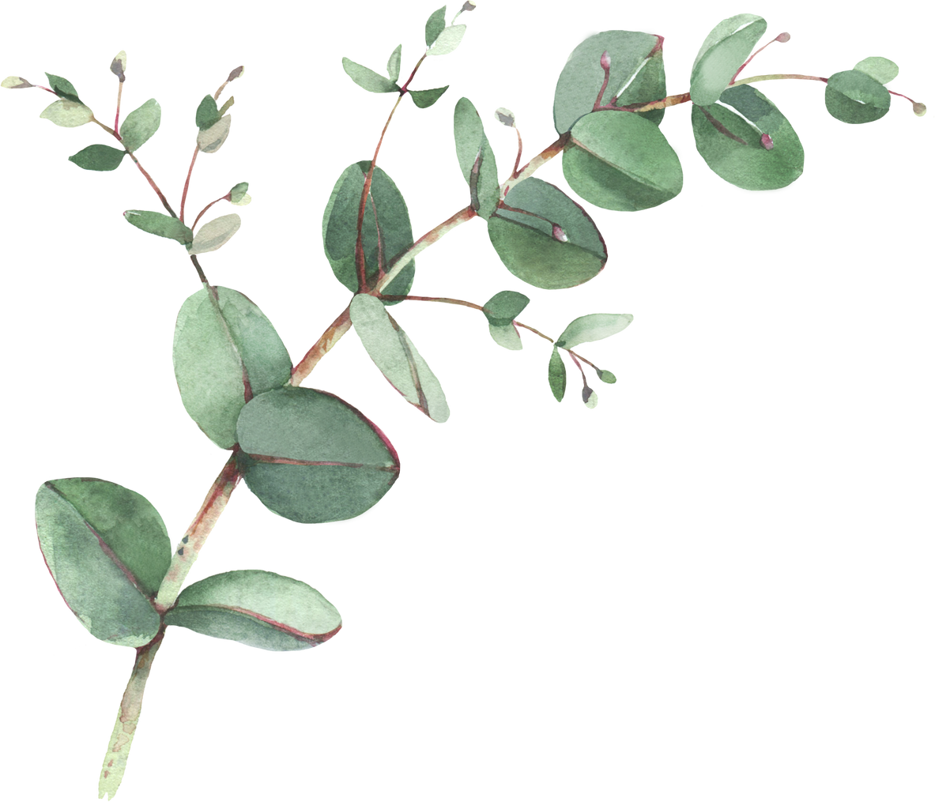

Year 1 Spellings – Spring 1
Week 1- WB 12th January | Week 2- WB 19th January | Week 3- WB 26th January
slide slime while ride hide shine could | home cone rope phone bone nose should | cube tube prune huge June flute after
i _ e In a while crocodile | o _ e Phone home | u _ e Huge cube
Week 4- WB 2nd February | Week 5- WB 9th February
fright tried five toe hope cute when | happy baby funny tiny lucky jelly would
consolidation | _ y Silly happy puppy

