Slide 1
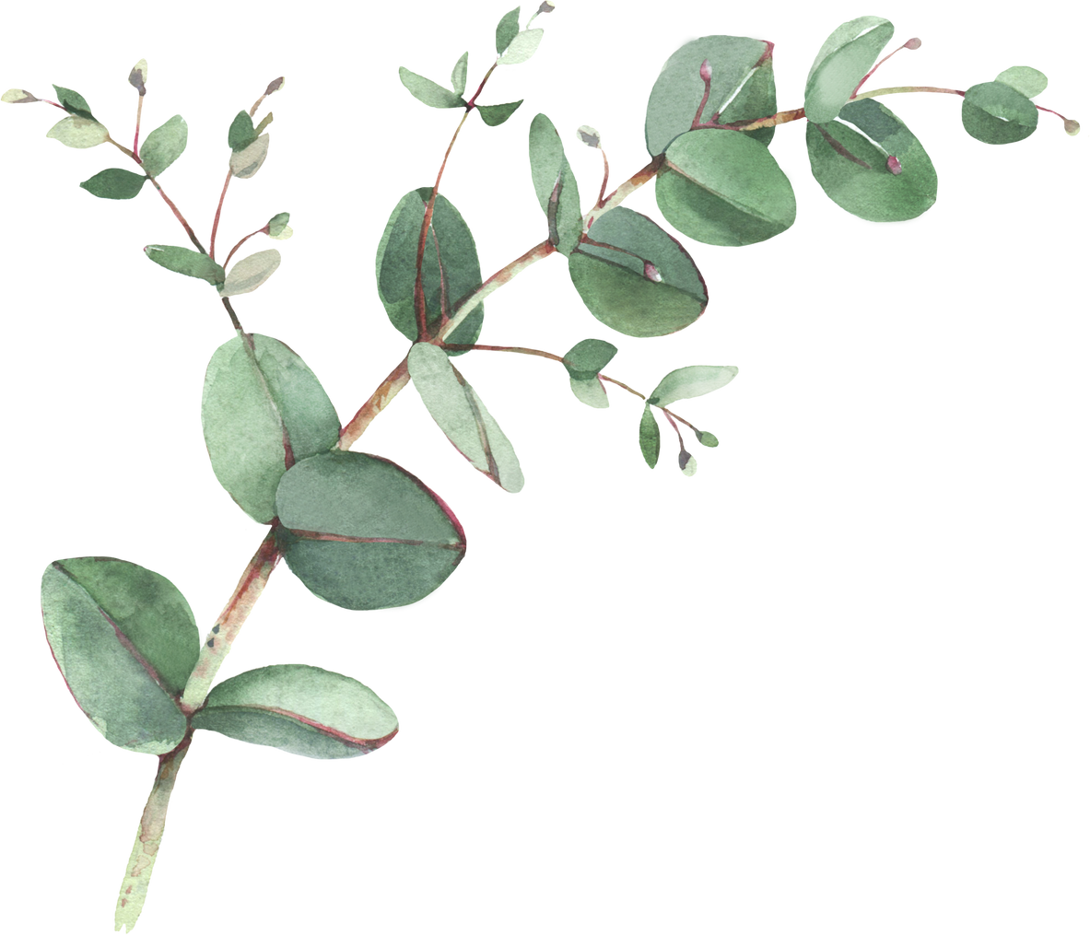

Year 5 Spellings- Autumn 1
Week 1- WB 8th September | Week 2- WB 15th September | Week 3- WB 22nd September
1. vicious 2. precious 3. conscious 4. delicious 5. malicious 6. suspicious 7. audacious 8. spacious 9. subconscious 10. unconscious | 1. ambitious 2. cautious 3. fictitious 4. infectious 5. nutritious 6. vexatious 7. pretentious 8. contentious 9. ostentatious 10. conscientious 11. overambitious 12. unpretentious | 1. physical 2. symbol 3. system 4. myth 5. gym 6. Egypt 7. pyramid 8. mystery 9. style 10. hymn 11. lyric 12. type
Week 4 – WB 29th September | Week 5 – WB 6th October | Week 6 – WB 13th October
1. conscience 2. conscious 3. controversy 4. convenience 5. confide 6. connected 7. content 8. control 9. consumer 10. continue 11. contract 12. conspire | 1. invention (y4) 2. injection (y4) 3. action (y4) 4. hesitation (y4) 5. completion (y4) 6. competition 7. explanation 8. pronunciation 9. dictation 10. position 11. fiction | 1. table (y3) 2. apple (y3) 3. bottle (y3) 4. little (y3) 5. middle (y3) 6. available 7. vegetable 8. vehicle 9. muscle 10. multiple 11. riddle 12. able

Slide 2
Year 5 Spellings- Autumn 2
Week 1- WB 3rd November | Week 2- WB 10th November | Week 3- WB 17th November
1. doubt 2. thistle 3. castle 4. island 5. lamb 6. numb 7. crumb 8. solemn 9. knight 10. knock 11. loch 12. ghost | 1. observant 2. observance 3. observation 4. expectant 5. expectation 6. hesitant 7. hesitancy 8. hesitation 9. tolerant 10. tolerance 11. toleration 12. substance 13. substantial 14. assistant 15. assistance | 1. innocent 2. innocence 3. decent 4. decency 5. frequent 6. frequency 7. confident 8. confidence 9. different 10. difference 11. competent 12. competency 13. obedient 14. obedience 15. independent 16. independence
Week 4 – WB 24th November | Week 5 – WB 1st December | Week 6 – WB 8th December
1. adorable 2. adorably 3. adoration 4. applicable 5. applicably 6. application 7. considerable 8. considerably 9. consideration | 1. changeable 2. noticeable 3. sizeable 4. likeable 5. liveable 6. loveable 7. dependable 8. comfortable 9. understandable 10. reasonable 11. enjoyable 12. reliable | 1. forcible 2. legible 3. horrible 4. terrible 5. visible 6. incredible 7. sensible 8. possible 9. invincible 10. flexible 11. illegible 12. tangible

Slide 3
Year 5 Spellings- Spring 1
Week 1- WB 5th January | Week 2- WB 12th January | Week 3- WB 19th January
1. possible 2. possibly 3. horrible 4. horribly 5. terrible 6. terribly 7. visible 8. visibly 9. incredible 10. incredibly 11. sensible 12. sensibly | 1. soldier 2. sufficient 3. variety 4. ancient 5. achieve 6. convenience 7. mischievous 8. believe 9. field (year 1) 10. chief (year 1) 11. pie 12. cried | 1. deceive 2. conceive 3. receive 4. perceive 5. ceiling 6. deceit 7. protein 8. caffeine 9. seize 10. either 11. neither
Week 4 – WB 26th January | Week 5 – WB 2nd February | Week 6 – WB 9th February
1. cemetery 2. convenience 3. excellent 4. existence 5. hindrance 6. necessary 7. prejudice 8. sacrifice 9. city (year 1) 10. civil 11. criticise 12. fancy (year 2) 13. bicycle | 1. co-ordinate 2. re-enter 3. co-operate 4. co-own 5. co-author 6. re-examine 7. re-educate 8. re-elect 9. co-operate 10. pre-existing | 1. parliament 2. environment 3. equipment 4. government 5. entertainment 6. advertisement 7. embarrassment 8. department 9. movement 10. cement 11. payment 12. document

Slide 4
Year 5 Spellings- Spring 2
Week 1- WB 23rd February | Week 2- WB 2nd March | Week 3- WB 9th March
1. identity 2. curiosity 3. community 4. opportunity 5. quantity (year 2) 6. intercity (year 4) 7. quality 8. capacity 9. opacity 10. simplicity 11. veracity 12. publicity | 1. referring 2. referred 3. referral 4. reference 5. referee 6. preferring 7. preferred 8. preference 9. transferring 10. transferred 11. transference | 1. official 2. special 3. artificial 4. social 5. racial 6. unsocial 7. superficial 8. facial 9. judicial 10. crucial
Week 4 – WB 16th March | Week 5 – WB 23rd March | Week 6 – Optional
1. partial 2. confidential 3. essential 4. substantial 5. initial 6. impartial 7. potential 8. consequential 9. influential 10. preferential | 1. accommodate 2. accompany 3. according 4. accept (year 3) 5. accident 6. accidentally 7. acceleration 8. access 9. accuse 10. account | 1. occur 2. occupy 3. occupier 4. occupant 5. occupancy 6. occupation 7. occasion 8. occasional 9. occasionally

Slide 5
Year 5 Spellings- Summer 1
Week 1- WB 13th April | Week 2- WB 20th April | Week 3- WB 27th April
1. relevant 2. restaurant 3. consonant 4. giant 5. meant 6. elephant 7. plant 8. infant 9. instant 10. vibrant 11. dormant | 1. thorough 2. enough 3. though 4. although 5. thought 6. through 7. rough 8. cough 9. sought 10. bought 11. plough 12. tough | 1. appreciate 2. communicate 3. desperate 4. exaggerate 5. immediate 6. certificate 7. delicate 8. vacate 9. ate 10. indicate 11. placate 12. advocate
Week 4 – WB 4th May | Week 5 – WB 11th May | Week 6 – WB 18th May
1. creature (Y4) 2. furniture (Y4) 3. picture (Y4) 4. nature (Y4) 5. adventure (Y4) 6. immature (Y4) 7. temperature 8. signature 9. puncture 10. feature 11. lecture 12. fracture | 1. average 2. language 3. village (year 2) 4. courage 5. outrage 6. baggage 7. luggage 8. mileage 9. age 10. engage 11. lineage 12. cage | 1. dictionary 2. necessary 3. secretary 4. January 5. February 6. library 7. ordinary 8. salary 9. scary 10. weary 11. dreary

Slide 6
Year 5 Spellings- Summer 2
Week 1- WB 8th June | Week 2- WB 15th June | Week 3- WB 22nd June
1. sadly (Y3) 2. completely (Y3) 3. usually (Y3) 4. finally (Y3) 5. especially 6. frequently 7. immediately 8. sincerely 9. comically (Y3) 10. probably (Y3) 11. July 12. wholly (Y3) | 1. interfere 2. interrupt 3. intercity (year 4) 4. interact (year 4) 5. international (year 4) 6. interrelated (year 4) 7. interval 8. interest 9. interview 10. interface | 1. aggressive 2. apparent 3. appreciate 4. attached 5. committee 6. correspond 7. embarrass 8. equipped 9. harass 10. marvellous 11. profession 12. programme 13. recommend 14. suggest
Week 4 – WB 29th June | Week 5 – WB 6th July | Week 6 – WB 13th July
1. amateur 2. awkward 3. bargain 4. bruise 5. category 6. definite 7. develop 8. equip 9. guarantee 10. hindrance 11. neighbour 12. leisure 13. mischievous 14. forty 15. disastrous | 1. individual 2. lightning 3. nuisance 4. persuade 5. privilege 6. queue 7. recognise 8. rhyme 9. rhythm 10. sincere 11. stomach 12. twelfth 13. yacht 14. foreign 15. naughty | 1. advice/advise 2. device/devise 3. licence/license 4. practice/practise 5. aisle/isle 6. aloud/allowed 7. affect/effect 8. alter/altar

