Slide 1
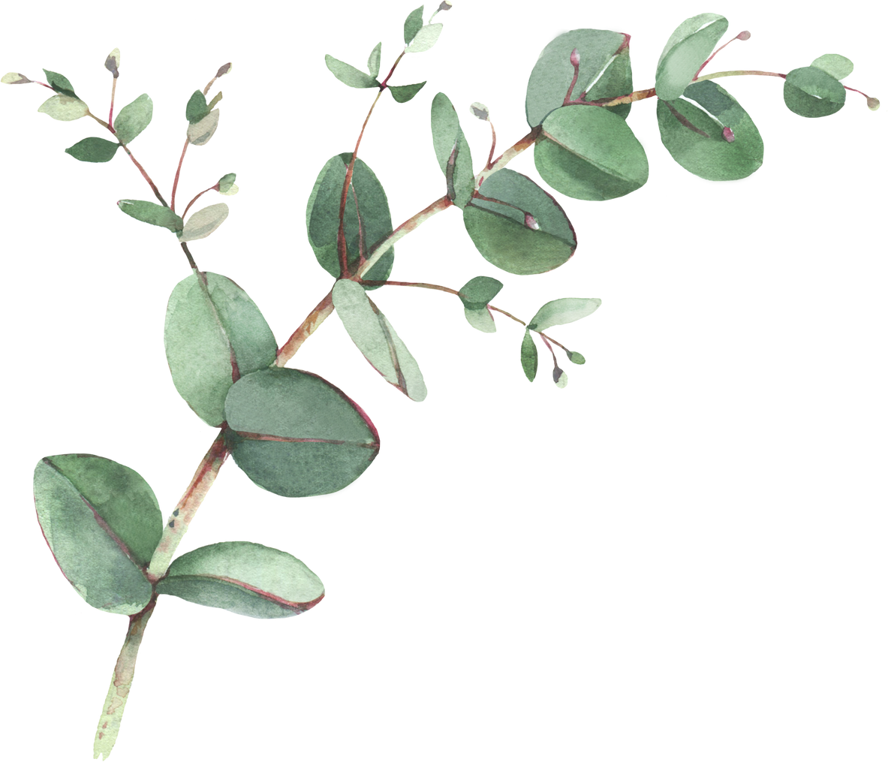

Year 4 Spellings- Autumn 1
Week 1- WB 8th September | Week 2- WB 15th September | Week 3- WB 22nd September
1. inactive 2. incorrect 3. insane 4. independent 5. invalid 6. income 7. invest 8. involve 9. invisible 10. inexpensive 11. intend 12. incomplete | 1. immature 2. immortal 3. impossible 4. impatient 5. imperfect 6. implant 7. impolite 8. immigrate 9. immaterial 10. immeasurable | illegal Illegible Illogical Illiterate Irregular Irrelevant Irresponsible Irreconciled Irrational Irrespective
Week 4 – WB 29th September | Week 5 – WB 6th October | Week 6 – WB 13th October
Subdivide Subheading Submarine Submerge Subconscious Subtle Supermarket Superman Superstar Supernatural superhero | 1. interact 2. intercity 3. international 4. interrelated 5. interval 6. intercept 7. interrupt 8. interview 9. intergalactic 10. interface 11. interfere | 1. antiseptic 2. anticlockwise 3. antisocial 4. anti-climax 5. antidote 6. anticipate 7. autobiography 8. autograph 9. automate 10. autonomy 11. autopilot 12. automatically

Slide 2
Year 4 Spellings- Autumn 2
Week 1- WB 3rd November | Week 2- WB 10th November | Week 3- WB 17th November
1. angrily 2. badly 3. cruelly 4. funnily 5. grumpily 6. happily 7. loudly 8. noisily 9. quietly 10. silently 11. shyly 12. well | 1. after 2. again 3. before 4. early 5. lately 6. now 7. often 8. recently 9. soon 10. today 11. tomorrow 12. yesterday | 1. above 2. below 3. up 4. down 5. around 6. nearby 7. back 8. forwards 9. backwards 10. everywhere
Week 4 – WB 24th November | Week 5 – WB 1st December | Week 6 – WB 8th December
1. information 2. adoration 3. sensation 4. preparation 5. admiration 6. creation 7. decoration 8. duration 9. donation 10. coronation 11. animation 12. conversation | 1. actual 2. believe 3. build 4. busy 5. continue 6. guard 7. important 8. interest 9. extreme 10. complete | 1. naughty 2. special 3. natural 4. strength 5. perhaps 6. potatoes 7. strange 8. important 9. pressure 10. separate

Slide 3
Year 4 Spellings- Spring 1
Week 1- WB 5th January | Week 2- WB 12th January | Week 3- WB 19th January
1. measure 2. treasure 3. pleasure 4. enclosure 5. leisure 6. composure 7. closure 8. disclosure | 1. creature 2. furniture 3. picture 4. nature 5. adventure 6. future 7. capture 8. feature 9. stature 10. puncture 11. fracture | 1. division 2. invasion 3. confusion 4. decision 5. collision 6. television 7. expansion 8. extension 9. comprehension 10. tension 11. occasion 12. explosion
Week 4 – WB 26th January | Week 5 – WB 2nd February | Week 6 – WB 9th February
1. expression 2. discussion 3. confession 4. permission 5. admission 6. possession 7. mission 8. obsession 9. procession 10. profession 11. impression | 1. invention 2. injection 3. action 4. hesitation 5. completion 6. position 7. abbreviation 8. acceleration 9. creation 10. punctuation 11. fiction | 1. musician 2. electrician 3. magician 4. politician 5. mathematician 6. optician 7. beautician 8. physician 9. tactician 10. technician

Slide 4
Year 4 Spellings- Spring 2
Week 1- WB 23rd February | Week 2- WB 2nd March | Week 3- WB 9th March
1. poisonous 2. dangerous 3. mountainous 4. hazardous 5. joyous | tremendous 2. enormous 3. jealous 4. obvious 5. hideous 6. spontaneous 7. serious 8. curious 9. gorgeous 10. courteous | humorous 2. glamorous 3. vigorous 4. odorous 5. rigorous
Week 4 – WB 16th March | Week 5 – WB 23rd March | Week 6 – Optional
1. various 2. envious 3. furious 4. glorious 5. mysterious 6. serious 7. obvious 8. curious 9. gracious 10. spacious | 1.courageous 2. outrageous 3. advantageous 4. famous 5. continuous 6. adventurous 7. nervous | 1. poisonous 2. dangerous 3. mountainous 4. tremendous 5. enormous 6. jealous 7. humorous 8. glamorous 9. vigorous 10. serious 11. obvious 12. curious 13. courageous 14. outrageous 15. hideous

Slide 5
Year 4 Spellings- Summer 1
Week 1- WB 13th April | Week 2- WB 20th April | Week 3- WB 27th April
1.girls' 2. boys’ 3. babies’ 4. children’s 5. men’s 6. mice’s 7. women’s 8. parents’ 9. teachers’ 10. dogs’ 11. people’s 12. students’ | 1.library 2. ordinary 3. February 4. dictionary 5. necessary 6. secretary 7. voluntary 8. stationary 9. primary 10. secondary 11. temporary 12. commentary | 1.particular 2. peculiar 3. popular 4. calendar 5. grammar 6. year 7. solar 8. dollar 9. cellar 10. bursar 11. guitar 12. nuclear
Week 4 – WB 4th May | Week 5 – WB 11th May | Week 6 – WB 18th May
1.remember 2. believer 3. answer 4. consider 5. shoulder 6. after (year 2) 7. computer 8. character 9. other 10. never 11. paper 12. ever | 1. universe 2. union 3. unicycle 4. unison 5. unit 6. bicycle 7. biannual 8. biweekly 9. tricycle 10. triangle 11. triathlon 12. quadbike 13. quadrilateral | 1. pentagon 2. pentagram 3. hexagon 4. hexagram 5. octagon 6. octopus 7. octet 8. decagon 9. decathlon 10. decade

Slide 6
Year 4 Spellings- Summer 2
Week 1- WB 8th June | Week 2- WB 15th June | Week 3- WB 22nd June
1.acrobat 2. acronym 3. Acropolis 4. accurate 5. acupuncture 6. acute 7. acuity 8. aeronaut 9. aerospace 10. aerobics 11. aerofoil | 1. anniversary 2. annual 3. annually 4. aqueduct 5. aquarium 6. aquatics 7. astronaut 8. astronomer 9. astrophysics 10. astrologer | 1.bicycle 2. biped 3. binoculars 4. bias 5. bicentennial 6. biennial 7. biweekly 8. bilingual 9. biology 10. biography 11. biosphere 12. biodiversity
Week 4 – WB 29th June | Week 5 – WB 6th July | Week 6 – WB 13th July
1. certificate 2. certain 3. ascertain 4. certitude 5. chronography 6. chronic 7. chronological 8. chronicle 9. circle 10. circuit 11. circadian 12. circa | 1. co-author 2. co-exist 3. co-operate 4. co-ordinate 5. co-locate 6. co-pilot 7. coincidental 8. cohesive 9. co-worker 10. corpse 11. corporation 12. corporal | 1. demography 2. demonstrate 3. epidemic 4. democracy 5. demagogue 6. dentist 7. trident 8. dentures 9. diagonal 10. diameter 11. diagram

