Slide 1
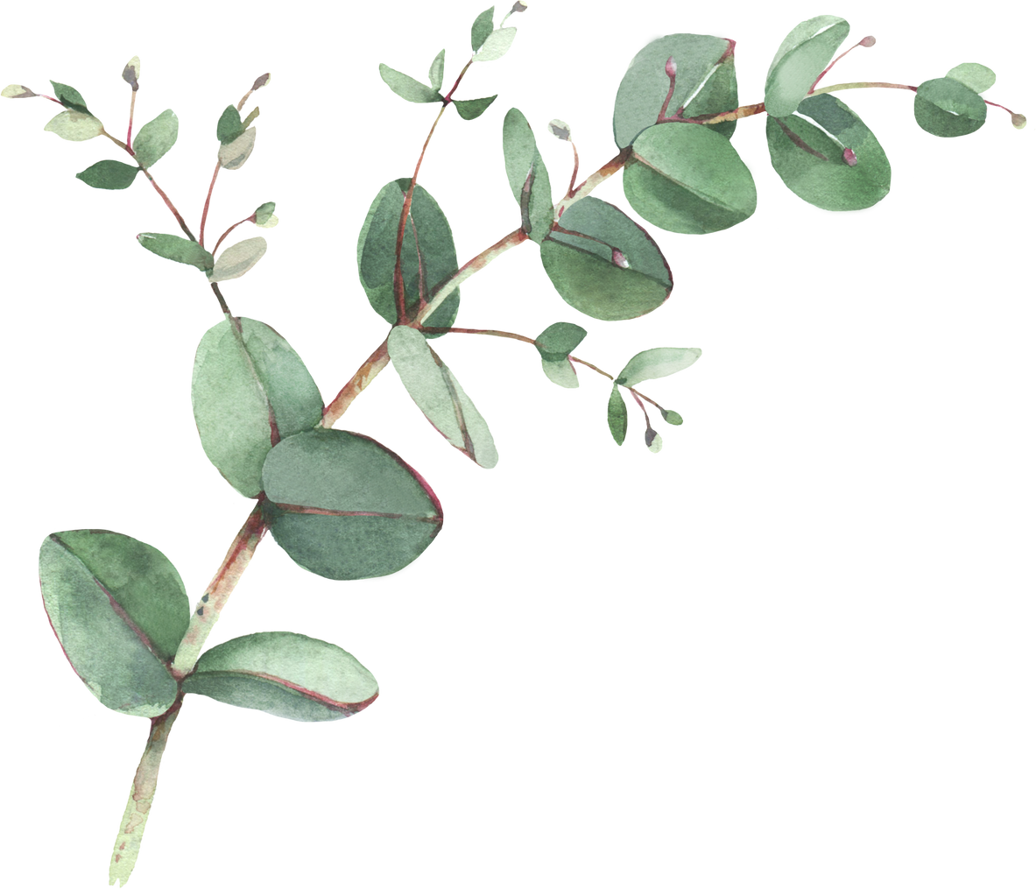

Year 3 Spellings- Summer 2
Week 1- WB 8th June | Week 2- WB 15th June | Week 3- WB 22nd June
1. dream 2. each 3. read (present tense) 4. breathe 5. head 6. read (past tense) 7. instead 8. breath 9. earth 10. heard 11. learn 12. early | 1. solve 2. solution 3. solver 4. dissolve 5. insoluble 6. resolute 7. resolutions 8. resolve 9. absolute 10. solvent | 1. decade 2. decagon 3. decathlon 4. century 5. centimetre 6. centigrade 7. millipede 8. millimetre 9. million 10. microscope 11. micrometre 12. micro-organism
Week 4 – WB 29th June | Week 5 – WB 6th July | Week 6 - WB 13th July
1. when 2. before 3. after 4. while 5. so 6. because 7. than 8. since 9. once 10. until 11. which 12. rather | 1. above 2. around 3. before 4. below 5. after 6. during 7. from 8. in 9. than 10. on 11. over 12. under | 1. berry 2. bury 3. busy 4. early 5. February 6. history 7. library 8. naughty 9. ordinary 10. probably 11. forty 12. category

