Slide 1
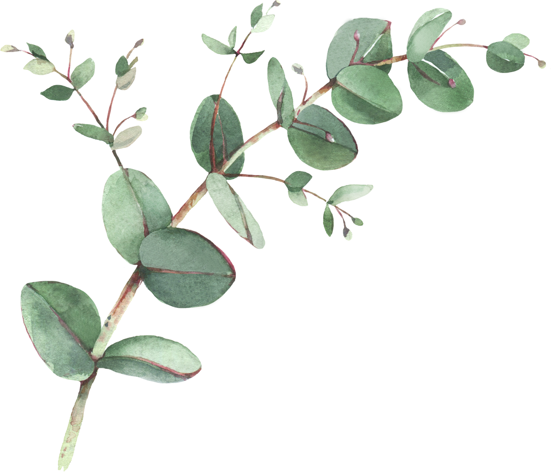

Year 3 Spellings- Spring 1
Week 1- WB 5th Jan | Week 2- WB 12th Jan | Week 3- WB 19^{h} Jan
1. disappoint 2. disagree 3. disobey 4. disappear 5. disbelieve 6. discover 7. disease 8. distrust 9. disable 10. disrepair 11. discount 12. disrespectful | 1. misbehave 2. mislead 3. misspell 4. misjudge 5. misfortune 6. misinform 7. misconduct 8. mistake 9. mistreat 10. misuse 11. misplace 12. misprint | 1. redo 2. refresh 3. return 4. reappear 5. redecorate 6. rebuild 7. reposition 8. reject 9. reduce 10. reflect 11. rearrange 12. revert
Week 4 – WB 26th Jan | Week 5 – WB 2nd Feb | Week 6 – WB – 9th Feb
1. gardening 2. gardener 3. limiting 4. limited 5. limitation 6. happening 7. forgetting 8. forgotten 9. beginning 10. beginner 11. prefer 12. Preferred | 1. arrive 2. decide 3. describe 4. guide 5. surprise 6. favourite 7. imagine 8. promise | 1. knock 2. know 3. knee 4. knowledge 5. knowledgeable 6. knew 7. knife 8. gnat 9. gnaw 10. sign 11. gnome 12. design

