Slide 1
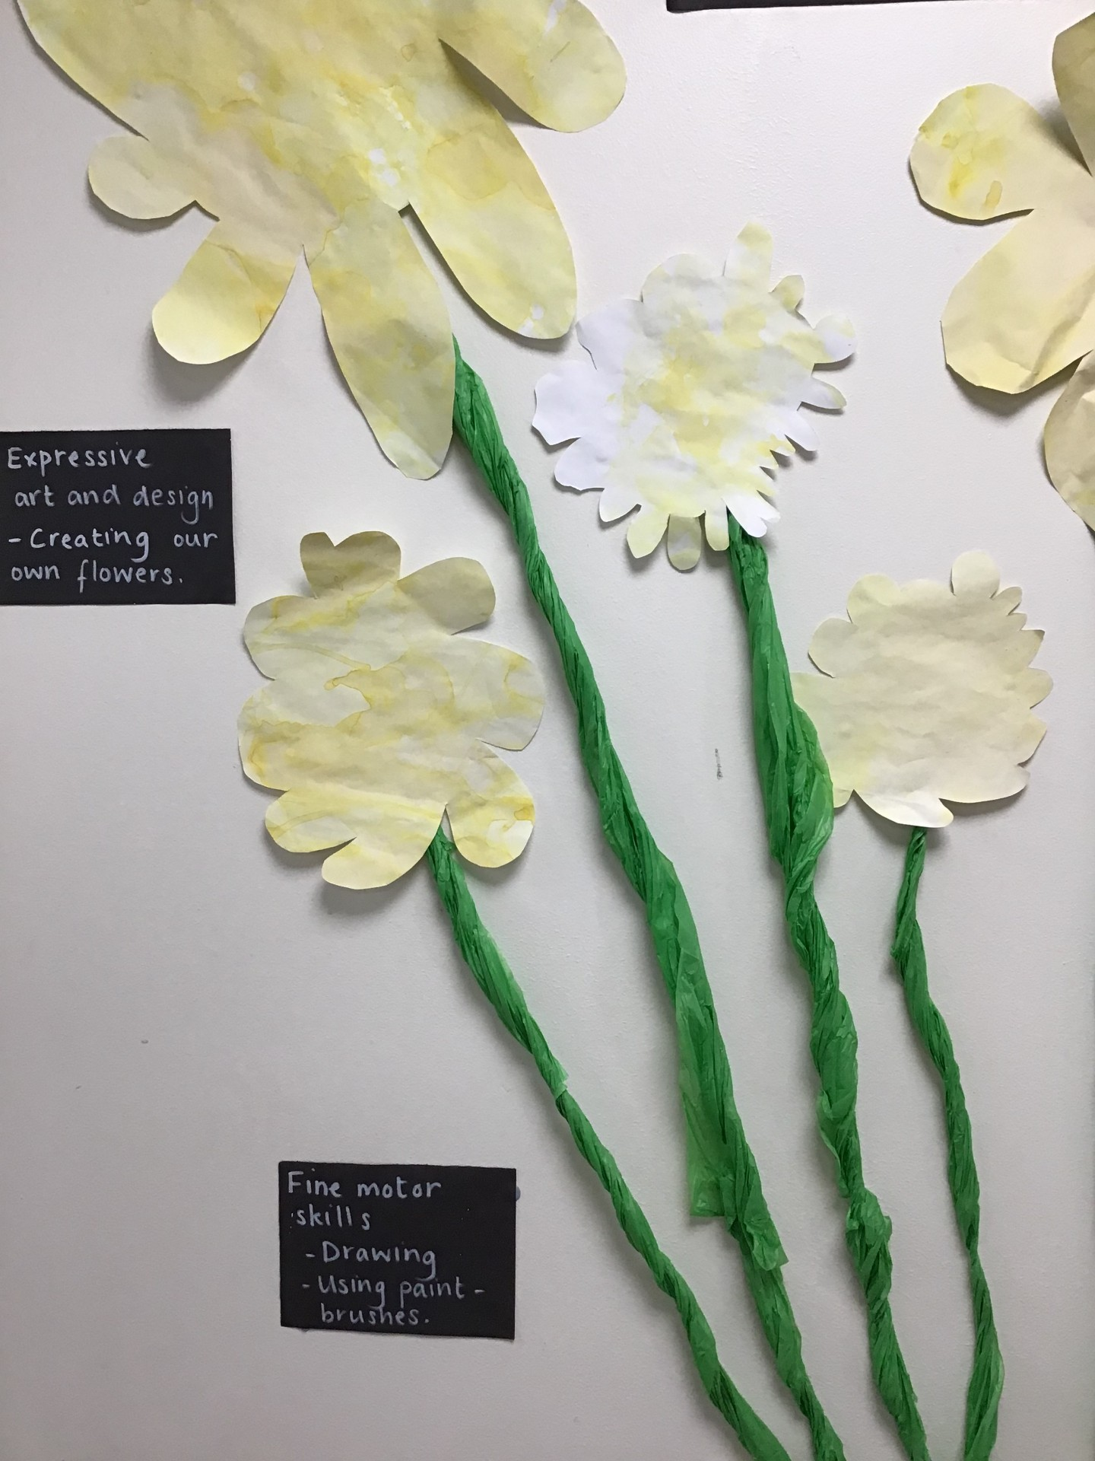
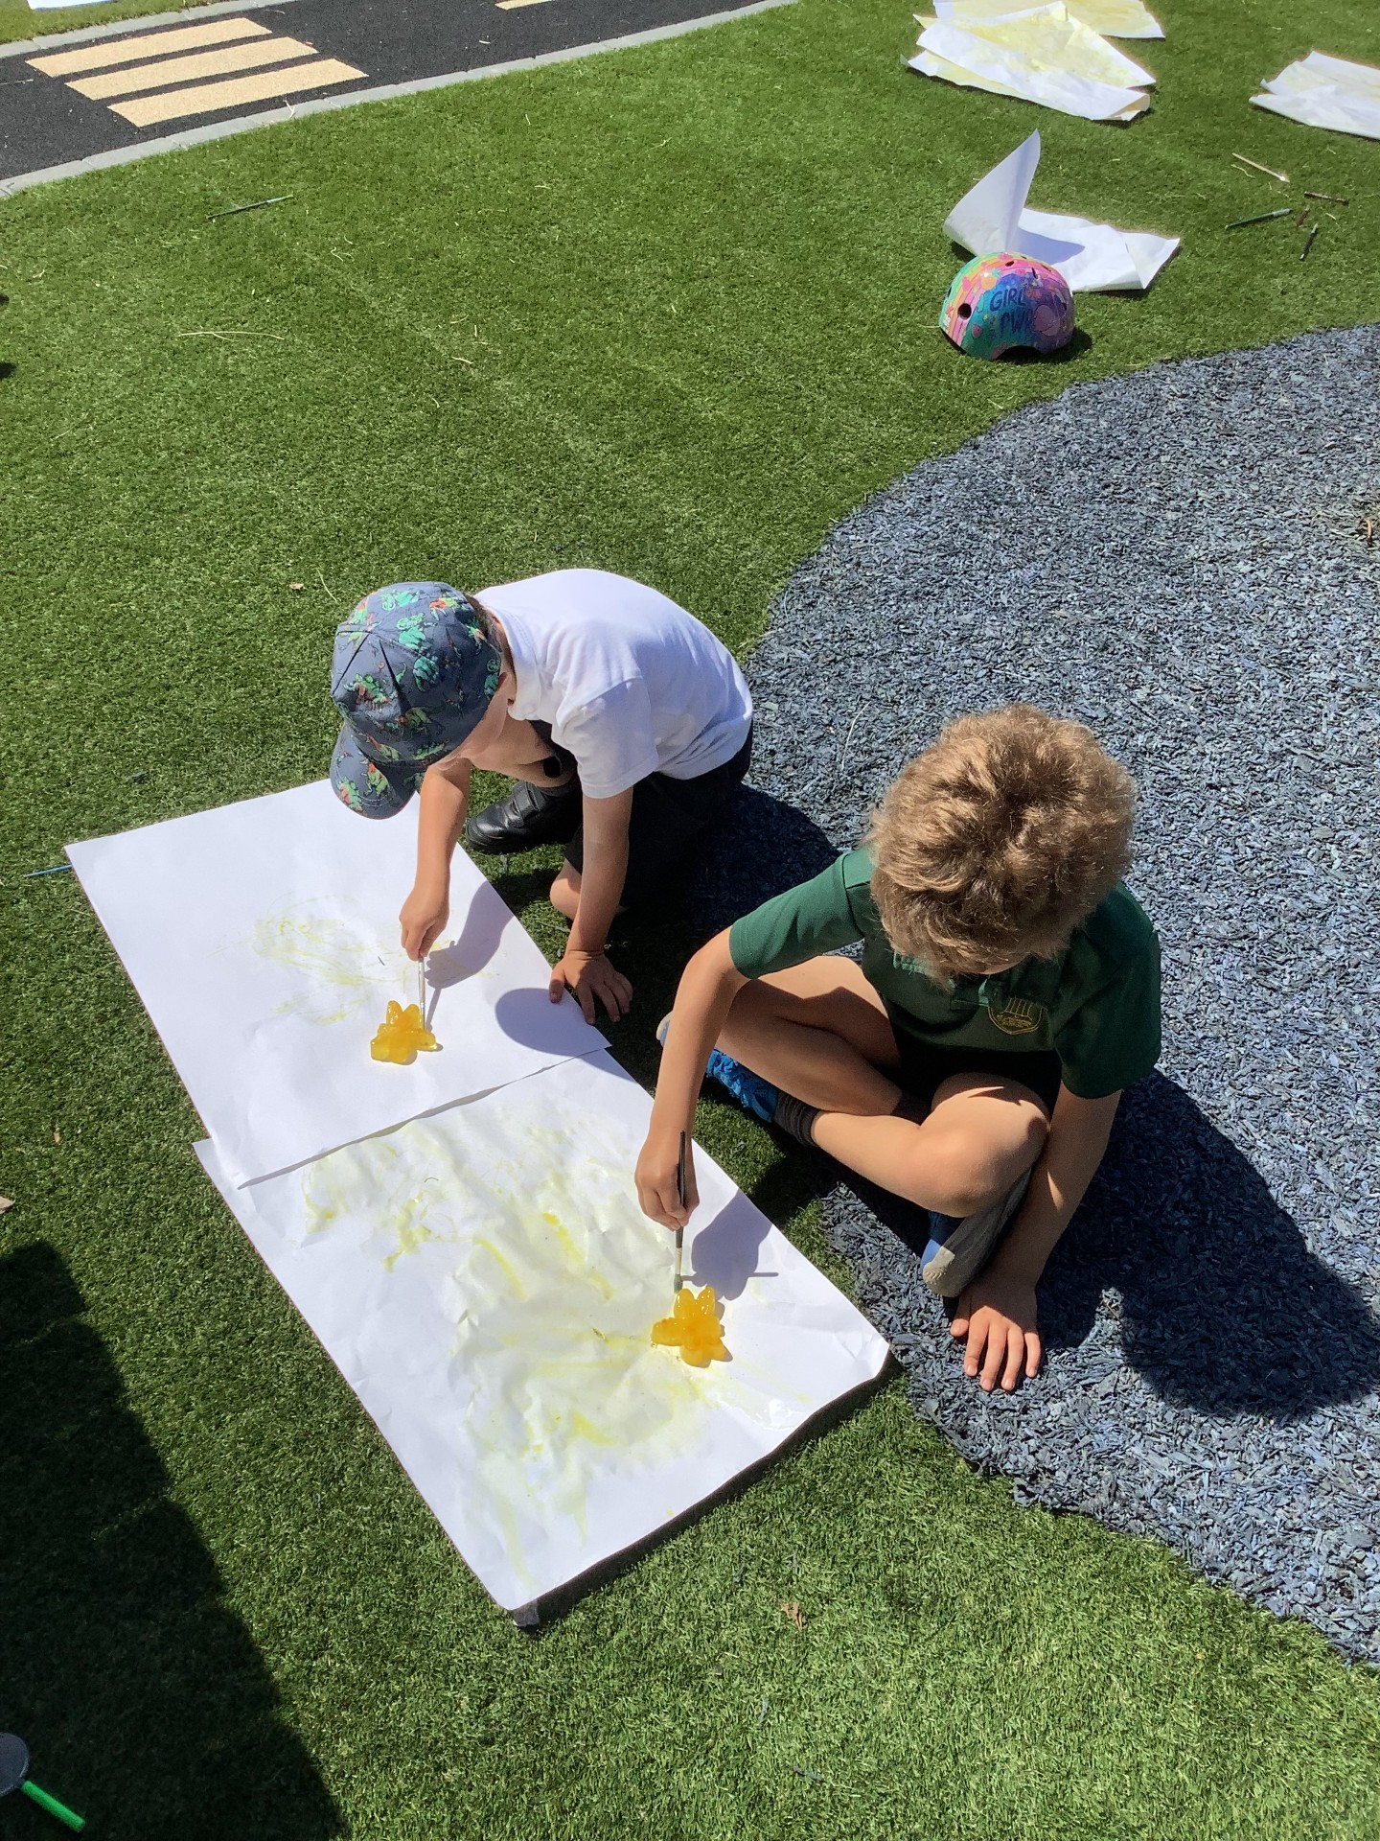
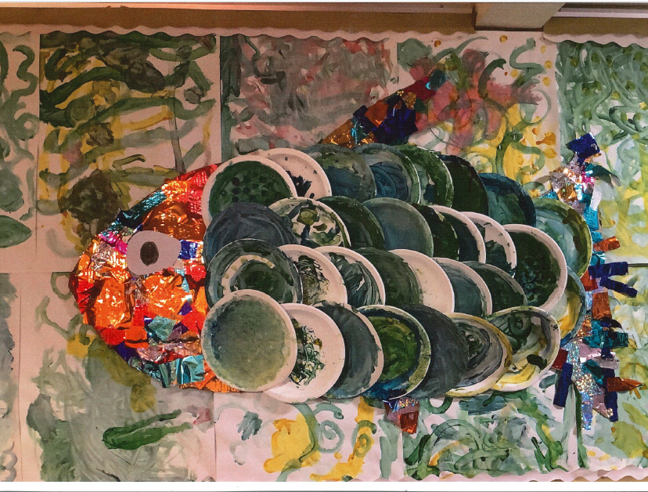
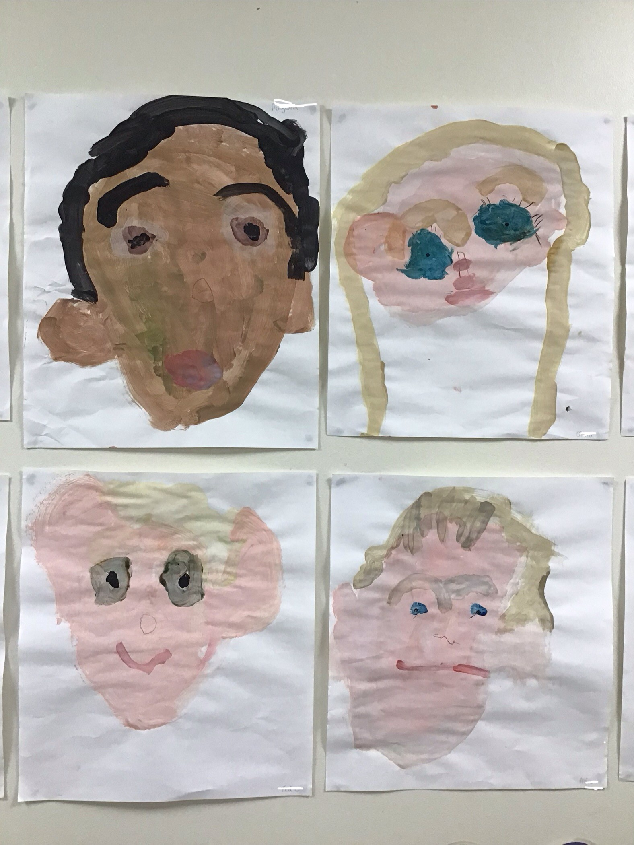
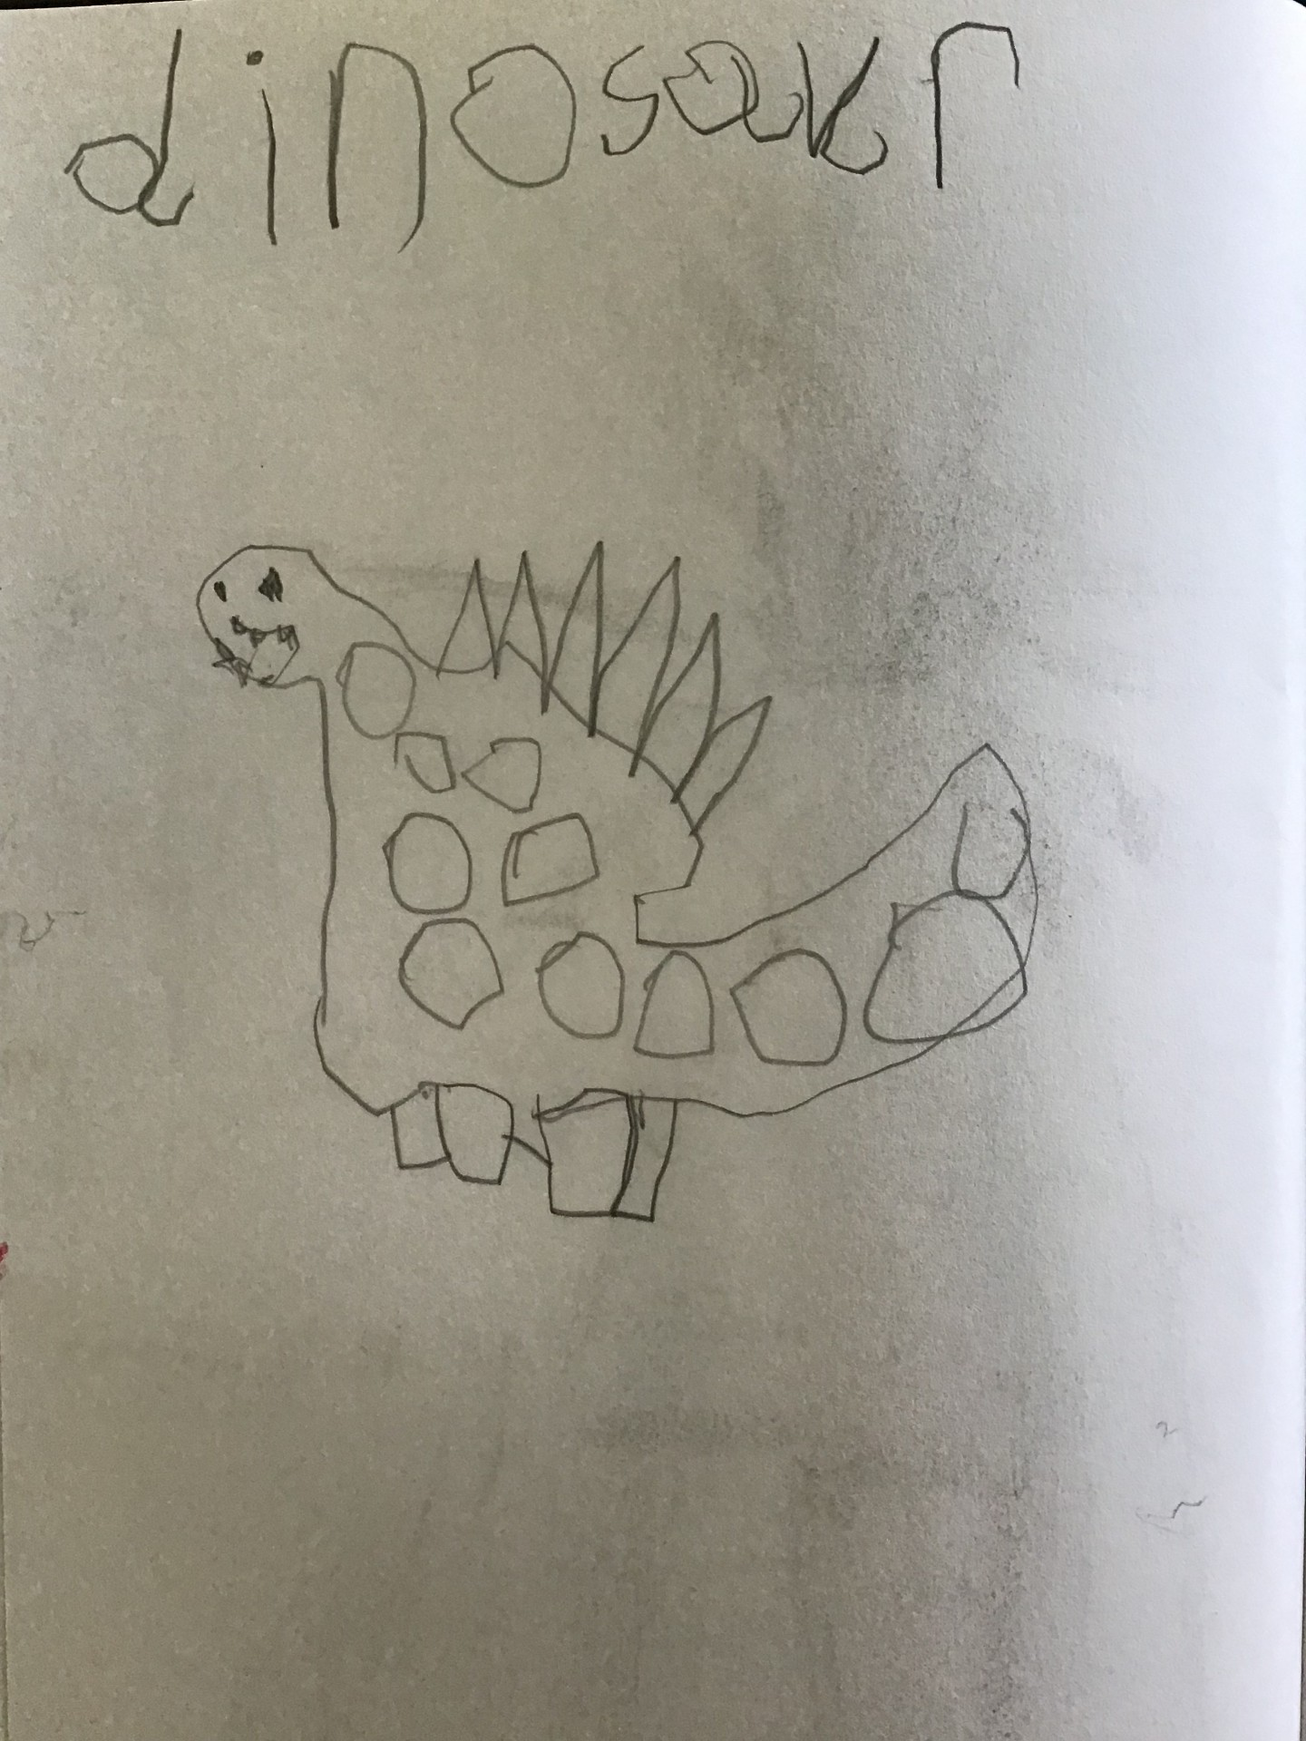
EYFS
Aspect 1: Creating with Materials
To achieve the GLD for this aspect, children are expected to:
Safely use and explore a variety of materials, tools, and techniques.
Experiment with and express their ideas about colour, design, texture, form, and function.
Share their creations, explaining the process and the meaning behind them

Slide 2
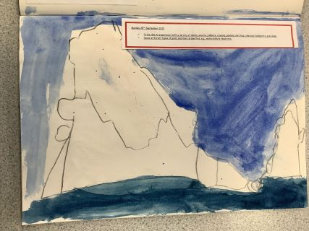
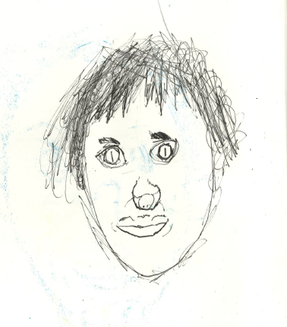
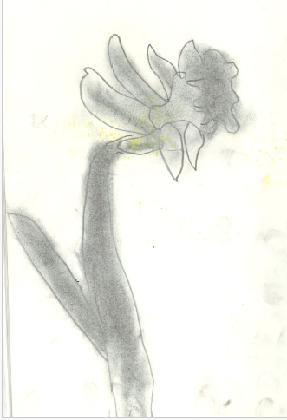
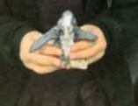
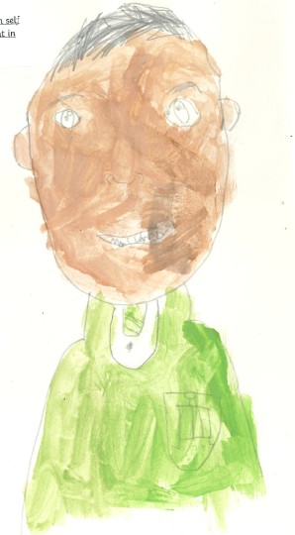
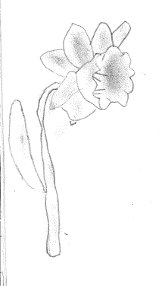
Year 1
Use tone, shading and smudging
Artists use observation to help them draw accurately
Name different types of paint and their properties; e.g. watercolours / ready mix.
Mix shades and tones
Mix colours to create skin, hair and eye tones.
Develop a drawing into a painted portrait using watercolours.
Roll, knead and shape clay to create simple forms.
Manipulate clay to create an animal sculpture.
Mix colours and paint a finished sculpture.

Slide 3
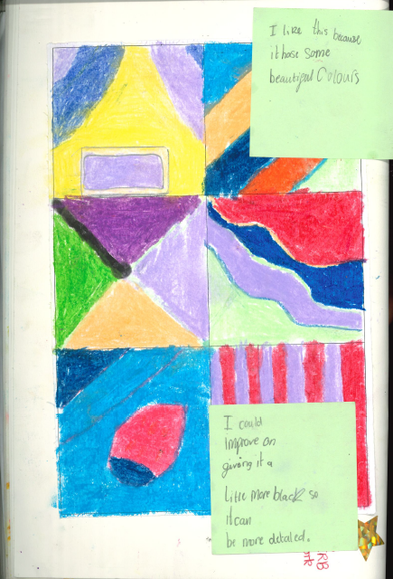
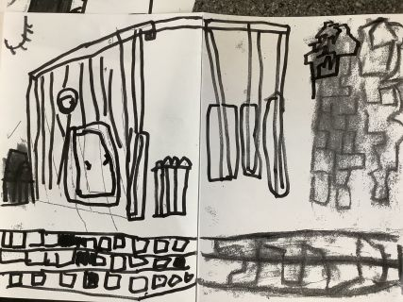
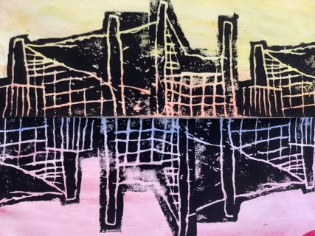
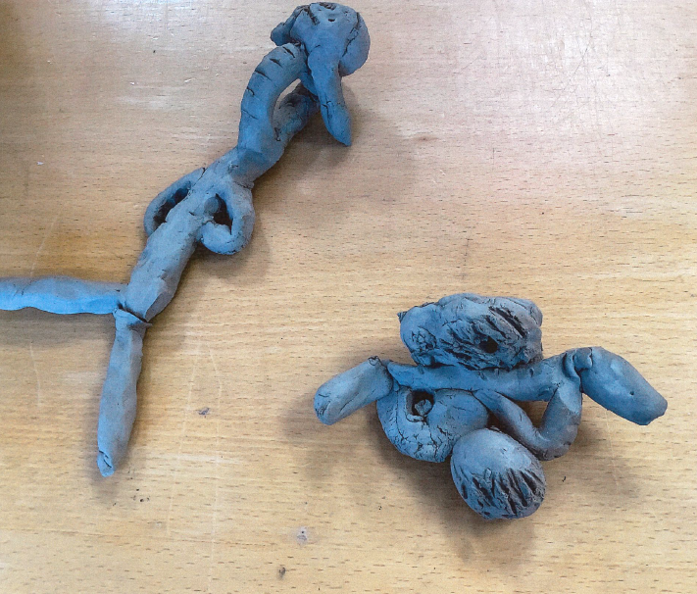
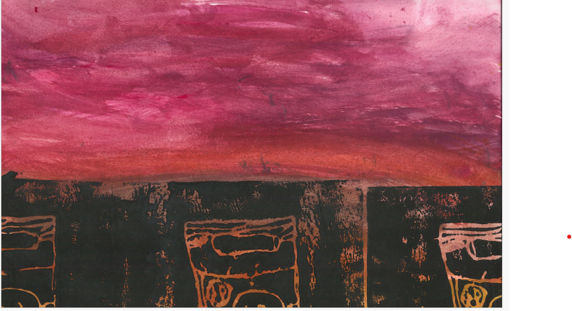
Build repeating patterns and recognise patterns in the environment.
Design repetitive patterns using shapes and motifs.
Create simple printing blocks using the Quickprint method.
Print a repeated design using a printing block.
Year 2
Different drawing media create different types of marks (pencil, crayon, pastel, felt tip, charcoal, chalk, ballpoint).
Tone can be created using lighter and darker lines, shapes and patterns.
Draw shapes and patterns with increasing control.
Create an abstract composition using shape, colour and pattern.

Slide 4
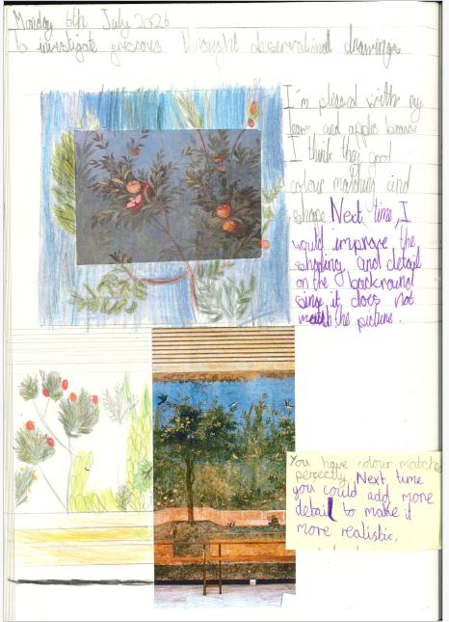
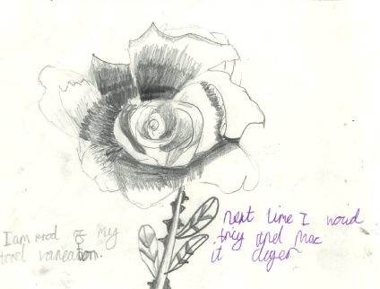
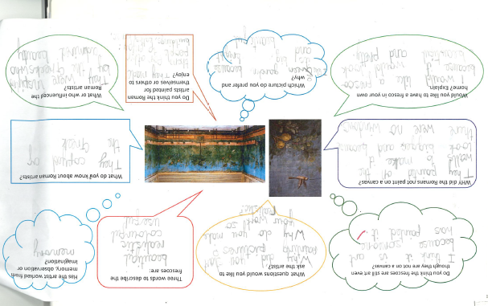
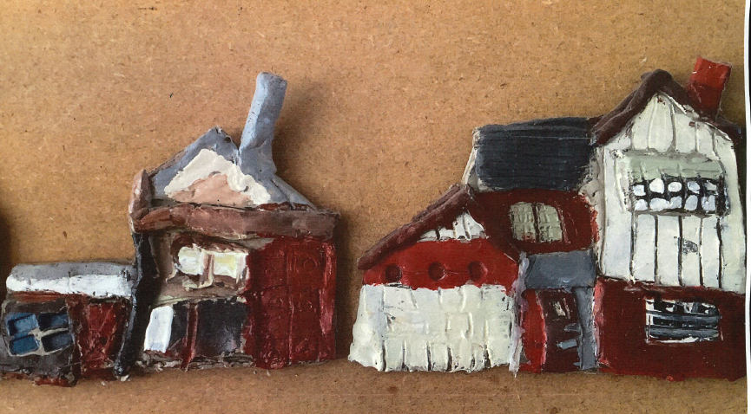
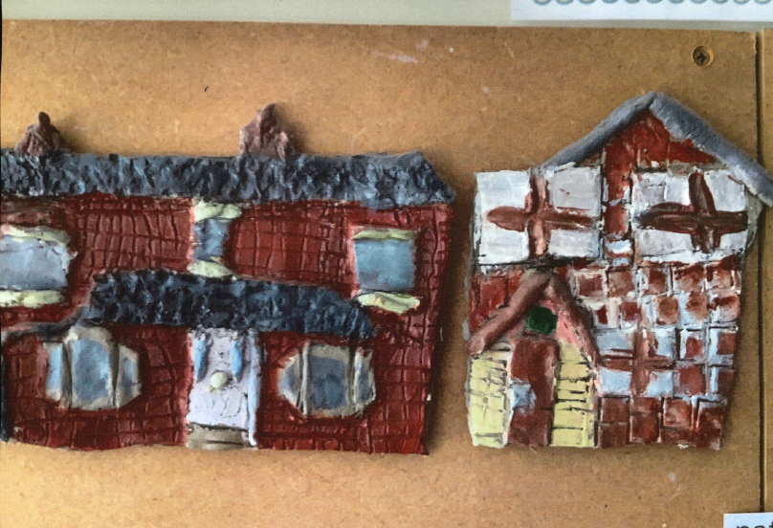
Year 3
Create observational drawings using a range of drawing materials.
Use tone and colour matching to represent flowers and natural forms.
Roll, shape and manipulate clay to create a bas-relief sculpture.
Use scratch and slip techniques to join clay pieces.
Create surface texture using a range of tools and objects.
Mix and match colours from observation when painting.
Select appropriate brushes and tools for different tasks.
Explore and discuss examples of Roman mosaics and frescoes.
Explain the purpose of Roman mosaics and frescoes.
Discuss how Roman artists used colour, pattern and imagery.
Compare different Roman artworks and identify similarities and differences.

Slide 5
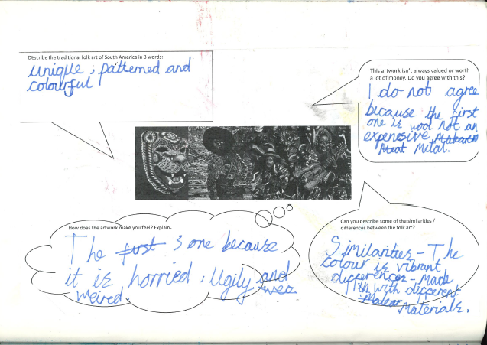
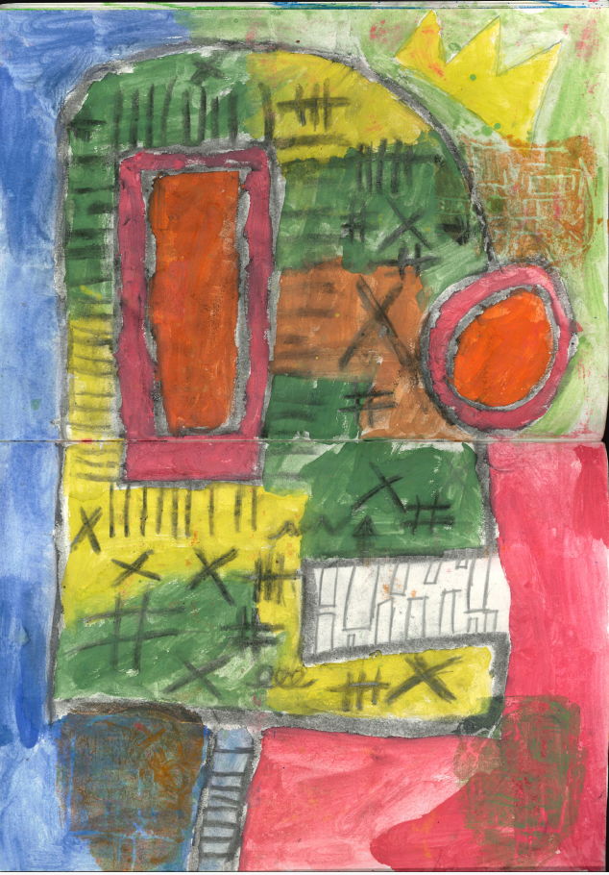
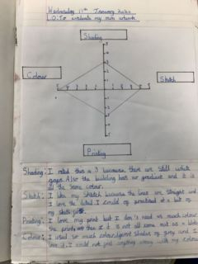
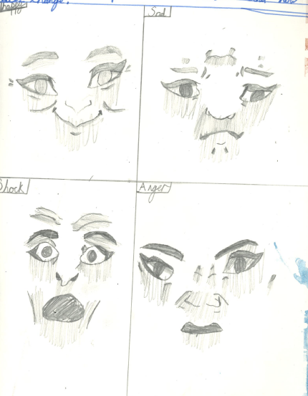
Develop drawings into paintings using colour inspired by Basquiat.
Apply surface detail through overdrawing, pattern and texture.
Year 4
Evaluate, adapt and improve their artwork throughout the creative process.
Masks are created for different purposes in different cultures, including celebrations, storytelling and ceremonies.
South American artists and craftspeople use colour, pattern, shape and texture to create visual impact. Discuss similarities and differences between masks from different cultures.
Explain how colour, pattern, shape and texture influence the appearance of a mask.
Describe how masks can communicate emotions, identity and meaning.
Facial expressions can communicate emotions and ideas. Observe and record facial expressions, masks and visual details through drawing and annotation.

Slide 6
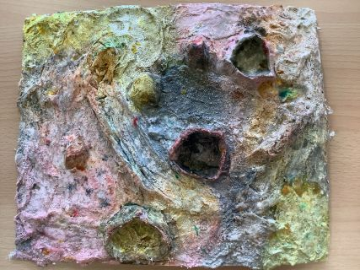
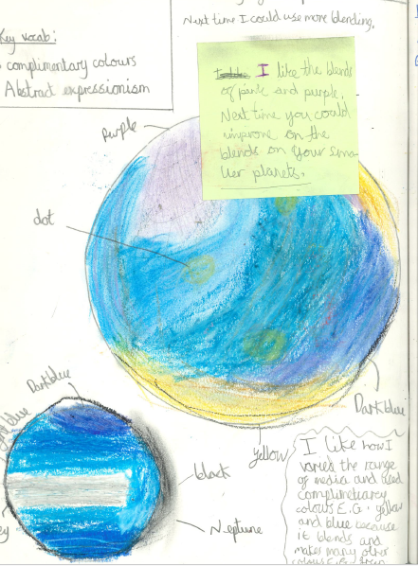
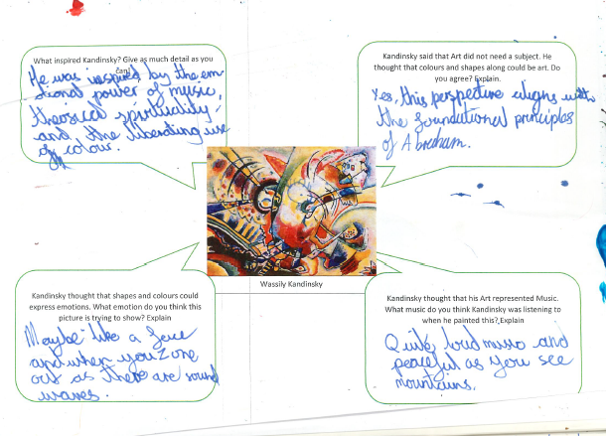
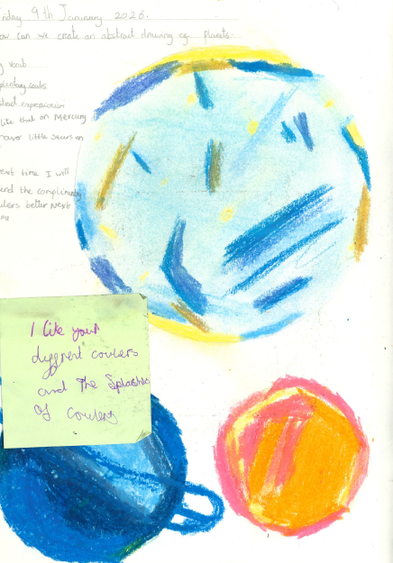
Year 5
Construct and paint a three-dimensional planet using mod-roc.
Abstract artists use colour, shape, line and pattern to express ideas and feelings.
Jackson Pollock, Mark Rothko, Joan Miró and Wassily Kandinsky developed distinctive abstract styles.
Explore and apply ideas from the work of abstract artists.
Evaluate and improve their work throughout the creative process. Mod-roc is a malleable material that can be shaped to create textured three-dimensional forms.

Slide 7
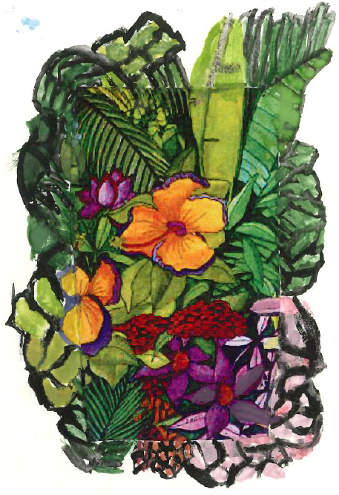
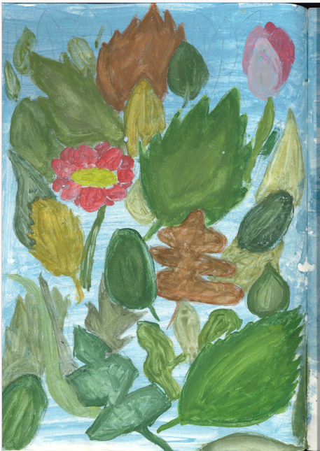
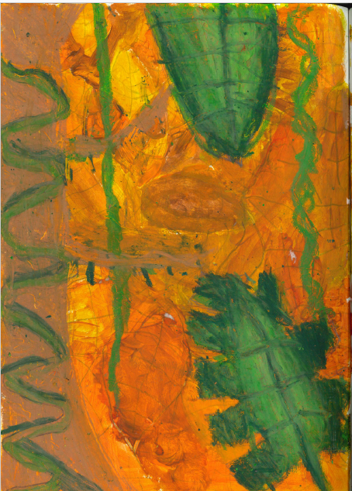
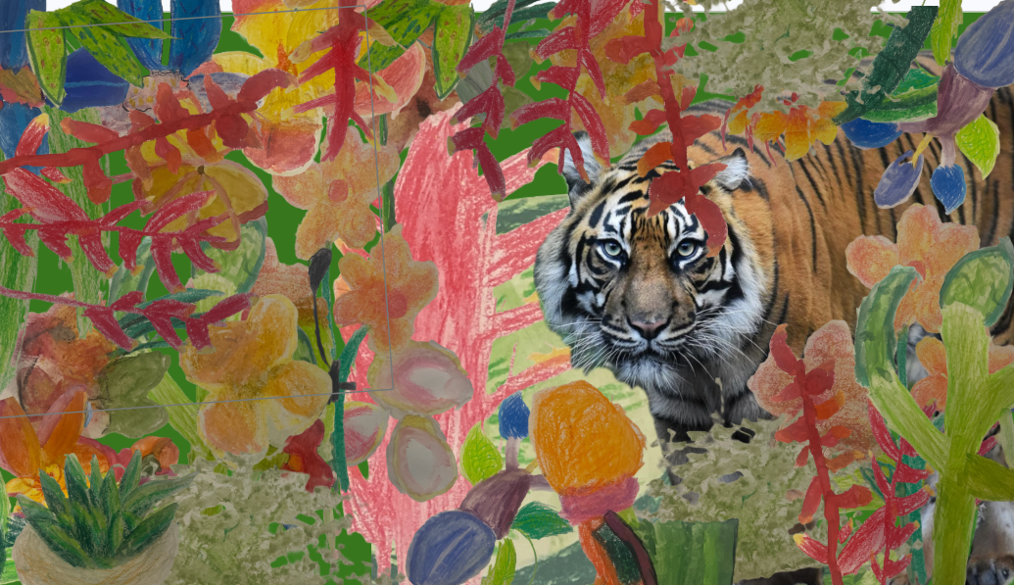
Year 6
Create paintings inspired by the composition and layering found in Rousseau's work.

