Slide 1
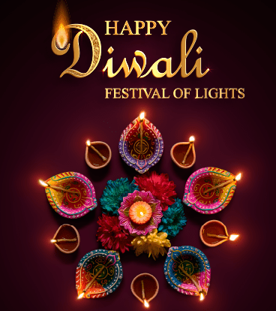
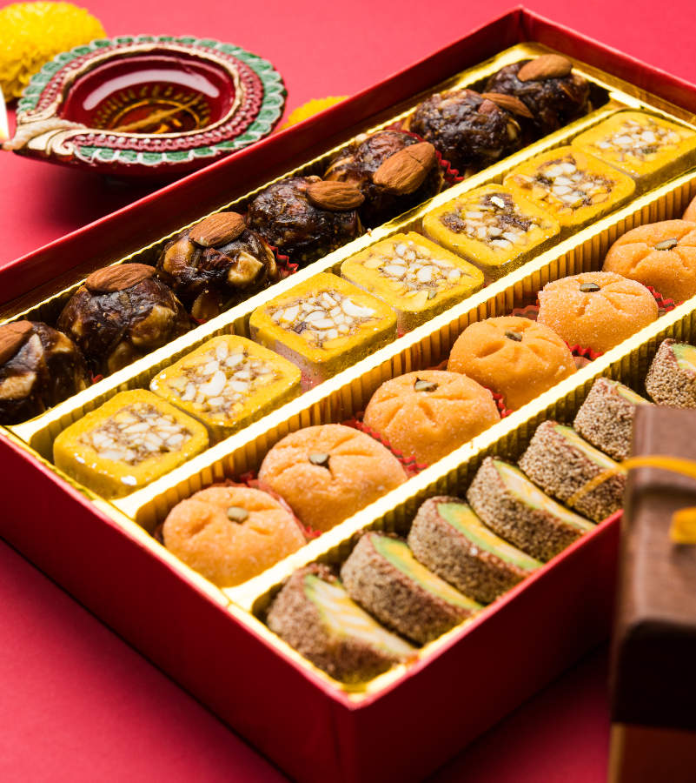

Slide 2

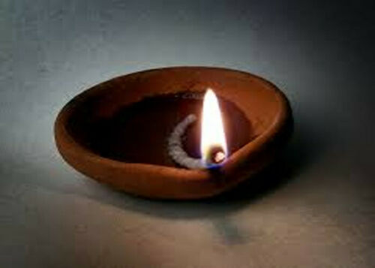
What is Diwali?
Diwali is a significant Hindu event well known as the festival of lights. People go to Hindu Temples to celebrate light over dark and good over evil.
It is also a celebration of the Hindu new year!
Behind every religious festival, there is a story about how the Gods give us peace and goodness in our lives.

Slide 3
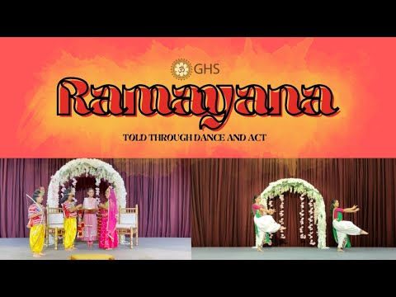
The story of Diwali – Gujarat Hindu Society
https://youtu.be/_j1gBjWD6Ug (3.39 mins)

Slide 4

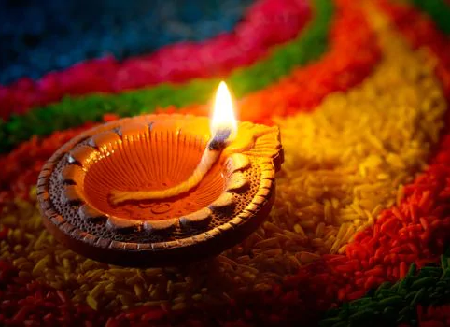

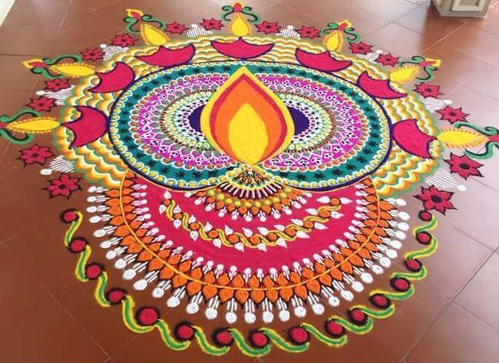
How is Diwali celebrated?
People celebrate Diwali by lighting candles to remind us how people lit lamps when Lord Ram, Mata Sita and Lakshman return home after 14 years of exile after defeating the evil demon Ravana.
Hindus exchange sweets and gifts. My favourite sweet is Kajukatri made of cashew nuts. Yummy!
Rangoli is an art represented in powder, chalk and flower petals.
People like to decorate their houses with rangoli pattern, lamps and flowers to attract good luck in their homes.

Slide 5
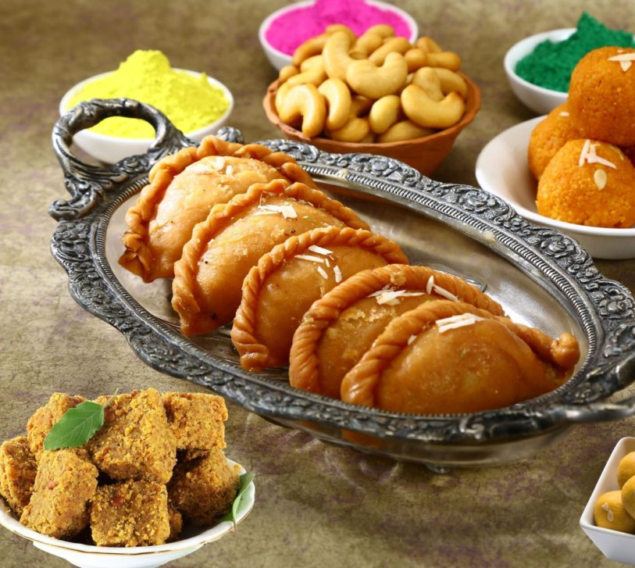
How long and when is Diwali?
Diwali celebrations lasts for 5 days.
This year, Diwali started on the 1st and ends with New Year’s day on Friday 5th November which is also Bonfire night! . It’s the main festival of the whole year. It’s like Christmas for Hindus! We celebrate both!
My favourite part of the holiday is making and eating traditional Indian sweets that are given out to friends and family. This year I gave out sweets to my classmates too.

Slide 6
What are the names of the five days?
Did you know?
We are in the year 2077 in the Hindu Calendar!!
Throughout the celebration period, we decorate our homes with rangoli patterns and divas(Lamps). The names of the days of Diwali period are:
November 2nd: Dhanteras, Worship of health. We pray to the Goddess Laksmi Mata for good health and wealth.
November 3rd: Kali Chaudas, We keep our houses clean and tidy, Hindus use fragrant oils and flowers to keep vibrations uplifted.
November 4th: Diwali, Lord Ram returned from 14 years of exile in the forest. Everyone lit lamps all the way to his house.
November 5th: Hindu New year, The Gorvadhan poojan is a ritual where 108 items of classic Indian sweets and savouries are presented to Lord Ram and his consort Mata Sita. This food becomes blessed and is called prasaad which is shared by all the devotees.
November 6th: Bhai Beej, We celebrate the bond and between siblings or cousins. This involves sisters ( including cousins!) inviting brothers to their homes for a scrumptious meal and wishing a long life for them. In return brothers promise to protect!

Slide 7

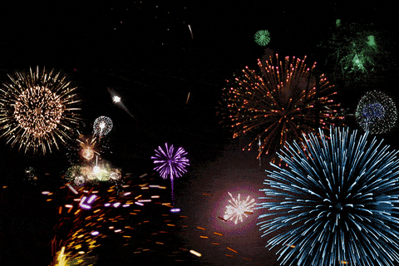
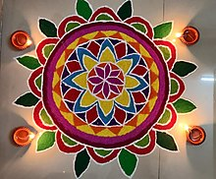

Happy Diwali Thank you!

