Slide 1

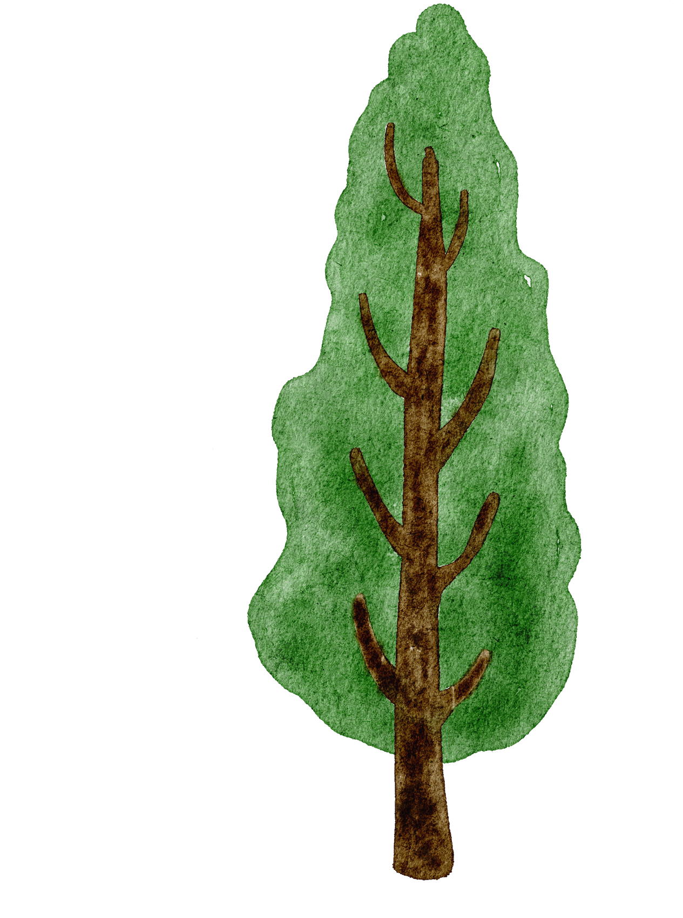

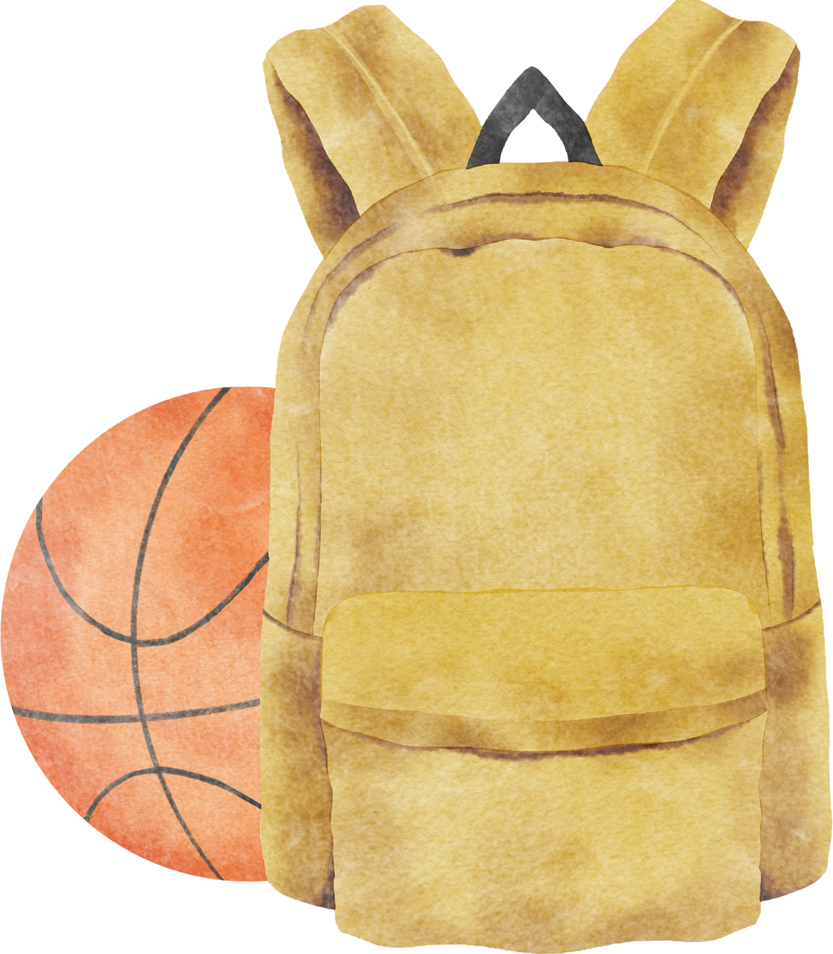


Welcome to
Year 2

Slide 2
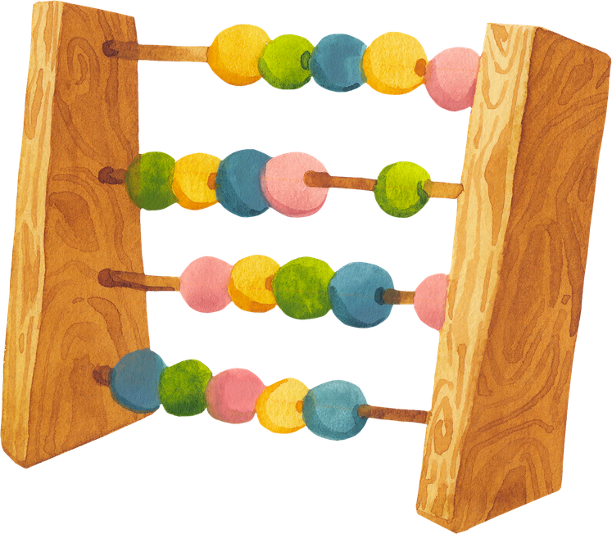


Miss Geraghty - Class teacher
Mrs Maskell - Teaching assistant

Slide 3


Class expectations
  We have a flexible, topic based timetable with structured routines.
  Mornings - more structured learning whilst we focus on core subjects. (sat at tables/ carpet for input and completing work at tables).
  Afternoons - area based learning. The children will have challenges based on our foundations subjects. They will be able to decide which challenges and when they are completed, as long as they are completed by the end of the week.
  Children are always encouraged to present their work neat and tidy.
  Children are encouraged to be independent - handing in homework, reading records and books, letters ect.

Slide 4




Reading books
We will endeavour to listen to the children read throughout the week.
When the child has finished their book, please could you write in their diaries. Their book will then be changed.
To help us monitor reading, we ask you to add a short comment about how your child has read with you.
If time is limited simply initial and date in the book.
We will only give one book at a time.
Children are able to change their book as soon as it is finished by handing it into our reading book basket.

Slide 5
20 Books to Read
In Year 2, we introduce the school-wide reading initiative ‘20 Books to Read Before You Leave’.
The children will come home with one book at a time. They can either read it themselves or you can read it together.
Once they have finished the book, they are to return the book and complete a written book review. The sheets are at school.
They will receive a sticker on their book list (in their yellow reading diaries) so we can keep track of how many books they have read. They can then pick a new book to read.
Once finished, If you could tick of the book from the list at the back of the children’s yellow reading diaries, it will help us keep up to date.

Slide 6
The joy of reading
Sharing a book with your child is a wonderful way to spend time together, helping them to develop not only their reading skills but also a genuine love of stories and learning.
A Guide to Reading with your Child:
https://www.st-lawrence.lancs.sch.uk/page/literacy-provision/86669
See guide on website under Curriculum – Literacy – Literacy Provision
Main themes:
Read together
Make it a special time
Read aloud (both parents and children)
Talk about books
Encourage choice
Be encouraging

Slide 7
Phonics/Spelling
20 minute sessions will take place daily.
Spellings will be sent out on Monday as part of the childrens homework. They will include the focus sound/rule that we have been learning the previous week. As well as words from the Year 2 High Frequency List.
Spelling tests will be completeted on the following Monday.

Slide 8
Times Tables
Each Thursday, the children will be tested on their times tables.
We encourage that as part of their homework the children practice their Times Tables at home. This can be done through ‘TT rockstars and chanting/song’
The following slide will explain the whole school approach on testing times tables.

Slide 9
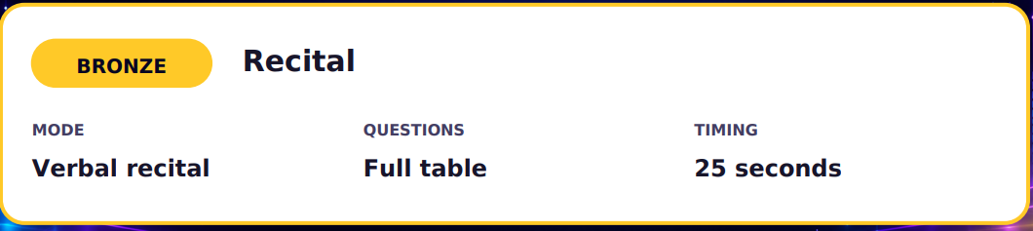
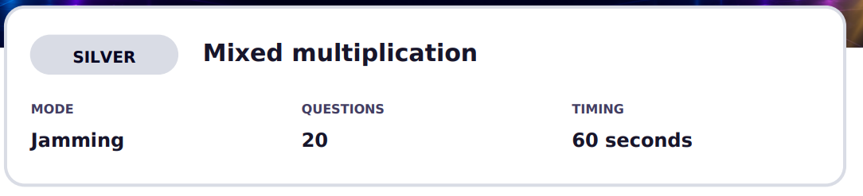
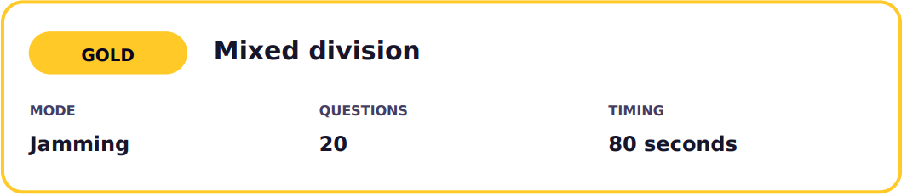
Times Tables
All the children will start on their 10 times tables.
As they pass their bronze, silver and golds they will move on to the next times tables.
Their current times tables will be written onto their spelling lists on a monday.

Slide 10
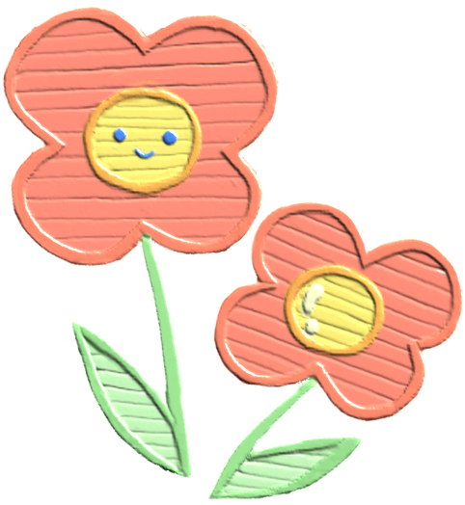
Guided Reading
To help children become more confident with their comprehension, we ask that when reading for you to ask the child questions about what they have read.
25 minute sessions will take place daily.
This will be done as a whole class and will focus on a different question style every week. Every lesson will have a retrival style question.
The activitys will consist of: group reading with a teacher, pleasure for reading in the library, a comprehension task and a more hands on activity. For example, drama, book mapping ect.
Example questions:
Retrieval e.g., "Where is the story set?",
Inference e.g., "Why do you think this happened?"
predictive questions "What do you think will happen next?"
vocabulary questions e.g,"What does this word mean?",
opinion-based questions e.g,"What was your favourite part?"

Slide 11
P.E Lessons
Year 2’’s P.E sessions will change on a half termly basis. Pe will be in on a Monday and a Friday for the first half term.
Children need to come to school in their full P.E kits .

Slide 12

Homework
Homework will be handed out on a Monday.
To be returned on the following Monday.
Homework will include:
  Regular reading (10 minutes per day)
  Learning spellings for a test on Monday.
  Learning Times Tables for a test on Thursday.
  Choice of task from the ‘Pick N Mix’ sheet (All tasks due at the end of the half term).

Slide 13
How can you help?
Take part in regular short reading sessions at home with the children and read their reading books.
Encourage your child to be independent and to remember to hand things in or to have things changed.
Support the children with their Homework.

Slide 14
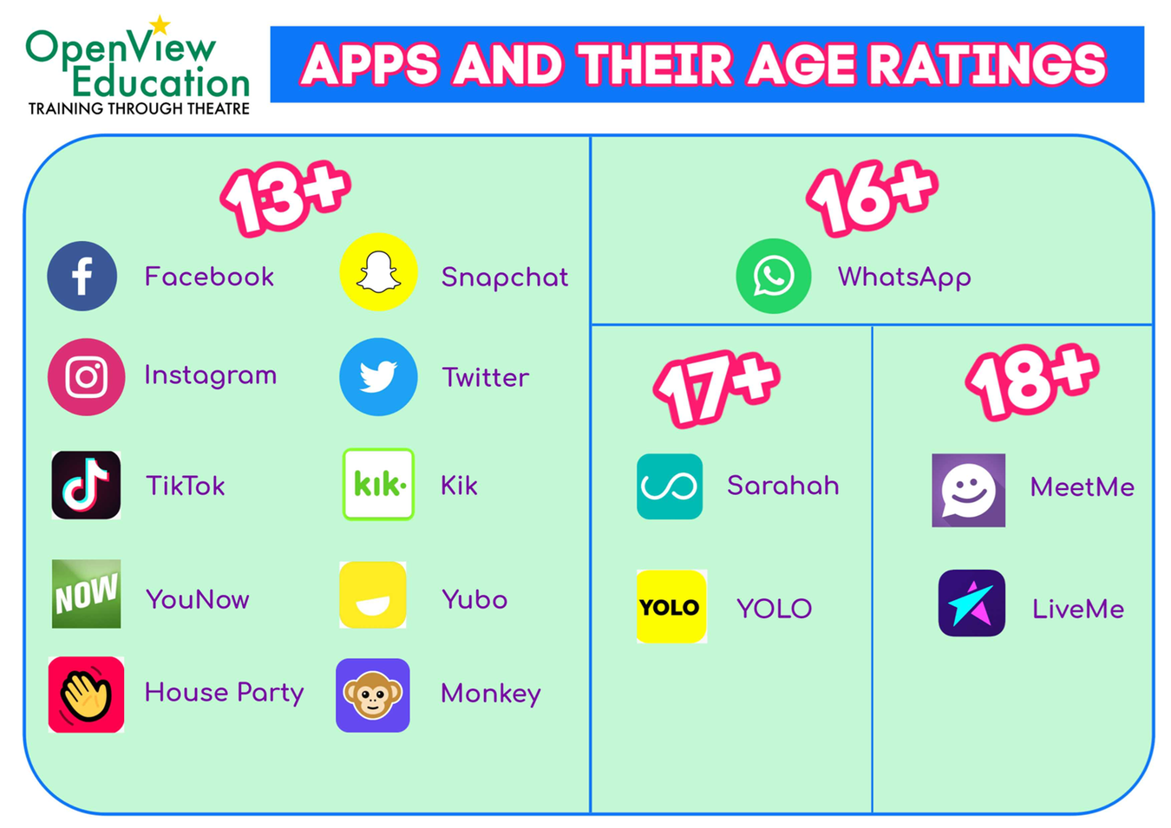
E - Saftey reminder

Slide 15
Thank You

