Slide 1
Welcome to Year 4

Slide 2
Staff in the Year 4 Class:
Mr McKnight
Miss Clarke

Slide 3
Staff
Mr McKnight
Miss Clarke is our classroom assistant each morning and most afternoons. She works with different groups of children depending upon the assessment focus of the lesson ; Miss Clarke provides short focused sessions in class time to secure understanding of an objective
Miss Clarke reads with individual children and groups during guided reading.
Miss Clarke works some afternoons in class with year 4.

Slide 4
Class Routines
Each half term will cover different topics. The topic web will be sent out each half term.
A mixed planning format is followed in class to enable all children to achieve success. Objectives and work set are tailored to suit the child: sometimes by year group and / or by personal need.
Children are always encouraged to present neat and tidy work. This is a major part of my teaching and ensuring that books are perfectly neat.
Children are encouraged to be independent (handing in homework, changing books, taking home letters etc). This is a big part of year 4 and heading to UKS2.

Slide 5
Timetable Information
Homework will be handed out on a Thursday.
Homework will be different this year…
Homework tasks will be set out each half term and the children have an opportunity to complete 3 of the tasks or all of them if they like.
Where objectives match, homework may be sent home if the teacher thinks this is necessary but this will be very dependent on understanding of lessons. This may also happen if extra learning is required or to push the children on further.
The children will also have their spelling words to learn and spellings from their weekly class spelling work.
The teaching of Spelling and Grammar in KS2 now takes place in class- 2/3 times each week with the child’s own class teacher. Spelling tests will be given each week. – Monday morning/afternoon

Slide 6
In mental maths, we are currently focusing on securing times tables and place value.
Statutory test in Times tables will take place in year 4. The link below is a great way to practise and get a better understanding of the timetable you’re on. It is also good to start to practise mixed times tables to get the exposure and gain confidence.
TT Rockstars https://play.ttrockstars.com/ttrs/online/stats/537877?t=effort
Times tables tests - Thursday
Spelling tests will be done on a Wednesday
Guided Reading is a taught session to the whole class. They will take part in different tasks daily which are related to the book they are reading.
Children should bring their reading books and reading record each morning in to class and ensure that it has been written in. Please record any information about what you read so there is evidence of this taking place.
PE is on a Monday each week for this half term. Swimming will take place on a Wednesday every week.

Slide 7
Maths Mastery approach
The way we are now approaching Maths…
https://www.ncetm.org.uk/teaching-for-mastery/mastery-explained/a-video-overview-on-teaching-for-mastery-at-primary/

Slide 8
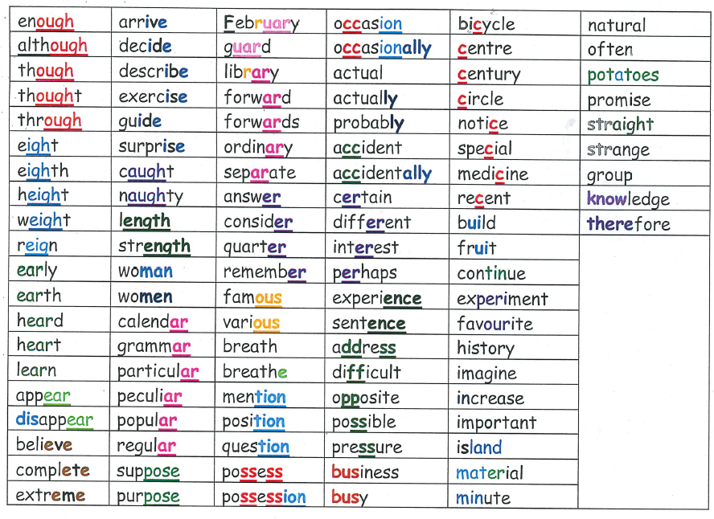
This is a full list of the year 3 and 4 statutory spellings. They have been grouped in to spelling rules which may make them easier to learn.

Slide 9
Targets & Expectations
High expectations are encouraged so that each child can reach their full potential.
Books in class should be an extremely high quality everyday.
Reading records should be completed in detail using the question bank to help (at the back). Books from home can also be read if you’ve finished your reading book. Please also record this in the reading record.
If you take books home please look after them so that other people can use them. 20 books to read.

Slide 10
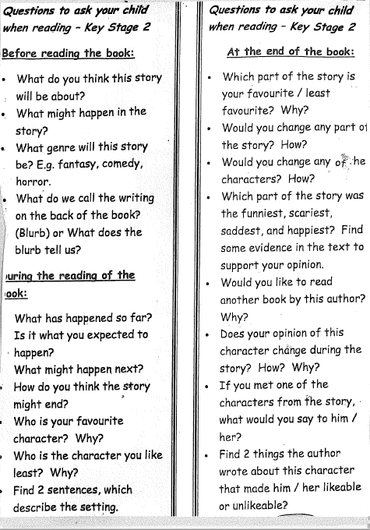
Questions to ask during guided reading or what they can write in their reading records.

Slide 11
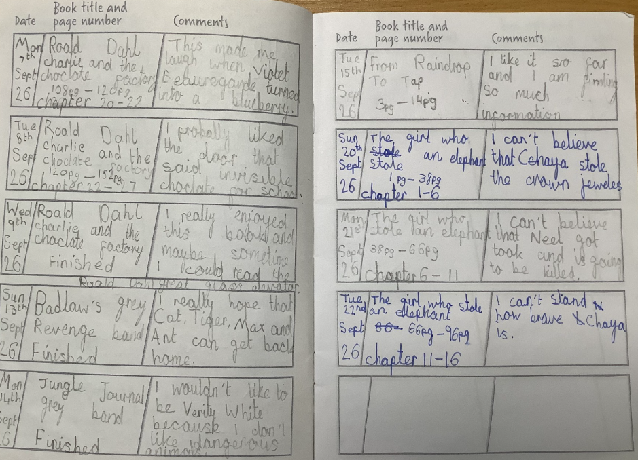
Here is an example of a year 4 reading record.

Slide 12
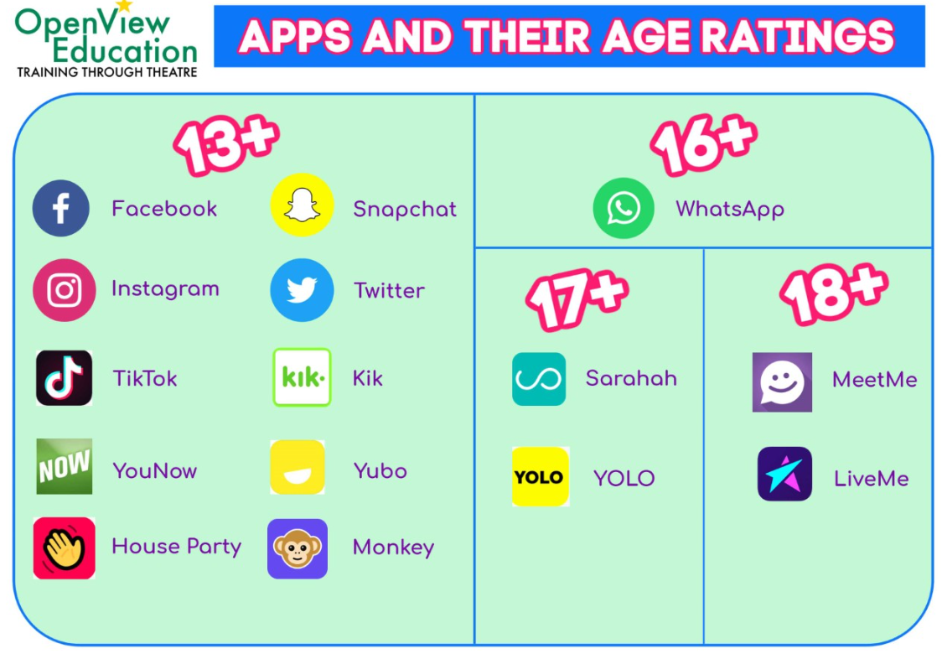
Online safety

Slide 13
How Can You Help?
Regular short reading sessions at home with reading books or one of the 20 books.
Remembering to change books and record it in reading records.
Encourage your child to remember to hand things in and having PE kits, swimming kits in school.
Spellings and times table practice, Nessy.
Support homework :
  Year 4 – help with homework where necessary as the tasks will be related to work we’ve done in class.

Slide 14
Other Information
Any concerns about anything then please find me after school or make an appointment at the school office.
Any questions?
Many thanks
Mr McKnight

