Slide 1
WELCOME TO YEAR 6
CLASS TEACHER – Mr Davis
TEACHING ASSISTANT – Mr Ponde

Slide 2
WHAT DOES LEARNING LOOK LIKE
The first few weeks in class are about ensuring that the strengths and weaknesses of each child are understood moving forward.
This allows all lessons to be tailored to suit your child’s individual needs and ensure that they achieve the maximum.
It might be that your child needs some additional support in key areas, perhaps for a few sessions or perhaps a little longer.
These will take the form of intervention sessions which will be communicated to you to allow for follow up at home.

Slide 3
READING BOOKS
Children may have a variety of books based on what they require.
Book band book – These are tailored to the child’s reading level. The aim is to complete one of these weekly, which then needs handing in to be changed.
Individual reading book – This is a book the child has chosen, either from the books available in the classroom, or from home . These will often take a little longer to read but progress will be monitored through reading records.
Guided Reading book – This book is used by children in all guided reading sessions. It may travel between home and school if additional reading is required.

Slide 4
READING BOOKS CONT.
Please ensure that reading records are filled in for each reading session. This acts as our log that reading is happening outside of school.

Slide 5
SPELLINGS
Children have a spelling list following the year ⅚ statutory words as well as the spelling rule of the week.
Spellings are given out on Monday, to be tested on Friday.

Slide 6
PE LESSONS
Year 6’s PE day will be on Wednesday and Friday for the first half term.
Children need to ensure they come in their PE kit on those days.
An old pair of trainers will be preferable for outdoor sessions and black pumps for indoor sessions.
We will be outdoors as much as possible this half term, so please dress prepared for the weather that day!
Football (Friday) will be on the field as much as possible – please bring shin pads.
Hockey (Wednesday) – please bring a gum shield and shin pads.

Slide 7
HOMEWORK
Spellings will be set Monday to be tested on Friday
Times Tables will be tested once a week
Usually, short weekly homework activities will be set to complete and sent home. These will be targeted to your child’s learning and needs. It may even be on a 1:1 basis so completing it will benefit their learning.

Slide 8
TOPIC
Our current topic is:
World War Two

Slide 9
CONTACT
If you need to pass something on, please let Mrs Higham know or catch an adult either on the gate or at the door.

Slide 10
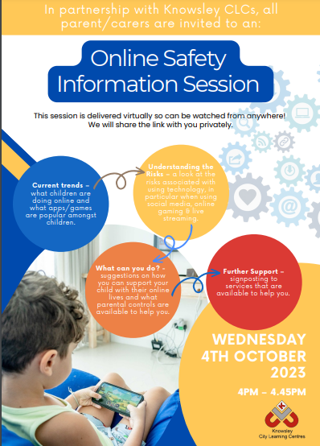
SOCIAL MEDIA
We will continue to run under the permissions provided last year.
If you wish to alter the social media permissions for your child, please let me know at the end.

Slide 11






HOW OLD DO I NEED TO BE?
UPDATED • SEP 2026
Social media, messaging & online communities • UK guide
13+
Minimum account age
AGE-TIERED
Can be used under 13 with
age-appropriate controls
TikTok
D
Discord
▶
YouTube
Snapchat
Reddit
Under 13: supervised account
◇
Roblox
Instagram
T
Twitch
Age-based Kids / Select accounts
18+
WhatsApp
M
Messenger
Some content & features
Facebook
X
X
Even on 13+ platforms, some spaces or content are restricted to adults.
D
Discord
r
Reddit
T
Twitch
Platform minimum ages — not a judgement that every app is suitable at 13.
Minimum ages can vary by country and feature. Check parental controls and talk regularly about privacy, contacts and reporting.
School online-safety guide

Slide 12
EXTRA SUPPORT
If there are any areas of learning that you feel would benefit from extra time spent on outside of the classroom, please do not hesitate to get in touch.
I am happy to provide resources to support extra learning from home wherever possible and can also direct you in the way of useful websites and resources for you to use yourself.
Thank you and Welcome to Year 6!

