Slide 1
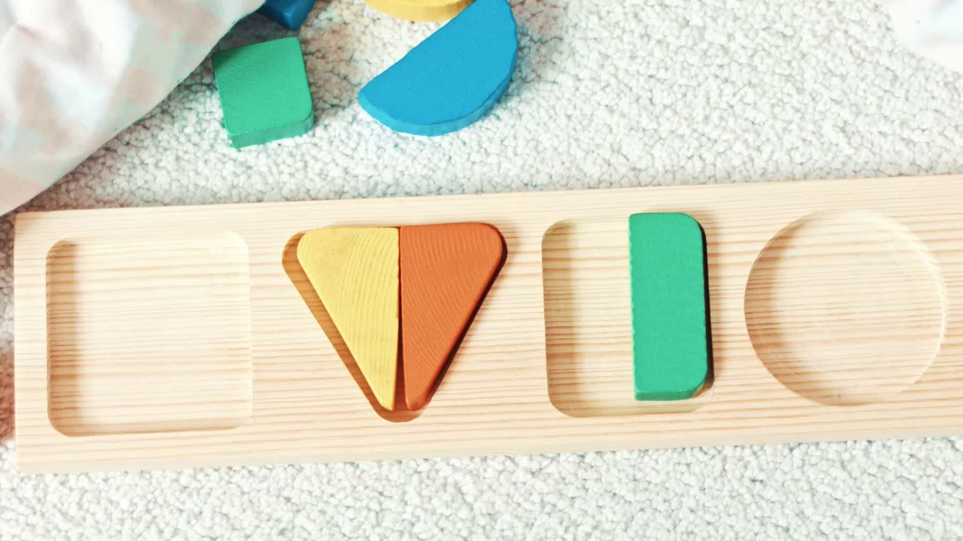
How to help your child at home
Problem solving skills
Memory and concentration
Spatial awareness
Fine motor skills
Language and communication
Emotional development
Early math's skills
Guidance for parents
September 2026

Slide 2
Phonics
Phonics is a way of teaching children to read by matching sounds (phonemes) to letters or groups of letters (graphemes). Instead of memorising whole words, children learn how sounds blend together to make words.
Why is it Important?
It helps children decode words when reading.
Builds a strong foundation for spelling and writing.
It’s the main approach used in UK schools for early reading.

Slide 3
How does it work?
Sounds First: Children learn the 44 sounds in English (like /s/, /a/, /t/).
Blending: They practise putting sounds together to read words (e.g., s-a-t → sat).
Segmenting: They break words into sounds to spell them.
Tricky Words: Some words don’t follow phonics rules (like “the” or “said”), so these are learned separately.

Slide 4
u
e
ck
c
k
o
g
d
m
n
i
p
t

Slide 5


Hear it say it, see it say it, say it write it...
r

Slide 6


Slide 7
How does it work?
Sounds First: Children learn the 44 sounds in English (like /s/, /a/, /t/).
Blending: They practise putting sounds together to read words (e.g., s-a-t → sat).
Segmenting: They break words into sounds to spell them.
Tricky Words: Some words don’t follow phonics rules (like “the” or “said”), so these are learned separately.

Slide 8

r
a
n

Slide 9
r e d

Slide 10
r u n

Slide 11
How does it work?
Sounds First: Children learn the 44 sounds in English (like /s/, /a/, /t/).
Blending: They practise putting sounds together to read words (e.g., s-a-t → sat).
Segmenting: They break words into sounds to spell them.
Tricky Words: Some words don’t follow phonics rules (like “the” or “said”), so these are learned separately.

Slide 12


Slide 13
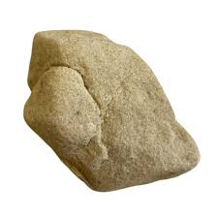

Slide 14

02856 185427

Slide 15
How does it work?
Sounds First: Children learn the 44 sounds in English (like /s/, /a/, /t/).
Blending: They practise putting sounds together to read words (e.g., s-a-t → sat).
Segmenting: They break words into sounds to spell them.
Tricky Words: Some words don’t follow phonics rules (like “the” or “said”), so these are learned separately.

Slide 16
to

Slide 17
the
to
I
no
go
into

Slide 18

No
I
am
not
.
red

Slide 19
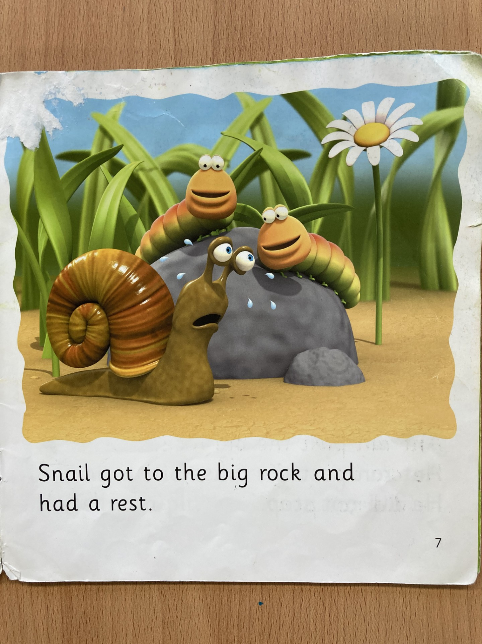

Slide 20
What can parents do at home?
Say the sounds, not the letter names (e.g., say /m/ not “em”).
Play listening games: Spot the first sound in words.
Read together daily: Let your child point out sounds they know.
Keep it fun: Use songs, rhymes, and games.

Slide 21
What can parents do at home?
Sound out everyday words: Time for b e d...
Play turn taking games: Snakes and ladders to 10.
Look for numbers on houses
Play 'I spy'
Be active and play out – potion making, den making, cars and ramps
Paint and be creative

Slide 22

Reassure them.
Every child learns at a different pace. The goal is confidence and enjoyment, not speed.

Slide 23
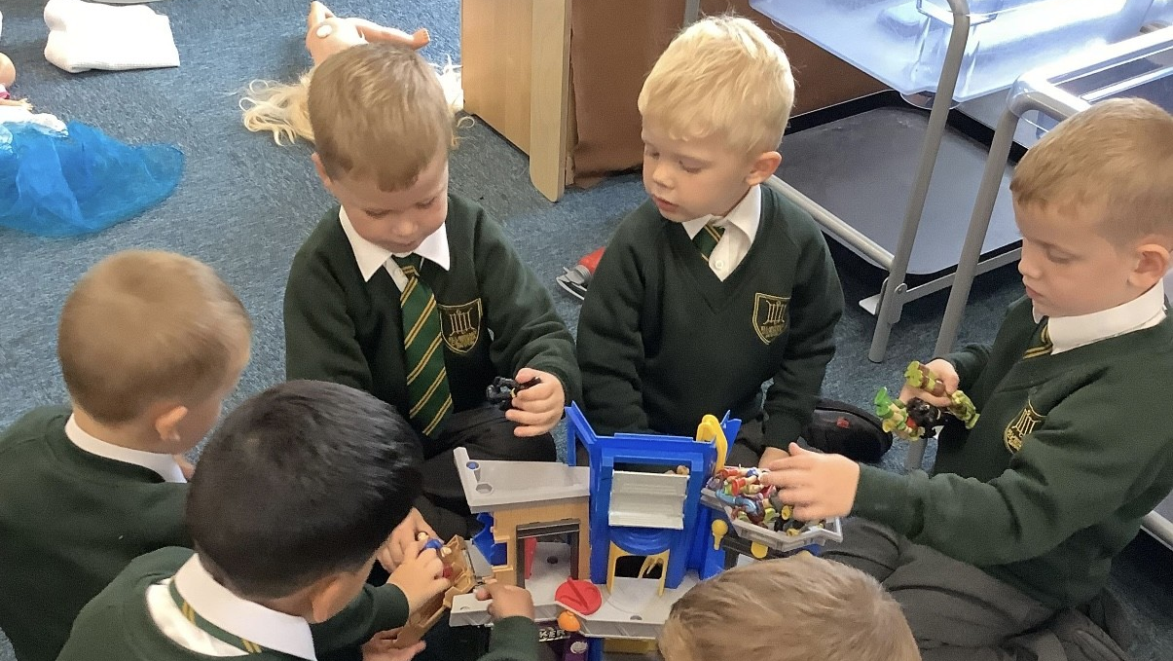

Slide 24
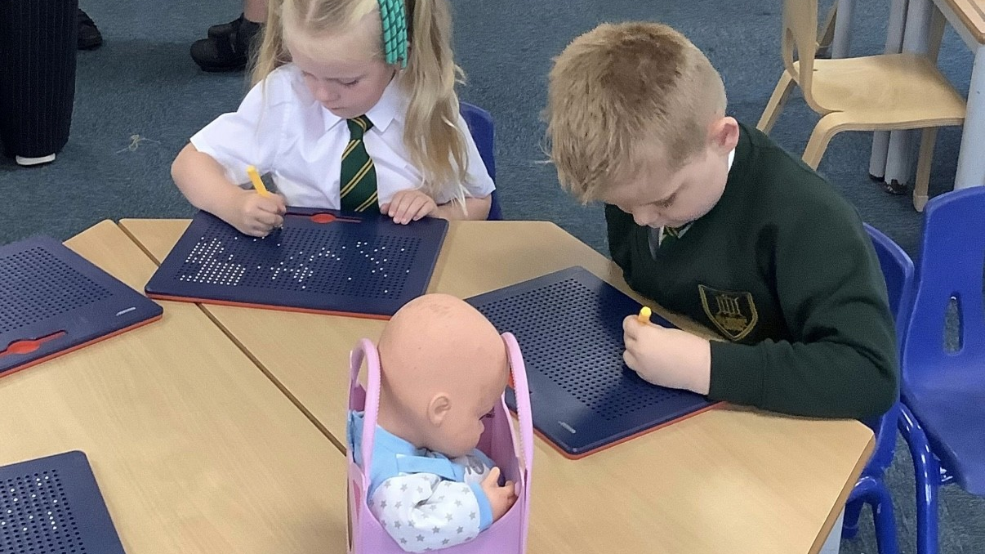

Slide 25
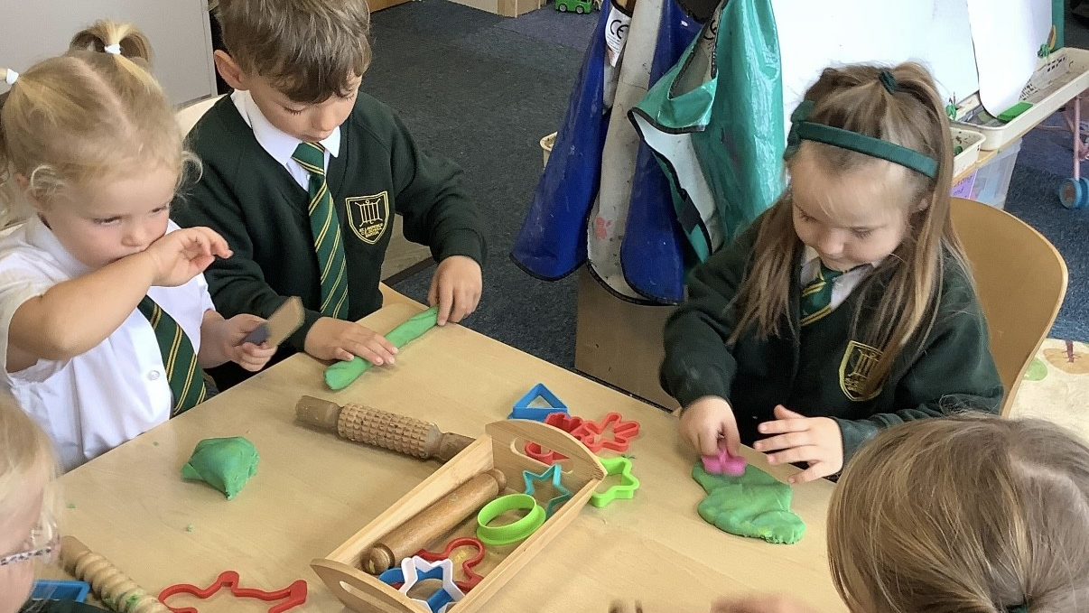

Slide 26
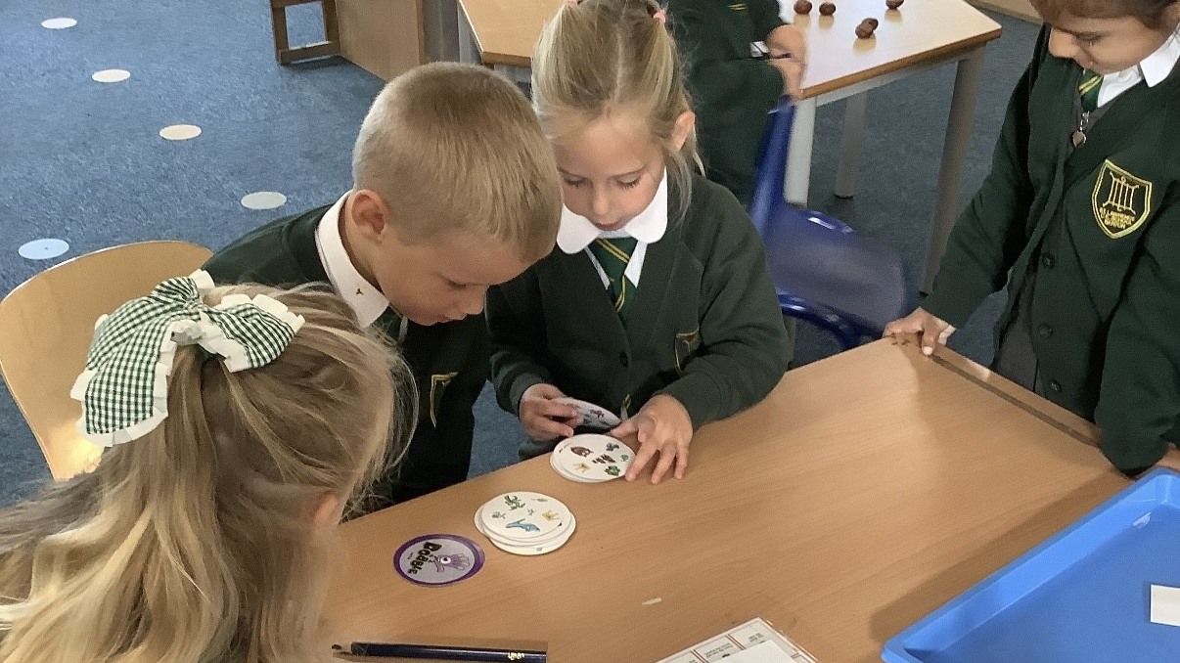

Slide 27
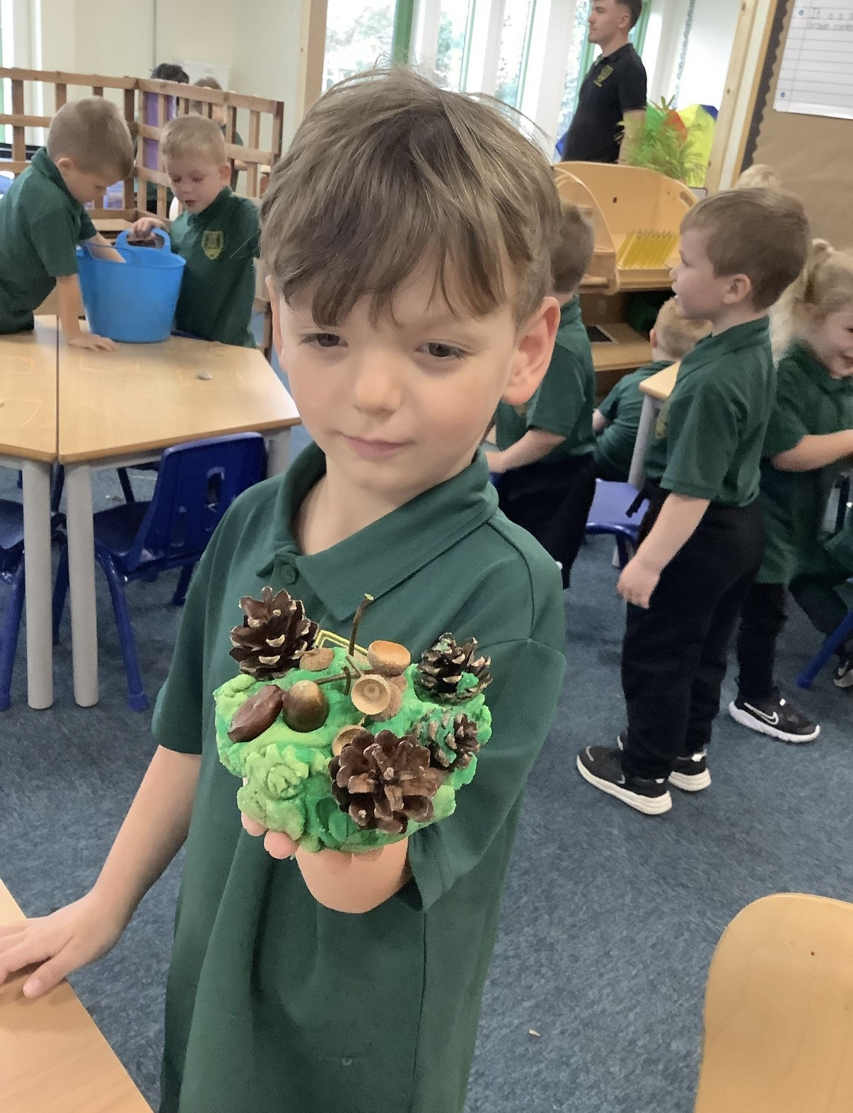

Slide 28
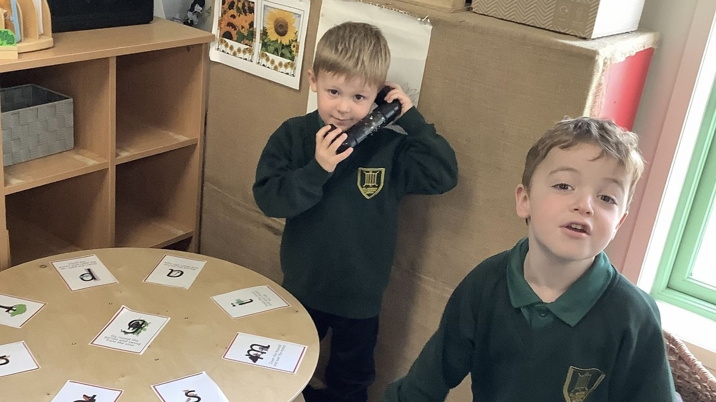

Slide 29
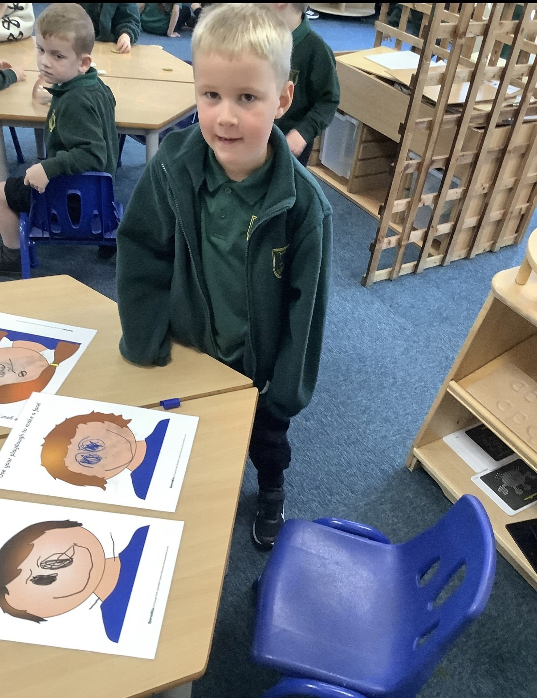

Slide 30
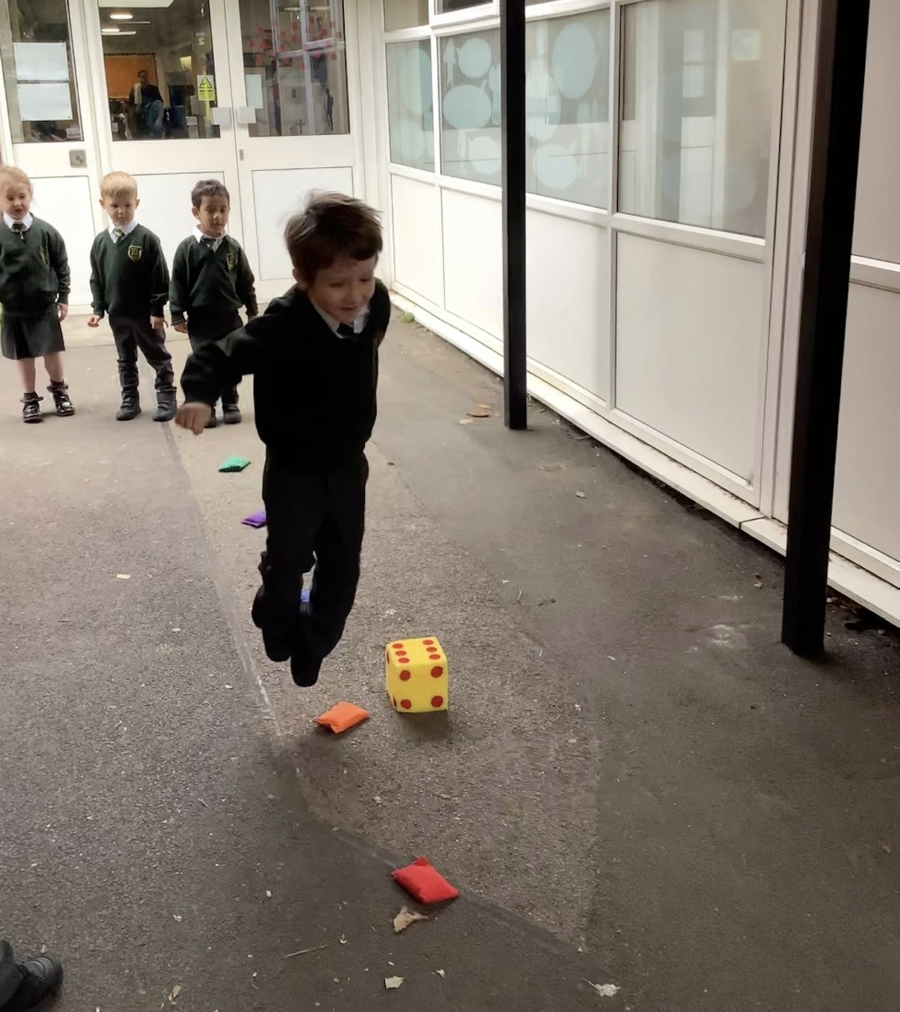

Slide 31
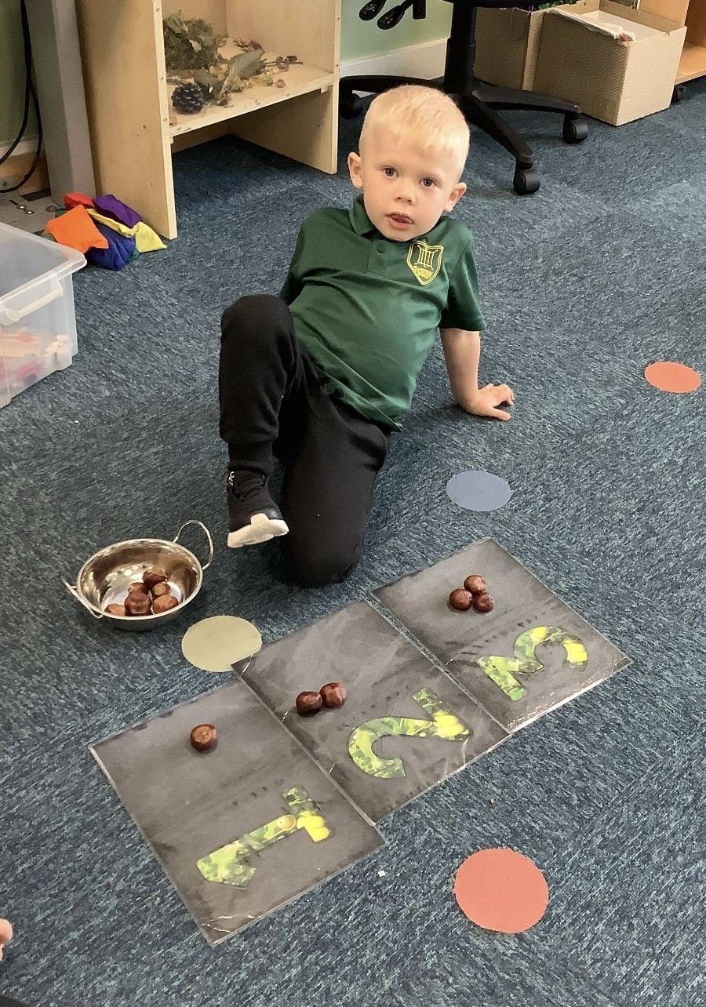

Slide 32
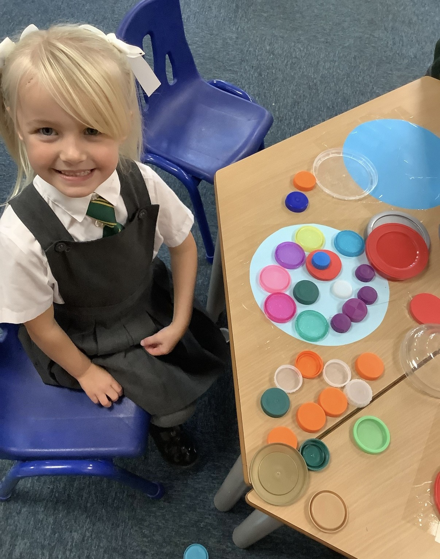

Slide 33
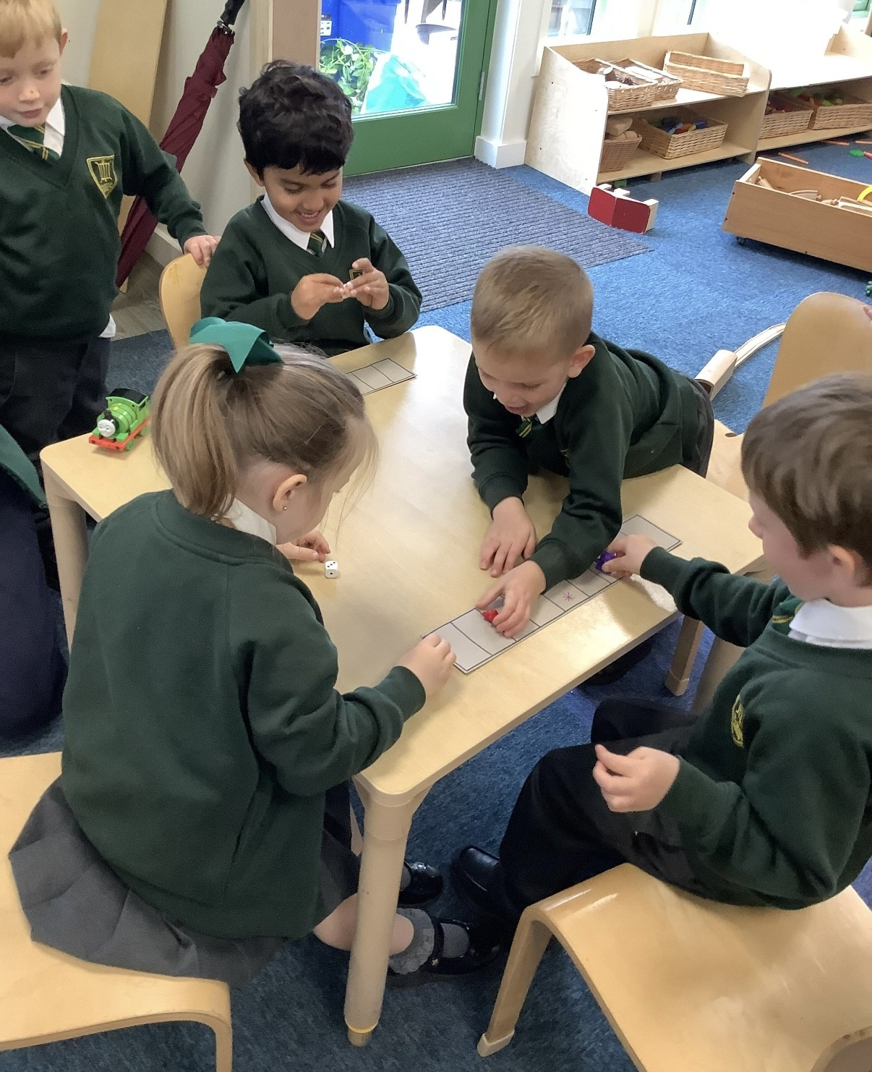

Slide 34
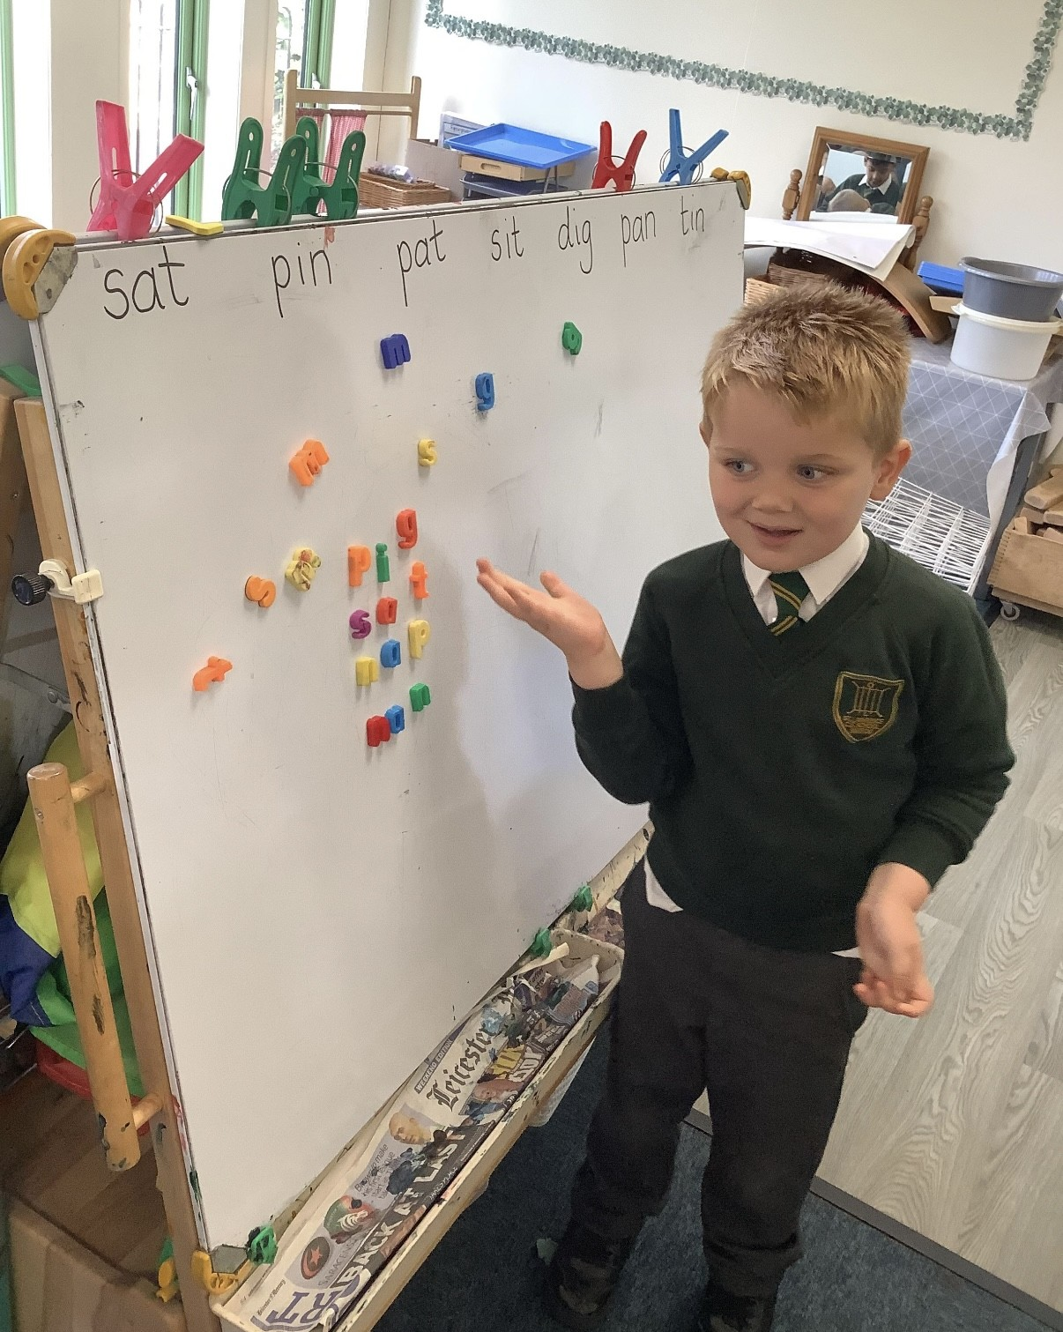

Slide 35
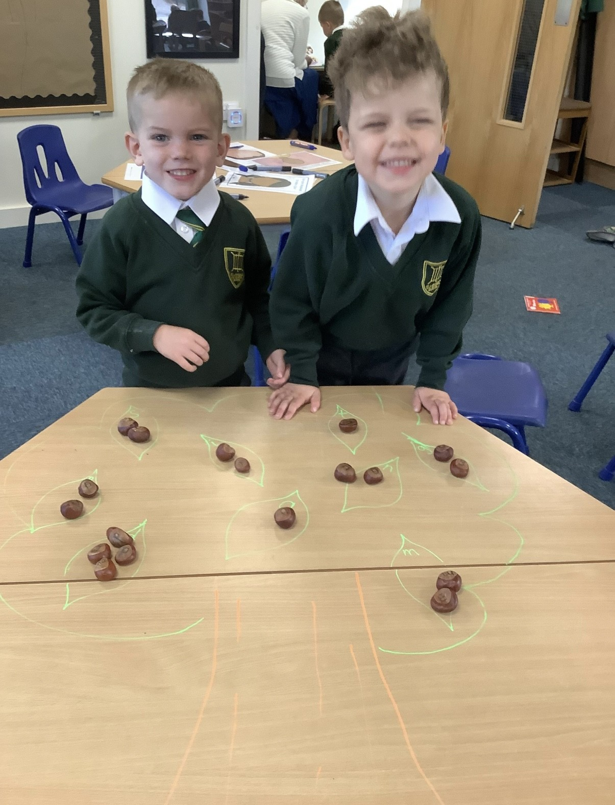

Slide 36
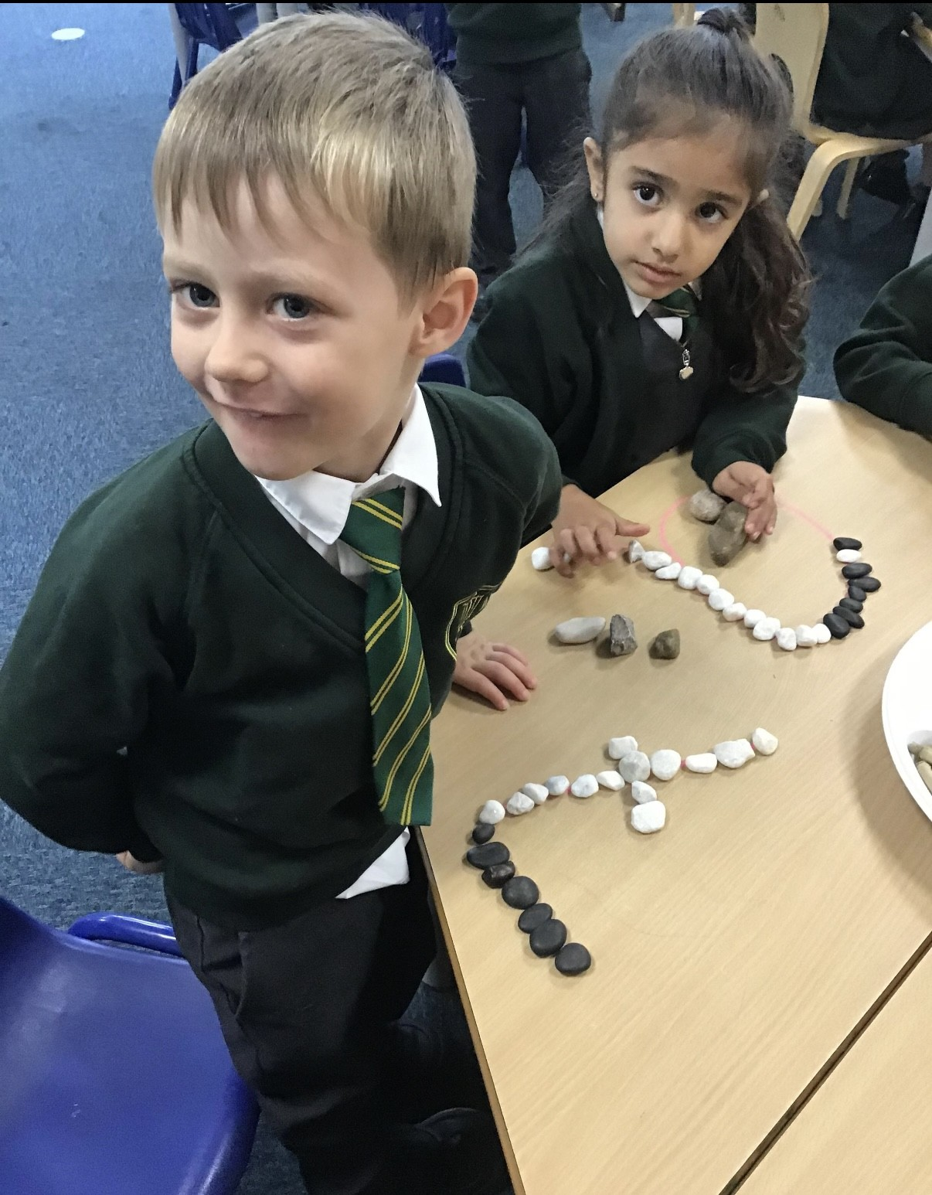

Slide 37
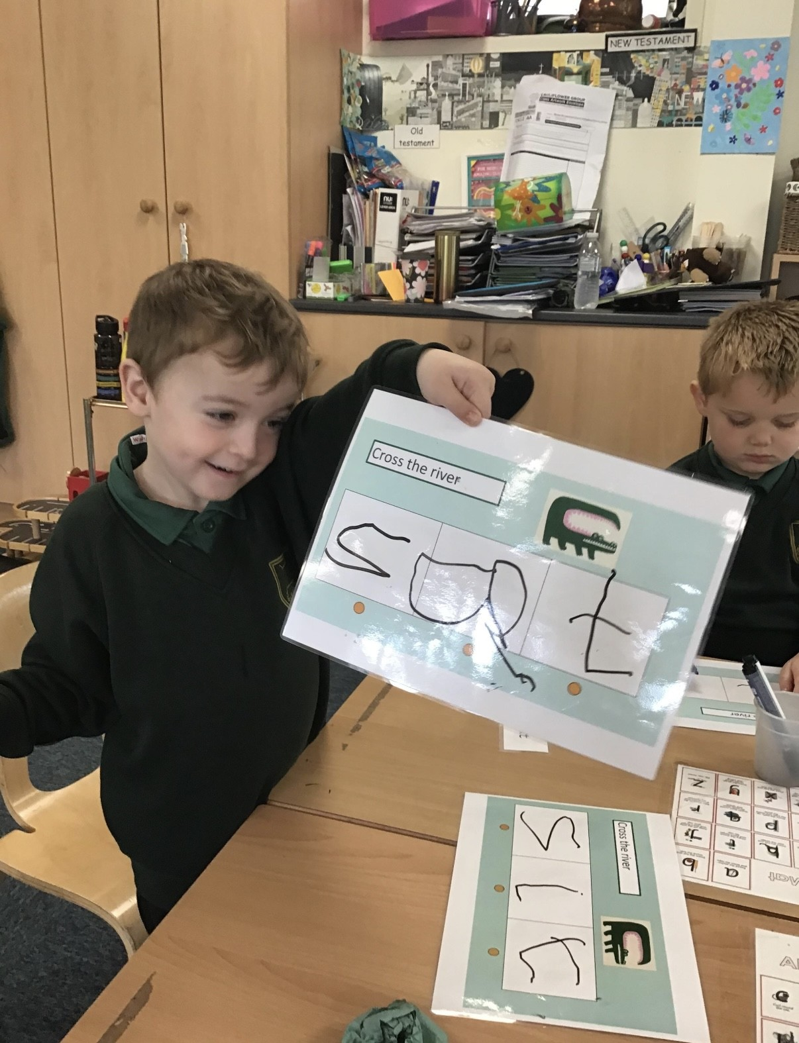

Slide 38
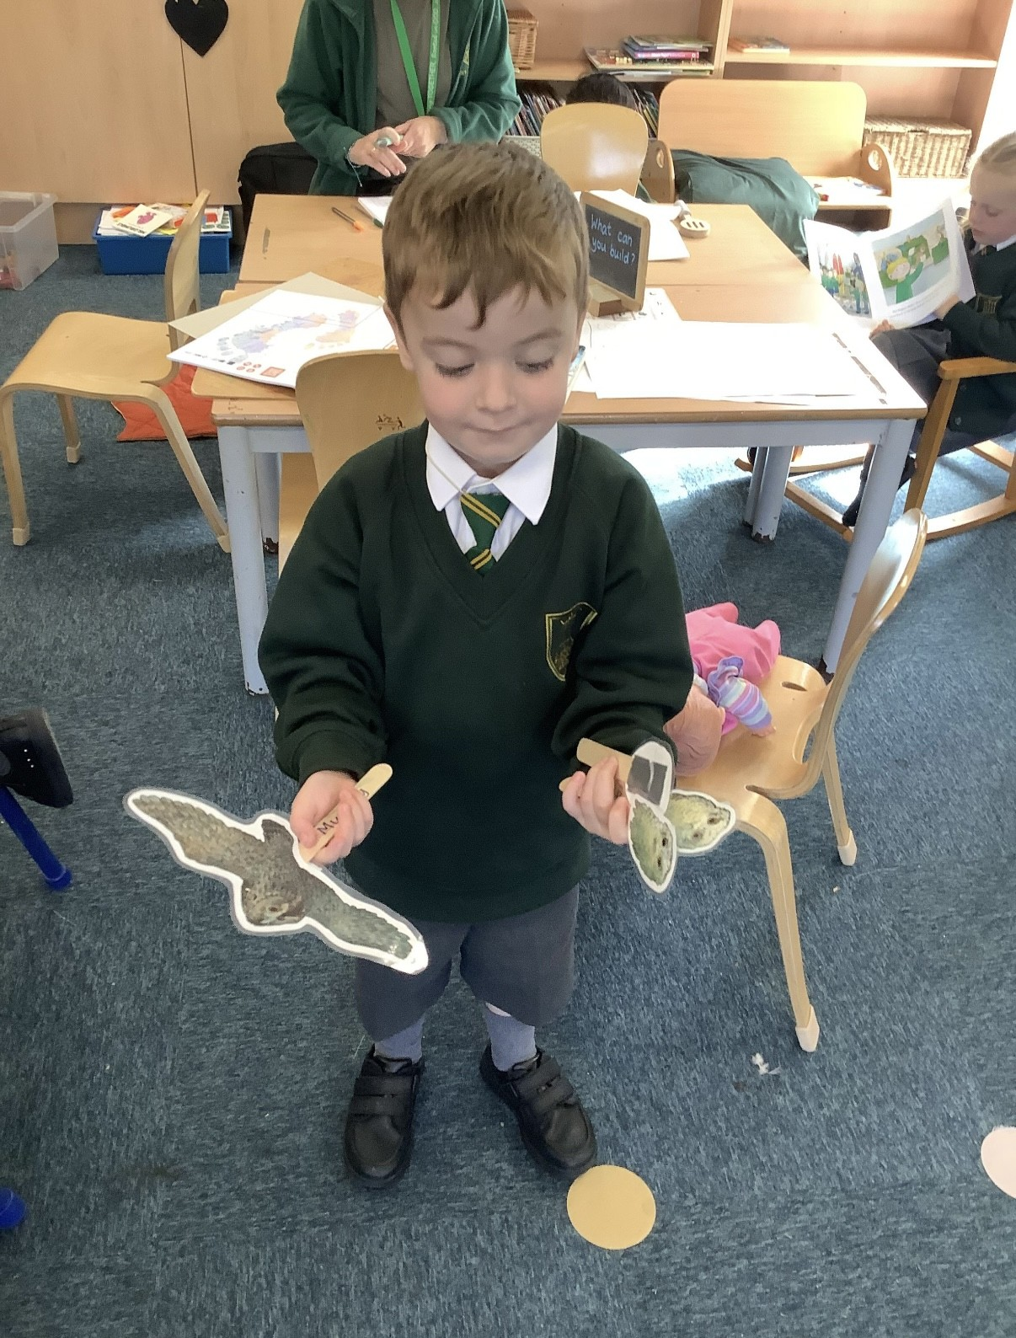

Slide 39
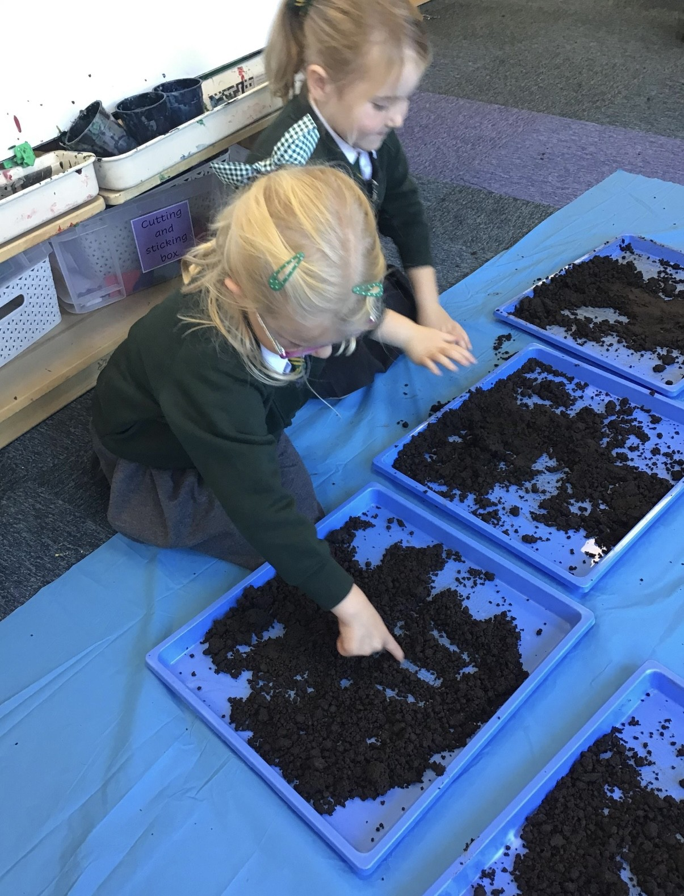

Slide 40
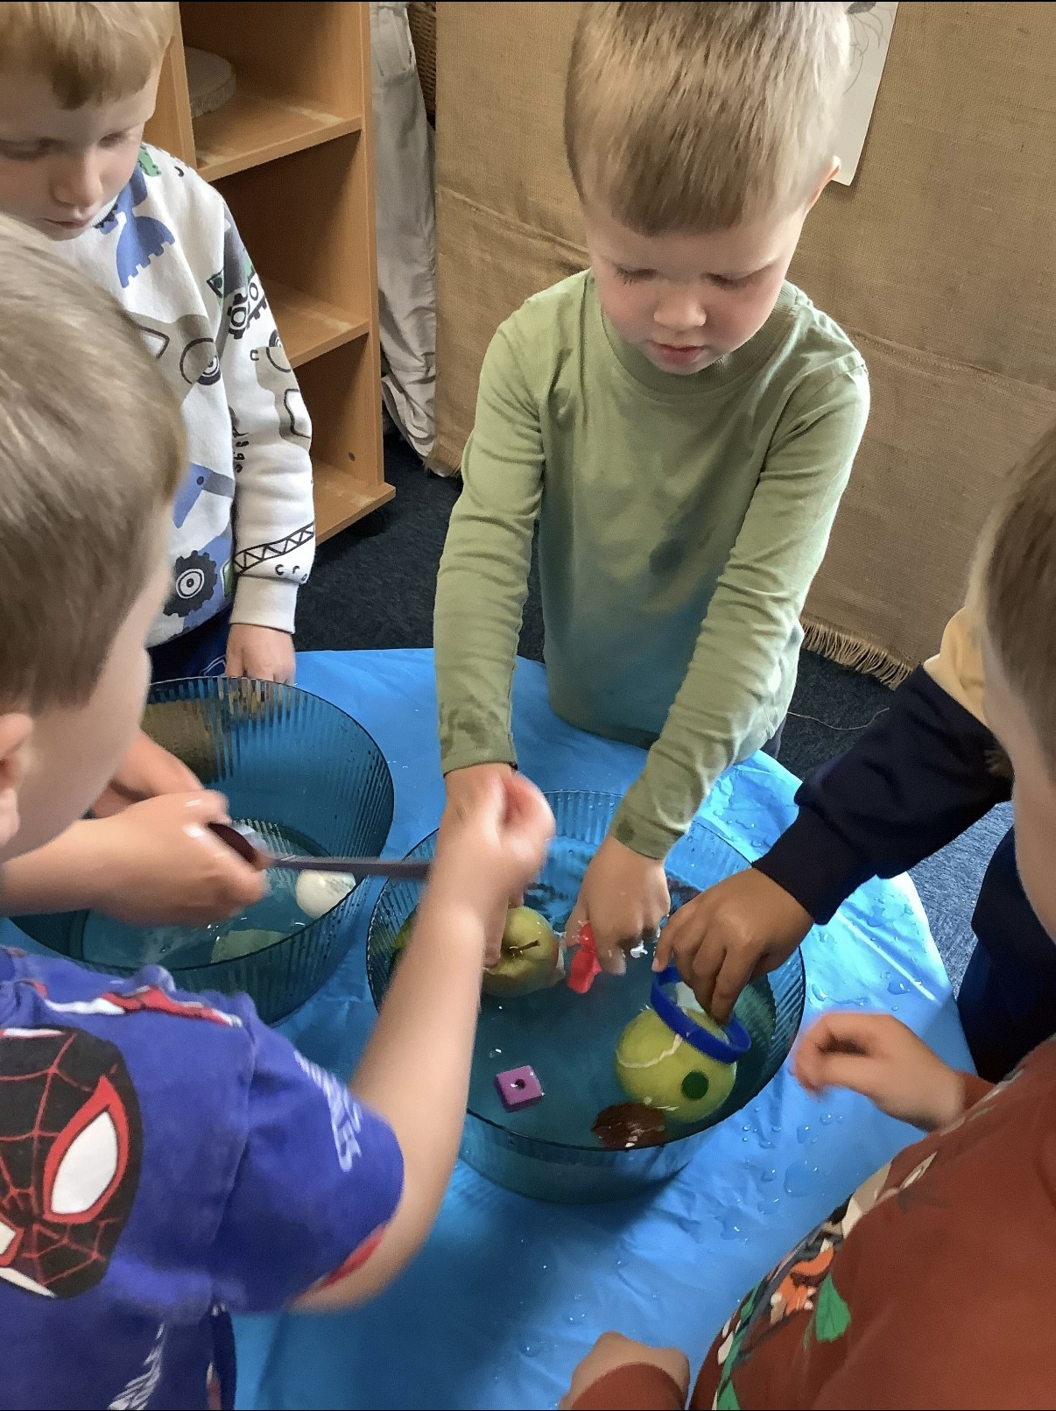

Slide 41
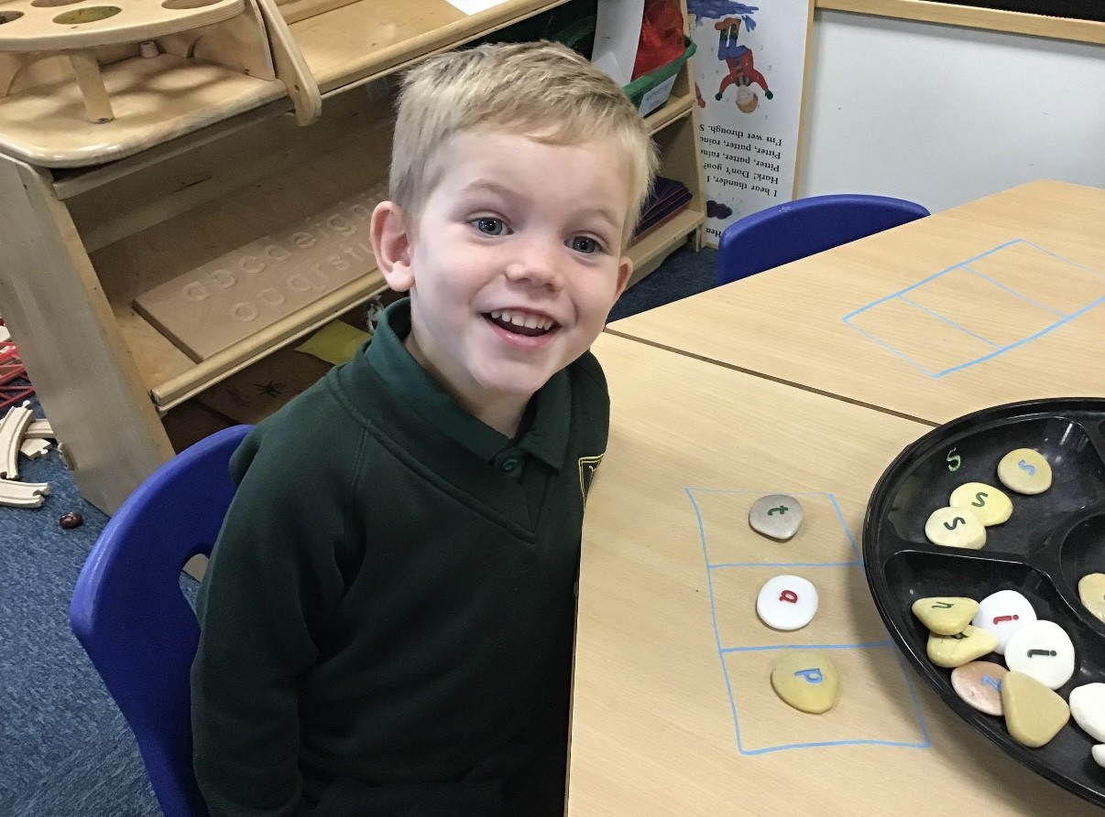

Slide 42
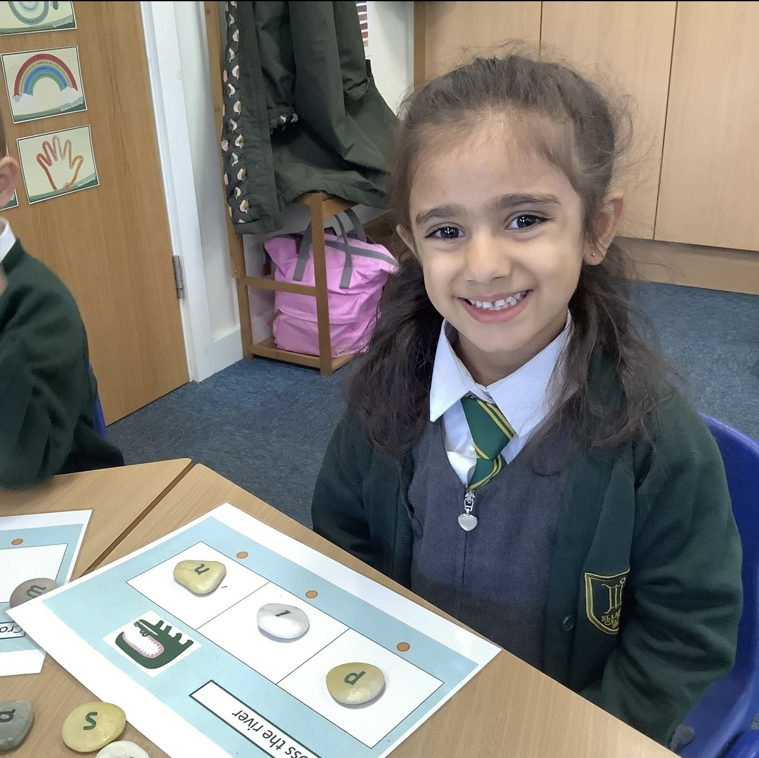

Slide 43
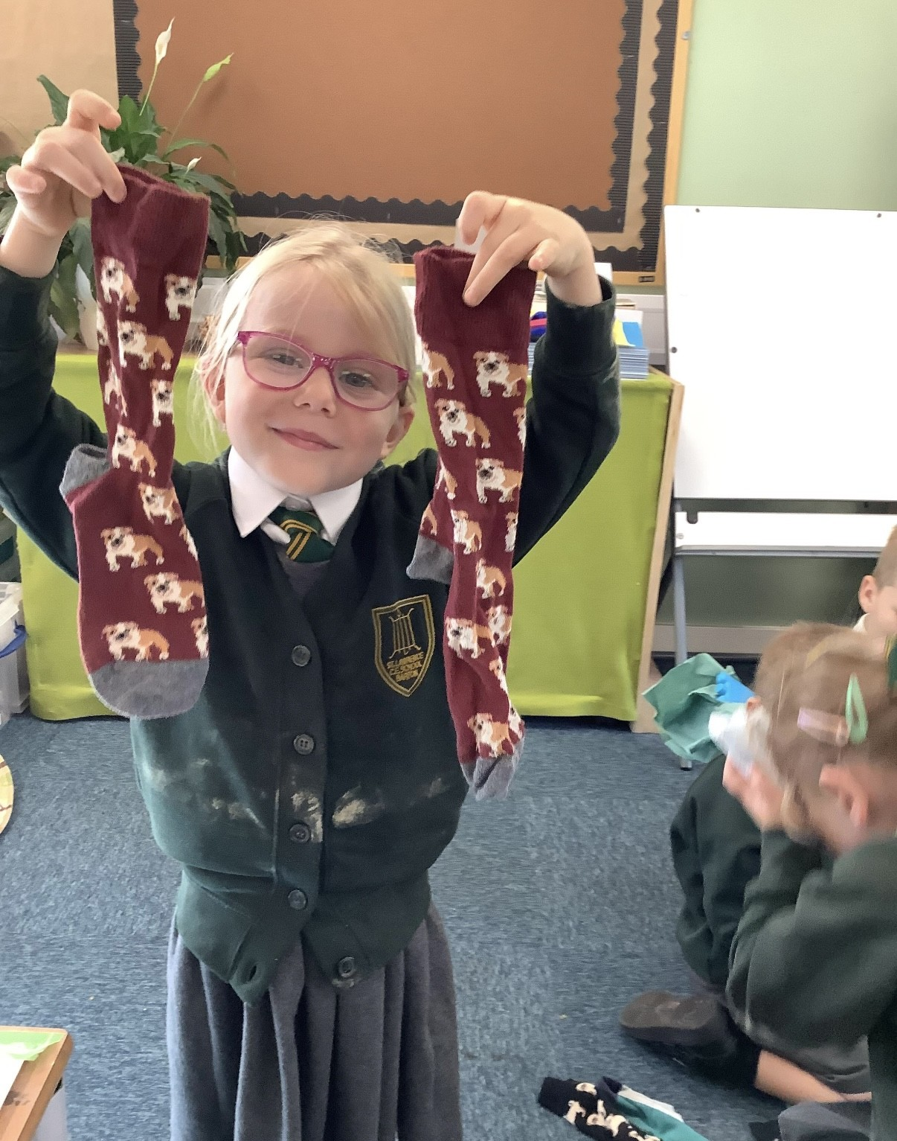

Slide 44
