Slide 1
Induction and welcome evening
2026
Helen Lonsdale
Barton St Lawrence C of E Primary School

Slide 2
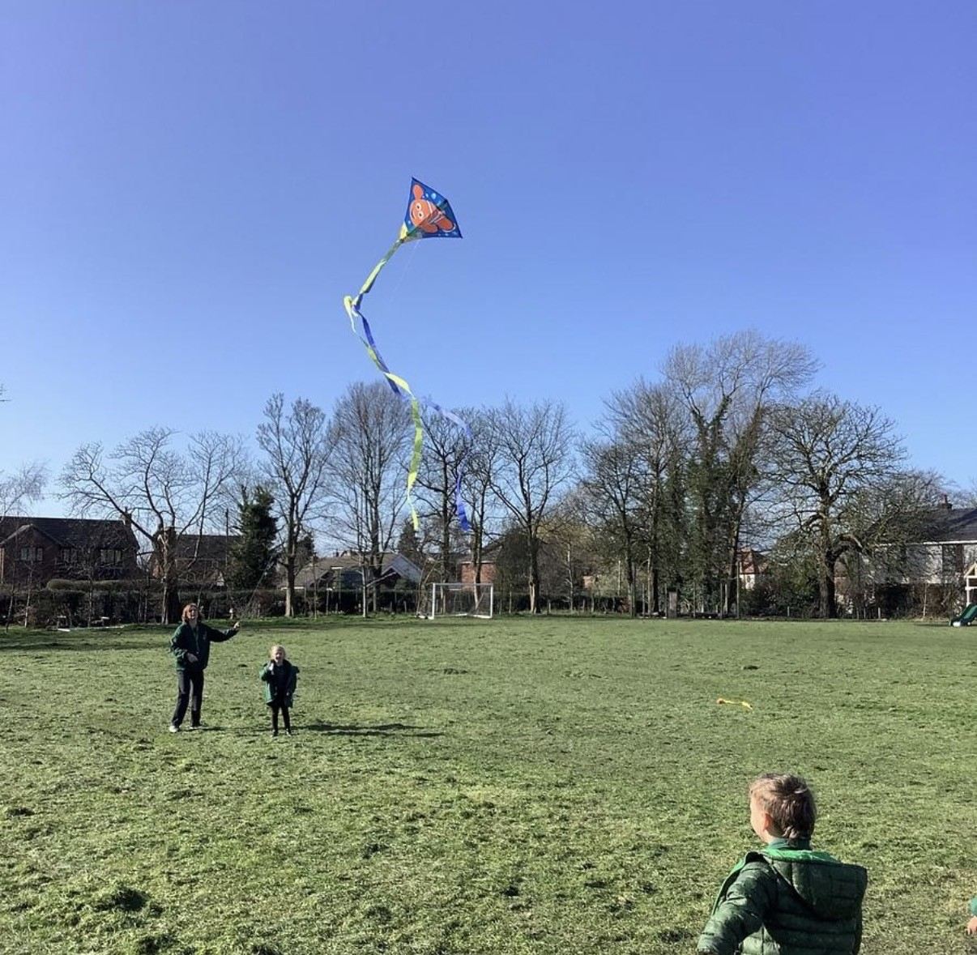
EYFS class at Barton St Lawrence
2 adults from our amazing EYFS team in our class:
Class teacher - Ms Lonsdale
Play based curriculum working at individual pace
Positive behaviour policy with a dojo point system

Slide 3
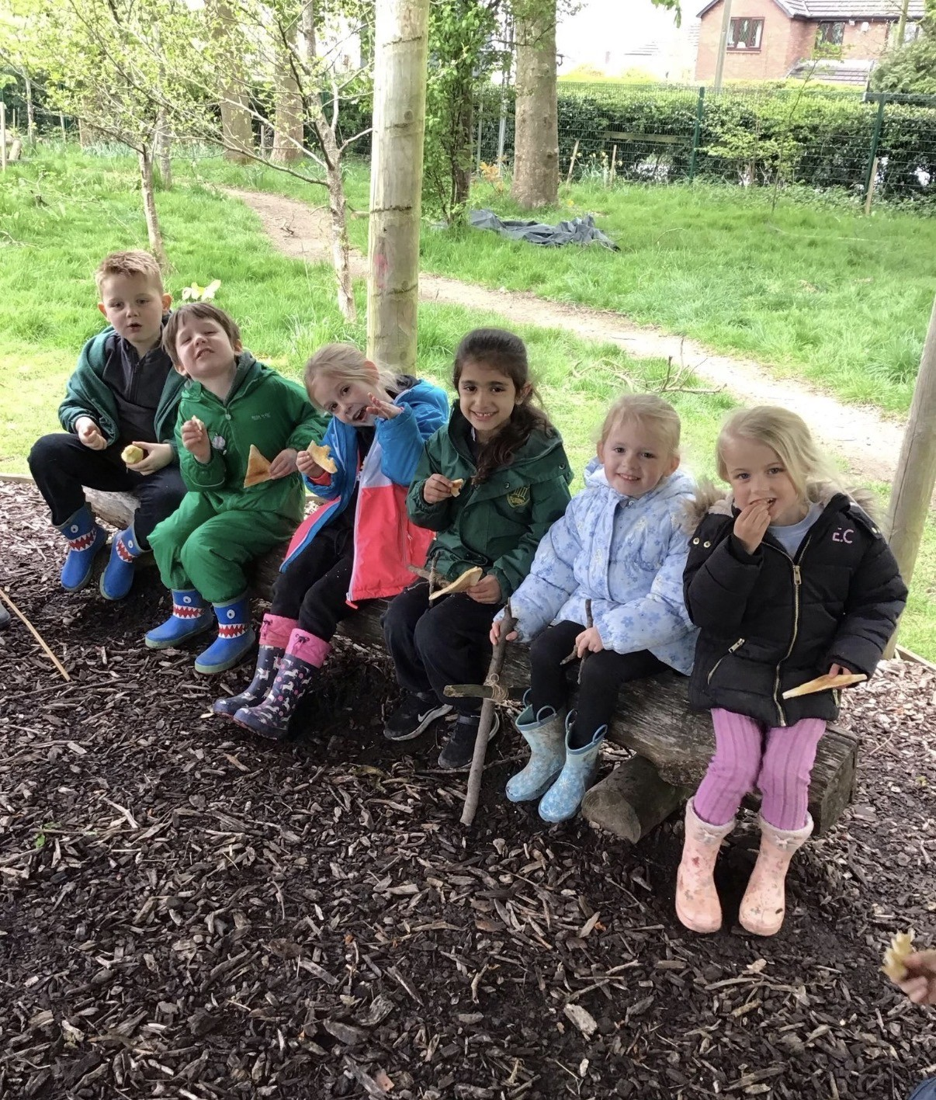
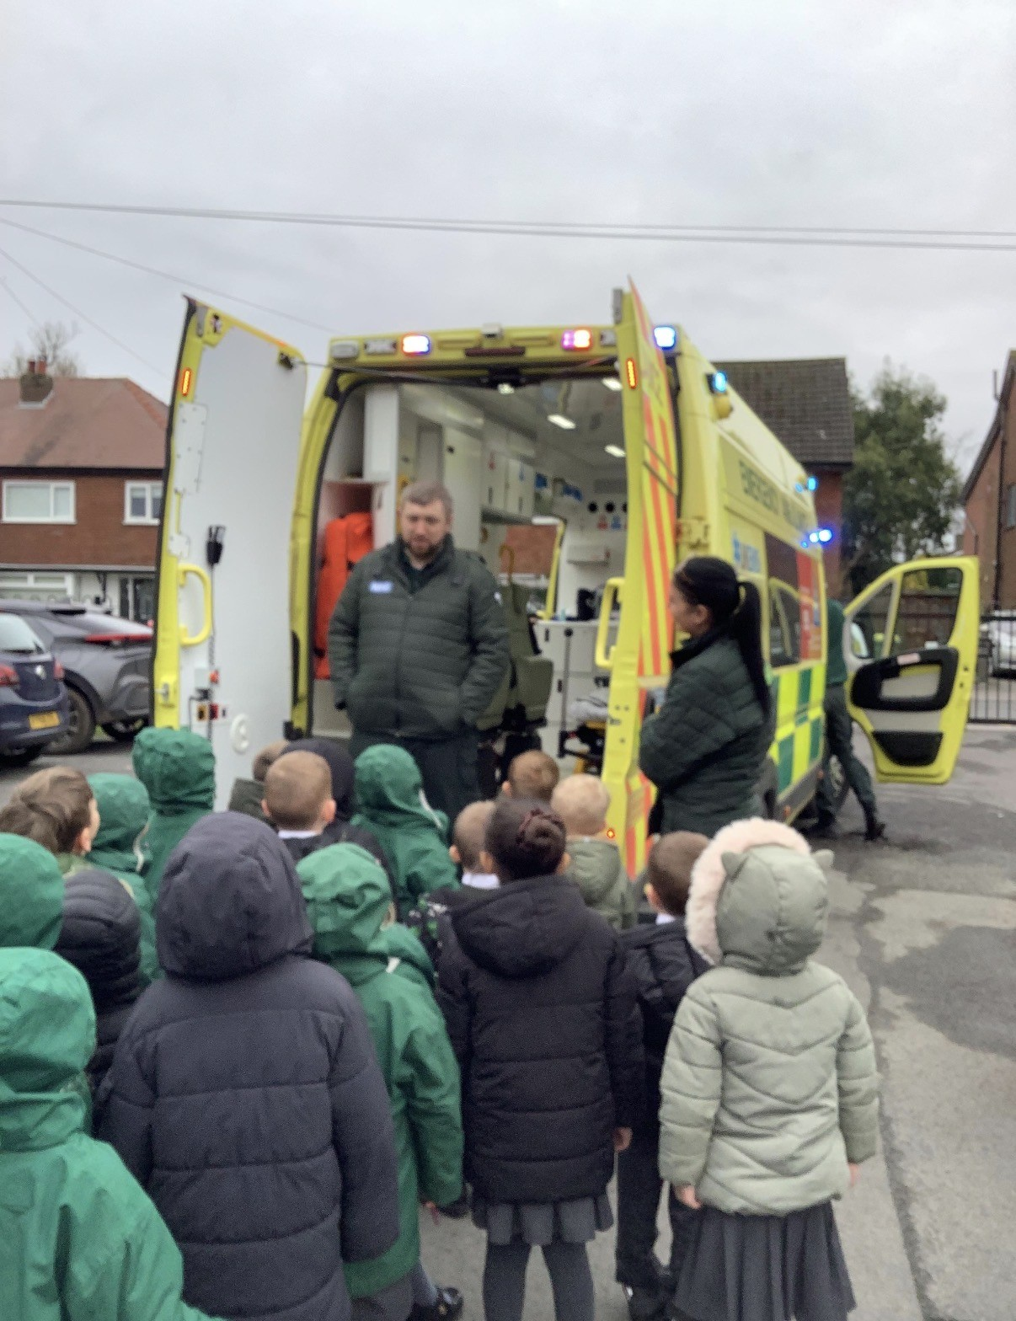
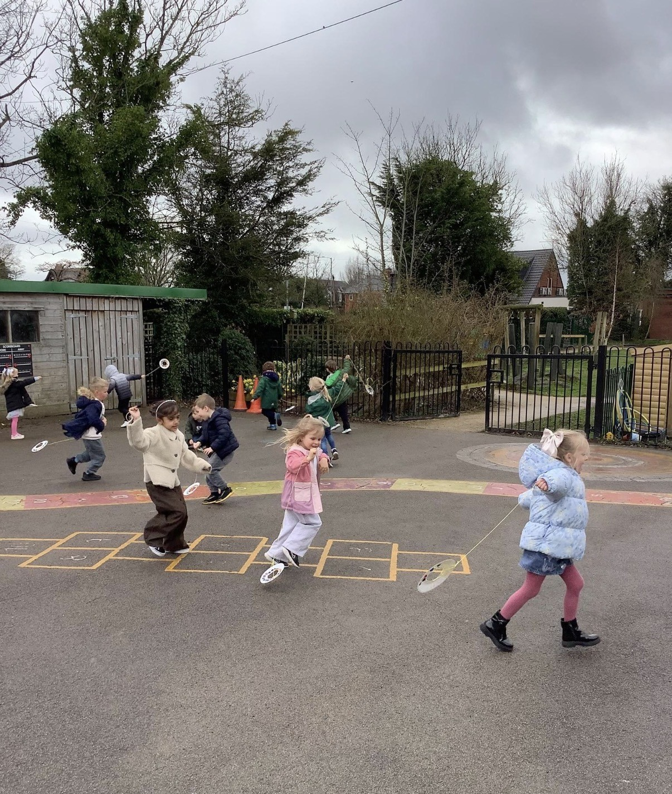
EYFS curriculum
Smooth transitions from nursery
Independent learners
Confident and resourceful children
Indoors and outdoors in all weathers
7 Areas of Learning and 17 Early Learning Goals for assessment at the end of the year
Children work at own pace through their developmental pathway

Slide 4
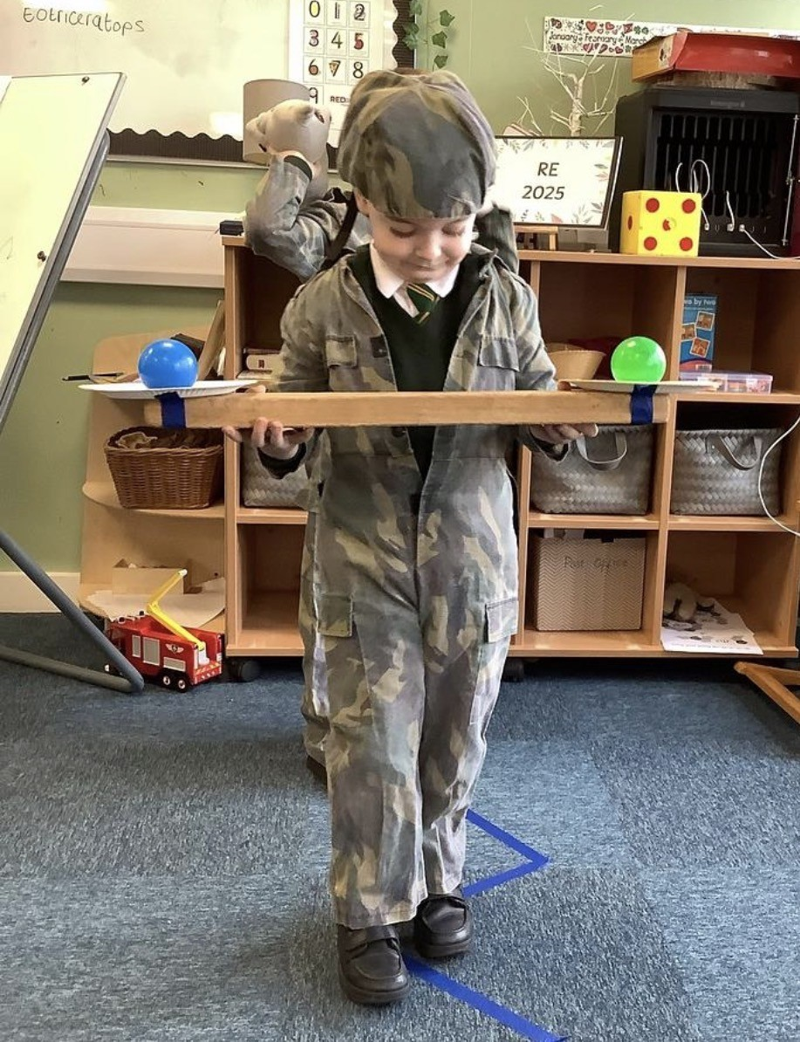
Areas of Learning
PSE – Building relationships, Self regulation & Managing self
Communication & Language – Listening and Understanding, Speaking
Physical Development – Gross motor skills & Fine motor skills
Literacy – Word reading, Comprehension & Writing
Maths – Number and Numerical patterns
Physical Development – Gross motor skills & Fine motor skills
Understanding the world – People, Cultures and Communities, Past and present & The natural world
Expressive arts and design – Creating with materials & Being imaginative and expressive
RE – Jesus and who he was, stories he told, friendships, Christmas and Easter

Slide 5
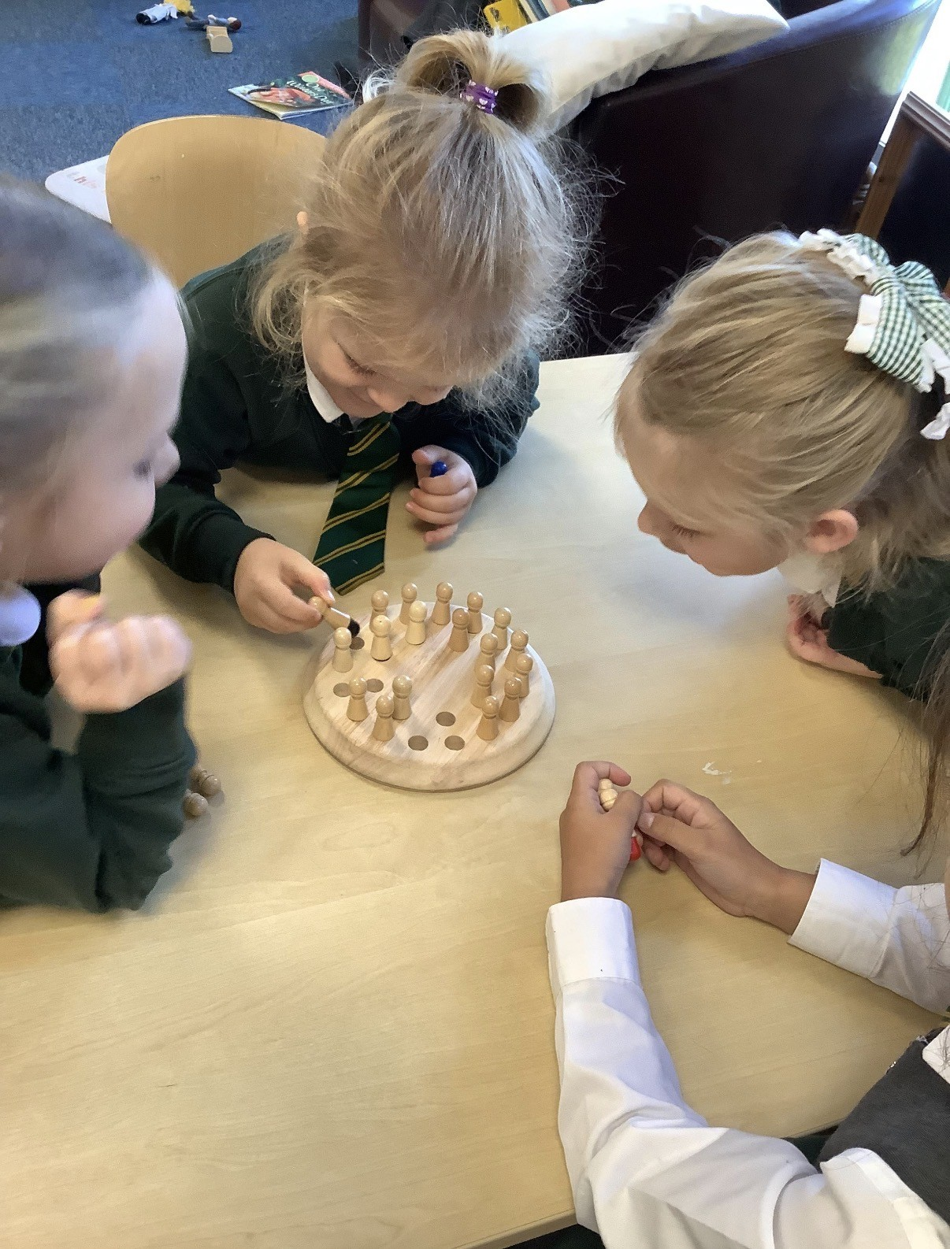
Follow simple instructions?
Separate from you with growing confidence?
Sit and listen for short periods?
Use the toilet independently?
Take turns and begin to share?
Bridging the gap between home and school
✔ Clear boundaries
✔ Consistent routines
✔ Adults who can hold firm expectations kindly
Without this, school can feel confusing and overwhelming.
School readiness
Can your child...
Accept 'no' or wait, even when it's tricky?
Put on their own coat and shoes?
Tidy up after play?

Slide 6
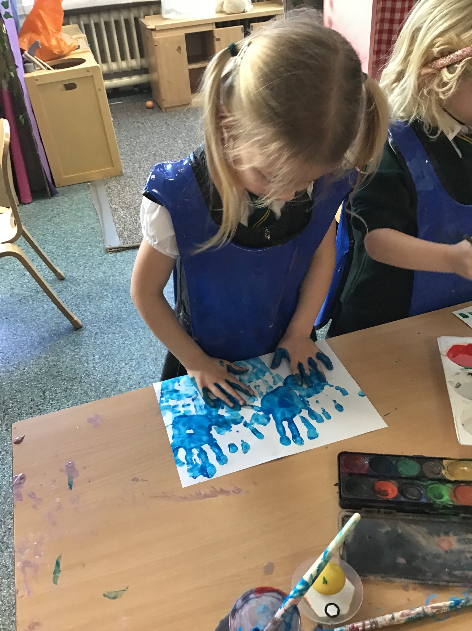
Preparing your child for school. What you can help your child with -
Putting on and fastening own coat and shoes.
Cutting food and eating with a knife and fork.
Going to the toilet, flushing and washing hands independently.
Recognising own name.
Being willing to have a go at something new

Slide 7
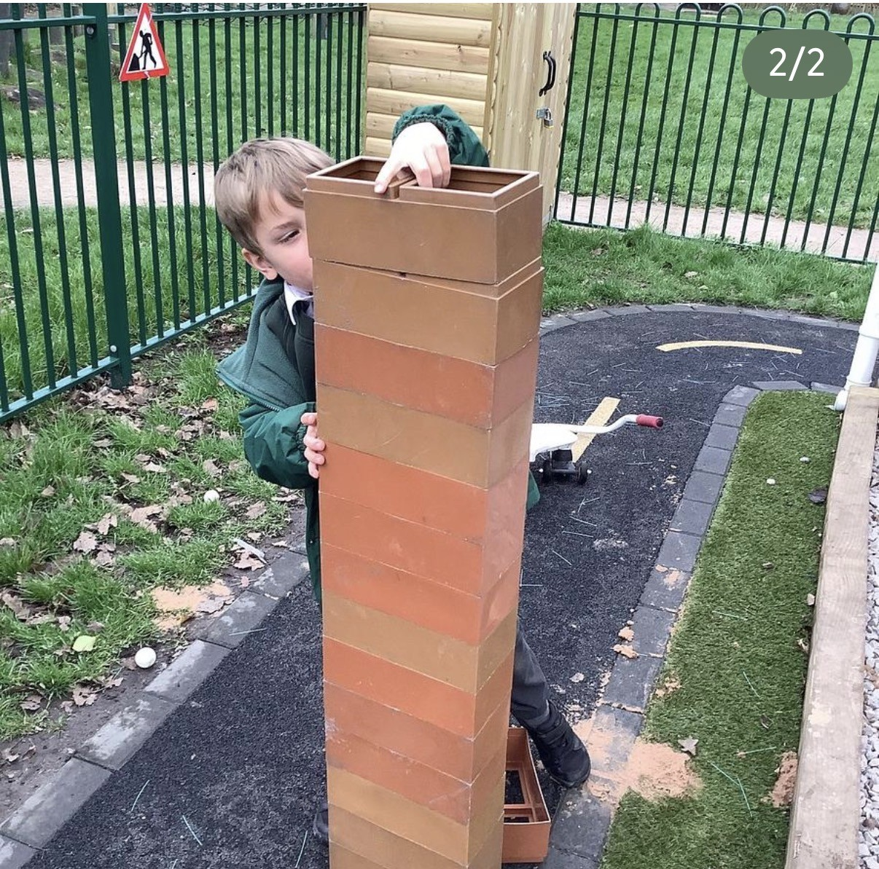
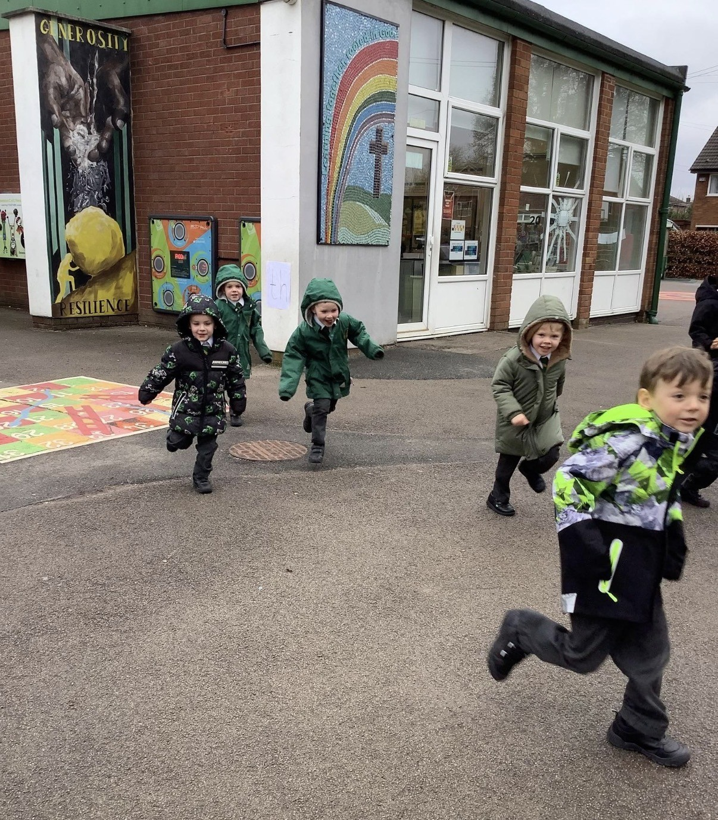
Assessment
Ongoing assessment using observations and pieces of work
Baseline assessment
ELG assessment at end of year – met or emerging
Note: Reports throughout the year.

Slide 8

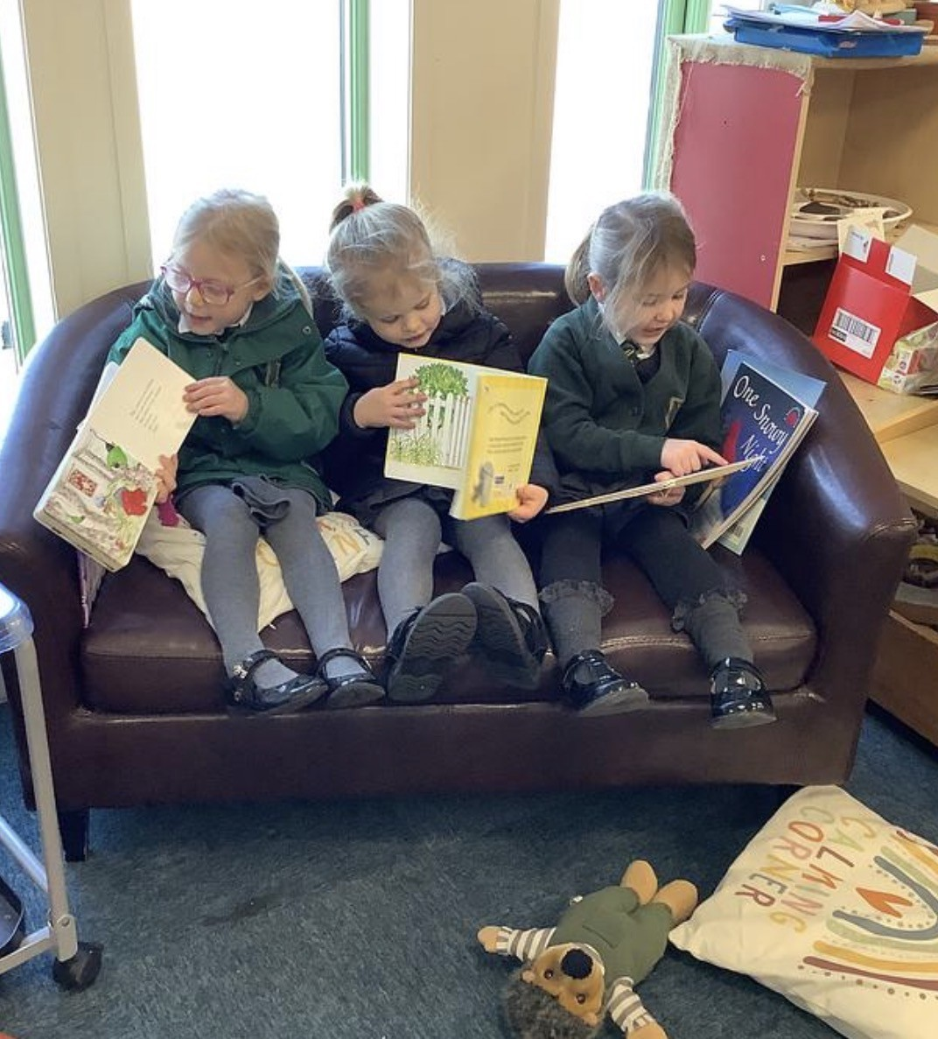
Reading and phonics at home
Daily phonic sessions and reading skills sessions in school
Information on Class Dojo
Home reading books – please fill in reading records with any reading experiences
Please read everyday with your child
Phonics meeting for parents: TBC

Slide 9



Class Dojo
Dojo Monsters
Class story
Individual portfolio of photographs
Green Points
Red Points
Parent invites in children’s folders

Slide 10
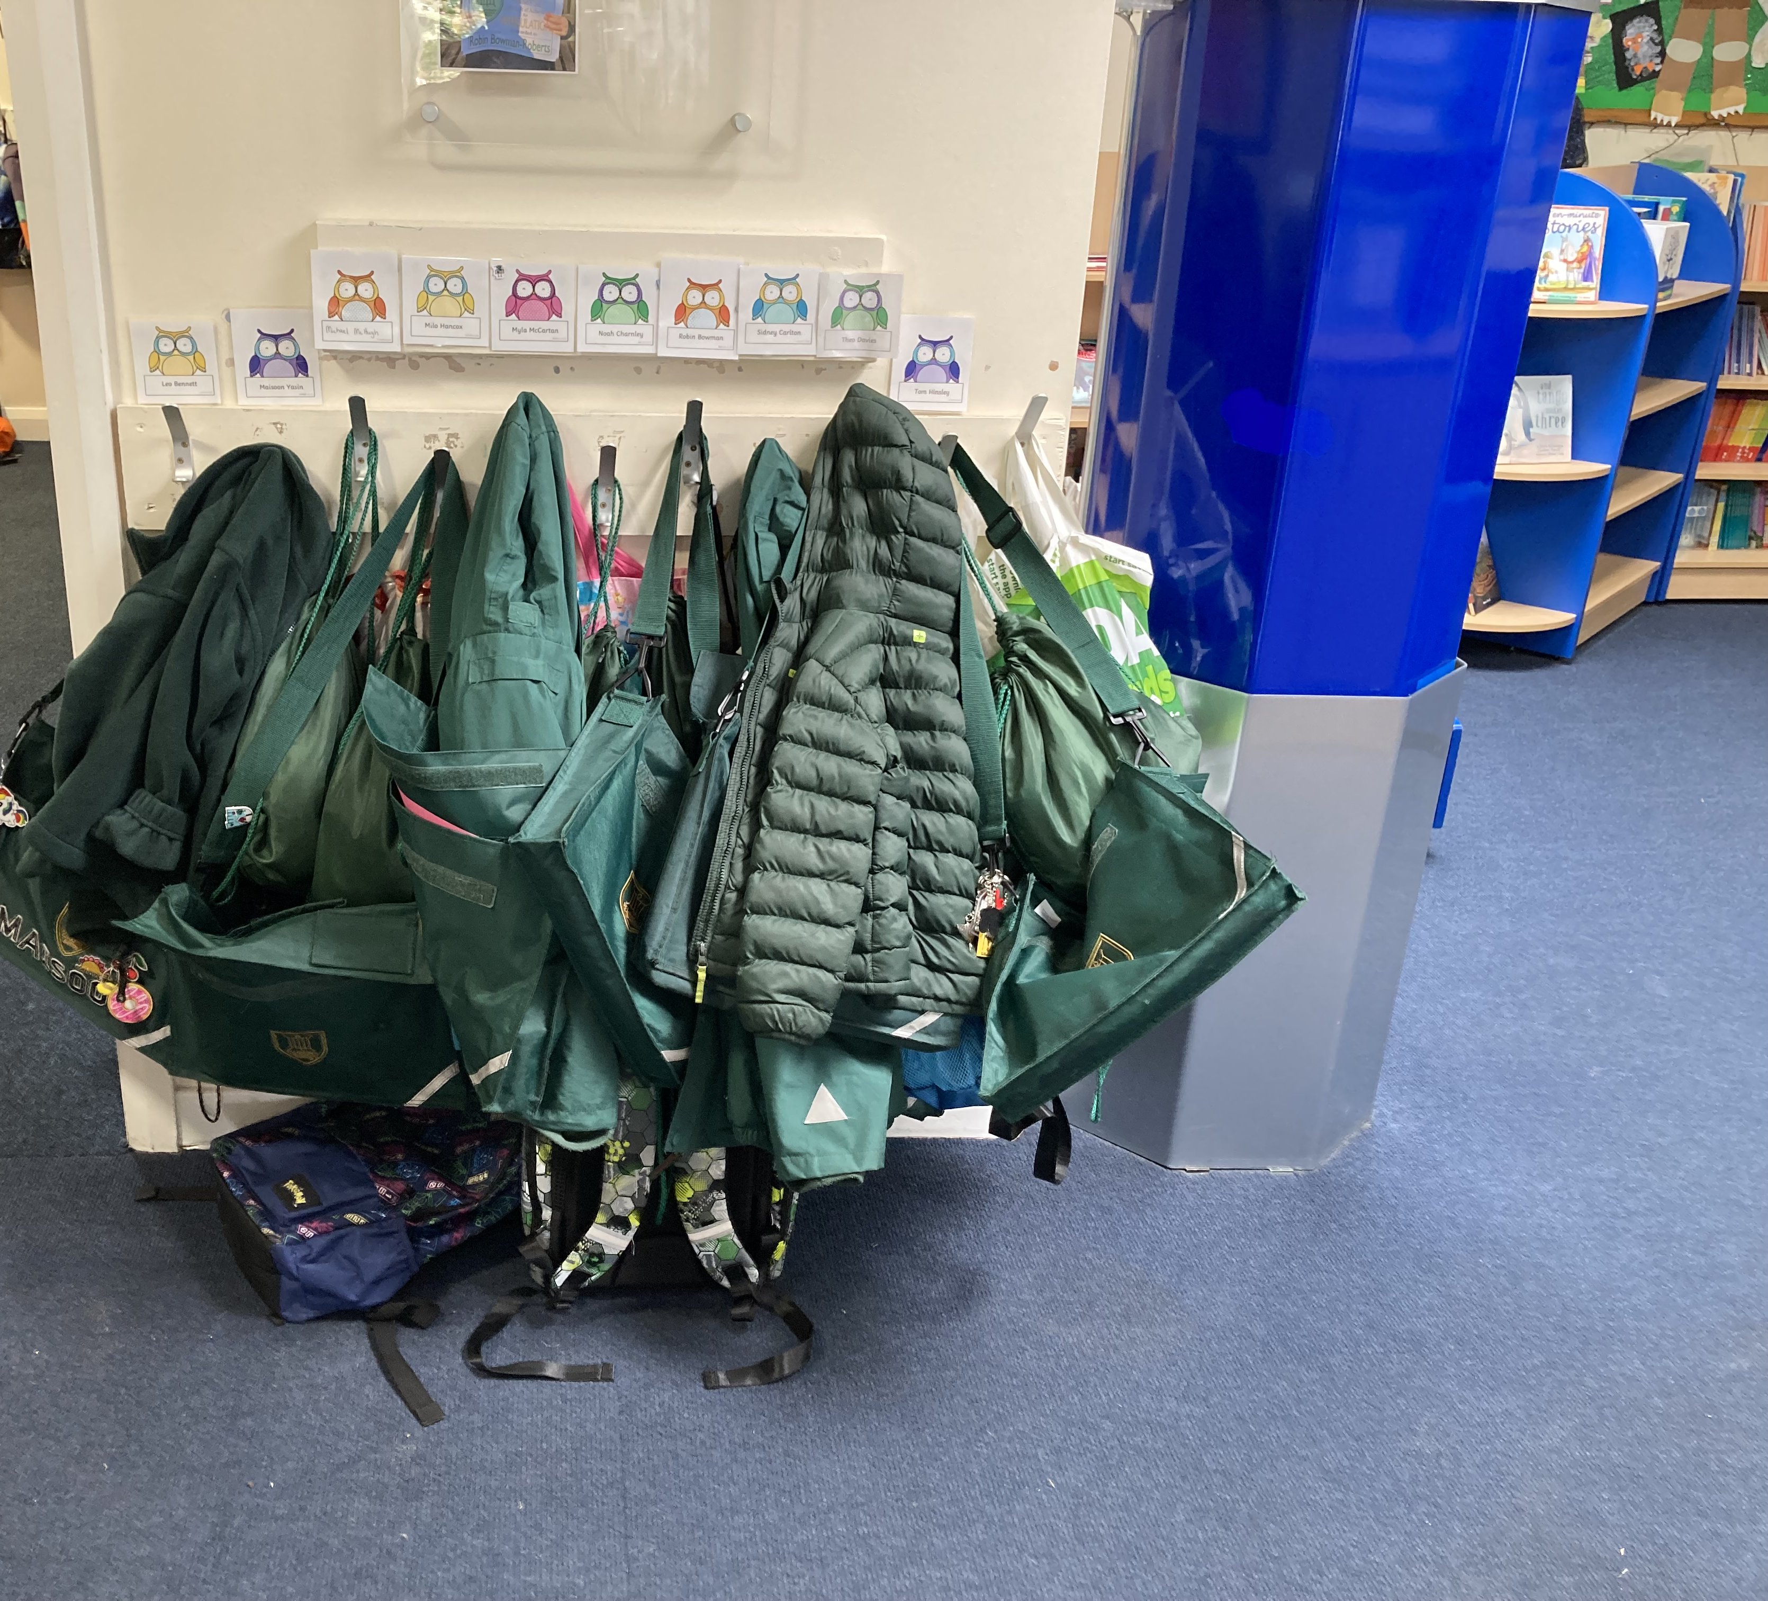
Routines and Equipment
PE days to be confirmed in September – children will come in their PE kit. (Well fitting trainers!)
Reading record and book to be brought to school each day. Please use a school bag where possible.
Water bottle in school everyday.
Coat everyday (even if it isn’t raining in the morning) Please send children ready for a weather change.
8:45 - 9am drop off
3:30pm pick up

Slide 11
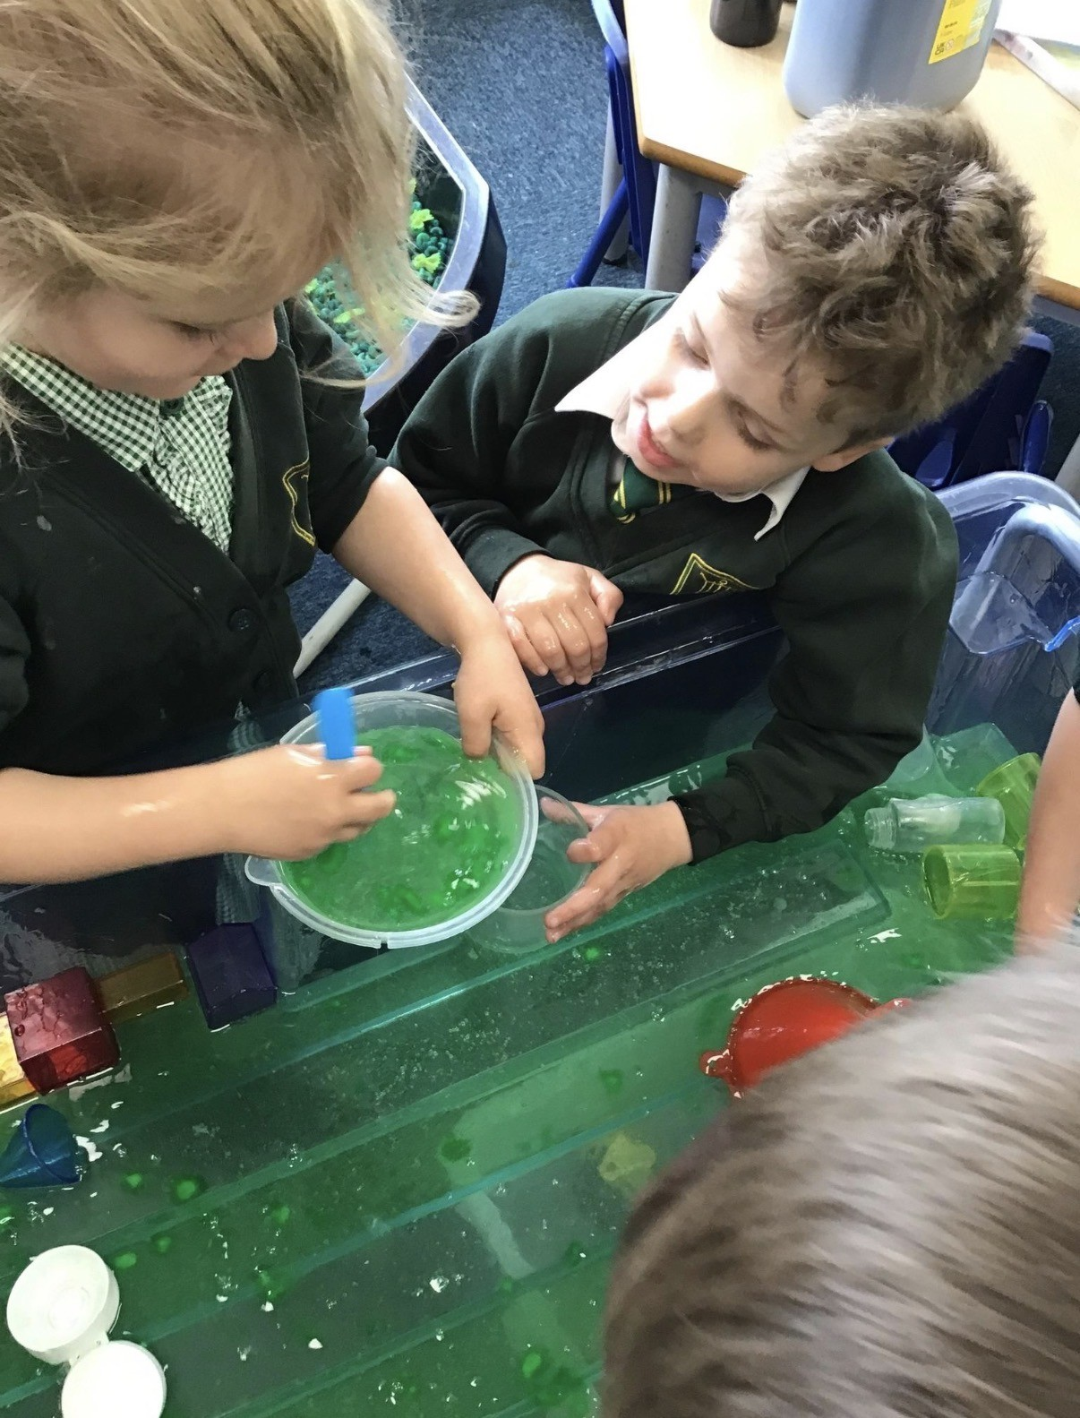
Induction sessions
Monday afternoons 1:15 – 3:15
Group A
8th June
15th June
Group B
22nd June
29th June
ALL children – 6th July

Slide 12
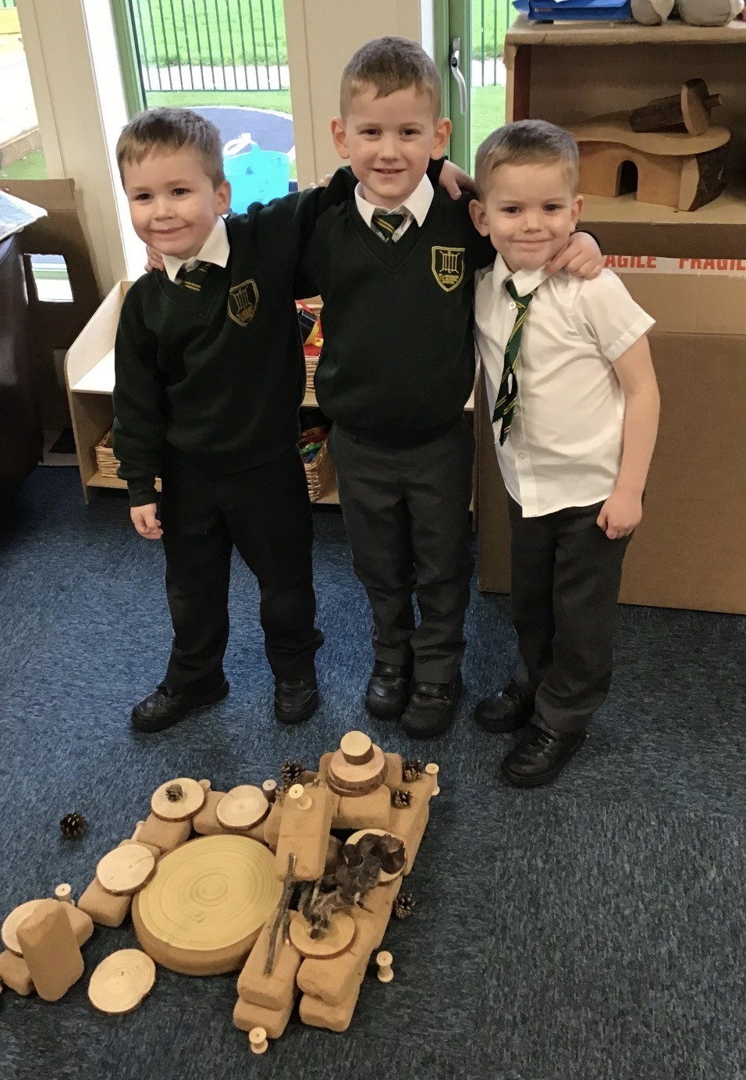
Any questions, concerns or queries
Don’t worry – get in touch.
Email bursar@st-lawrence.lancs.sch.uk

Slide 13
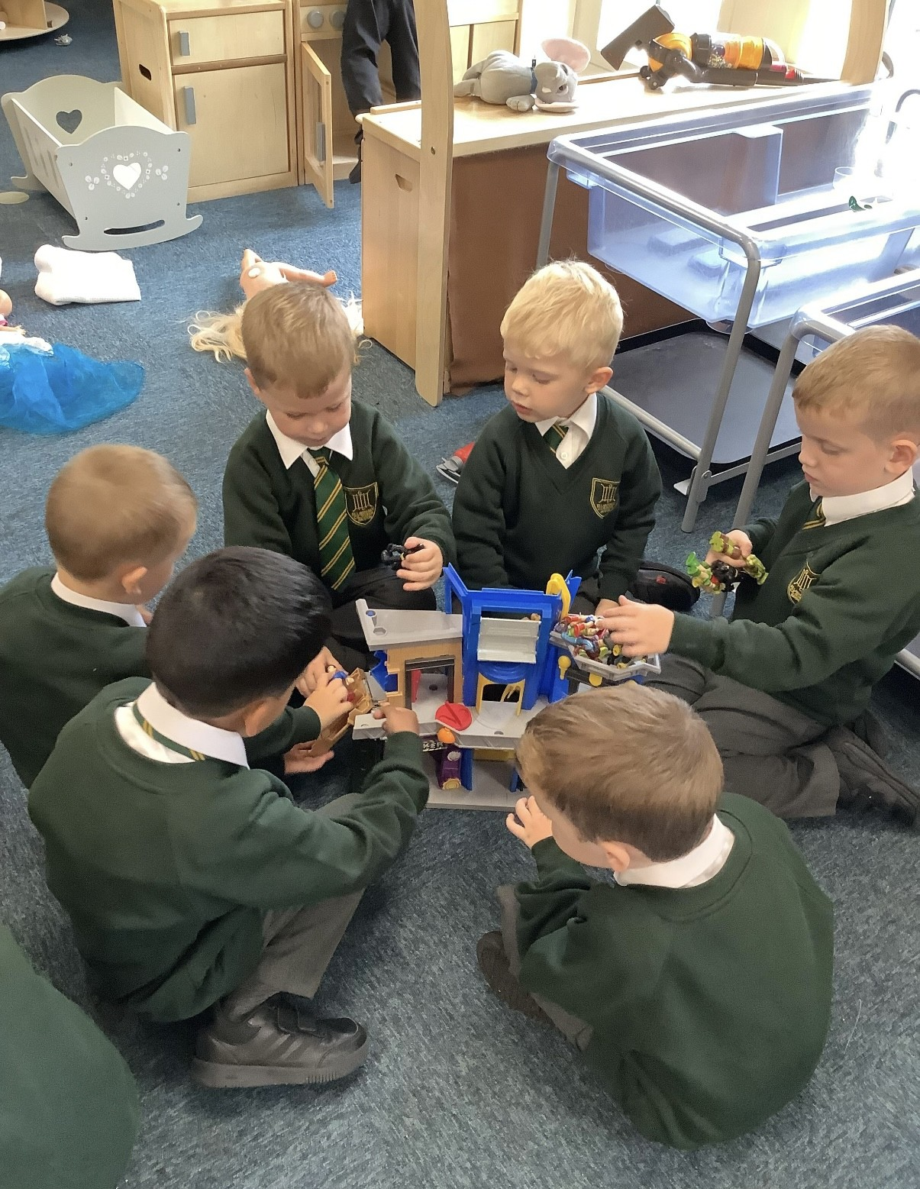
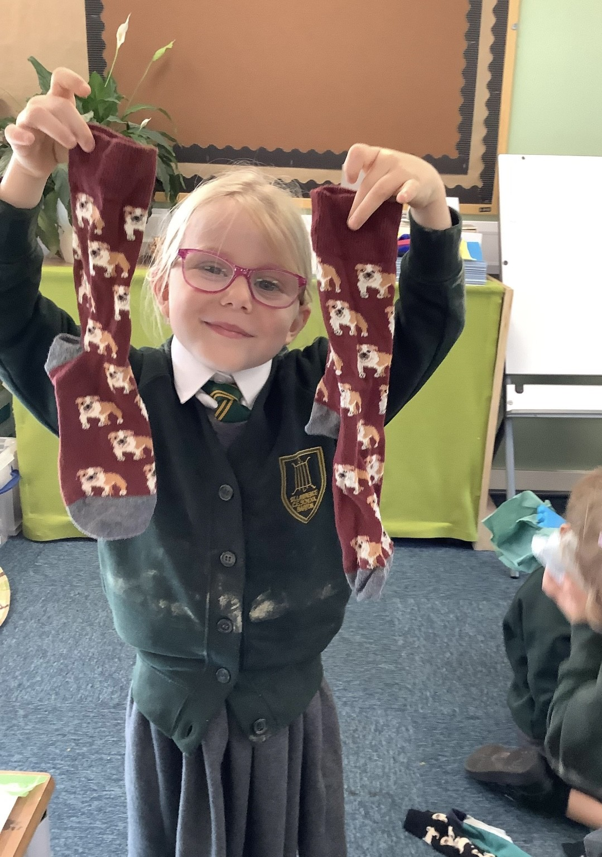
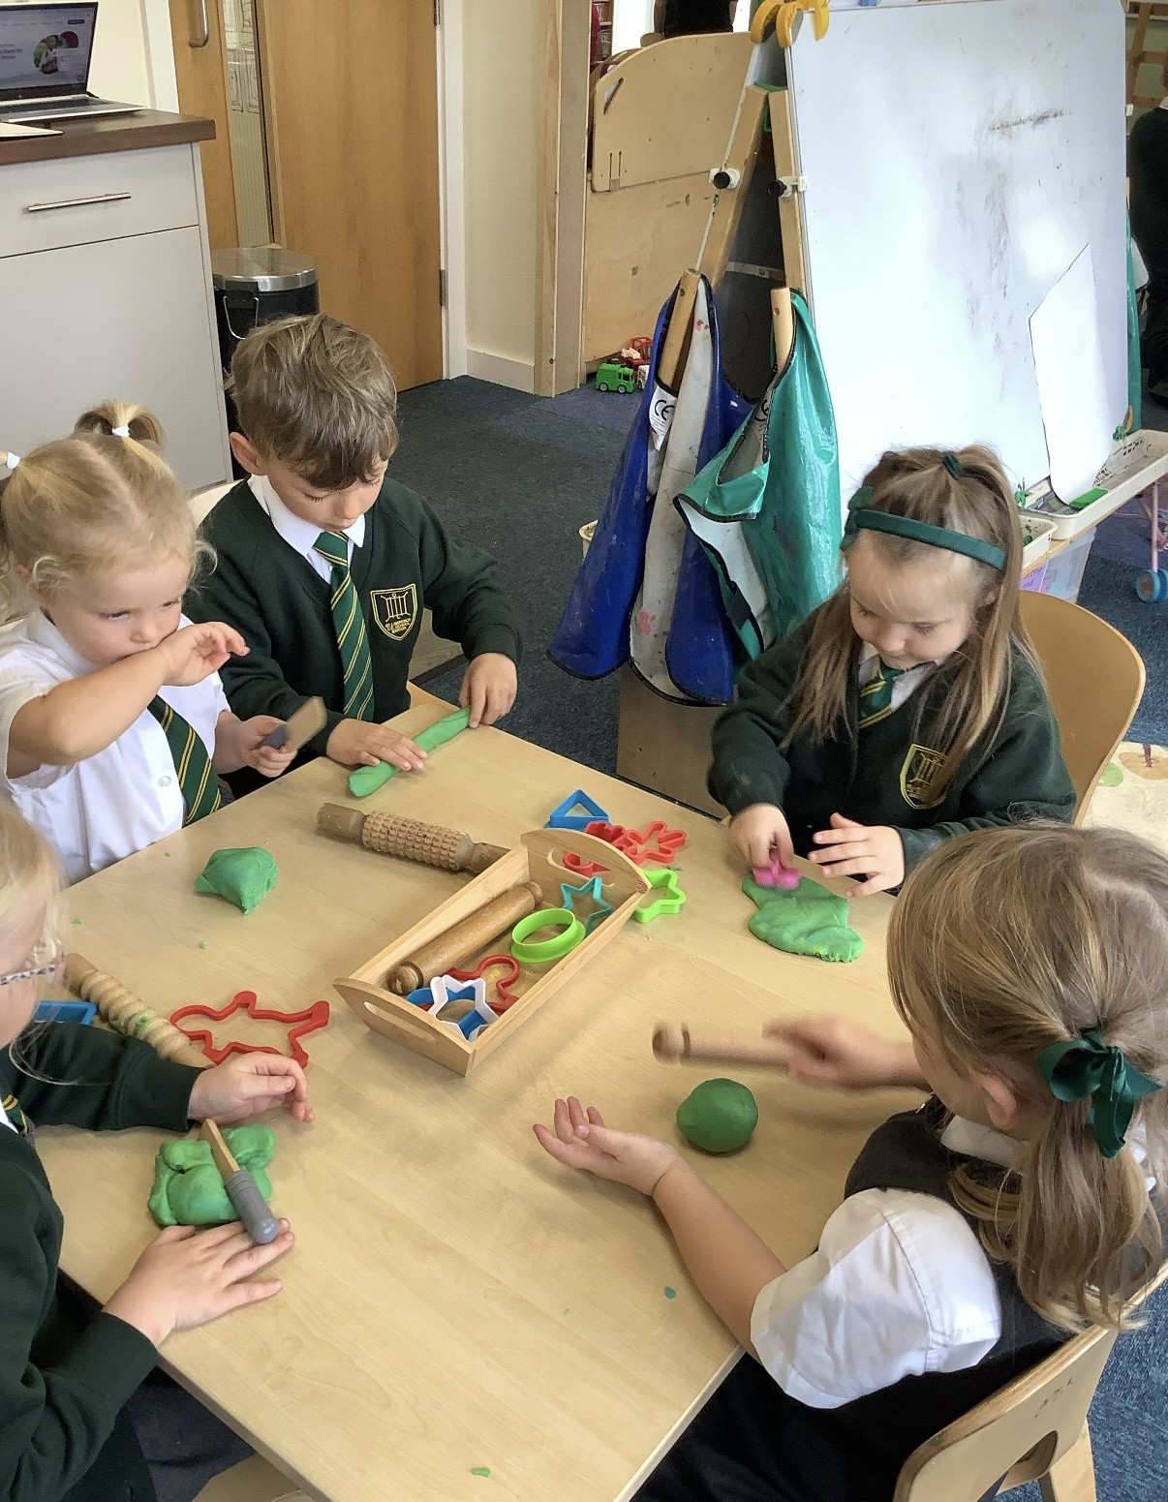
We can’t wait for a year of fun with you!

