Slide 1



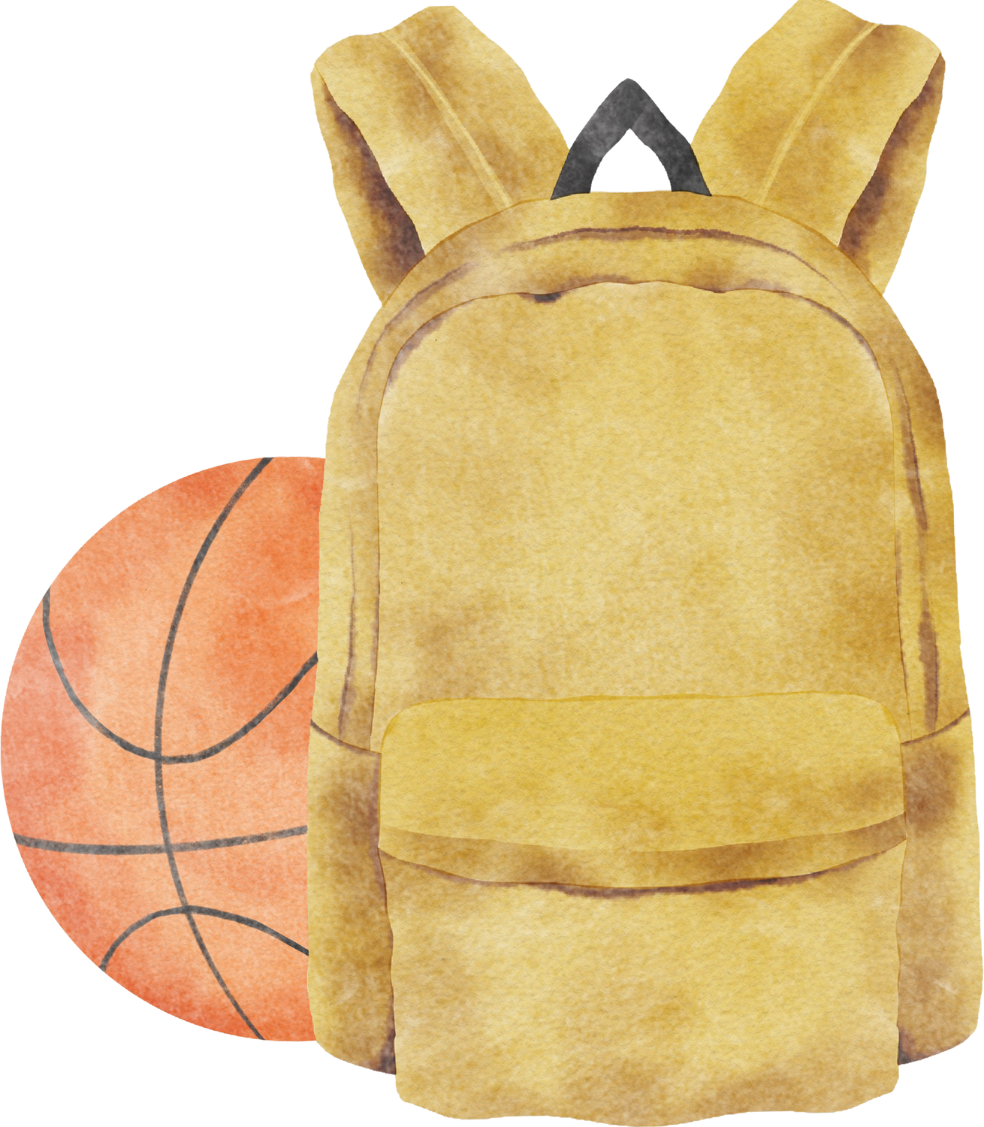


Welcome to
Year 3

Slide 2
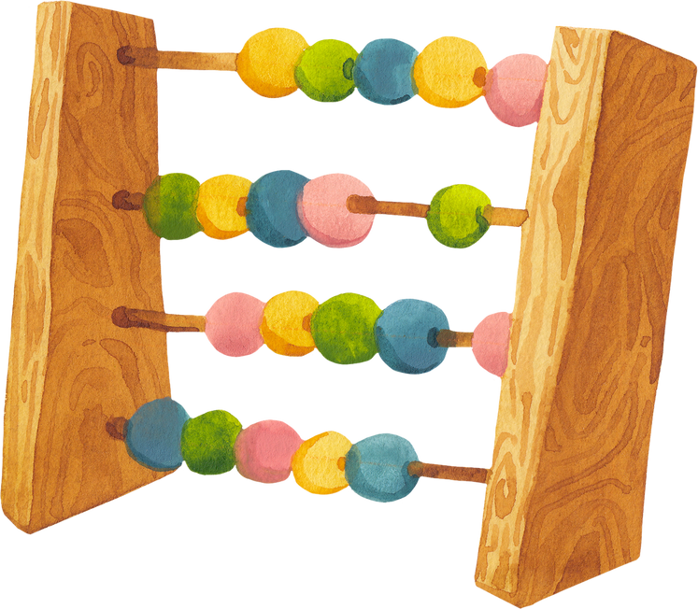


Mrs Pilling- Class teacher
Miss Hindle- Teaching assistant

Slide 3


Our Class
  We have clear routines and a structured timetable that help children feel confident and ready to learn.
  Mornings focus on the core subjects: Reading, Writing, SPaG and Maths.
  Afternoons are dedicated to foundation subjects such as Science, History, Geography, Art, DT, PE, French, PSHE and RE, as well as enjoying a class novel together.
  We will regularly share information about your child's learning so you can support them at home.
  Children are encouraged to take pride in presenting their work neatly.
  We promote independence and encourage children to take responsibility for handing in homework, reading records, books and letters.

Slide 4




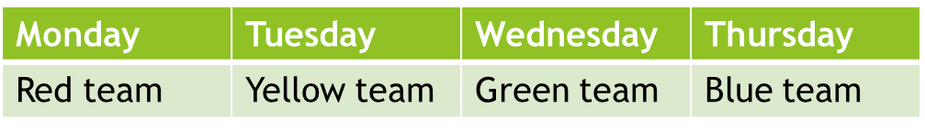
Reading
Please spend time reading with your child most days at home for at least 10 minutes. Books will be changed once your child has finished their book. We will check reading records on a weekly basis. Timetable below:
We also encourage children to write in their own records. Children might comment on their likes / dislikes, thoughts or feelings about the book, a character or an event (see next slide).
Please make sure that your write in your child’s reading record when they read, including noting down when they have finished a book.

Slide 5
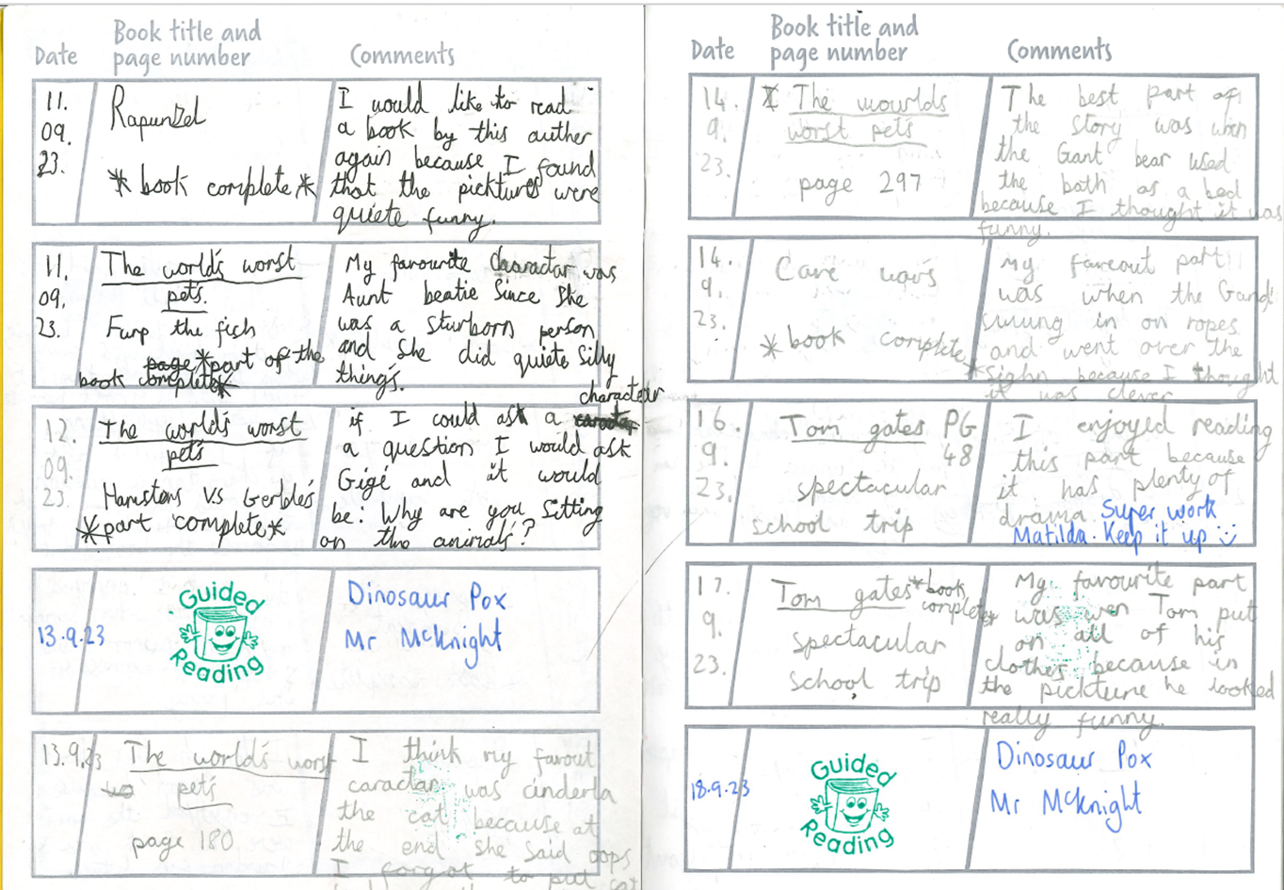
Reading Record Example
  .

Slide 6
Reading
The curriculum puts an emphasis on reading and then re-reading a book. This helps to develop fluency. Please encourage your child to re-read a book once finished!
Reading isn't just about decoding the words on the page; it is about making sense of the text, understanding the author's message, and being able to explain, predict and infer what is happening in the story.
Tucked into your child’s reading records, you will find a laminated bookmark that lists appropriate questions to help check your child’s understanding of the book. Regularly using these questions will help support your child’s ability to comprehend the text.

Slide 7
20 Books to Read
In Year 3, the children have the opportunity to take part in the school-wide reading initiative ‘20 Books to Read Before You Leave’.
The children will come home with one book at a time. They can either read it themselves or you can read it together.
Once they have finished the book, they are to return the book and complete a written book review.
Bronze – 4 books
Silver – 9 books
Gold – 14 books
Platinum – 20 books
WOW Award – all 23 books – come in your own clothes
Once a book is completed, please fill in the running record located at the front of the children’s yellow reading diaries in order to help us keep track.

Slide 8
The Joy of Reading
Sharing a book with your child is a wonderful way to spend time together, helping them to develop not only their reading skills but also a genuine love of stories and learning.
A Guide to Reading with your Child:
https://www.st-lawrence.lancs.sch.uk/page/literacy-provision/86669
See guide on website under Curriculum – Literacy – Literacy Provision
Main themes:
Read together
Make it a special time
Read aloud (both parents and children)
Talk about books
Encourage choice
Be encouraging

Slide 9
Homework
Children in year 3 should spend approximately 20 - 30 minutes per week doing homework set by the teacher (or a total of 3 hours per half-term), plus a minimum of 10 minutes per day reading, times table practice and spelling practice.
Homework will be a pick and mix style activity. Some of the activities will link to our topic whereas others will be linked to life skills.
All project homework will be set via school spider.
Spellings and times tables sheets will be sent home each week in the children’s bags.
Targeted homework may also be sent home to children if needed.
Children who use Nessy should attempt to access this for 10 minutes daily at home.

Slide 10
Spellings
Children are encouraged to learn a set of spellings each week for homework.
- 3 (ish) of these will be derived from the spelling patterns taught that week in class. We encourage children to generate other words at home that follow the same spelling pattern. Unseen words that follow the same spelling pattern will be included in the test.
- 5 of these will be individual spellings taken from the statutory list for Year 3
Test: Wednesday / Thursday

Slide 11
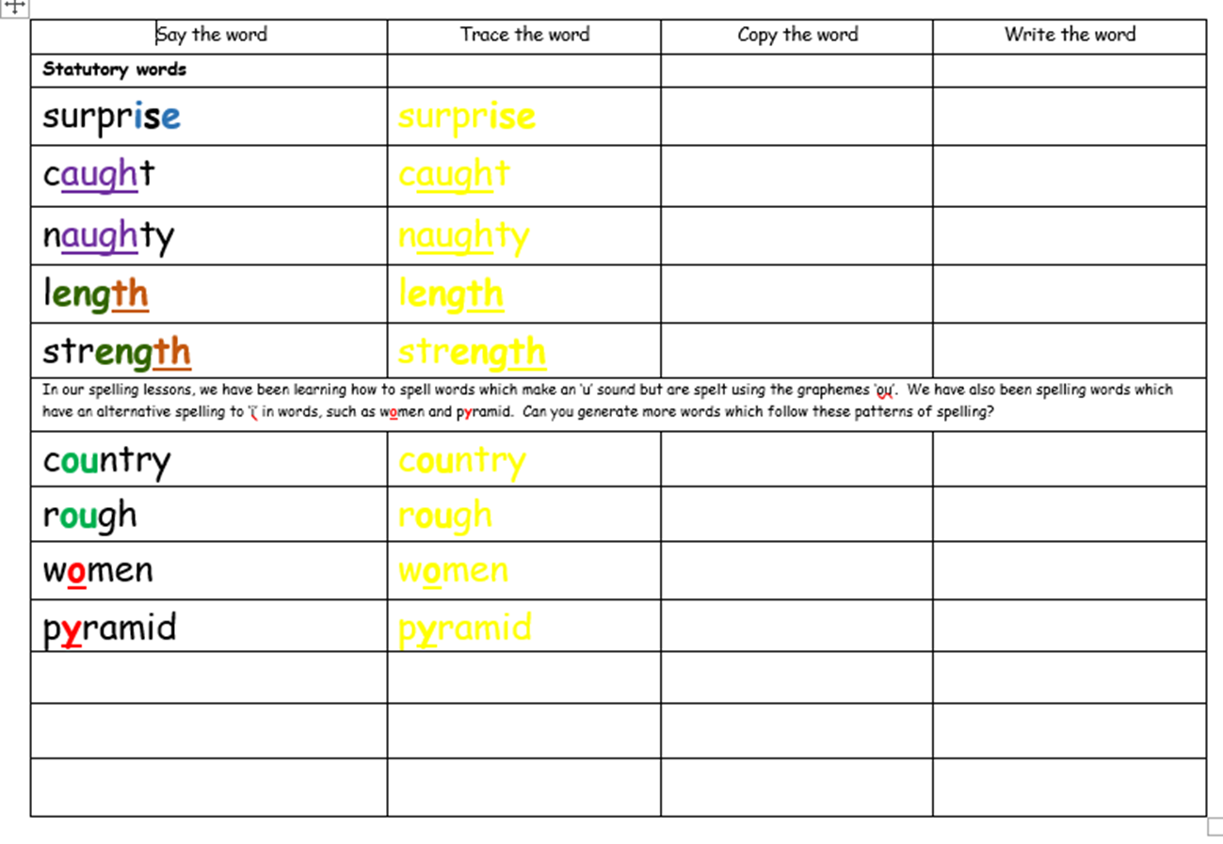
Spellings – homework example

Slide 12
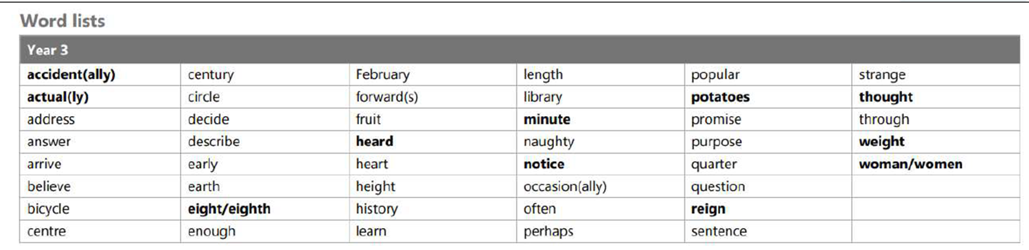
Year 3 Statutory Words
These words will be repeated to give the children an opportunity to revisit the spellings.
Challenges:
write words in the context of a sentence
add suffixes to words where appropriate
find the definition of words in a dictionary
find synonyms and antonyms in a thesaurus

Slide 13
Times Tables
At the end of year 3, children are expected to know multiplication and division facts for the 2, 3, 4, 5, 6, 8 and 10 times tables.
Each week your child is tested on the times tables that they are currently working on. These will be sent home for children to practise as part of their homework.
BRONZE award – 25 seconds to chant
SILVER award – 45 seconds to answer 20 multiplication facts
GOLD award – 45 seconds to answer 20 division facts
* Year 4 national test*
Children are now expected to know all of the multiplication facts up to 12x12 by the end of year 4
http://www.st-lawrence.lancsngfl.ac.uk/page/704/Times-Tables.htm
https://www.topmarks.co.uk/maths-games/hit-the-button
https://play.ttrockstars.com/ttrs/online/play?mode=garage

Slide 14
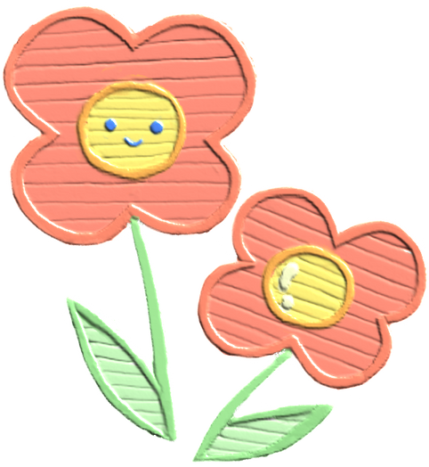
How can you help?
Take part in regular short reading sessions at home with the children and listen to the children read their reading books.
Encourage your child to be independent and to remember to hand things in or to have things changed.
Praise your child when they show our school values through acts of kindness, respect and thoughtfulness. Positive reinforcement helps these behaviours become lifelong habits.

Slide 15
P.E Lessons
P.E sessions will be in on a Monday and a Friday for the first half term.
Children need to come to school in their full P.E kits .
Changes in PE days will be confirmed via School Spider on a half-termly basis.

Slide 16
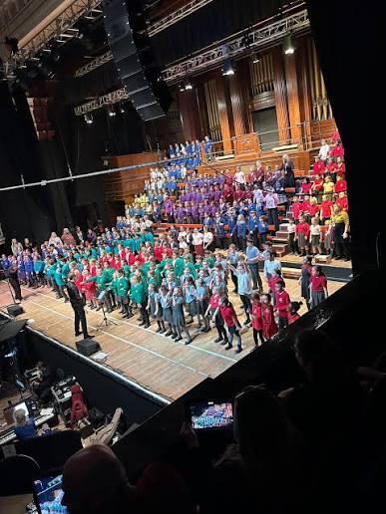
Let’s Go Sing
We are delighted to be taking part in Let's Go Sing!, a singing project that gives children the opportunity to learn and perform a range of original songs.
As well as developing musical skills, the project encourages teamwork, confidence and the joy of performing alongside children from other schools.
All children in Year 3 are expected to attend the concert. No date has been confirmed yet but it is normally in March.
More details to come!

Slide 17
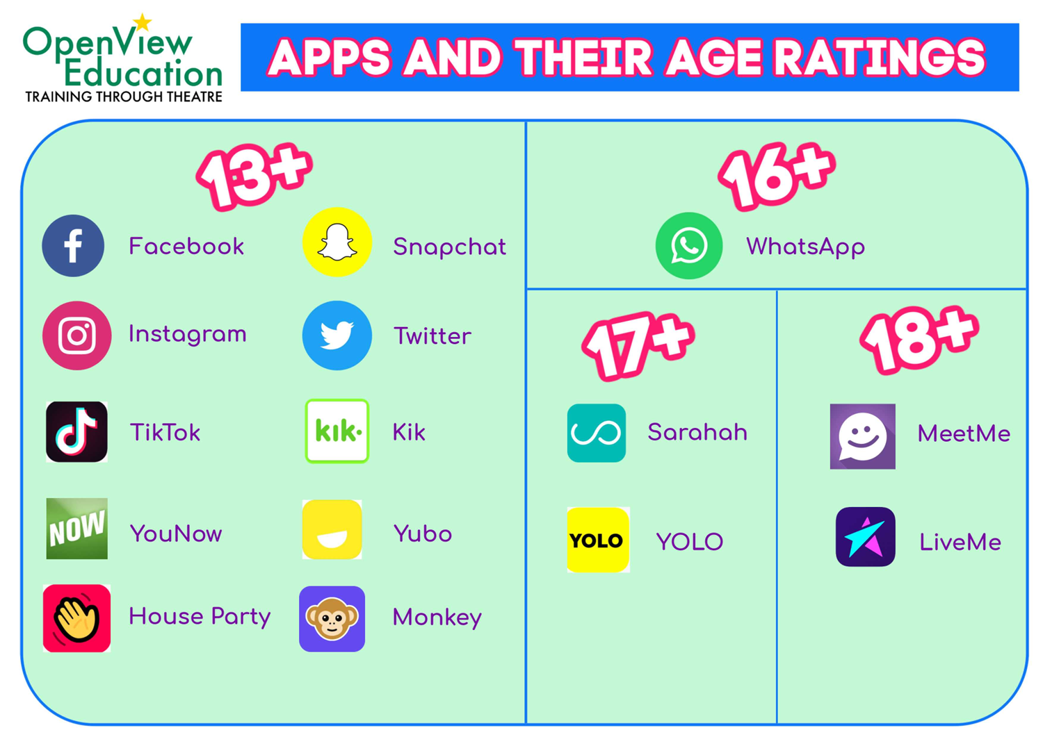
E-safety Reminder

Slide 18
Thank you

