Slide 1
WELCOME TO YEAR 6
CLASS TEACHER – Mr Davis
TEACHING ASSISTANT – Mrs Desai

Slide 2
WHAT DOES LEARNING LOOK LIKE
The first few weeks in class are about ensuring that the strengths and weaknesses of each child are understood moving forward.
This allows all lessons to be tailored to suit your child’s individual needs and ensure that they achieve the maximum.
It might be that your child needs some additional support in key areas, perhaps for a few sessions or perhaps a little longer.
These will take the form of intervention sessions which will be communicated to you to allow for follow up at home.

Slide 3
READING BOOKS
Children may have a variety of books based on what they require.
Book band book – These are tailored to the child’s reading level. The aim is to complete one of these weekly, which then needs handing in to be changed.
Individual reading book – This is a book the child has chosen, either from the books available in the classroom, or from home . These will often take a little longer to read but progress will be monitored through reading records.
Guided Reading book – This book is used by children in all guided reading sessions. It may travel between home and school if additional reading is required.

Slide 4
READING BOOKS CONT.
Please ensure that reading records are filled in for each reading session. This acts as our log that reading is happening outside of school.

Slide 5
SPELLINGS
Children have a spelling list following the year ⅚ statutory words as well as the spelling rule of the week.
Spellings are given out on Monday, to be tested on Friday.

Slide 6
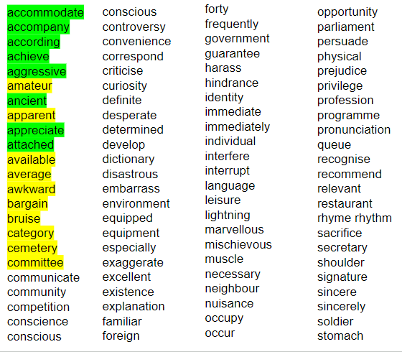

Slide 7
PE LESSONS
Year 6’s PE day will be on Monday and Friday for the first half term
Children need to ensure they come in their PE kit on those days.
An old pair of trainers will be preferable for outdoor sessions and black pumps for indoor sessions.
We will be outdoors as much as possible this half term, so please dress prepared for the weather that day!

Slide 8
HOMEWORK
Spellings will be set Monday to be tested on Friday
Times Tables will be tested once a week
Usually, short weekly homework activities will be set to complete and sent home. These will be targeted to your child’s learning and needs. It may even be on a 1:1 basis so completing it will benefit their learning.

Slide 9
TOPIC
Our current topic is:
Survival

Slide 10
CLASSROOM REWARDS
Children earn dojos for positive actions and behaviours and lose dojo’s for wrong choices
These dojos add up to rewards throughout the year.

Slide 11
CONTACT
All contact from school will be through school spider
If you need to pass something on, please let Mrs Higham know or catch an adult either on the gate or at the door.

Slide 12
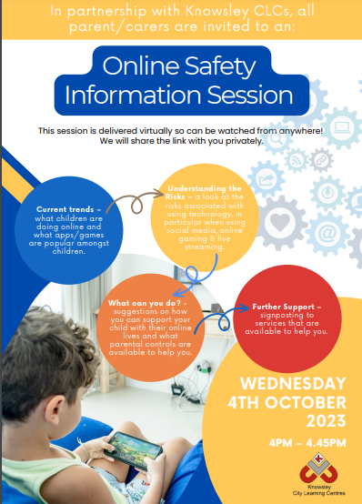
SOCIAL MEDIA
We will continue to run under the permissions provided last year.
If you wish to alter the social media permissions for your child, please let me know at the end.

Slide 13
EXTRA SUPPORT
If there are any areas of learning that you feel would benefit from extra time spent on outside of the classroom, please do not hesitate to get in touch.
I am happy to provide resources to support extra learning from home wherever possible and can also direct you in the way of useful websites and resources for you to use yourself.
I will be in touch over the coming weeks to provide links to additional learning, such as example 11+ papers.
Thank you and Welcome to Year 6!

