Slide 1

Welcome to
Year 5!
Class teacher: Mrs Sharp
Teaching Assistant: Miss Burgess
Independence
Achievement, Full Potential
Memorable experiences, Fun!

Slide 2
Classroom Ethos
‘When you enter this classroom…’ Children learn best when they feel safe and are respected. A strong emphasis on teamwork and kindness- underpinned by our school values.
Teaching and learning style: practical, spoken language, drama! A strong academic foundation to prepare for the children’s next steps.
A holistic education: broad and balanced curriculum; enrichment opportunities (balanced throughout the year- different priorities take precedence at different times in the year).
Clear behaviour expectations: 4 Golden Rules: Be Ready, Be Respectful, Be Safe, Be Kind.
Rewards: Dojos, Blue/Purple tokens, Teacher Mail, Star of the week, Gold Stars, Reward Jar!
Consequences (in line with whole school policy): reflection time- mistakes are an opportunity to learn.
Support and teamwork- parent/teacher partnership in order to achieve the best outcomes for all pupils.

Slide 3
Our Class Routines
Timetable*
Curriculum map*
Home learning grid, staff, snacks, PE...*

Slide 4
How will my child be supported to reach their full potential?
Evidence-based, innovative practice: children learn best by exploring, creating, innovating. This both challenges and supports children.
Curriculum design: inclusive, ambitious for all, underpinned by Talk.
Reading to Writing teaching sequence*. Reading is at the heart of the curriculum!
Mastery approach in Mathematics: concrete, pictorial, abstract (based on the 5 Big Ideas)*
Developing expertise in the wider curriculum: the whole school curriculum is carefully designed so that skills and knowledge are coherently planned in a connected curriculum.
Learning is planned in small steps and revisited regularly throughout the year. No ceiling on learning: learning is facilitated in a way so that ALL children can access the curriculum. There is no end to the challenge- children can go deeper into their learning every lesson.
Classroom structure: groupings- mixed, partner, small group. May change throughout the year- we always strive for the best outcomes for every child. Teamwork is crucial for all to succeed!
Intervention/support for SEND, AGT, additional needs- opportunity for discussion at parents’ evenings throughout the year where IEPs will be shared.
Continuous assessment and re-evaluation of every child's progress and attainment- classroom practice adapted accordingly

Slide 5
Assessment...
Assessment continuously happening as part of cycle of teaching and learning... Children being able to respond to ‘in the moment feedback’ is most effective.
More formal assessment weeks across the year (once a term)- test-based.
Summative assessments are communicated to you through written reports.
Important year for your child: attendance, punctuality, working in partnership.

Slide 6
How can I support my child’s learning at home?
Home Learning Grids: ongoing skills, topic-based (enhancing/celebrating wider curriculum)*
Priorities for home learning: daily reading, spellings, basic Maths skills rehearsed (resources e.g. video links shared)...
Calculation policy; A Guide To Reading With Your Child*
Recommended reading list:Books for Year 6 children aged 10-11 | School Reading List School reading initiative: 20 Books to Read*

Slide 7
Trips/enrichment opportunities
Trips (to enhance the teaching of the wider curriculum).
Visitors in class (a great way of enhancing the curriculum and providing memorable experiences for the children).
Learning outside: One of our curriculum ‘Golden Threads’, Forest School…
Parent volunteers: special skills to share... please let us know. DBS checks will be arranged.

Slide 8
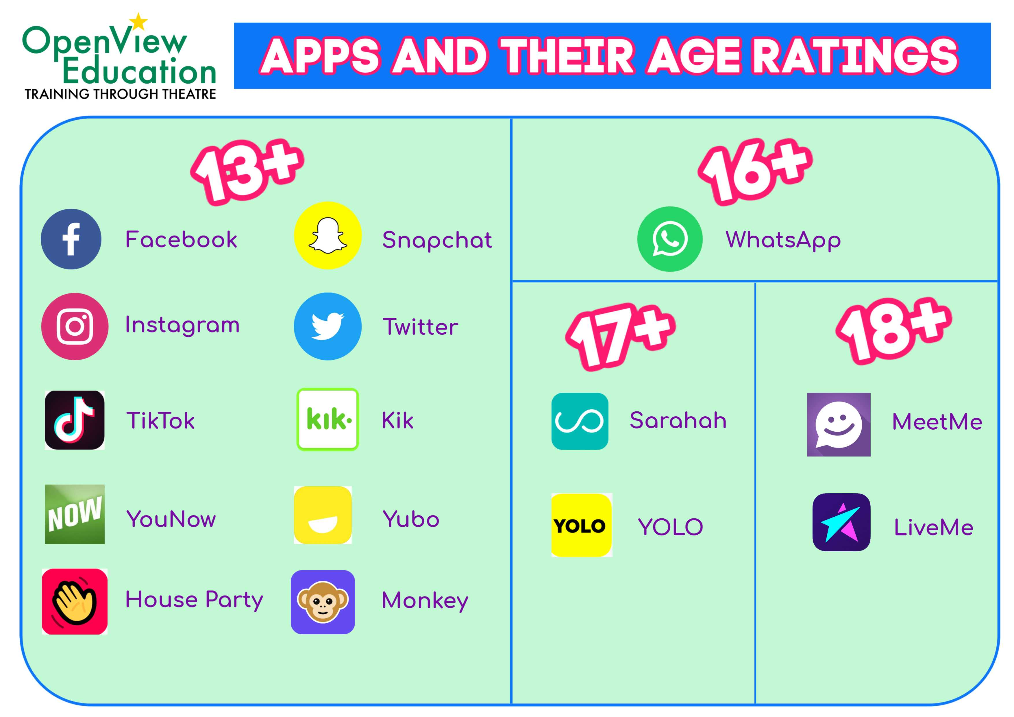
E-Safety

Slide 9
Please...
See the helpful links at the end of the powerpoint for further information.
Don’t hesitate to speak to Year 5 staff team about any concerns/queries.
The best way to communicate is by contacting me via the school office to arrange a meeting at a mutually convenient time; touching base on the school door; or sending your child with a note e.g. to inform of a change in family circumstance.
Trust: We want the very best for all the children in our school family.

Slide 10
Thank You!
I very much look forward to getting to know your family; and working in partnership with you to achieve the best possible outcomes for your children!

Slide 11
Links
A Guide To Reading With Your Child KS2 Barton St Lawrence CE Primary School: Literacy Provision (st-lawrence.lancs.sch.uk)
Research-led Mastery Approach in Mathematics A video overview on teaching for mastery at primary | NCETM
Glossary of Spelling, Punctuation and Grammar terms The national curriculum in England - Glossary (st-lawrence.lancs.sch.uk)
Calculation Policies Barton St Lawrence CE Primary School: Mathematics (st-lawrence.lancs.sch.uk)
Year 5 Curriculum Overview https://www.st-lawrence.lancs.sch.uk/class/year-5
English Teaching Sequence full-english-unit-planning-guidance.pdf (lancashire.gov.uk)

