Slide 1

Tuesday 4th February 2020
Welcome to our
Let Your Light Shine
Festival

Slide 2
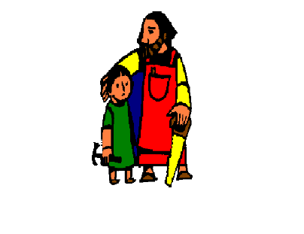
Our School Prayer
Dear St Joseph the Worker,
This is our school
Let peace dwell here.
Let the rooms be full of happiness
Let love be here,
Love of one another,
Love of life itself.
And love of God,
Let us remember,
That as many hands build a house,
So many hearts make a school.

Slide 3
Together as God’s Children we will learn, love, grow, inspire
“Let your Light Shine”
Matthew 5:15 - 16
How do you let your light shine?

Slide 4


Slide 5
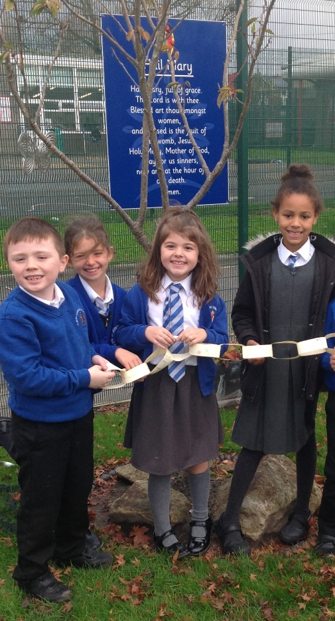
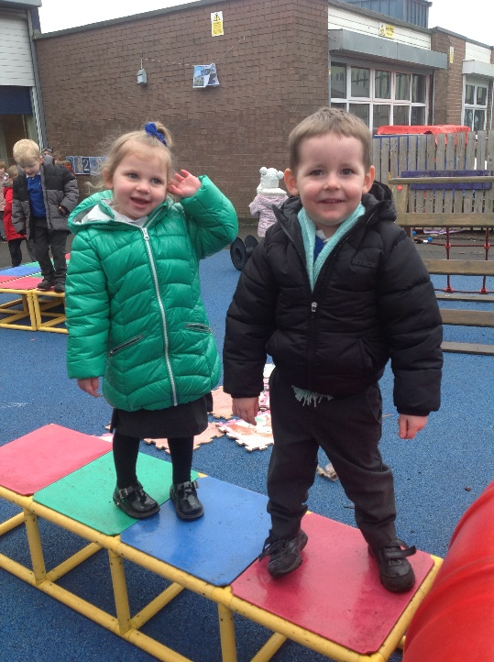
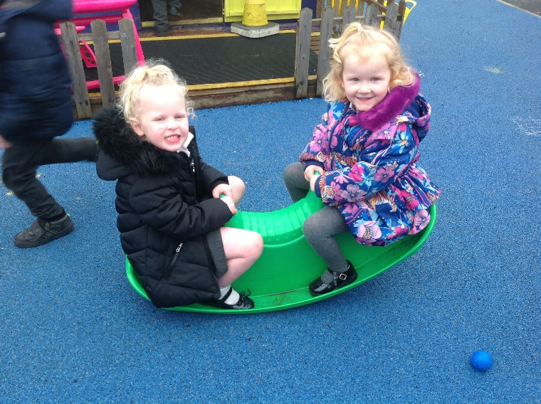
This is me
Performed by Early Years & Key Stage 1

Slide 6
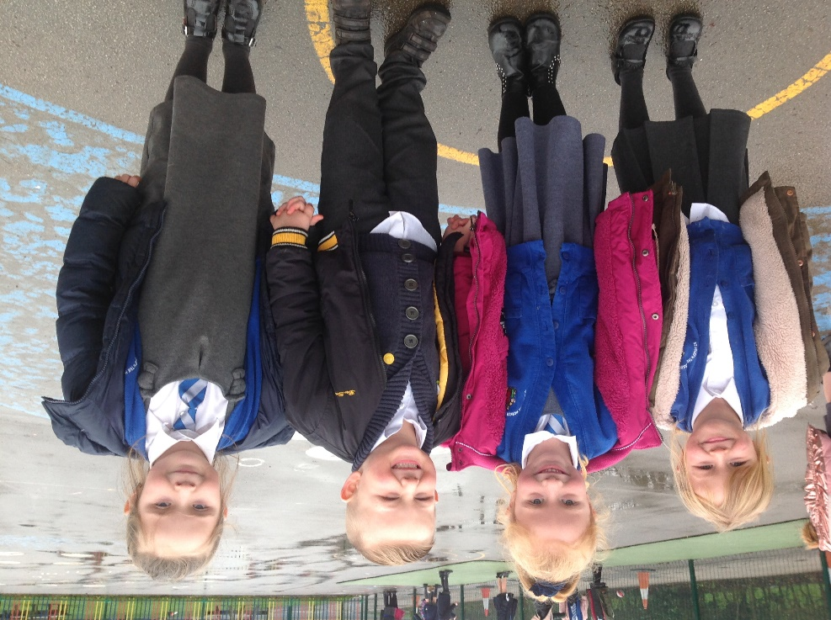
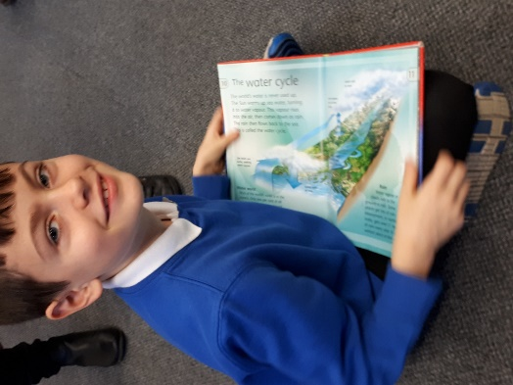
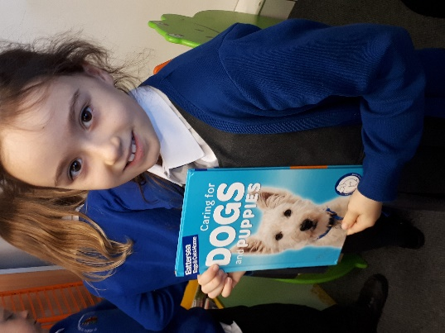
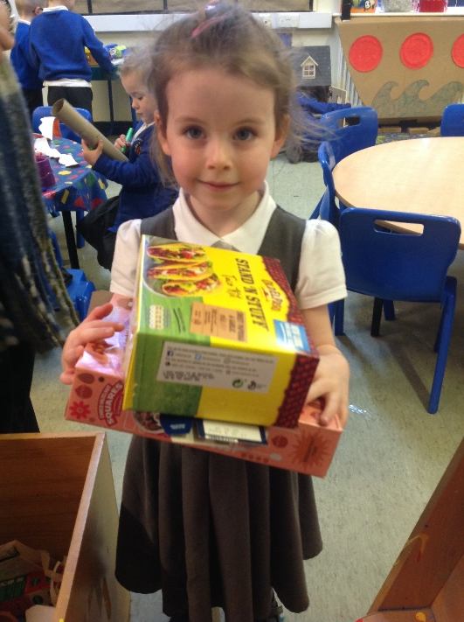
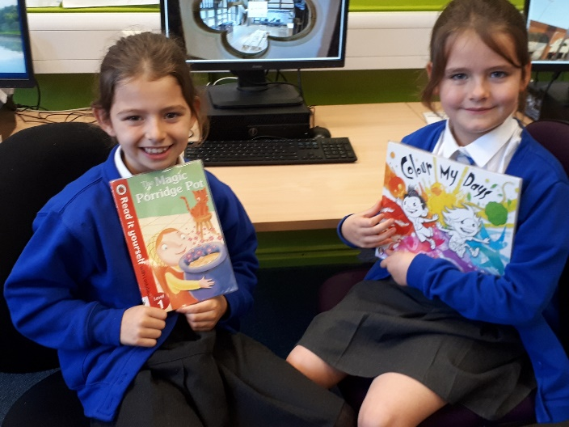
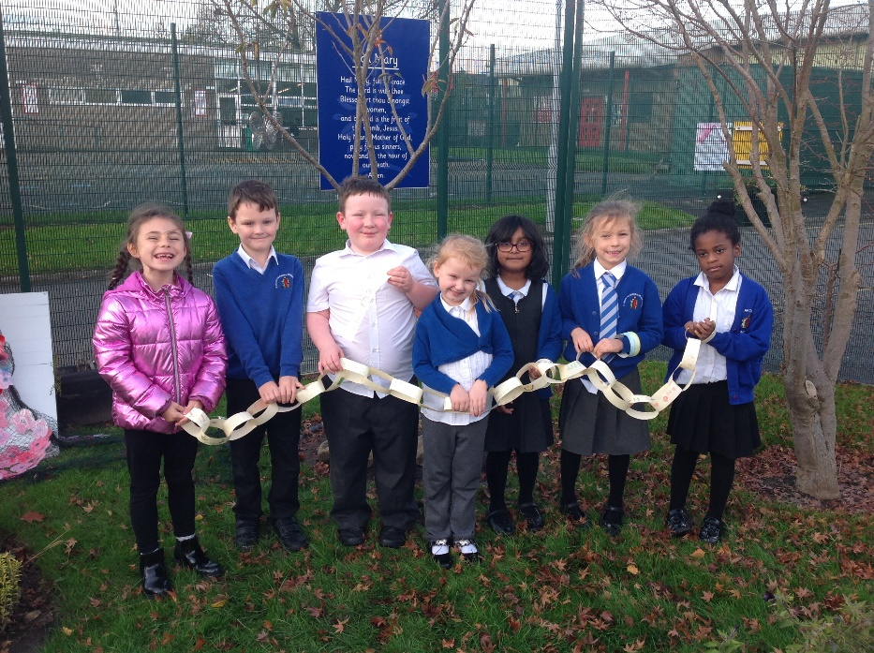
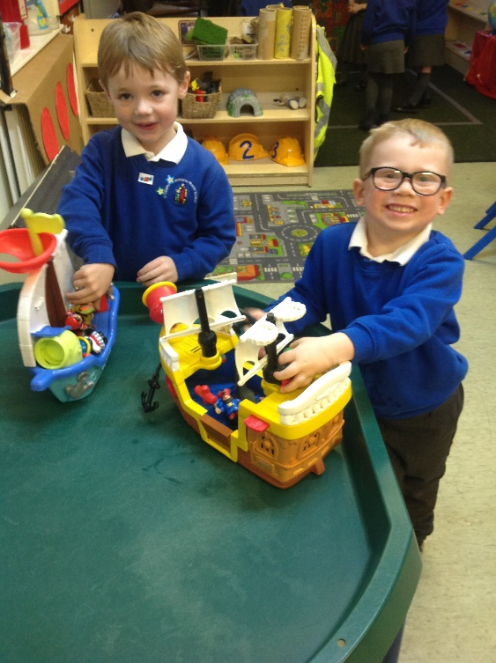

Slide 7
I'm not a stranger to the dark
Hide away, they say
'Cause we don't want your broken parts
I've learned to be ashamed of all my scars
Run away, they say
No one will love you as you are
But I won't let them break me down to dust
I know that there's a place for us
For we are glorious

Slide 8
When the sharpest words wanna cut me down
I'm gonna send a flood, gonna drown them out
I am brave, I am bruised
I am who I'm meant to be, this is me
Look out 'cause here I come
And I'm marching on to the beat I drum
I'm not scared to be seen
I make no apologies, this is me!
Oh Oh Oh Oh (Oh Oh Oh Oh) x 2
Oh Oh Oh, Oh Oh Oh, Oh Oh Oh, Oh Oh

Slide 9
Another round of bullets hits my skin
Well, fire away 'cause today, I won't let the shame sink in
We are bursting through the barricades
And reaching for the sun (we are warriors)
Yeah, that's what we've become
Won't let them break me down to dust
I know that there's a place for us
For we are glorious

Slide 10
When the sharpest words wanna cut me down
Gonna send a flood, gonna drown them out
I am brave, I am bruised
I am who I'm meant to be, this is me
Look out 'cause here I come
And I'm marching on to the beat I drum
I'm not scared to be seen
I make no apologies, this is me
Oh Oh Oh Oh (Oh Oh Oh Oh) x 2
Oh Oh Oh, Oh Oh Oh, Oh Oh Oh, Oh Oh

Slide 11
When the sharpest words wanna cut me down
I'm gonna send a flood, gonna drown them out
I am brave, I am bruised
I am who I'm meant to be, this is me
Look out 'cause here I come
And I'm marching on to the beat I drum
I'm not scared to be seen
I make no apologies, this is me
Oh Oh Oh Oh (Oh Oh Oh Oh) x 2
Oh Oh Oh, Oh Oh Oh, Oh Oh Oh, Oh Oh
This is me!

Slide 12
In my wrestling and in my doubts
In my failures You won't walk out
Your great love will lead me through
You are the peace in my troubled sea, oh oh
You are the peace in my troubled sea

Slide 13
In the silence, You won't let go
In the questions, Your truth will hold
Your great love will lead me through
You are the peace in my troubled sea, oh oh
You are the peace in my troubled sea

Slide 14
My Lighthouse, my lighthouse
Shining in the darkness, I will follow You
My Lighthouse, my lighthouse (oh oh)
I will trust the promise,
You will carry me safe to shore (Oh-oh-oh-oh-oh)
Safe to shore (Oh-oh-oh-oh-oh)
Safe to shore (Oh-oh-oh-oh-oh)
Safe to shore

Slide 15
I won't fear what tomorrow brings
With each morning I'll rise and sing
My God's love will lead me through
You are the peace in my troubled sea, oh oh
You are the peace in my troubled sea.

Slide 16
My Lighthouse, my lighthouse
Shining in the darkness, I will follow You
My Lighthouse, my lighthouse (oh oh)
I will trust the promise,
You will carry me safe to shore (Oh-oh-oh-oh-oh)
Safe to shore (Oh-oh-oh-oh-oh)
Safe to shore (Oh-oh-oh-oh-oh)
Safe to shore

Slide 17
Fire before us, You're the brightest
You will lead us through the storms
Fire before us, You're the brightest
You will lead us through the storms
Fire before us, You're the brightest
You will lead us through the storms
Fire before us, You're the brightest
You will lead us through the storms

Slide 18
My Lighthouse, my lighthouse
Shining in the darkness, I will follow You
My Lighthouse, my lighthouse (oh oh)
I will trust the promise,
You will carry me safe to shore (Oh-oh-oh-oh-oh)
Safe to shore (Oh-oh-oh-oh-oh)
Safe to shore (Oh-oh-oh-oh-oh)
Safe to shore

Slide 19
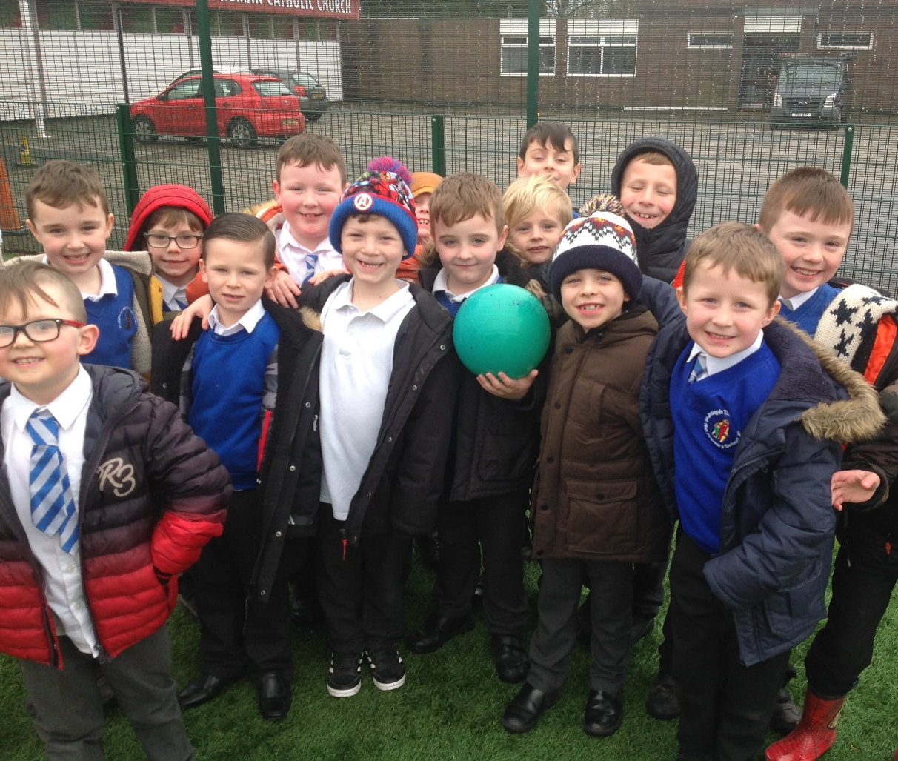

Slide 20
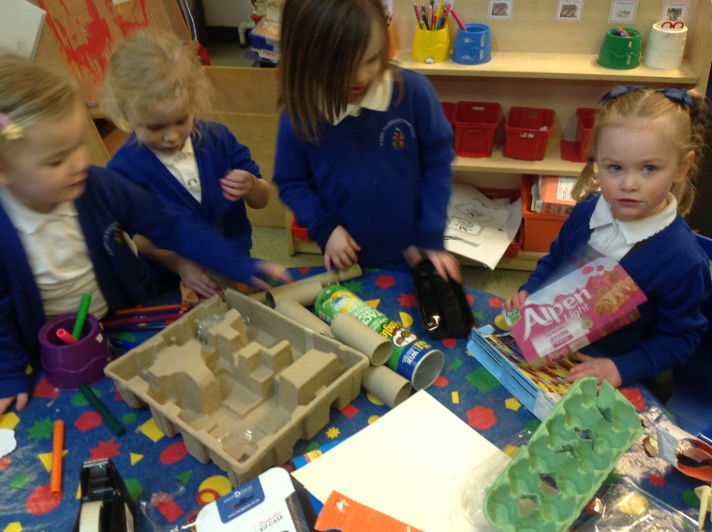
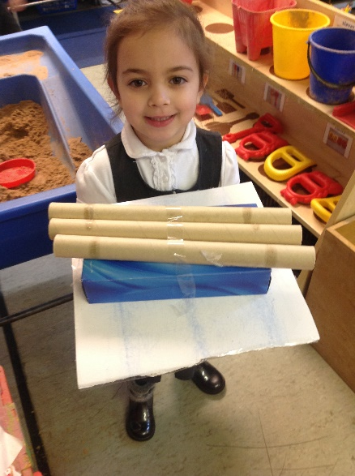
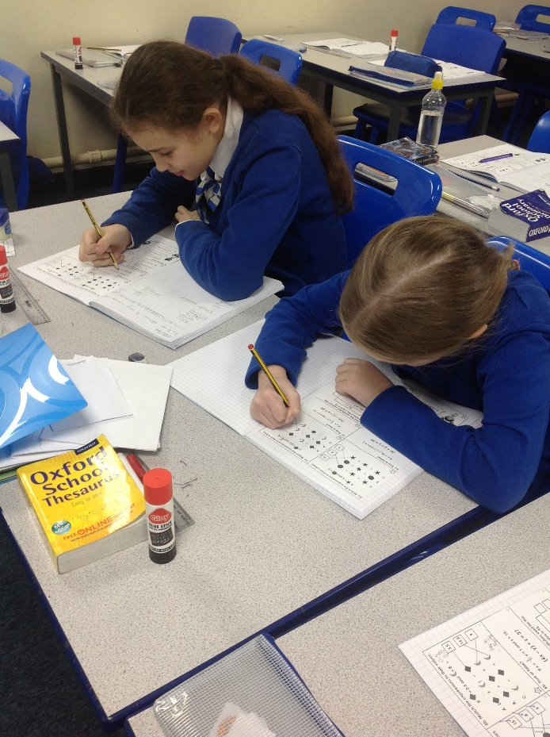
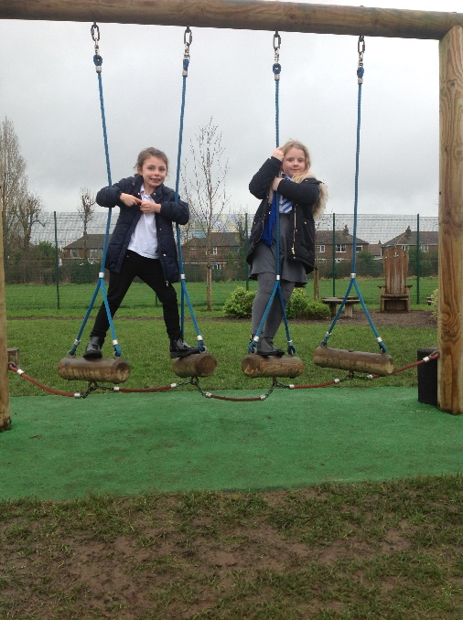
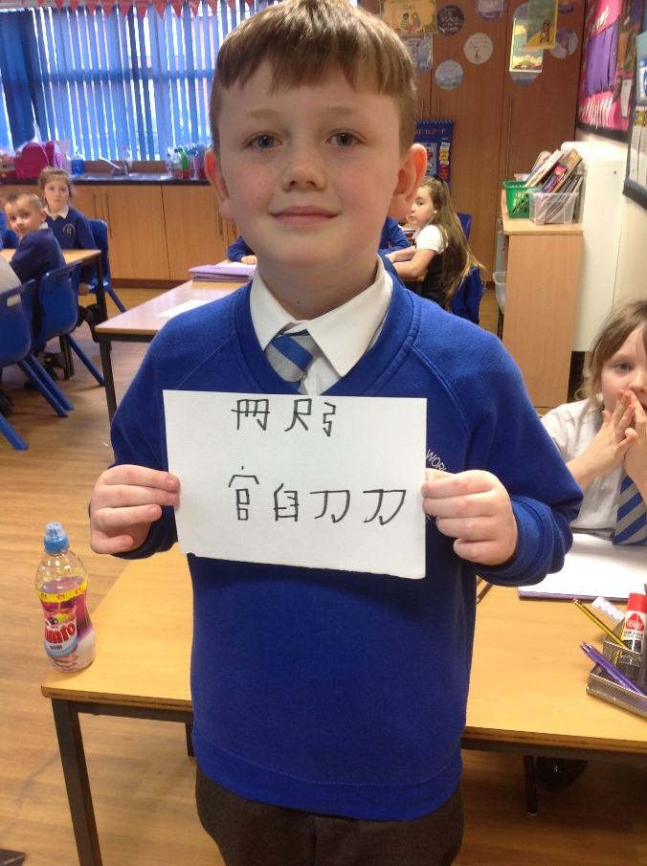
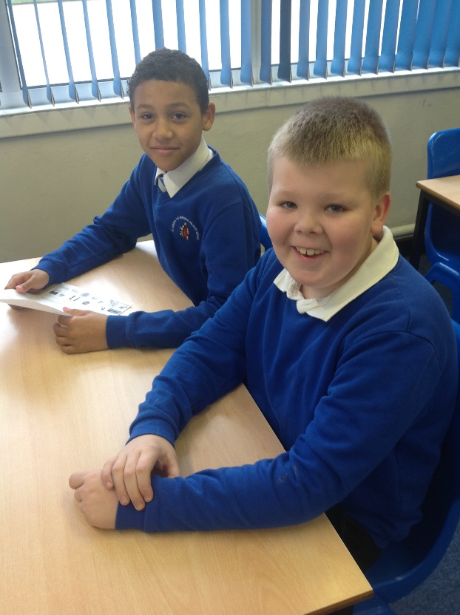
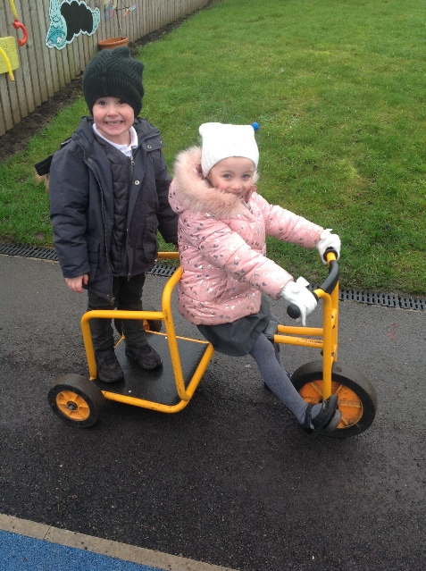

Slide 21
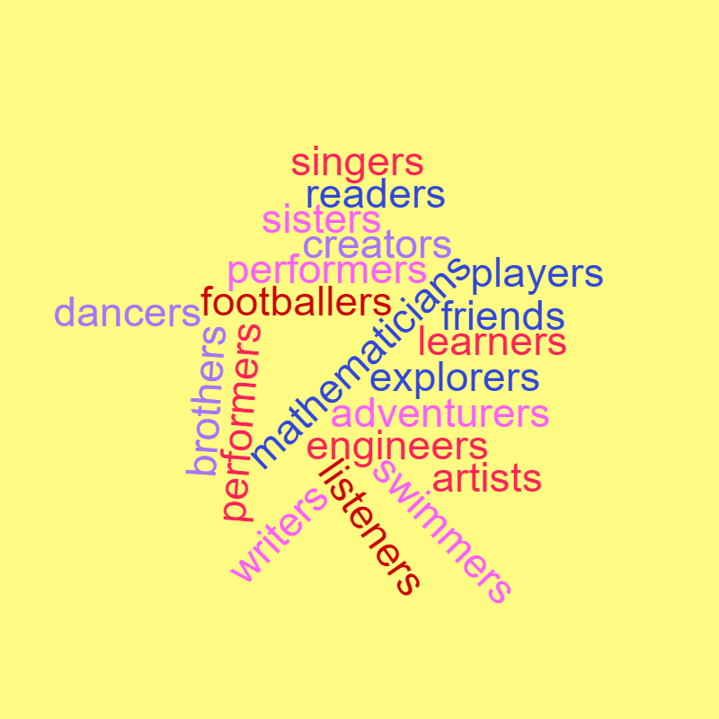
Basketballers
Athletes
Horse Riders
Designers
Musicians
Bakers

Slide 22




Slide 23
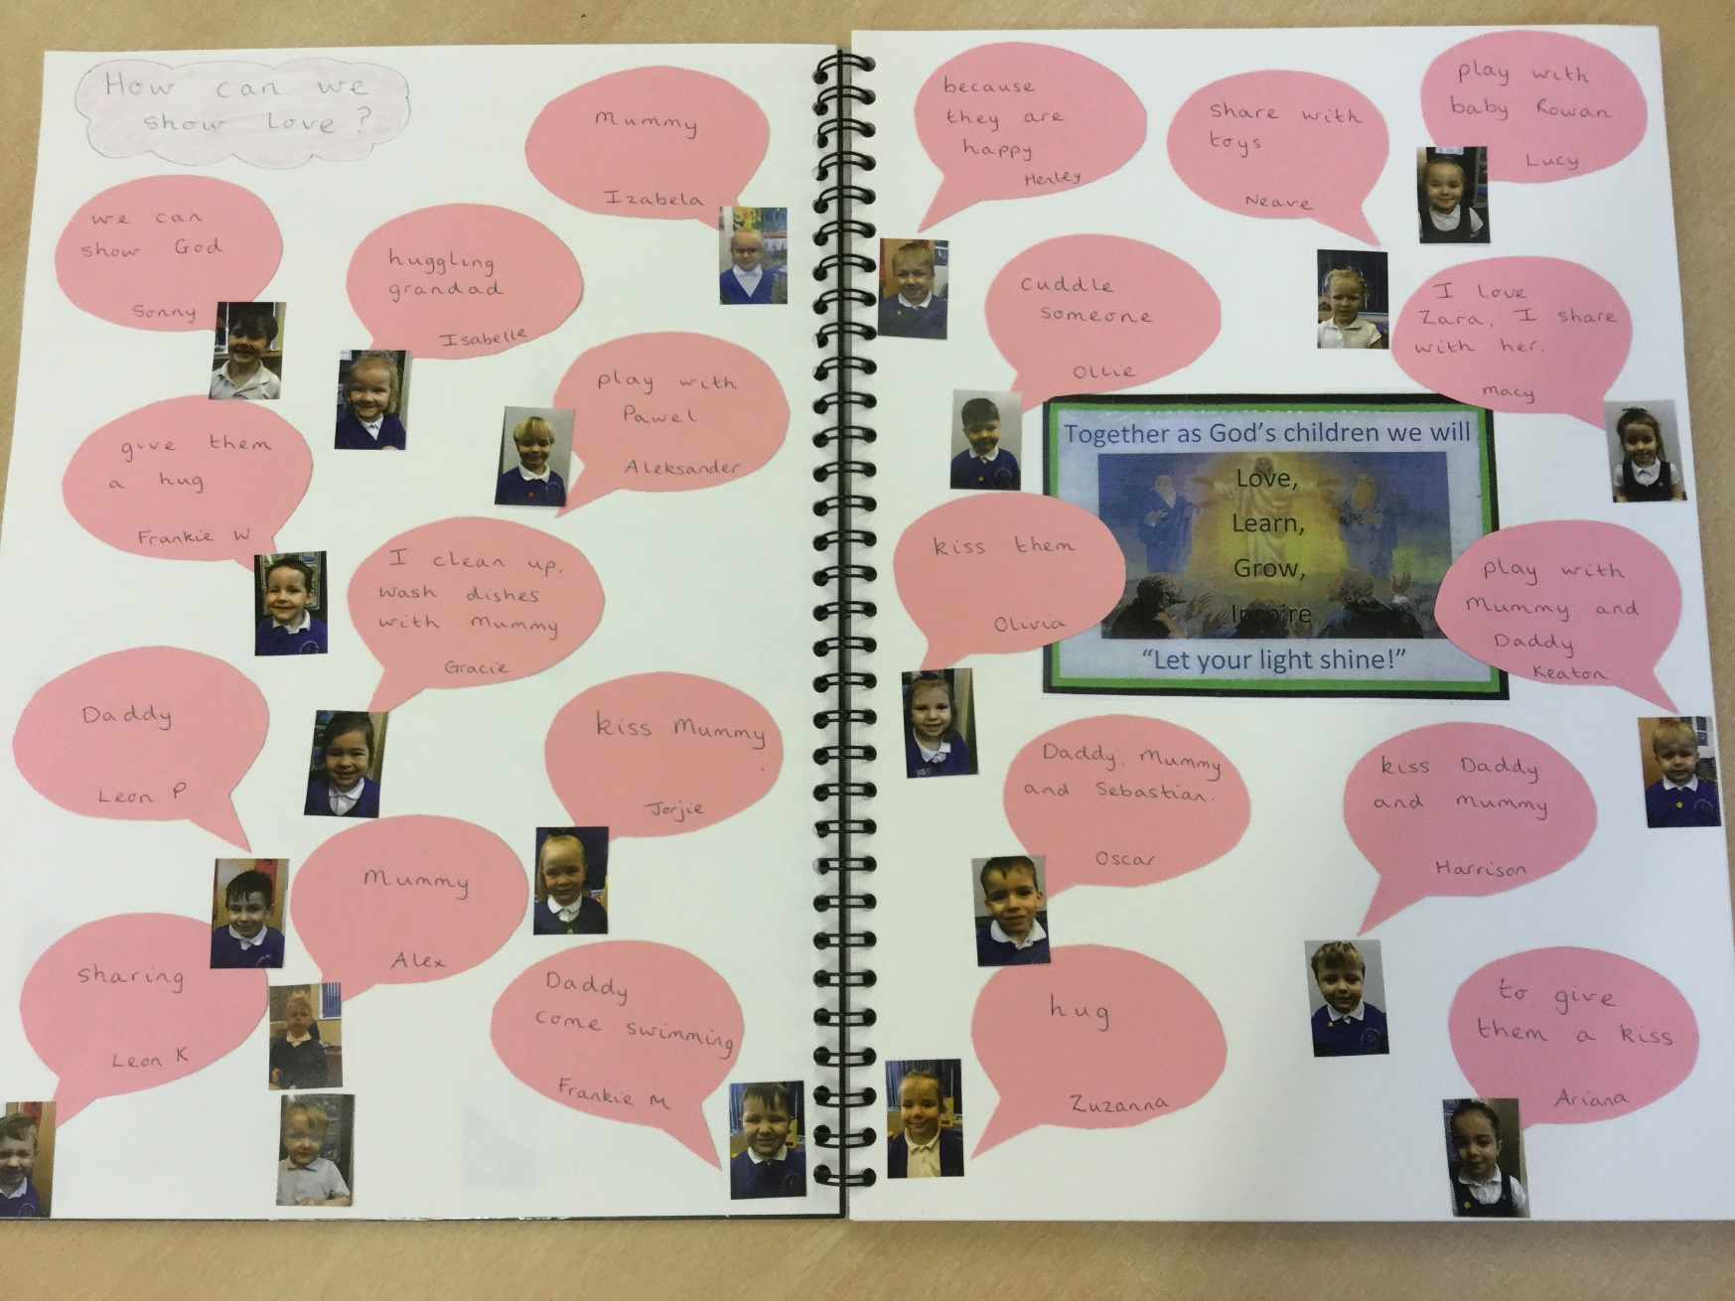
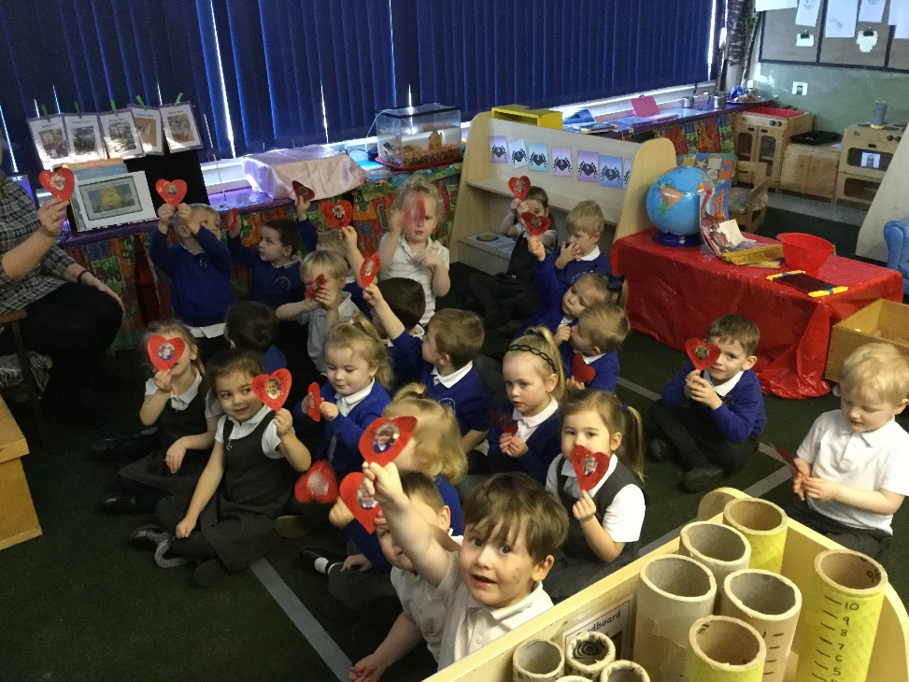
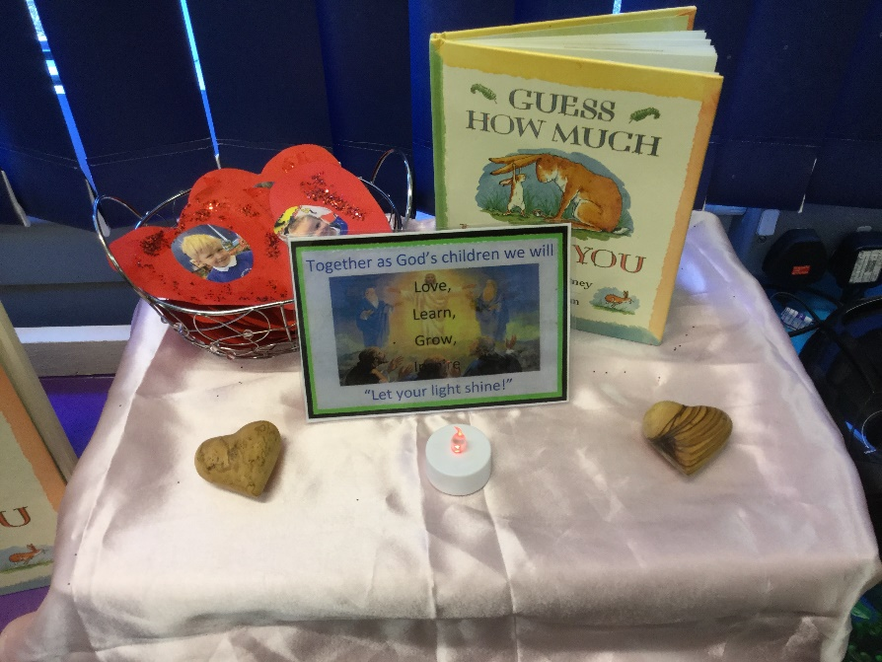
Nursery - Love

Slide 24
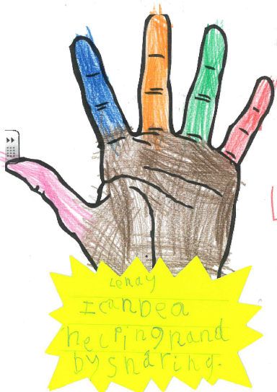
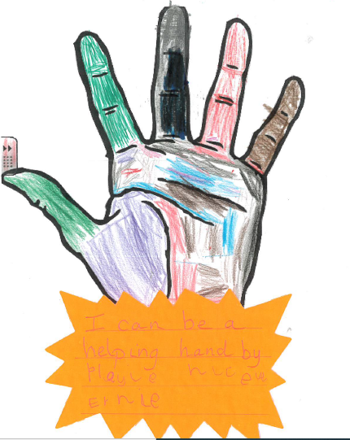
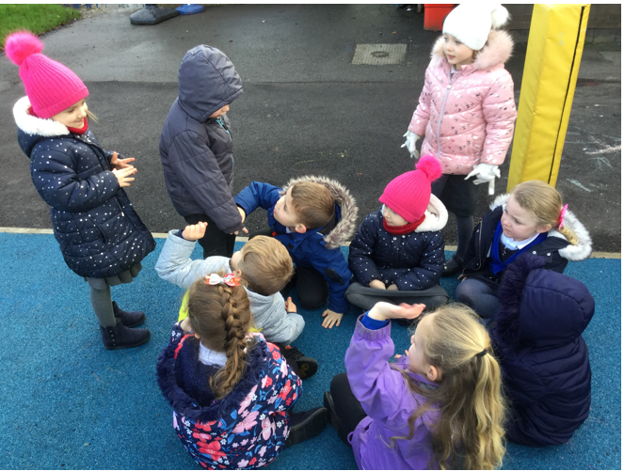
We let our light shine by being good friends
We are being the helping hands of Jesus.
I can be a
helping hand by
playing nicely.
I can be a helping
hand
by sharing.

Slide 25
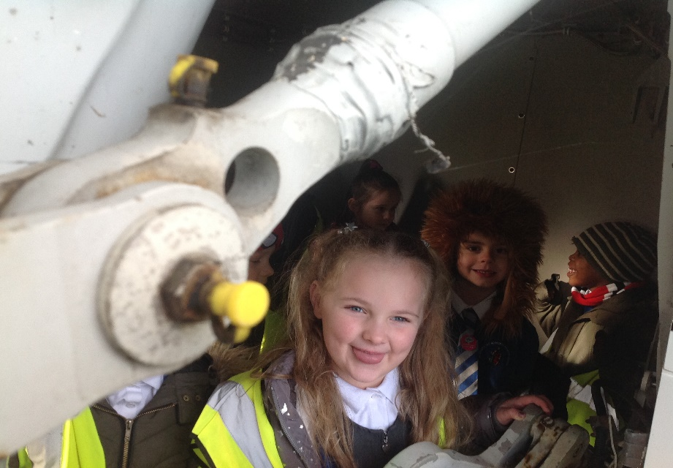
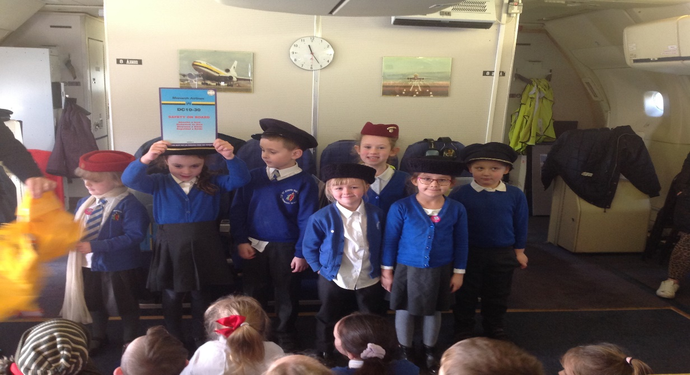
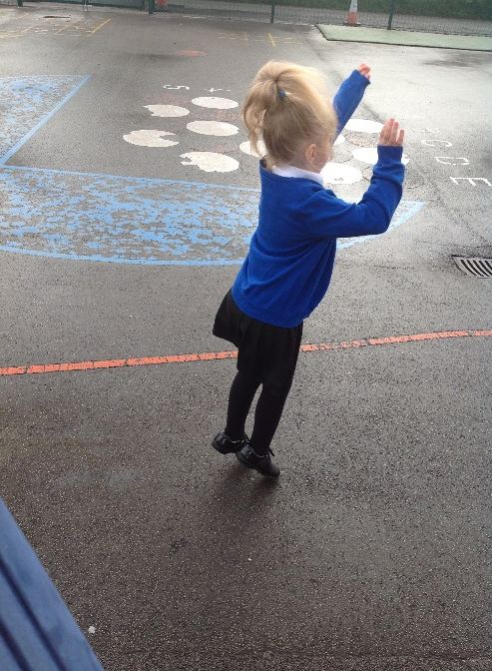
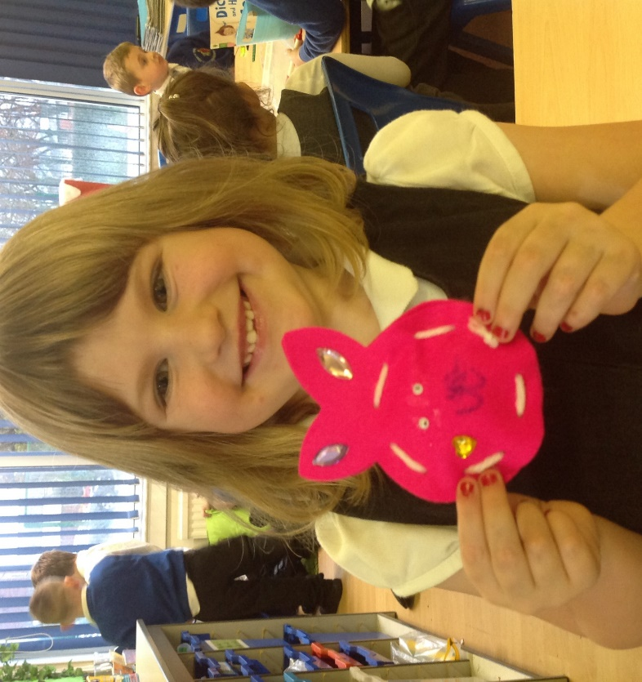
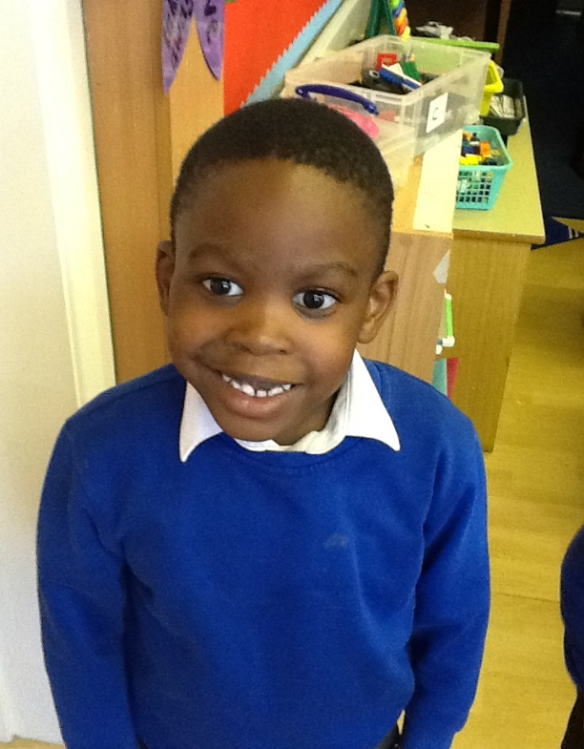
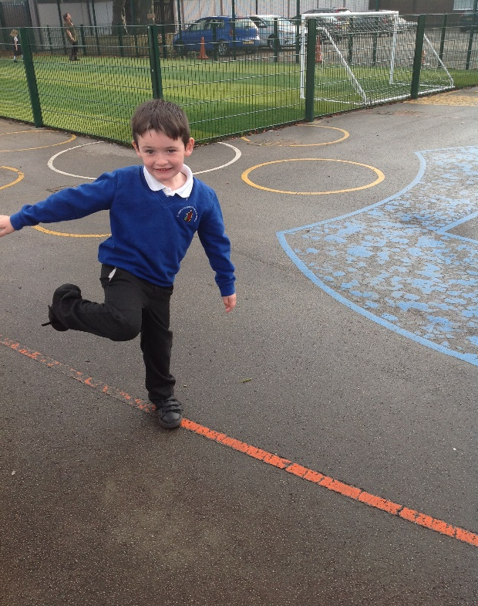
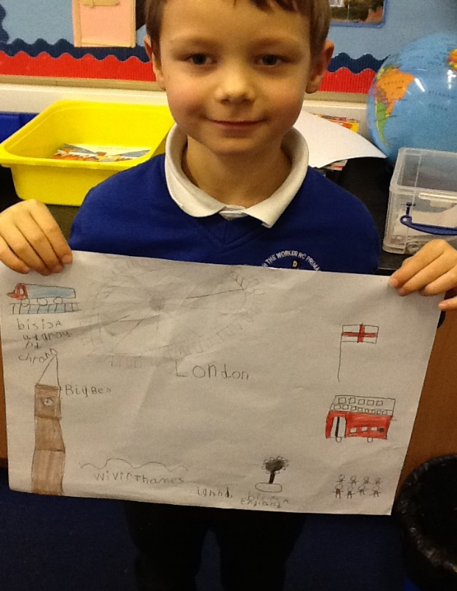
Acting
Friends
Playing
Year 1 are always HAPPY!
Crafts
Learning
Drawing

Slide 26
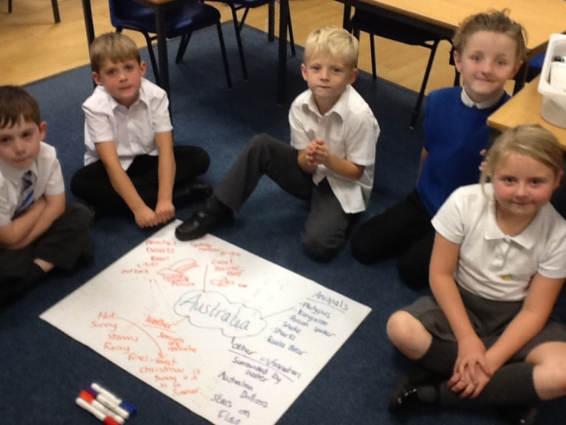
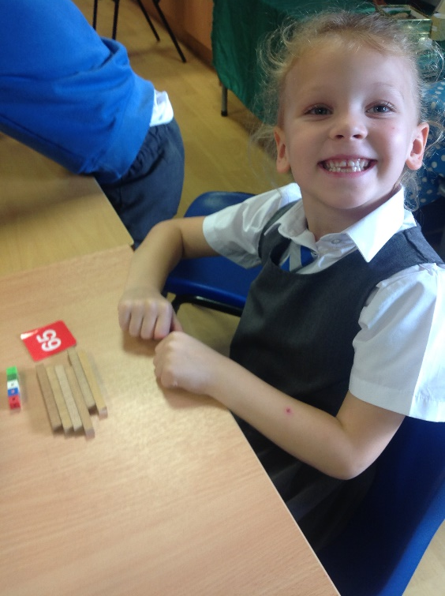
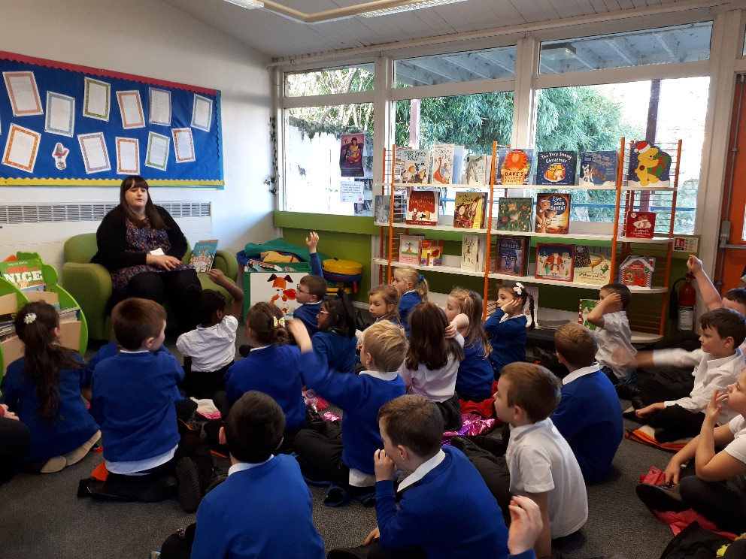
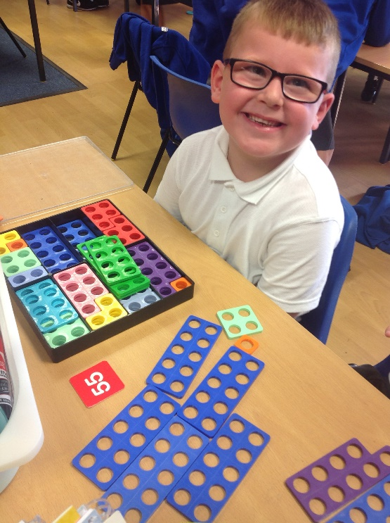
Working together
Following rules
Keeping Safe in Year 2
Respecting others and equipment
Listening to instructions

Slide 27
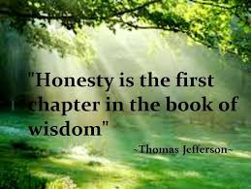

Slide 28
Year 3: What does honesty mean?
If you tell a lie, God will always forgive you but if you are honest, He will always thank you.
Honesty is important because you are following Jesus’ ways do that means you are being good and everyone will trust you.
Honesty is being genuine, it means you are kind-hearted, joyful, loving, inspiring, growing and true.
Honesty is important because when we are honest we show we are trustworthy – its all about letting our light shine.
Honesty is working as a team, helping each other and being truthful – it means following God’s and Jesus’ example and being the best that we can be.

Slide 29


Slide 30
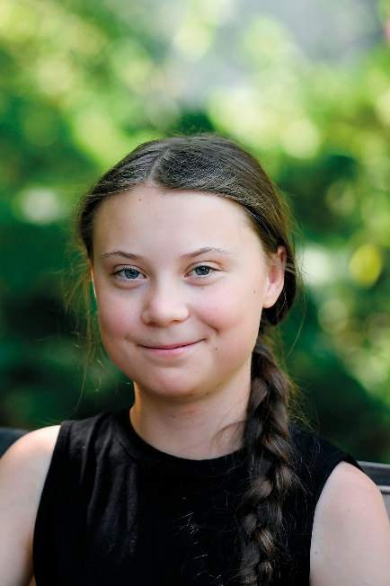
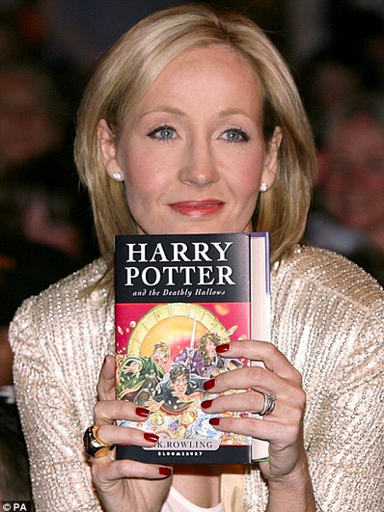
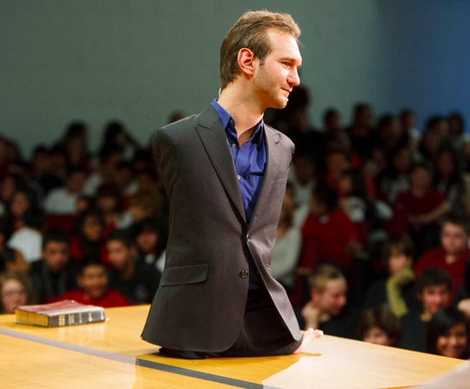
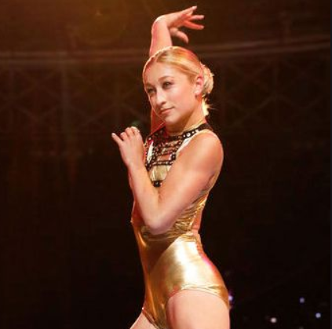
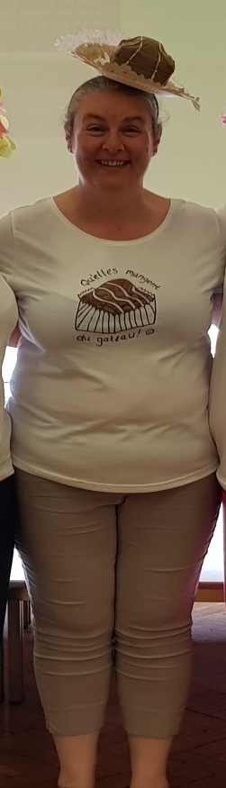
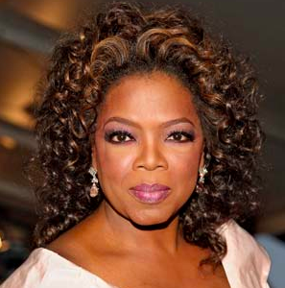
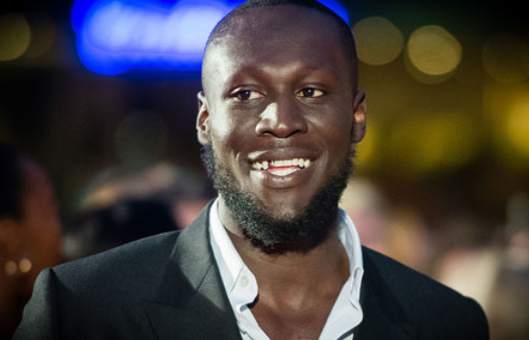

Slide 31
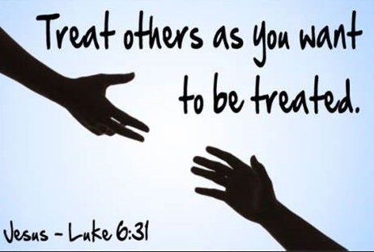


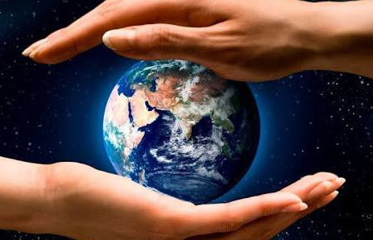


Slide 32


Slide 33

Oh Oh Oh Oh
Oh Oh Oh Oh
Oh Oh Oh Oh
Oh
x4

Slide 34
We're the forgiven,
Singing redemption's song
There's a fire that burns inside
A fire that burns inside
Nothing can stop us
We'll be running through the night
With a fire that burns inside
A fire that burns inside

Slide 35
We are the free, the freedom generation
Singing of mercy
You are the One who set us all in motion
Yours is the glory
There's a fire in our hearts and it burns for You
It's never gonna fade away
We are the free,
and Yours is the glory

Slide 36
Oh Oh Oh Oh
Oh Oh Oh Oh
Oh Oh Oh Oh
Oh
x2

Slide 37

Up from the grave He rose again
Up from the grave He rose and we will
Rise up, Rise up
Into the world that You so love
Into the world we go and we will
Rise up, Rise up
Rise Up……

Slide 38
We are the free, the freedom generation
Singing of mercy
You are the One who set us all in motion
Yours is the glory
There's a fire in our hearts and it burns for You
It's never gonna fade away
There's a fire in our hearts and it burns for You
It's never gonna fade away
We are the free,
and Yours is the glory

Slide 39
Oh Oh Oh Oh
Oh Oh Oh Oh
Oh Oh Oh Oh
Oh
x4

Slide 40
Christ be our Light
Longing for light, we wait in darkness.
Longing for truth, we turn to you.
Make us your own, your holy people,
Light for the world to see.
Christ be our light! Shine in our hearts, shine through the darkness.
Christ be our light! Shine in your Church gathered today.

Slide 41
Longing for peace, our world is troubled.
Longing for hope, many despair.
Your word alone has power to save us,
Make us your living voice.
Christ be our light! Shine in our hearts, shine through the darkness.
Christ be our light! Shine in your Church gathered today.

Slide 42
Longing for food, many are hungry.
Longing for water, still many thirst.
Make us your bread, broken for others,
Shared until all are fed.
Christ be our light! Shine in our hearts, shine through the darkness.
Christ be our light! Shine in your Church gathered today.

Slide 43
Longing for shelter, many are homeless.
Longing for warmth, many are cold.
Make us your building, sheltering others,
Walls made of living stone.
Christ be our light! Shine in our hearts, shine through the darkness.
Christ be our light! Shine in your Church gathered today.

Slide 44
Many the gifts, many the people,
Many the hearts that yearn to belong,
Let us be servants to one another,
Making your kingdom come.
Christ be our light! Shine in our hearts. Shine through the darkness.
Christ be our light! Shine in your Church gathered today.

Slide 45
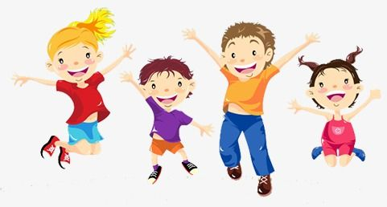
Joeys we are here** St Joseph’s
Ev’rybody cheer ** St Joseph’s!
We will shine and never fear**St Joseph’s
Everybody sing along
Sing the St Joseph Song

Slide 46
When I’m lost in a storm
you guide me to the place I belong.
When I’m in trouble
you teach me right from wrong.
You help me shine in every way
when I work and when I play.
Thank God
St Joseph’s saves the day!

Slide 47
Joeys we are here** St Joseph’s
Ev’rybody cheer ** St Joseph’s!
We will shine and never fear**St Joseph’s
Everybody sing along
Sing the St Joseph Song

Slide 48
Together we grow in friendship and in love.
Sharing the grace that comes from God above.
Like St Joseph we work and pray.
We do our best every single day.
Let’s lift our hearts and celebrate!

Slide 49
Together we grow in friendship and in love.
Sharing the grace that comes from God above.
Like St Joseph we work and pray.
We do our best every single day.
Let’s lift our hearts and celebrate!

Slide 51


