Slide 1
parkrun primary
Mesnes Park, Wigan
30th November 2025
8:55am
Notes:
For this assembly you will need the following
Projector or screen to show presentation
A4 or larger printed barcode and finish token (if available)
Volunteer High Viz
Volunteer Lanyard
Directional signs
If available, junior parkrun signs
Milestone wristbands
On each slide there are discussion points on subjects to talk about. Remember this is just a guide so please put your own fun and passion in the presentation and use your own stories where possible. The presentation should take around 25 minutes and should be delivered in a positive, active and engaging way.
This slideshow is customisable, so please download, save and edit where appreciate. Most changes that are advised are marked in red.
(Insert Name of school in this slide)
If possible coordinate this assembly with a letter to go home to Parents/Carers and information in the school newsletter.

Slide 2

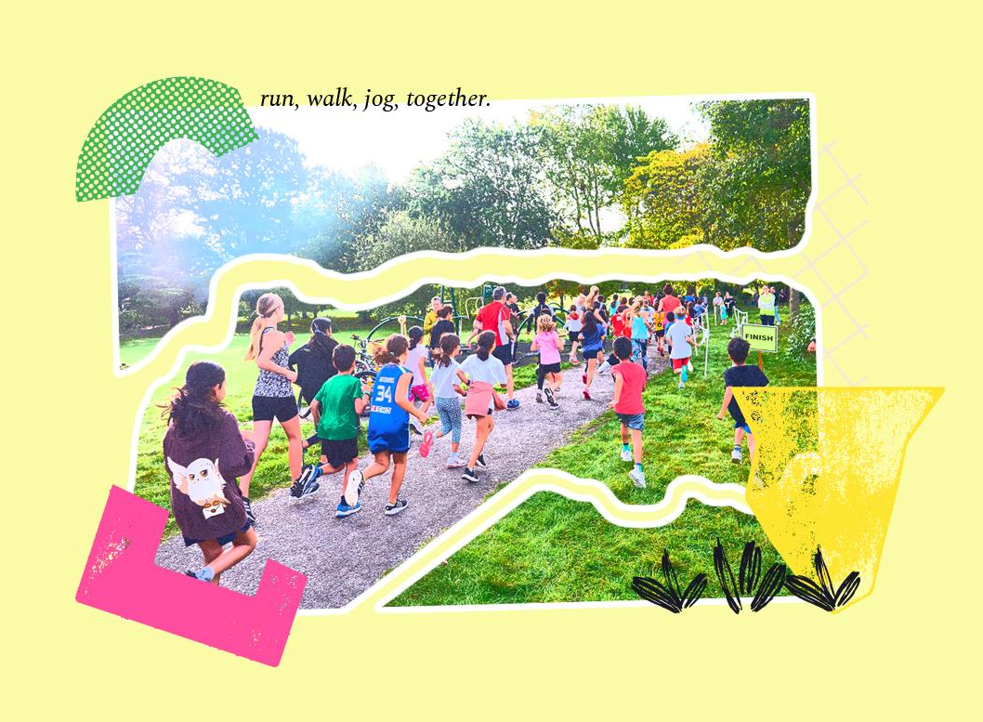
Notes:
SLIDE 2: “Hello”
Good morning/afternoon everyone.
Thank you very much for inviting me to your assembly today.
My name is (Insert Name) and I have come to talk to you about junior parkrun. Hands up if you have heard of junior parkrun before?
Now, before I tell you about junior parkrun, I would like you to raise your hands again if you like to do the following:
Who likes walking?
Who likes skipping?
Who likes running?
Who likes having fun?
Well, I think that includes most of you so that means you can all do junior parkrun!
I love running and walking, and this is what I wear when I go running, (change following where appropriate) I have running trainers, shorts, running top. When it’s cold I wear more layers and sometimes a hat too. But you don’t really need any special clothes to go out running or walking.
Running and walking are great as you can do it anytime anywhere, you can do it with your friends or family or even on your own when you are older, and just like junior parkrun it’s completely free to do.

Slide 3
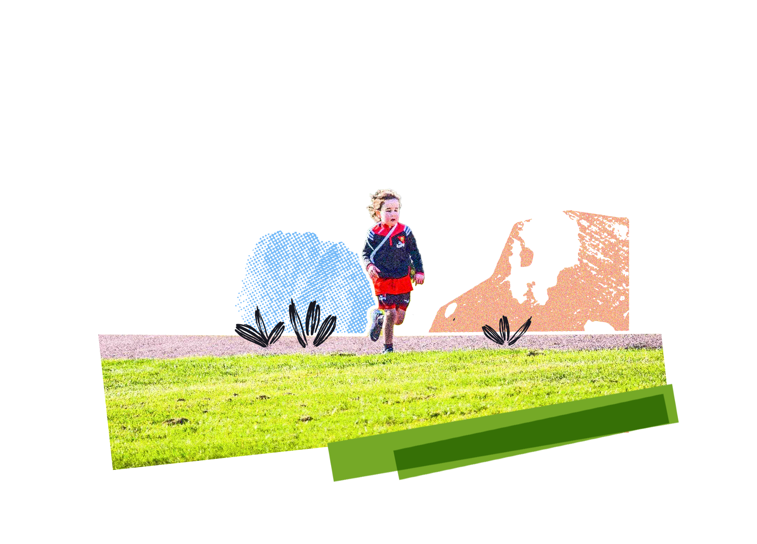
What is junior parkrun?
First timers welcome
It’s 2k community event and for 4 to 14 year olds
It’s free and every Sunday
Walk, jog, run, skip around the course, volunteer or spectate
Event are created and run by our amazing volunteers
It’s fun, no one finishes last and we welcome everyone!
Notes:
SLIDE 3 – What is junior parkrun?
junior parkrun is 2,000 metres long community event.
It’s free and it is every Sunday.
Events are created and run by our amazing volunteers.
You can walk, run, jog, skip, volunteer or spectate, loads of ways to take part.
It’s fun for everyone and no one finishes last - junior parkrun and our motto is that “it’s a run not a race, keep a smile on your face”
If you are a really fast runner you could probably do that in about 10 minutes or less and you can walk 2K in around 25 minutes. Whichever you do is an amazing achievement, the most important thing is that you have fun and it puts a smile on your face!
We do time you and see how long it takes you to do so you can see how long it took you to complete it. You can even come back the week after and see if you can beat your personal best time.
You can run with your Mum and Dad or older brothers or sisters, even your grandparents if you want to. Or you can run or walk on your own to show them just how good you are.
But the most important thing at junior parkrun is that you have fun and enjoy yourself.
When you register for parkrun on the website, you get sent your own barcode, no one else can use it as it keeps a record of what you have done at parkrun.
Your barcode looks like this [show A4 barcode] although the one you print out will be much smaller!
When you finish the 2K course on a Sunday morning, you are handed a finish token that looks like this [show A4 token].
You hand this in with your barcode and that’s how we know how long it took you to complete the course. Our very clever volunteers put all of the results on the parkrun website too!

Slide 4
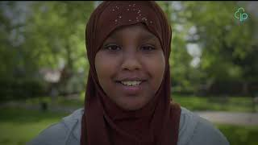
Notes:
SLIDE 4 - Take a look at the junior parkrun video.

Slide 5
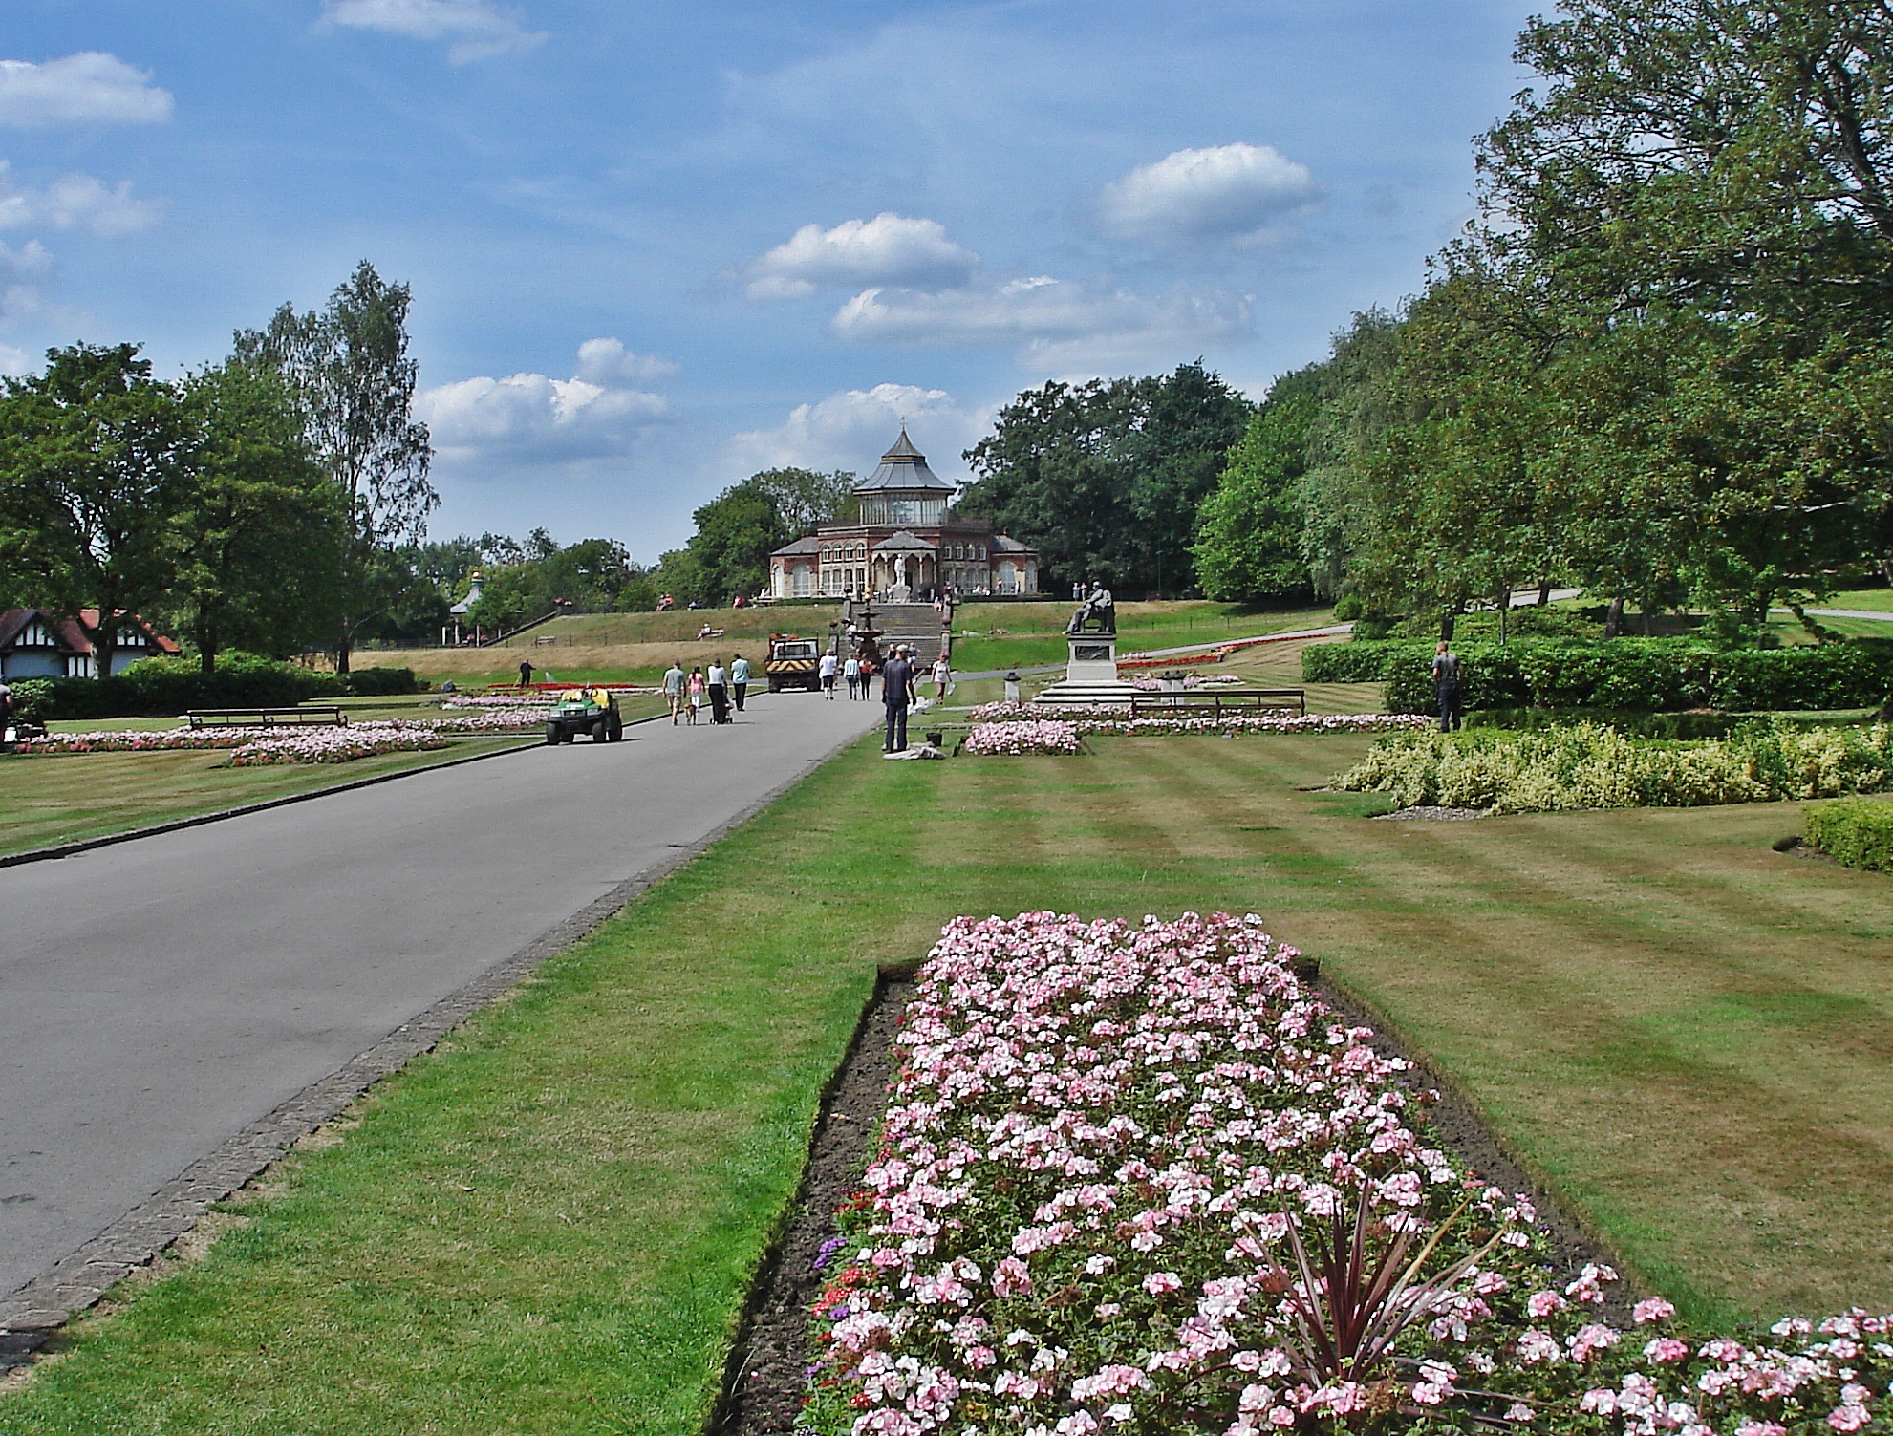
Do you know this park?
Notes:
NOTE: INSERT PHOTO OF YOUR OWN PARK HERE.
SLIDE 6 – Your park
Does anyone know XXXXXXX park with the [INSERT RELEVANT FEATURES ABOUT YOUR PARK e.g. big climbing frame and the café where you can buy ice cream?]
Well this is where we do junior parkrun and we meet every Sunday by the XXXXXXX and do a warm up at 8.55am/9.25
It is (Insert number of laps) laps of the park, starting on the hill near the café and finishing near the playground.
If you have more photos of your park please include these over the next few slides.

Slide 6
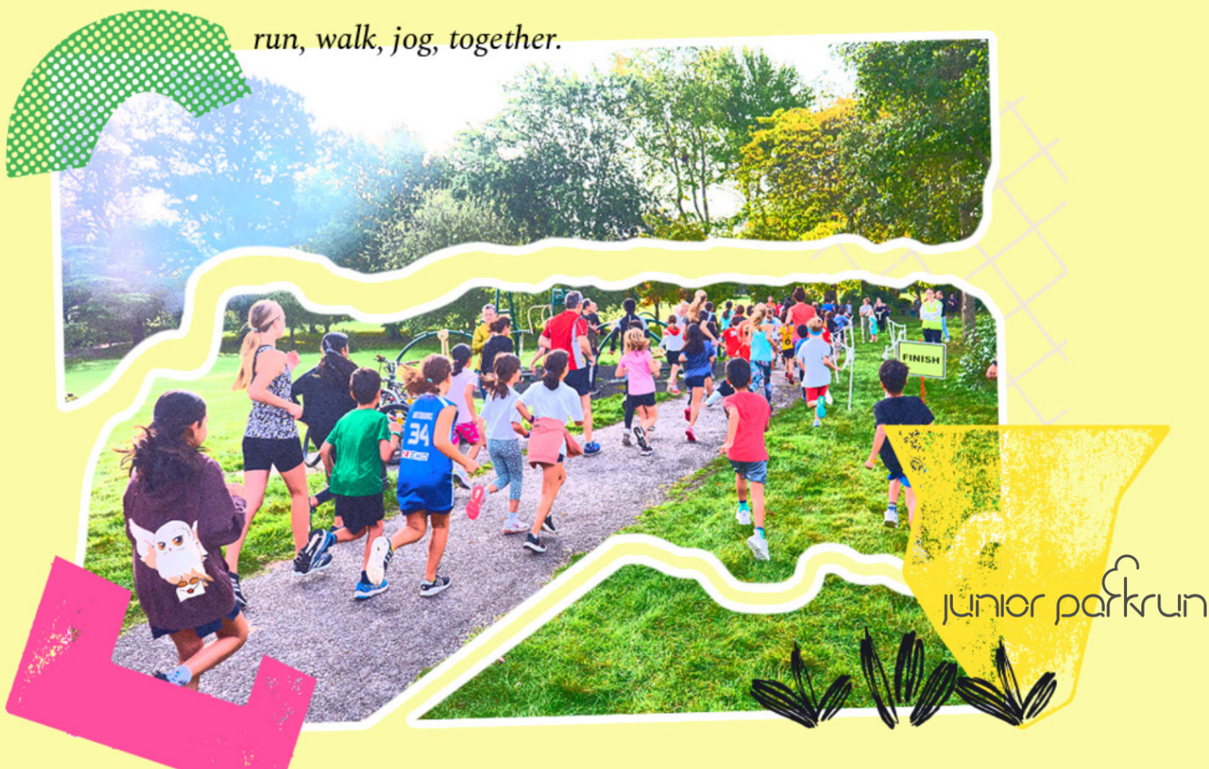
Why should you take part in junior parkrun?
Notes:
SLIDE 8 - Why should you take part in junior parkrun?
If you have time ask a few children if they have any ideas, on why you should take part in junior parkrun?

Slide 7
Why should you take part in junior parkrun?
Less screen time
It makes you feel good!
It improves your physical health
It’s fun
Make friends
It’s outside and in nature
Increases confidence
Better sleep
Improves your fitness & Stamina
Notes:
SLIDE 9 - The benefits of being physically and socially active at junior parkrun.
Highlight some of the answers from the children or a few on the slide here:
It’s a great opportunity to make friends or met friends on the weekend for a fun activity.
It’s outside, in the fresh air, in nature so you will be looking at screens less.
Being around the friendly junior parkrun community can help increase your confident (especially if you give volunteering a go).
It makes you feel good, the sense of achievement is amazing.
It helps to improve and maintain your physical health and fitness.
Exercising regularly will help you to get better nights sleep.
IT’S FUN, for everyone!

Slide 8
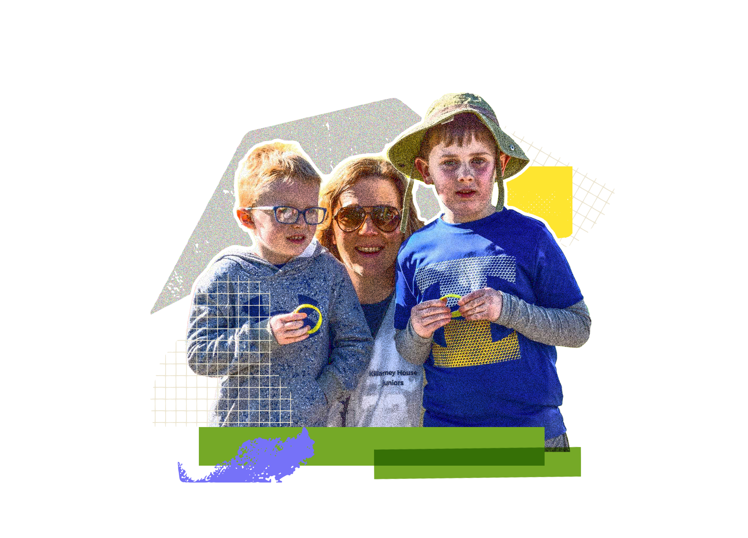
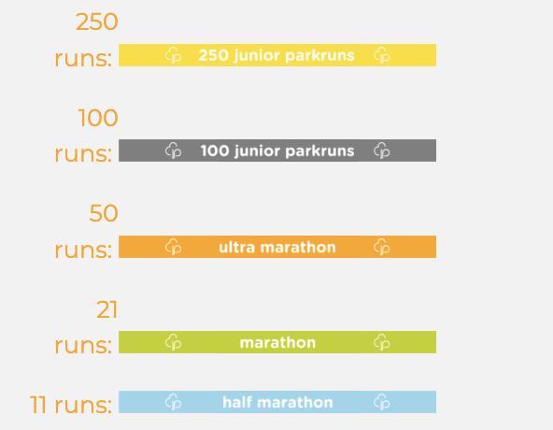
junior parkrun milestones
Notes:
Slide 10 - Milestone Wristbands
Everytime you complete a junior parkrun it goes towards special junior parkrun clubs. You will need to complete a certain nember of junior parkruns to join these clubs. One you get to this number you will be awarded one of these wrist bands which you can only get from junior parkrun, you can’t buy these anywhere else (show the wristbands)
These are the wristbands you can get and how many junior parkruns you need to do to get one
11 junior parkruns - half marathon - blue wristband
21 junior parkruns - marathon - green wristband
50 junior parkruns - ultra marathon - orange wristband
100 junior parkruns - grey wristband
250 junior parkruns - yellow wristband
For more information on wristbands please see here.

Slide 9
Five steps to get involved
Ask a parent or adult to register you on the parkrun website, you will then be sent your very own parkrun barcode
Join us at any junior parkrun or parkrun event
Bring your personal barcode with you
Walk, jog, run, skip around the course, volunteer or spectate
Most importantly have fun… see you on Sunday!
Notes:
SLIDE 11 - Five steps to get involved in junior parkrun.
See our five simple steps to get involved.
Parent or adult to register you once via the parkrun website.
Join us at any junior parkrun or parkrun event.
Bring your personal barcode with you.
Walk, jog, run, skip around the course, volunteer or spectate.
Most importantly have fun!
We have put together this information together to be sent out to your parents and carers after the assembly.

Slide 10
Free, for everyone, forever.
Thank you!
Notes:
SLIDE 13 - Any questions?
It has been lovely to speak to your all today about xxxxxx junior parkrun and we hope to see you on Sunday!

