Slide 1


Wood Fold
Sports Council Meeting

Slide 2
Roles & Responsibilities
Help set up PE lessons
Run warm-up games in PE lessons (Monday, Tuesday & Friday)
Keep the PE store room tidy
Ensure football, netball, rugby balls are pumped up
To give out certificates and awards in assembly
To write a short report of what’s been happening in PE at Wood Fold
Ensure the Play Leaders are carrying out games on the playground
Ensure that Play Leader equipment is stored away
Be role models

Slide 3
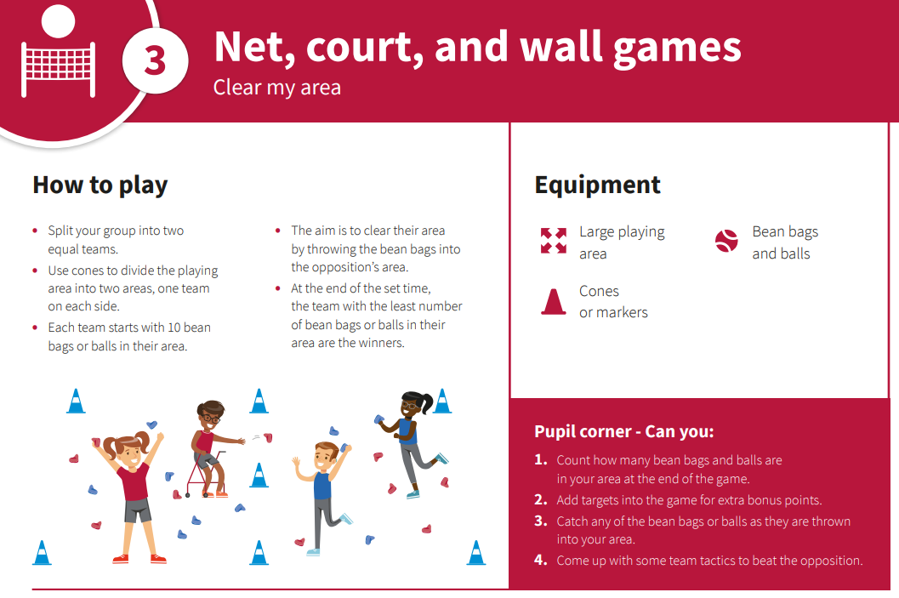
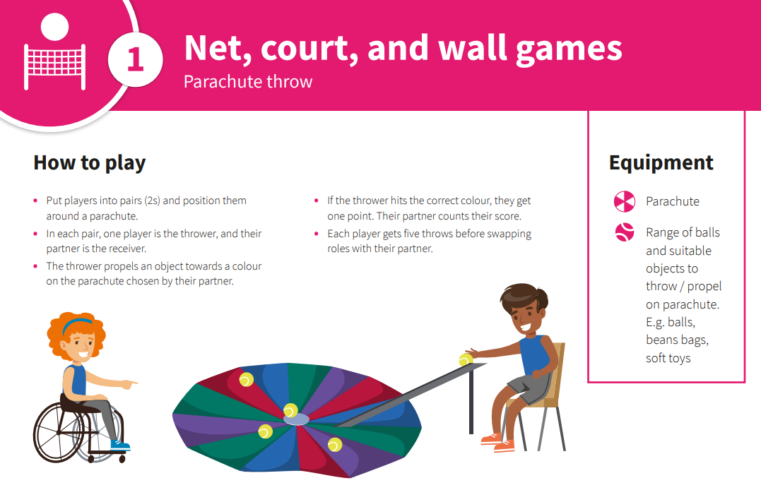
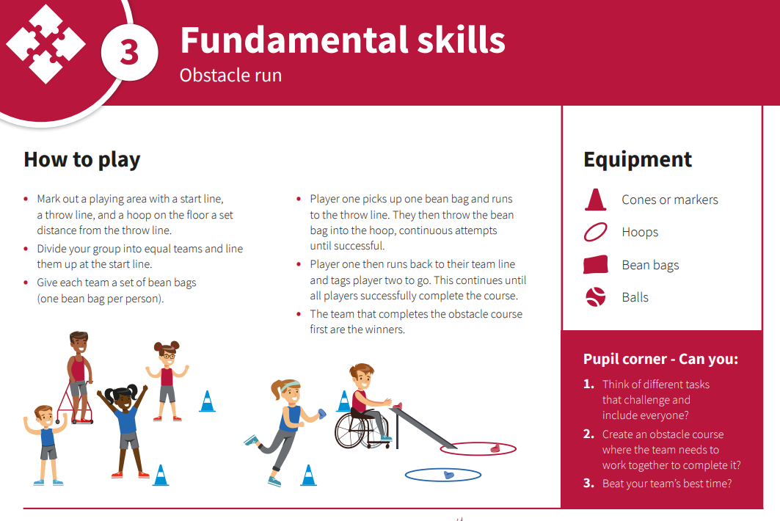
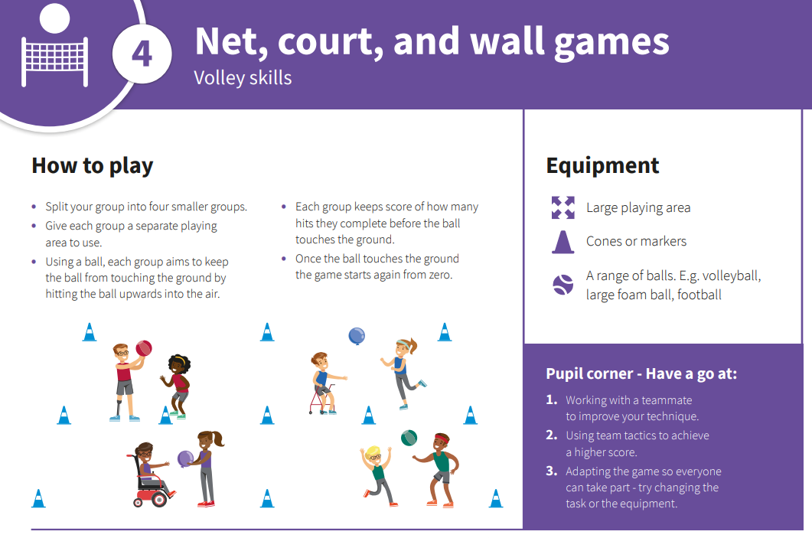
Inclusive Games

