Slide 1

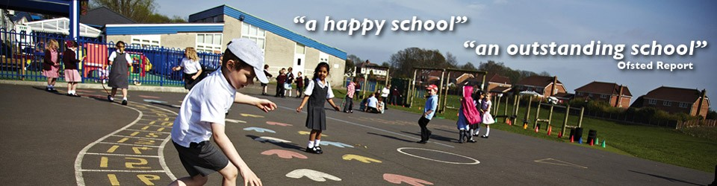
Welcome to Year 3
Miss Grady and Miss Hunter

Slide 2
Year 3 Staff
‘A safe, warm, secure and caring environment’.
Y3G– Miss Grady
Teaching Assistant- Mr Speakman
Y3H – Miss Hunter
Teaching Assistant- Miss Southway & Miss James

Slide 3
‘A broad and balanced curriculum’.
Daily Timetable
Morning Registration – 8:40am – 8:55am
Morning Lessons – 9:00am – 10:30am
Break Time – 10:30am – 10:45am
Mid-Morning Lessons - 10:45am – 12:00pm
Lunch Time – 12:00pm – 1:00pm
Afternoon Lessons – 1:00pm – 3:15pm
Home Time – 3:15pm

Slide 4
Reading Records
Planners will be checked three times a week
Monday / Wednesday / Friday
Please note that we encourage the children to read and record daily in their Reading Records. Children are asked to bring their Reading Records into school every day.

Slide 5
Reading Books
Reading for Pleasure
The children will have the opportunity to take a reading book of their choice home from our classroom library.
We kindly request that the children return the books back to school after they have read them so that another child can share the same reading adventure!

Slide 6
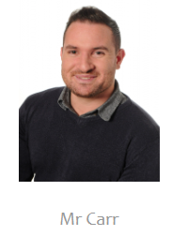
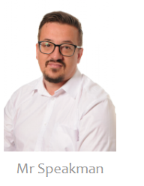
P.E Days & Kit
PE= Tuesday morning and Wednesday afternoon every week
P.E Kit - White t-shirt, maroon shorts, black pumps
Sports Kit - Tracksuit, t-shirt, trainers
Summer Months (Including anytime there is warm weather)
White t-shirt, maroon shorts and trainers or pumps
Winter Months (If outside and it’s cold weather)-Tracksuit pants, tracksuit top and trainers. Woolly hats and gloves may be worn also.
For gymnastics, children can wear either pumps or go barefoot. No trainers to be worn on the mats.
To avoid PE kits being left at home, we encourage the children to bring with them their own sports kits to wear for their sports clubs after school.
At the moment, the children should only have their PE kit in school. At the end of this half term, the children will bring their PE kits home to be washed.
All uniform (polo shirts, sweatshirts, PE & sports kits, school rucksacks, book bags and PE bags, all embroidered with the school logo) can be ordered through school
Children may wear watches in school, but jewellery, including earrings, are not allowed.

Slide 7
Forest School
Forest School: Friday morning 9:00-10:30am (Autumn Term) Starting 18.09.26
Forest School Kit - Warm clothing – leggings or tracksuit bottoms, t-shirt, jumper, A waterproof coat and waterproof trousers. Walking boots or wellingtons.
No trainers.
Children are advised to dress warmly and wear waterproofs if necessary. However, there are some occasions where it may not be safe or practical to go ahead with a planned session due to extreme weather.

Slide 8
Music
Overview:
Children will have one music lesson per week with a specialist teacher
Children may bring their own instruments if they wish – please liaise with the teacher beforehand
The children will also have one singing assembly each week.
Performance Opportunities:
TBC

Slide 9
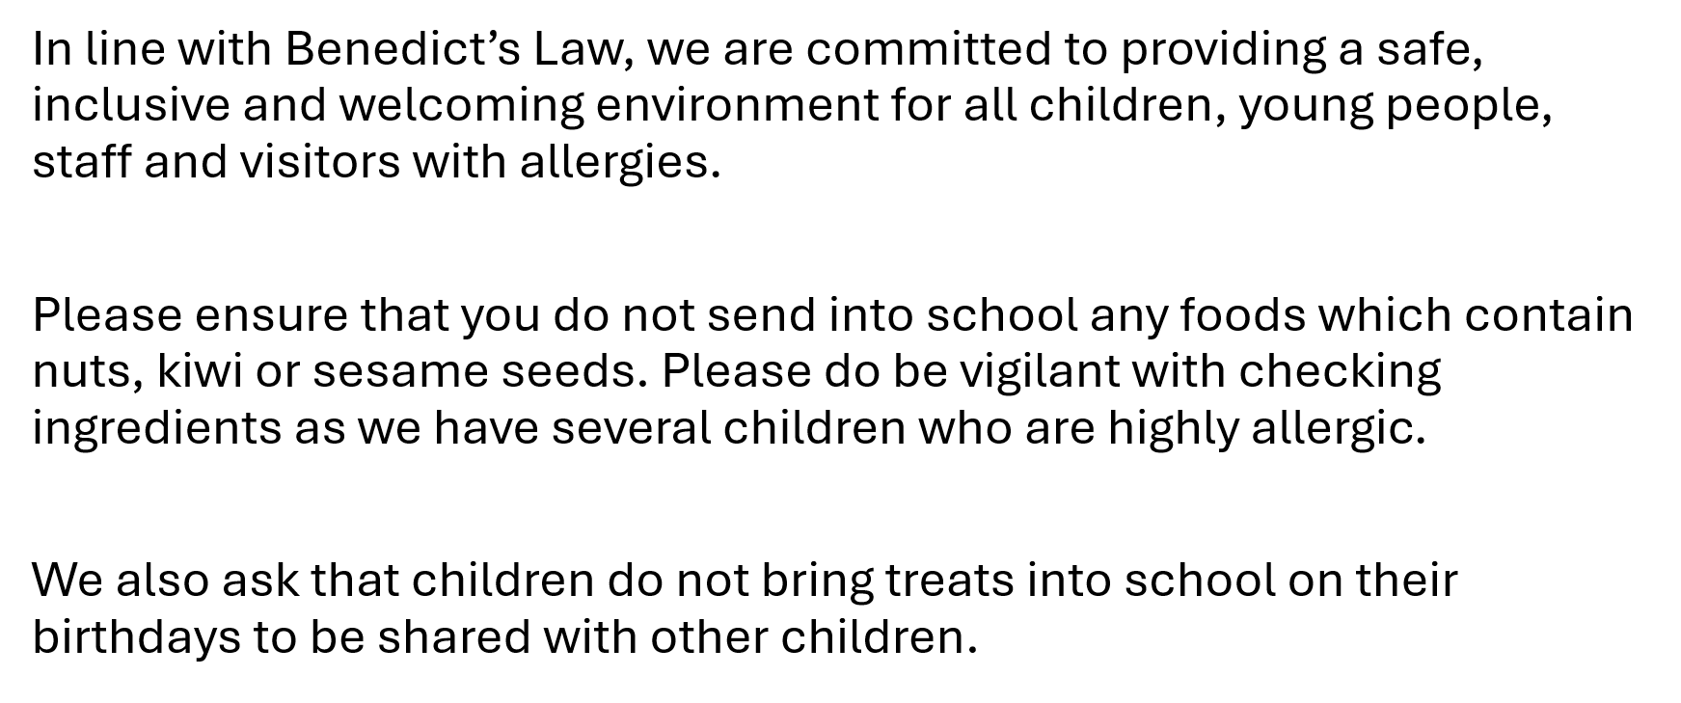
Allergies

Slide 10
Long Term Plan
Our Long Term Plans are accessible on the school website. They provide details of your child’s learning each half term.

Slide 11
Trips
Summer 2: Bolton Museum

Slide 12
Times Tables
In Year 3, we will be learning all of the multiplication and division facts, both in and out of order, focusing on the 3, 4 and 8 times tables.
The children will do 10 minutes of times table practice per day and on a Friday will complete a times table quiz.

Slide 13
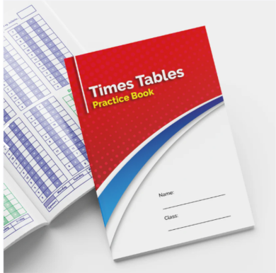

Times Tables
Children will be given a Times Tables Practice Book which will be used in school and at home to support the children with their times tables. We will also be awarding a weekly ‘Times Tables Award’ to really encourage the children to practice as often as they can.

Slide 14
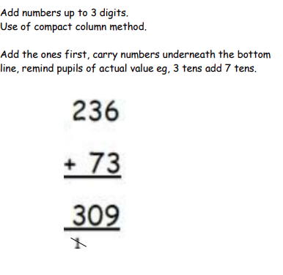
Year 3 Maths Strategies
Addition:

Slide 15
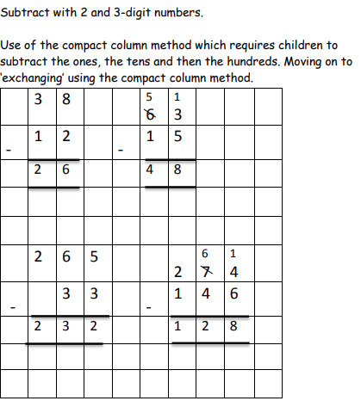
Year 3 Maths Strategies
Subtraction:

Slide 16
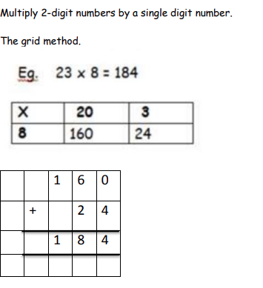
Year 3 Maths Strategies
Multiplication:

Slide 17
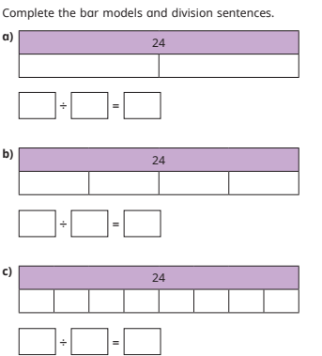
Year 3 Maths Strategies
Division:

Slide 18
Homework
Homework is set every Friday to be returned or completed by the following Wednesday.
The homework will be Spelling practice, Times Tables and a Carousel Learning Link.
At the end of every half term, it will be a learning postcard.
Homework is set as an opportunity for the children to further their learning beyond the classroom. We ask that the children should complete homework independently, however if they are struggling, please don’t hesitate to come and speak to a member of our Year 3 team.

Slide 19
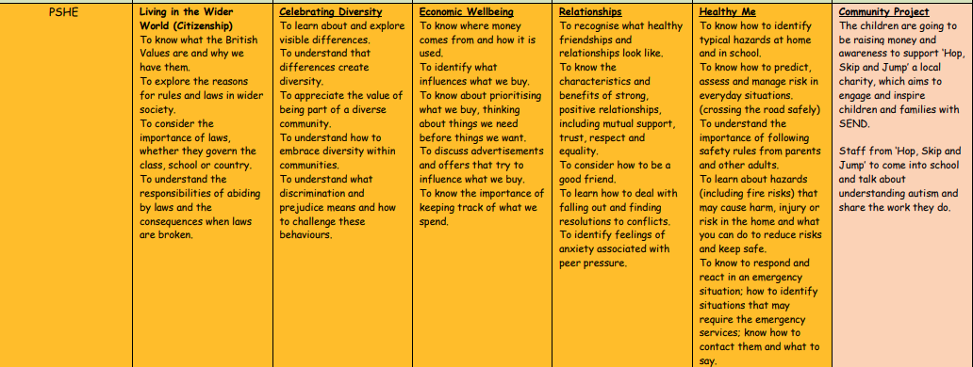
Year 3 PSHE Curriculum

Slide 20
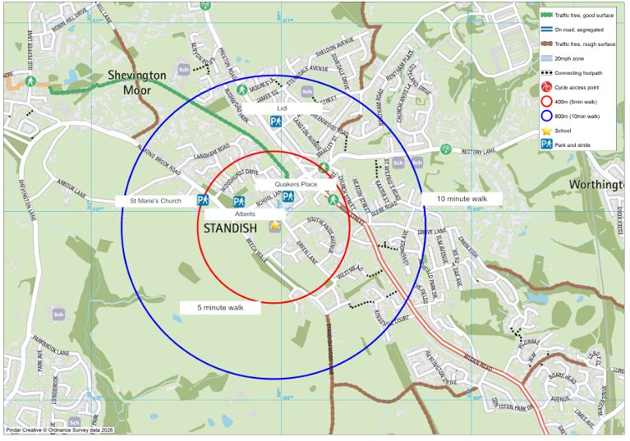
Active Travel
We encourage all families to consider active travel to school whenever possible by walking, scooting, or cycling instead of driving. Active travel helps children stay healthy, develop independence, and arrive at school ready to learn. It also reduces traffic congestion and improves safety around the school gates, creating a cleaner and more pleasant environment for everyone. Thank you for supporting our efforts to promote healthier and more sustainable journeys to and from school.

Slide 21
Questions and Answers
Thank you for coming to the Year 3 welcome meeting. If you have any questions or concerns, please don’t hesitate to ask us.
We look forward to getting to know you throughout the school year.
Miss Grady and Miss Hunter

