Slide 1
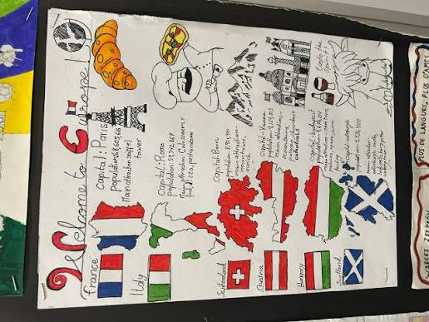
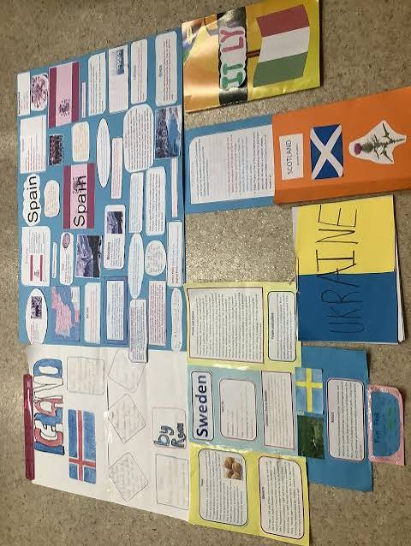
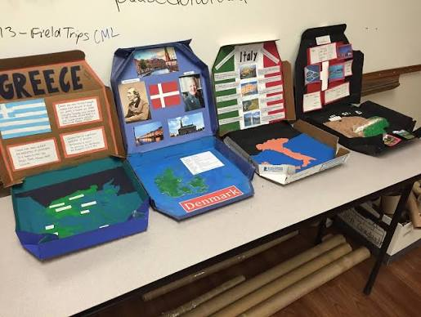
Year 4
Autumn 2 Project – EUROPE
Your task for this project is to research a European country of your choice and present your findings.
Research: location, climate, culture, landmarks, physical and human features.
How you choose to show your research is up to you.

