Slide 1
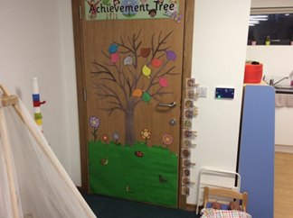
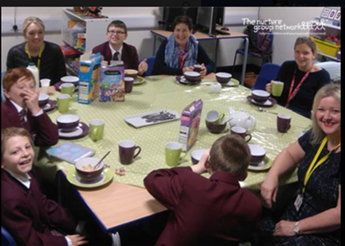
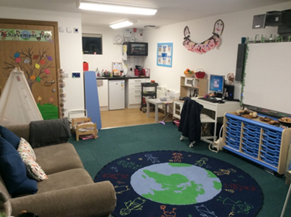

Boxall Profile Training
Designated Teacher Training
Monday 4th December

Slide 2
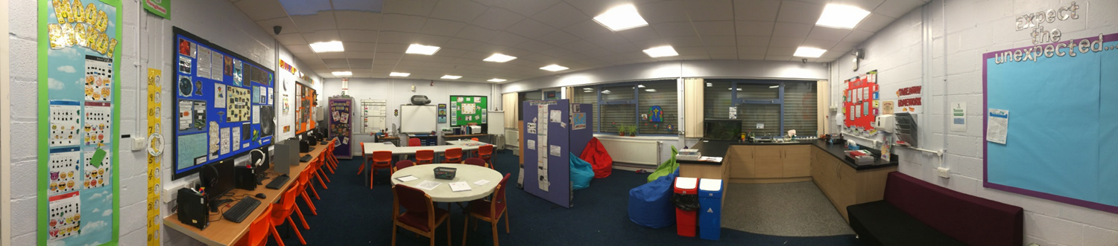
6 Principles of Nurture
Children’s learning is understood developmentally
The classroom offers a safe base
Nurture is important for the development of self-esteem
Transition is recognised as being important in children’s lives
Language is a vital means of communication
All behaviour is communication

Slide 3
Developmental
Developmental strands provides a description of the personal and social development of the child in primary from age 3 years 4 months to 8 years and the secondary from age 11- 15.
Characteristics of the developing child that reflect or contribute to a constructive learning process.
Easy to administer
  Two clusters:
    Organisation of experience e.g. makes appropriate use of the materials provided by the teacher without the need for continuing support
    Internalisation of controls e.g. looks up and makes eye contact when the teacher addresses him by name.

Slide 4
Diagnostic
Behaviours which interfere with satisfactory engagement with learning.
Directly or indirectly the outcome of impaired learning in the early years.
  Three clusters
    Self-limiting features e.g. avoids, rejects or becomes upset when faced with a new or unfamiliar task or a difficult/competitive situation
    Undeveloped behaviour e.g. restless or erratic, behaviour is without purposeful sequence, continuity or direction
    Unsupportive development e.g. lacks trust in the adults’ intentions and is wary of what they might do, avoids contact or readily shows fear.
Notes:
Section 2 shows areas of deviant behaviour that inhibits or interferes with the learning process and in conjunction with section 1, gives clear indication of those children who would be well places within the nurture group, those who need other skilled intervention and those who can be helped within the ordinary class

Slide 5
Why use the Boxall?
Initial concerns from class teacher/TA
To gain a more accurate understanding about a CYP
To give an understanding of behaviours and areas to work on when building a relationship with the child
To correct perceptions of the CYP which aren’t always true. The handbook highlights a wider range of concerns than might be initially obvious
To inform other professionals
To track a CYP’s progress

Slide 6
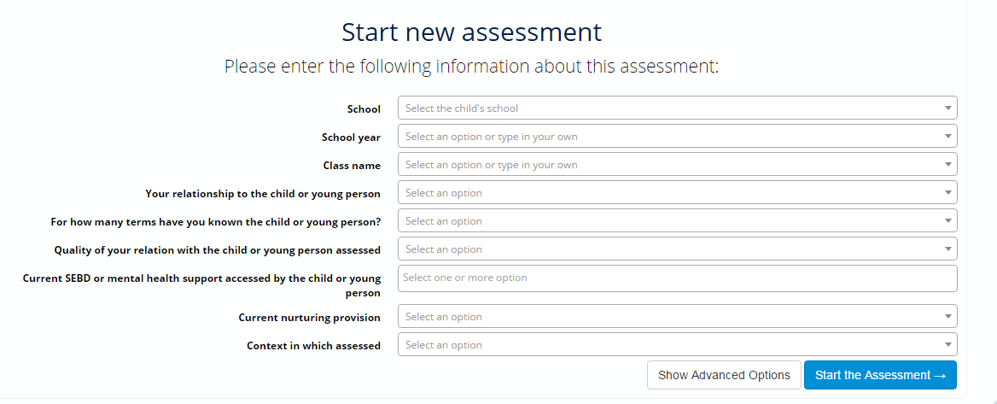
Boxall Online

Slide 7
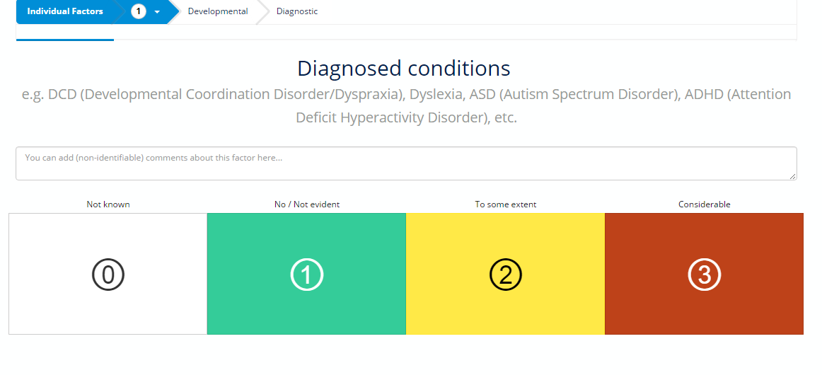

Slide 8
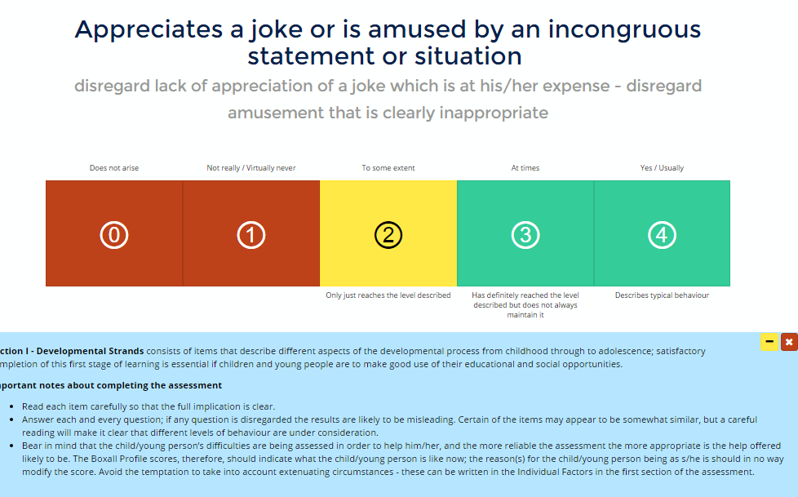

Slide 9
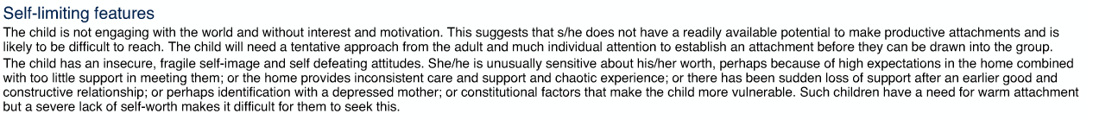
Boxall Report

Slide 10
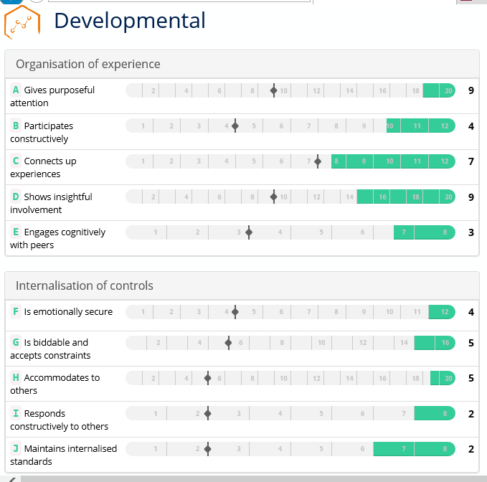

Slide 11
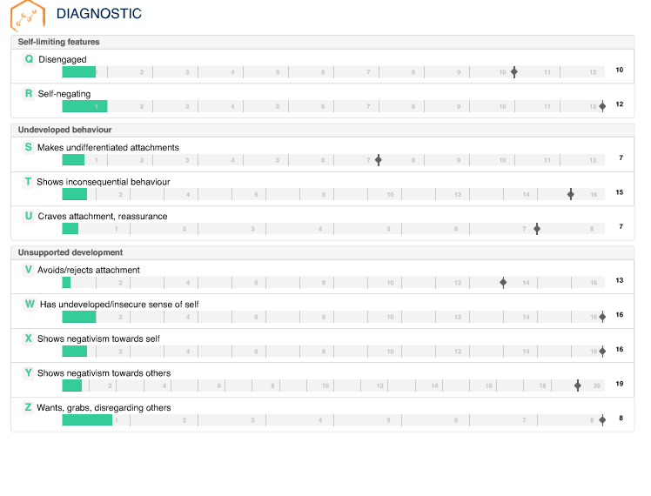

Slide 12
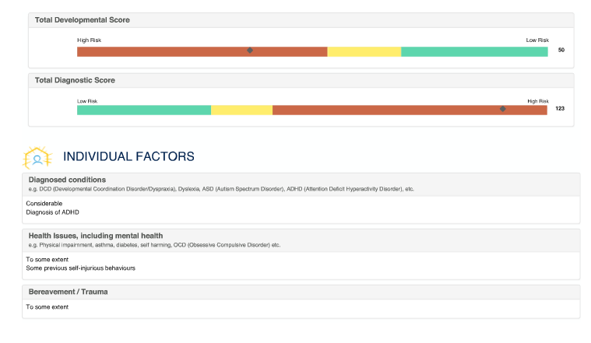
Final report

Slide 13
Interpreting the Boxall Profile
S-U interferes with how the child learns to socialise appropriately
Q &R Until these improve, you are unlikely to make progress
V
W
X
Y
Z
Q
R
S
T
U
F
G
H
I
J
Followed by these
A
B
C
D
E
These are your most basic needs and should be dealt with first

Slide 14
Developmental | Diagnostic
A- gives purposeful attention | Q- disengaged
F- is emotionally secure | R- self-negating
G- is biddable and accepts constraints | T- shows inconsequential behaviour
H- accommodates to others | Y/Z- wants, grabs, disregards others

Slide 15
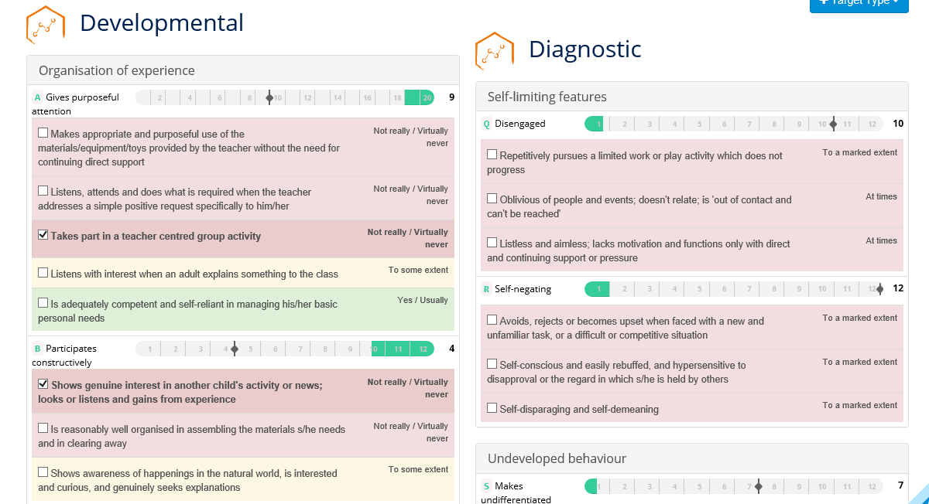
Helps to set targets

Slide 16
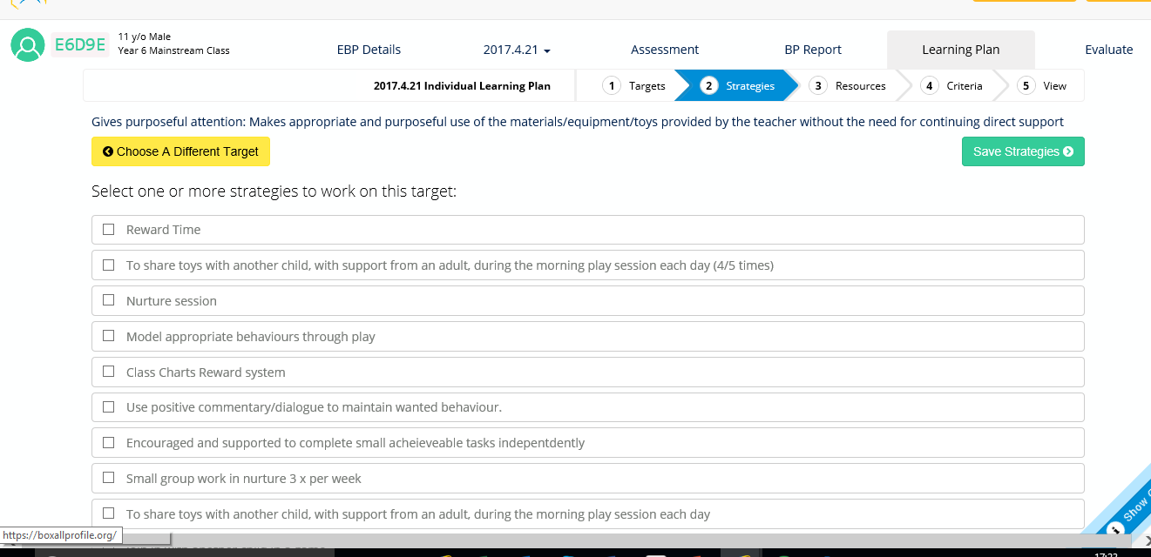
Select strategies or add your own

Slide 17
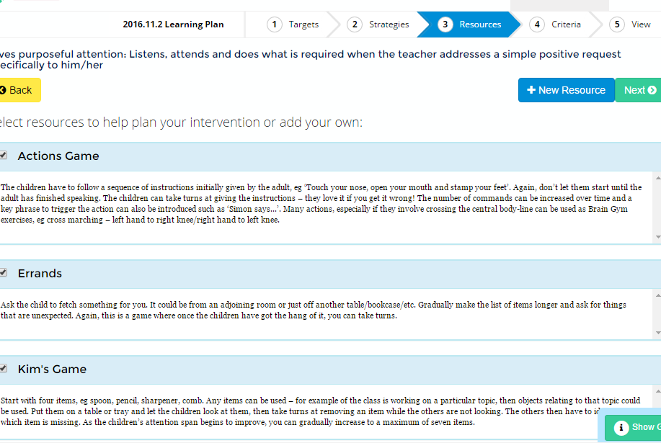
Provides resources

Slide 18
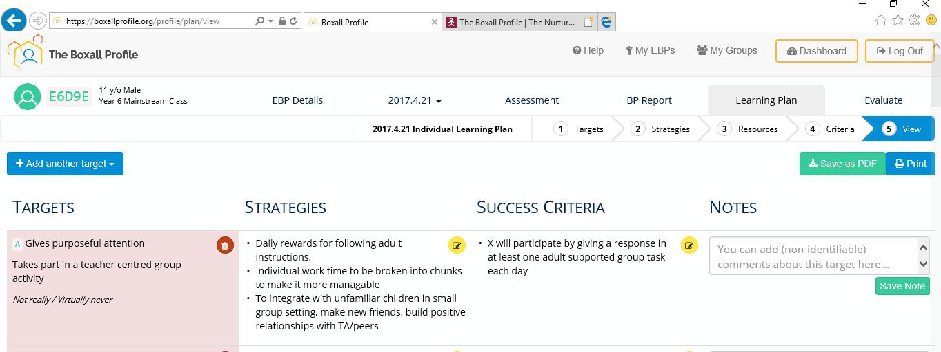
Plan

Slide 19
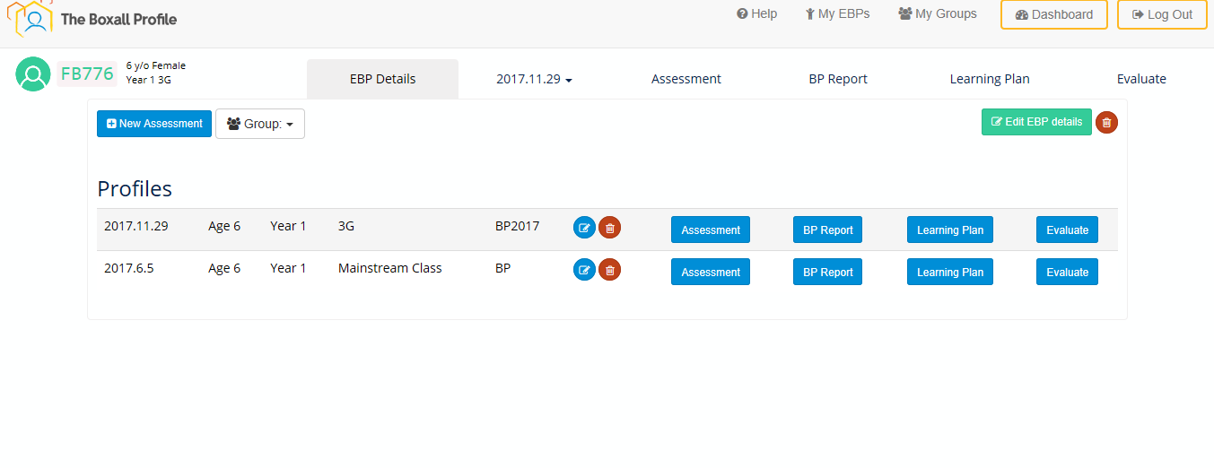
Re-evaluate and measure impact

Slide 20
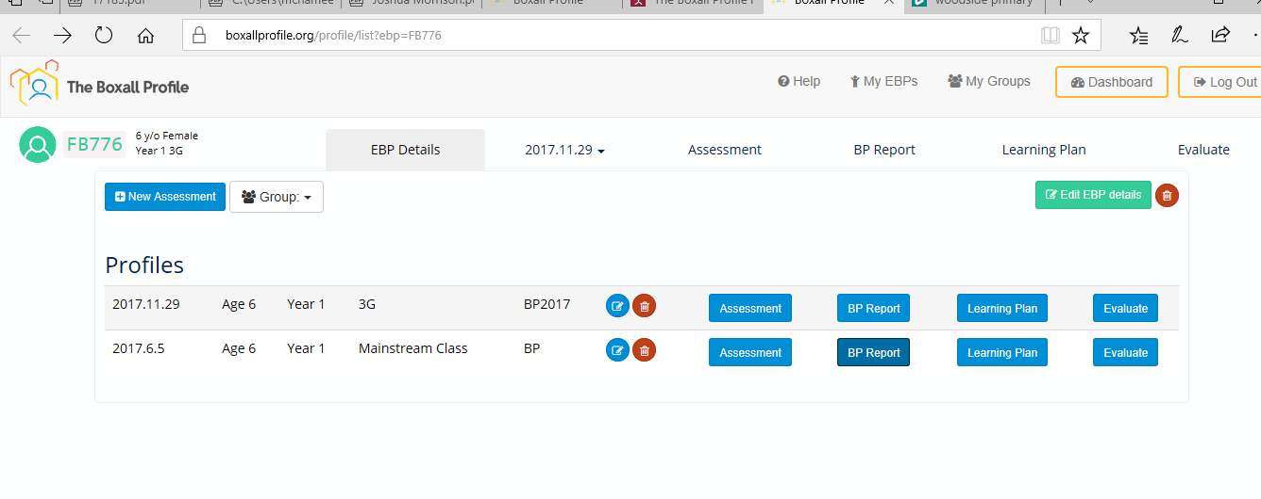
Grouping children

Slide 21

Boxall Profile Use
Interpret the results carefully
Be mindful of what you know about the CYP and use this to inform what you do and the strategies you use.
You may have strategies that are more appropriate or have been recommended that would meet that Boxall strand, feel free to use it.
Use it to help inform one page profiles

Slide 22


