Slide 1

Virtual School Network Meeting
Tuesday 1st July
16:00-16:30

Slide 2

Agenda
Virtual School Updates
Diary dates
EY Safeguarding
Safeguarding Children in Education
Questions/Feedback

Slide 3

Meet the Team
Headteacher - Joanne Dunning Joanne.Dunning@halton.gov.uk 0151 511 8642
Acting Deputy Headteacher - Peter McPartland Peter.McPartland@halton.gov.uk 0151 511 8872
Education Support Worker - Min Ling Lee-Tai MinLing.Lee@halton.gov.uk 0151 511 8341
Early Years Support Worker - Gemma Donaldson Gemma.Donaldson@halton.gov.uk 0151 511 5433
Primary PEP Lead – Sarah Rawnsley Sarah.Rawnsley@halton.gov.uk 0151 511 4066
Secondary PEP Lead – Alys James Alys.James@halton.gov.uk 0151 511 5499
KS4 & Post-16 Education & Employability Officer - Ian Wilson Ian.Wilson@halton.gov.uk 0151 511 5208
Previously Looked after Coordinator - David Bradshaw David.Bradshaw@halton.gov.uk 0151 511 5432
Safeguarding Children in Education Officer for Halton – James Jordan James.Jordan@halton.gov.uk 0151 511 7656

Slide 4

PEP’s
Early Years: N1-Reception Gemma Donaldson
Primary: Y1-Y7 Sarah Rawnsley
Secondary: Y8-Y11 Alys James
Post-16: Y12-Y13 Ian Wilson/David Bradshaw
UASC: Min Ling Lee-Tai/David Bradshaw
New into Care: Min Ling Lee-Tai
School/setting moves: All

Slide 5
Early Years/Primary Updates
PEP template changes
Early Education Funding – 30 hours for working Carers from September 2025/2YO funding
SENIF funding/EHCP applications – detail any support provided through PP+ on the forms to evidence what’s already in place
Good level of development data
Phonics data
SATs data
Secondary Updates
PEP template changes
Summer exam data collection

Slide 6
PLAC Updates…
Previously looked after funding element on EHCP application (SEND)
October census (2.10.25 - 29.10.25; consent required)
Adoption Support Fund (ASGSF) reduced (- 40%)
Changes to the Fund from April 2025 - Adoption UK Update -
The 'Fair Access Limit' has been reduced from £5,000 to £3,000 per child per year.
The £2,500 per child per year set aside for specialist assessments is no longer available. These assessments will now have to be funded through the £3,000 allocation per child per year.
The ASGSF will no longer match fund support for children with an exceptional level of need.
Update on Adoption and Special Guardianship Support Fund - Adoption England
Funding for therapeutic services for adopted children | Adoption England
Notes:
.

Slide 7
…PLAC Updates
PLAC Pupils School Admissions:
As a DT/School you need to firstly make sure you know which children qualify for PLAC status. Ask parents to declare this via a general newsletter etc.
PLAC Pupil Premium £2630 a year for academic year 2025-2026
Parental choice to self-declare their children’s status to schools
School should ask and be satisfied they qualify and have seen evidence (court order)
Schools/DTs should ensure PLAC children are recorded on October Census, as this determines PP funding
EPAC – like PEPs (see HVS website) identify need, make SMART target, action plan and determine how using PP (non-statutory)

Slide 8
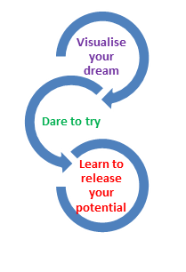
Post-16 FE Updates…
Autumn Term Open Evenings
Riverside College & Cronton 6th Form:
Tuesday 21st October 2025, 5pm – 7pm
Tuesday 18th November 2025, 5pm – 7pm
Carmel 6th Form College, St Helens:
Thu 6 Nov 2025 5:00PM - 7:30PM
Warrington & Vale Royal College, Warrington:
Wednesday, October 8th, from 5:00 PM to 8:00 PM
St Helens College – check website Home - St Helens College
City of Liverpool College – check website Open Days & Events - The City of Liverpool College

Slide 9
…Post-16 FE Updates
Closing dates for applications:
Cronton 6th Form - December 2025
Riverside College - January 2026
Riverside College School Admissions Team will be attending assemblies/parents’ evenings arranged via schools Careers contacts throughout the autumn term
Other Colleges – check websites

Slide 10

Diary Dates
Virtual School Conference: Wednesday 22nd October, DCBL Stadium
Training Calendar: To be shared in Autumn term

Slide 11
EYFS Safeguarding and Welfare Reforms
September 2025
Early Years Foundation Stage safeguarding reforms - consultation response
Jodie Wylie
Notes:
As we know, from the 1st September 2025, the DfE EYFS safeguarding and welfare reforms will come into force.
We’ll look briefly at the changes, but we’ll focus on the safeguarding training changes in more depth in the 2nd part of the briefing.
Whistle stop tour of the reforms – please ensure that you have read and understood the government’s response to the consultation (link on slide) – this sets out all of the changes and provides the new wording that will be in both versions of the EYFS.
*please add your name and setting in the chat box to give us an accurate register*

Slide 12
Safer recruitment
Paediatric First Aid
Children’s absences
Whistleblowing
Toileting and privacy
Safer eating practices
Notes:
These are the main headings that the reforms fall under (with as well as safeguarding training, which we will look at in the second part of the briefing).

Slide 13
Safeguarding Training
Annex C
Annex C will outline what safeguarding training must cover
    For all staff
    For DSLs
Early Years Foundation Stage safeguarding reforms – consultation
Pages 22 and 23 outline Annex C

Slide 14
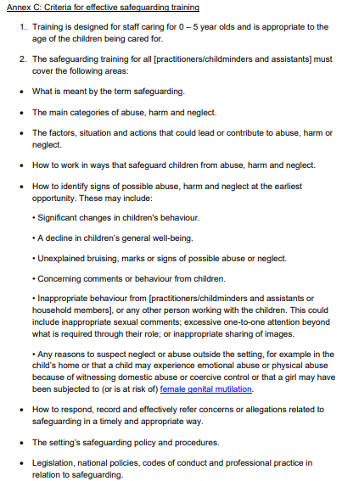
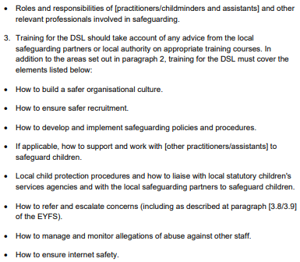

Slide 15
Safeguarding Policy
Safeguarding policies MUST include:
Detail of how safeguarding training is delivered and how practitioners are supported to put this into practice
Notes:
You will still need to personalise this policy.

Slide 16
Safeguarding Children in Education
James Jordan
response

Slide 17

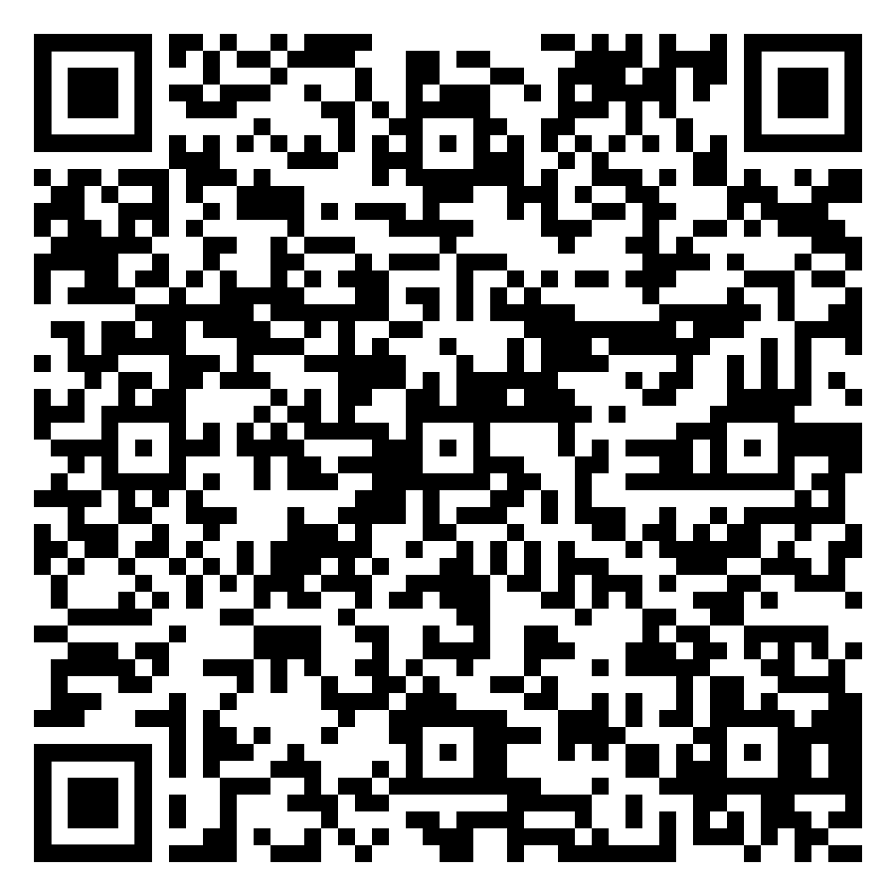
Questions/Feedback

