Slide 1



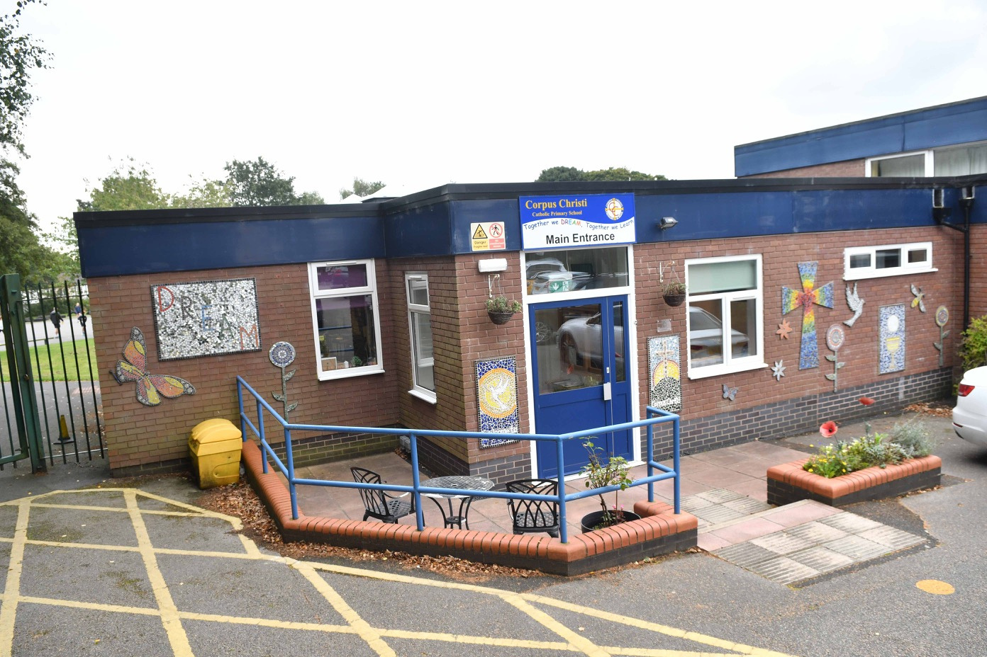

Corpus Christi
Catholic Primary
School and Nursery
Pupils, including children in the early years, benefit from a high-quality education at this
small, family-orientated school.
Ofsted, April 2023

Slide 2



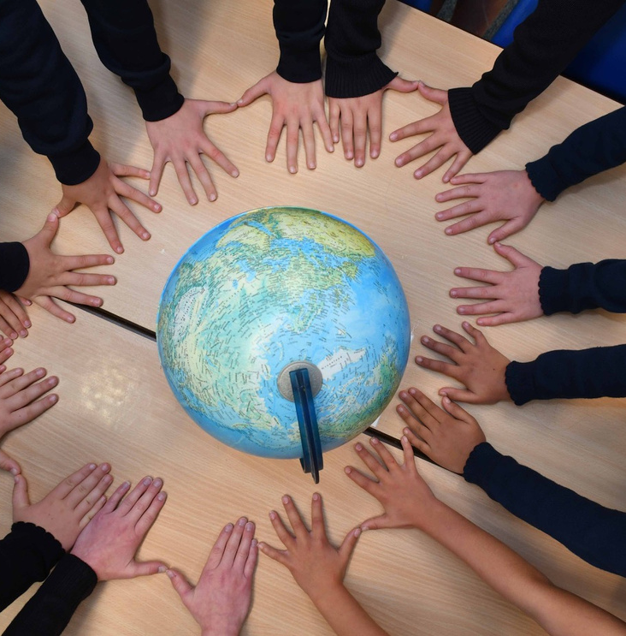
Headteacher Welcome
We are a small, successful and happy school in the semi-rural village of Rainford, St Helens. Our high expectations and high standards, combined with a sense of creativity and an enthusiasm for discovery create a drive to DREAM, Believe, Achieve for all.
Our school family is made up of hardworking, supportive and caring children, staff, governors, PSFA, parents and parish members, who all provide an engaging, friendly and warm place to be, with the Gospel Values of Jesus Christ at the centre of all we do. We are a place where everyone is accepted for who they are and all children are encouraged to be the best versions of themselves.
At Corpus Christi we ensure your child will be encouraged, motivated and guided so that they develop their natural gifts and talents, whilst becoming confident, ambitious and independent learners, who know how to make well informed decisions about the choices they make in life.
Miss Alexandra Mowatt - Acting Headteacher

Slide 3

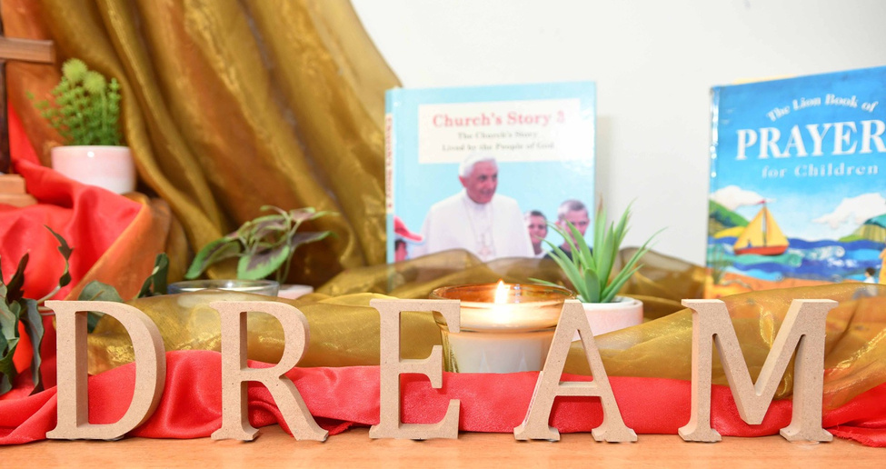
Our School Aims
Corpus Christi aims to ‘Make a Difference’, inspired by the life, and teaching of Jesus Christ.
The school recognises each child’s uniqueness by providing a broad, varied and balanced curriculum which fosters individually their spiritual, social, physical and intellectual development.
We encourage everyone to do their best.
The school values all members of the school community including staff, children, parents,
governors, parishioners and visitors.

Slide 4

School Vision
All members of our school community have high expectations of themselves and each other. Inclusion is a priority and Catholic values are promoted within all aspects of school life. There are supportive and positive relationships between staff, parents and children.
Lifelong learning is encouraged and valued. All members of our school community display respect, sensitivity and empathy towards others. All are encouraged to have high aspirations and are able to reach their potential in all aspects of school life.
The work of our school is achieved through trust, cooperative teamwork and positive attitudes.
Technological advances are embraced as an opportunity to develop learning. Time for reflection is built into the development processes of our school.

Slide 5

Key details
Address
Contact Information
Corpus Christi Catholic Primary School
Old Lane
Rainford
St Helens
Merseyside
WA11 8JF
Telephone: 01744 678102
Email: corpuschristi@sthelens.org.uk
Website: corpuschristirainford.co.uk
Acting Headteacher: Alexandra Mowatt BA (Hons)

Slide 6
School Governing Body
Chairperson: Mr Tony Ford
Vice Chair: Melanie Lee
Associate Governor : Father Paul Harris
Foundation: Jane Monk, Denise Gibney, Sarah O’Brien, Jason Pickett, Katherine Grange
Elected Parent Governor: Emma Hartley
LEA Representative: Robert Reynolds
Elected Staff Governor: Katie Bailey
Acting Headteacher: Alexandra Mowatt
Clerk to the Governors: Local Authority Clerk

Slide 7
Teaching Staff
Miss A Mowatt Acting Headteacher
Mrs K Bailey Acting Deputy Headteacher
Main Class Teacher
Learning Support Assistants
Mrs K Bailey Early Years Teacher
Miss M Fawcett Year 1 Teacher
Mrs M Goulbourne Year 2 Teacher
Mrs S Athey Year 3 Teacher
Mr S Chapman Year 4 Teacher
Miss E Johnson Year 5 Teacher
Mrs S Vogel Year 6 Teacher
Mrs N Sharples Year 6 Teacher
Mrs C Moran Learning Assistant Foundation
Mrs S Rimmer Learning Assistant Foundation
Ms C Dean Learning Assistant Foundation
Miss L Moran Learning Assistant Foundation
Mrs S Johnson Learning Assistant Year 1
Mrs C Johnson Learning Assistant Years 3-6
Mrs G Dodson Learning Assistant Years 2/6
Mrs D Perkins Learning Assistant Year 5
Ms B Nacey Learning Assistant Year 2
Mrs B Doyle Learning Assistant Years 2/6
Midday Supervisors
Ms C Dean Midday Supervisor
Mrs G Dodson Midday Supervisor
Mrs S Johnson Midday Supervisor
Mrs C Johnson Midday Supervisor
Mrs D Perkins Midday Supervisor
Mrs H Jones Midday Supervisor
Miss L Moran Midday Supervisor
Office Staff
Breakfast/After
School Club
Mrs S Haley Office Manager
Mrs H Jones Clerical Officer
Mrs D Perkins
Ms C Dean
Mrs G Dodson
Mrs C Moran
Miss L Moran
SENDCo
Mrs K Bailey

Slide 8
Classification of the School
Corpus Christi is a Roman Catholic Aided Primary School in the Archdiocese of Liverpool admitting boys and girls in the 3+ to 11+ age range. The main catchment area is the Parish of Corpus Christi, Rainford.
The Governors of the school have agreed on the following priorities for admission to the school in the Academic Year 2024-2025
In the event of over-subscription in any one criterion, then preference will be given to children on the basis of distance from school, measured by the LA in a straight line using a Geographical Information System (GIS) based on Local Land and Property Gazetteer (LLPG) data and the National Grid co-ordinates for the family home and the school.
Children with a Statement of Special Educational Needs or Education Health Care Plan that names a school will be offered place without using the admission criteria and will count as part of the school’s published admission number.
  Looked After Children and previously Looked After Children.
  Baptised Catholic children who have a sibling in the school at the time of admission.
  Baptised Catholic children resident in the parish of Corpus Christi.
  Other baptised Catholic children.
  Other children who have a sibling in the school at the time of admission.
  Children from other Christian denominations. Proof of Baptism in the form of a Baptismal Certificate or confirmation in writing that the applicant is a member of their Faith community from an appropriate Minister of Religion is required.
  Children of other faiths. An appropriate Faith Leader would need to confirm in writing that the applicant is a member of their faith group.
  Other children.

Slide 9

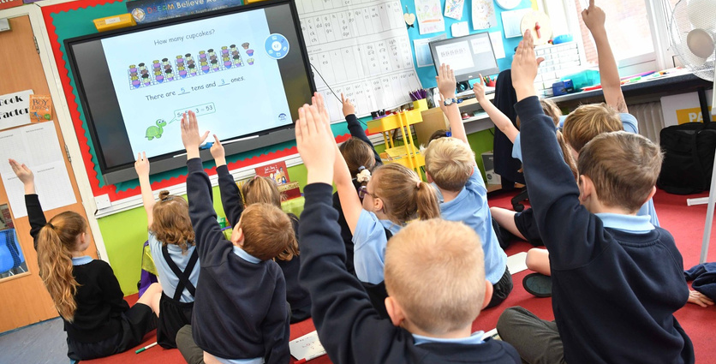
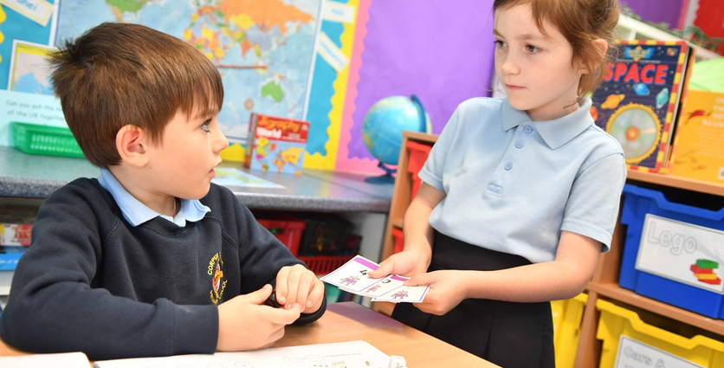
School Hours
Infants 9:00 - 12:00
1:30 - 3:30
Juniors 9:00 - 12:15
1:30—3:30
Break Times:
Infants 10:30 —10:45
Juniors 10:30 —10:45
Hours of Teaching
During a normal school week, but excluding registration, breaks and
collective acts of worship, a pupil at KS1 will receive 21.5 hours of school, and at KS2 23.5 hours.
Please try to ensure that your child is at school on time, as late arrival at school can be upsetting, especially for infant children.
Children should not be brought to school too early. If you wish, you can take advantage of the Breakfast Club which is open from 7:30am to 8:50am. Each session costs £5.00. Our After School Club starts at £5 for the first hour and is £9.25 up until 6pm.
For safety reasons, if children arrive before 8:45 am, they must report to Breakfast Club, in the school hall.
Supervision is undertaken for pupils on the school premises and playground at 8:50 am. Infants and Juniors should be in class ready to commence lessons by 9:00 am.
During the morning break, children in the Foundation Stage and Key Stage 1 have access to fruit and milk. Children in Key Stage 2 may bring their own healthy snack. A water bottle should be brought to school by all children so they can keep hydrated during the day.
Mobile phones/ camera phones and similar devices are not permitted beyond the school entrance area. All devices should be switched off and stored in a safe place.

Slide 10

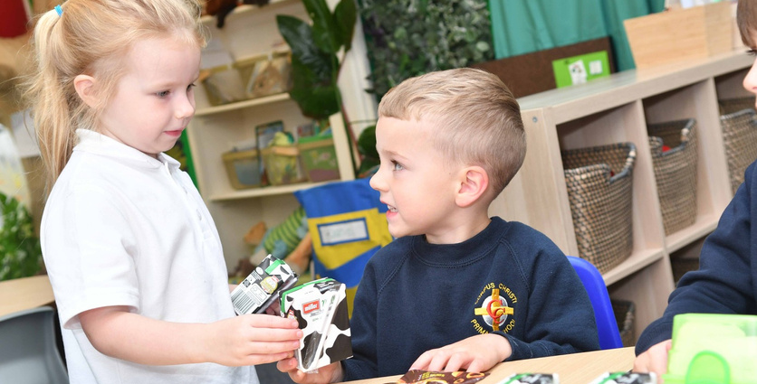
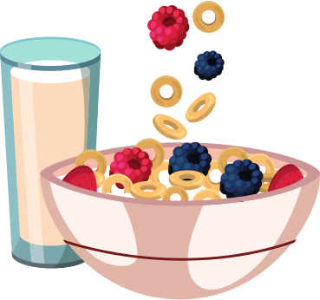
Nursery Hours
Morning session: 9:00am - 12:00 noon
Lunchtime session: 12:00 noon —1:00pm
Afternoon Wrap Around Care : 12:00pm —3:00/3.30pm
Breakfast Club: 7:30am - 8:50am
After School Club: 3:30pm - 6:00pm
Lunchtime: 12:00 noon -1:00pm
Afternoon: 12:00 noon -3:00pm
Nursery hours can be fixed to suit individual circumstances .
  Children should be brought to the Foundation Unit door where they will be met by a member of staff. Children should be collected from the Foundation unit door at 3:30pm.
  If you are collecting your child outside of typical school hours, please collect from the school office.
  If you are late picking up your child, they will go into After School Club and can be collected from the main entrance (Caspers rates apply)
  Children accessing After School Club can be picked up at the main entrance up to 6pm.
  Please put your child’s name on all clothing including shoes and wellingtons.
  If your child is unable to come to Nursery, please contact the office 01744 678102 or use School Spider on the first morning of absence.
.
Parents are able to make use of our Wrap-Around Care, Breakfast and After School Clubs. Bookings must be made in advance of the session. Prices are available from the school office.

Slide 11
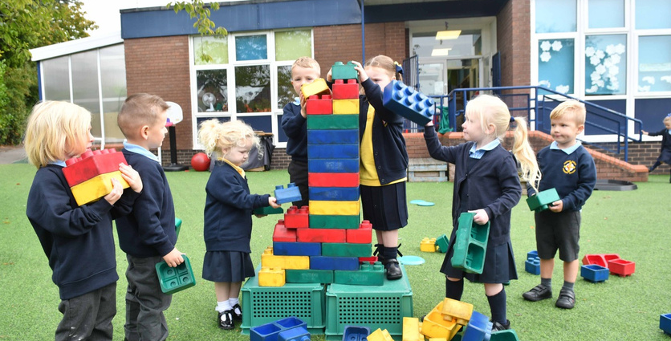
Application for Nursery/School
30 HOURS FREE CHILDCARE
Charges
Morning Session - £12
Full day - £26
We are able to offer a number of 30 hour funded nursery places. To check your eligibility please visit www.childcarechoices.gov.uk
Parents are welcome to visit the school prior to their child’s registration.
Parents will be supplied with an application form. A starter pack will be given to parents at a meeting/visit before the child starts school. Staff are happy to come and do a home visit, if you would like one.
Children attend nursery for a half or full day session, in the year prior to their entry into Reception Class. We are able to accept children into nursery the term after their third birthday.
CASPERS offers additional wrap-around care for children in nursery (who are not accessing the free 30 hours) from 12.00-13.00 and from 12:00 –15:00. If you would like your child to stay until 3.30pm an additional charge will apply. Prices are available from the school office.
The Nursery and Reception Class work closely together to deliver the Foundation Stage curriculum.

Slide 12



Parents
Parents are most welcome at Corpus Christi. If you would like to visit the school or discuss matters with the Headteacher, then a telephone appointment can be arranged (01744 678102). Any urgent matters will be dealt with as soon as possible. Documents relating to individual children are available on request, to the registered parent or guardian of the child concerned.
Parent Communications
Open Door Policy
Parents Evening
  School messaging service – School Spider
  Weekly newsletter
  parents' evenings
  Collective Worship
  School website
Corpus Christi is a family and welcome meetings with parents to build relationships and work together for the benefit of the child.
There are three opportunities to meet with the class throughout the academic year.
  Autumn term
  Spring term
  Summer term

Slide 13


Medical
Illnesses or Accidents
Medicines and Tablets
If your child is ill or had an accident at school, staff will contact, parents directly.
Arrangements can be made for your child to be collected by the parent or responsible adult. In the event of parents being unavailable, reference will be made to the child’s personal record, which should state the name and address of an adult to contact in the case of an emergency.
It is therefore most important that these records are kept up to date.
All medicines should be handed in to the Office Manager by the parent/carer. Parents will be expected to complete an Administer Medicine Form. Medicines must come in the original packaging and be prescribed by the doctor.
Asthmatics are responsible for their own inhalers which should be available at all times.
Children are not allowed to self administer medicine.

Slide 14
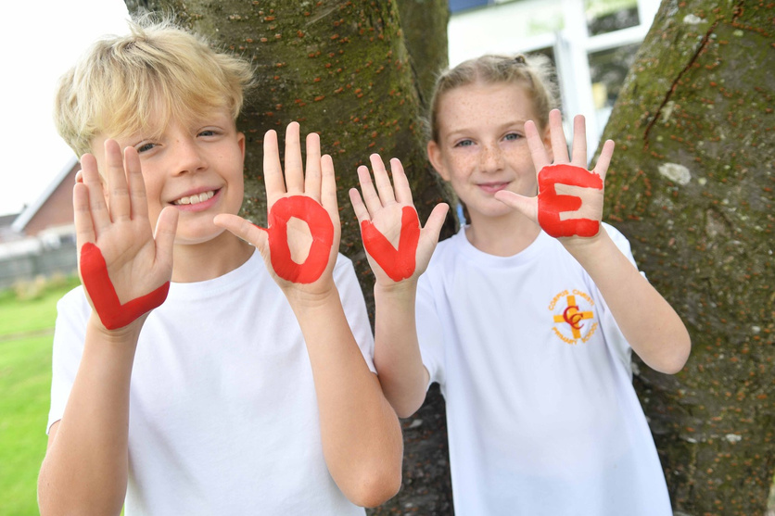
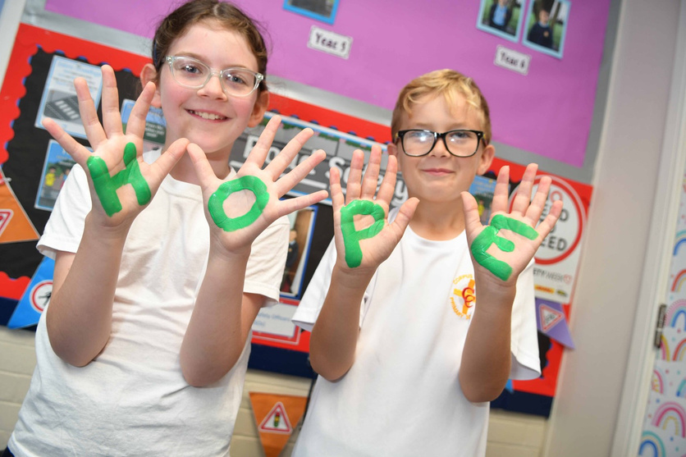
Breakfast and Afterschool Club
The school offers a Breakfast and After School Club facility to all children.
Breakfast Club opens at 7:30am and runs until the beginning of the school day. Children are taken to their classrooms by a member of staff from the club.
Afterschool club runs from 3:30pm-6:00pm
Charges
Breakfast Club - £5.00 per session
Afterschool Club - 3:30-4:30pm - £5.00
3:30-5:30pm - £7.40
3:30-6:00pm - £9.25
Siblings qualify for a reduced rate
Clubs can be booked and paid for through School Money.
Access to this service is given by the office staff who will be happy to help you set it up.

Slide 15
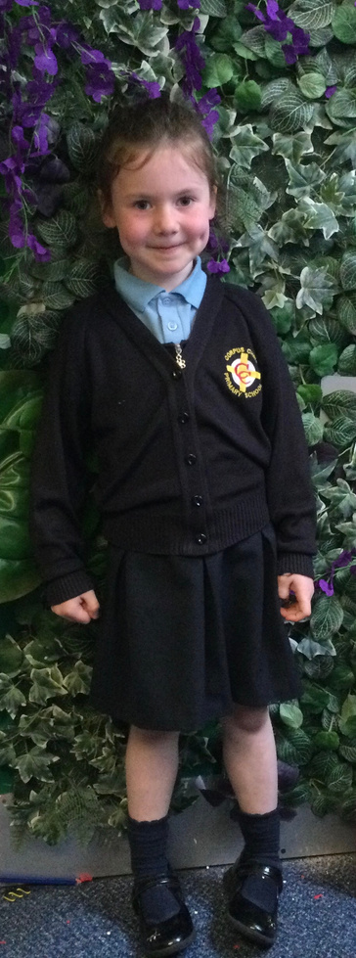
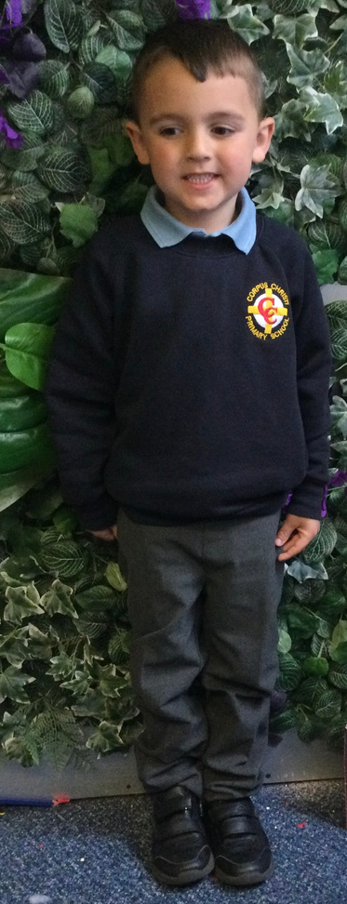
Uniform
Schools are often judged by the appearance and conduct of its pupils. We encourage the use of our school uniform and through this medium we hope to foster in each pupil, pride in personal appearance, neatness and good taste. We, therefore, reserve the right to prohibit unsuitable fashions or styles in dress, personal appearance and footwear. The uniform is as follows:
Winter Uniform
Girls Navy blue cardigan with the school crest, navy skirt, trousers or pinafore dress. Sky blue polo shirt with the school crest, white or navy socks/tights, black shoes.
Boys Navy blue jumper with school crest, grey trousers, sky blue polo shirt with the school crest, grey socks, black shoes.
Jewellery and Make up
The wearing of make-up, nail varnish and body art is strictly forbidden. For safety reasons the wearing of jewellery, including necklaces, bracelets, earrings and hair braids is considered dangerous. For this reason no jewellery at all should be worn in school. Parents are asked to ensure that the timing of ear piercing coincides with the summer holidays to enable safe removal for the start of the autumn term.

Slide 16
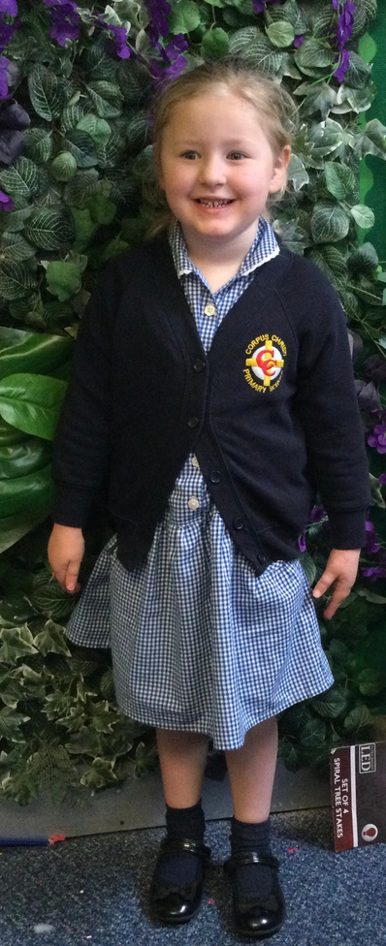
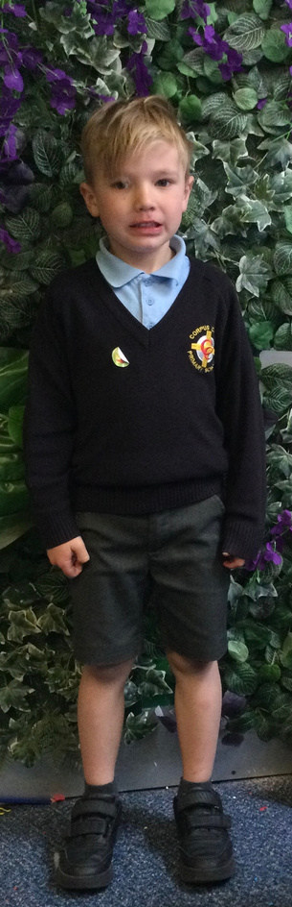
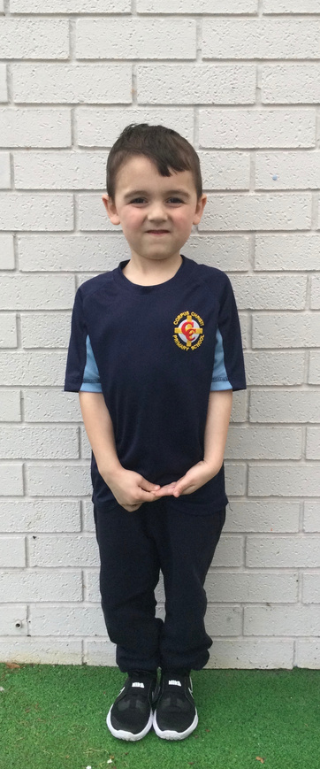
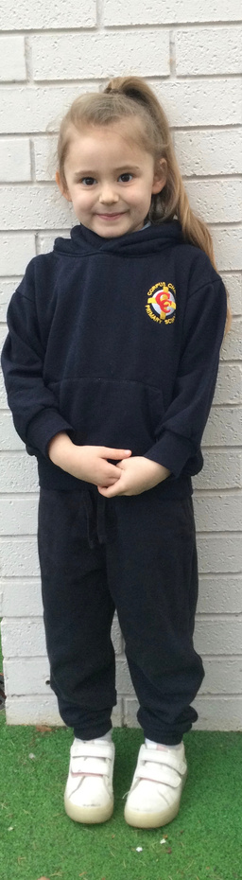
Uniform
A school coat should be available everyday (even during the summer months).
Please ensure that your child has their name on all items of school clothing and personal items.
Summer Uniform
Girls: Blue and white check dress, navy blue cardigan with the school crest, white socks, black shoes.
Boys: Sky blue polo shirt, navy blue jumper with the school crest, grey trousers (long or short), grey socks, black shoes.
PE Kit
The school has its own PE uniform:
Indoors Plain navy blue shorts, blue school PE T shirt and black elasticated pumps.
Outdoors Plain navy blue jogging bottoms, plain white T shirt, plain navy blue sweatshirt and trainers.

Slide 17
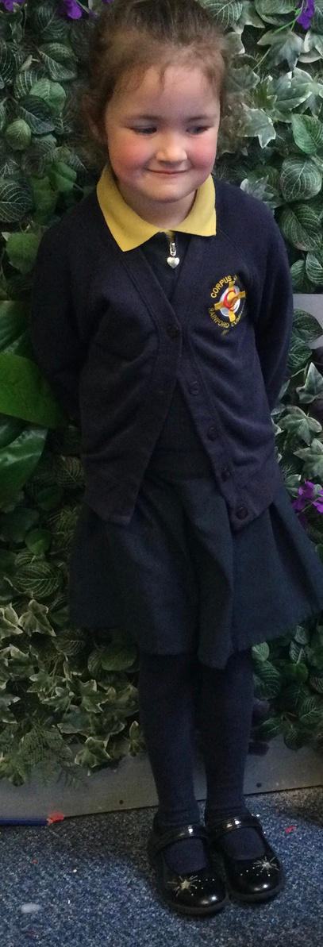
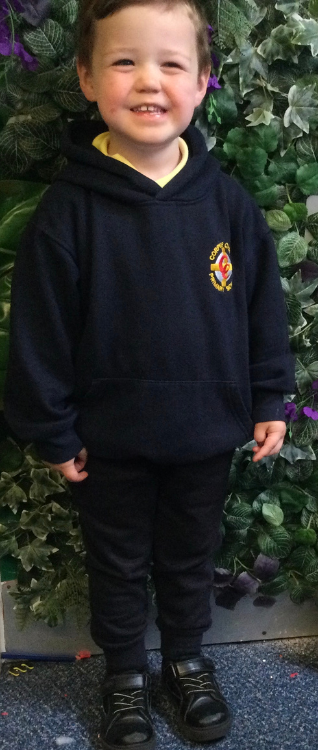
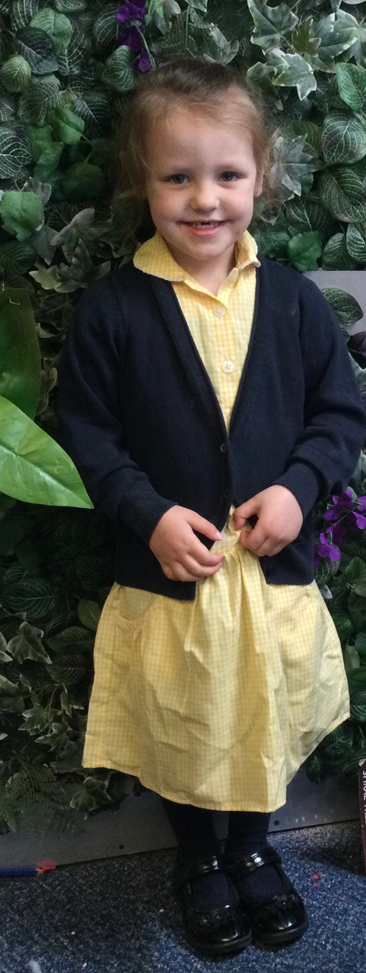
Nursery Uniform
The Nursery uniform is a canary yellow polo shirt and a navy blue sweatshirt and jogging bottoms featuring the Corpus Christi school logo.
In the Summer months grey shorts can be worn with the yellow polo shirt and navy blue jumper or a yellow gingham dress with a navy blue cardigan.
(We recommend that children wear the pre-school uniform as we find it more practical and robust for the daily activities the children encounter. It is also easily recognisable when we go out as a group on trips and visits)
Shoes should be sturdy with good grip soles, flimsy, slip-on shoes are not practical or safe in the pre-school environment. All shoes should have elastic or Velcro fasteners to aid independence. No sandals.
A school coat should be available everyday (even during the summer months).
Please ensure that your child has his/her name on all items of school clothing and personal items.

Slide 18



Early Years Foundation Stage
The Foundation Stage is one phase in education, including Nursery and Reception classes. Young children develop rapidly between birth and six years and much of what is learnt remains for life.
The children are entitled to a curriculum that:
  Responds to individual needs
  Acknowledges their enthusiasm and need to be active learners
  Building on previous experiences
  Support and develops their thinking and learning
We aim to maintain close links with parents/family, during this phase and encourage parents to discuss their child’s individual needs with the teacher

Slide 19
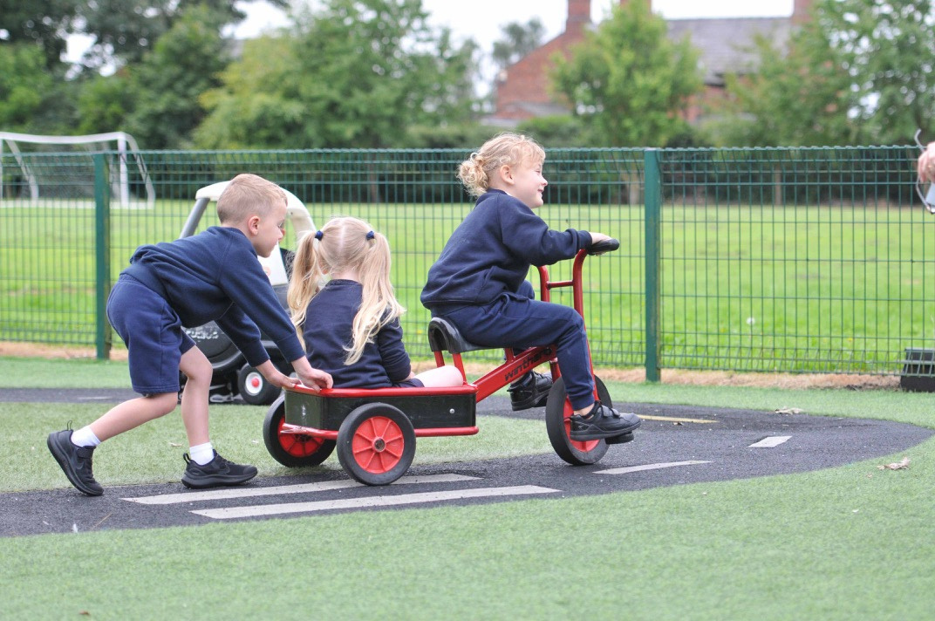

Foundation Stage Curriculum
The new Foundation Curriculum was introduced in 2012 there are seven areas, which are called Prime and Specific.
The Prime Areas are;
  Communication & Language
  Physical
  Personal, Social & Emotional
The Specific Areas are;
  Literacy
  Mathematics
  Understanding the World
  Expressive arts & Design

Slide 20


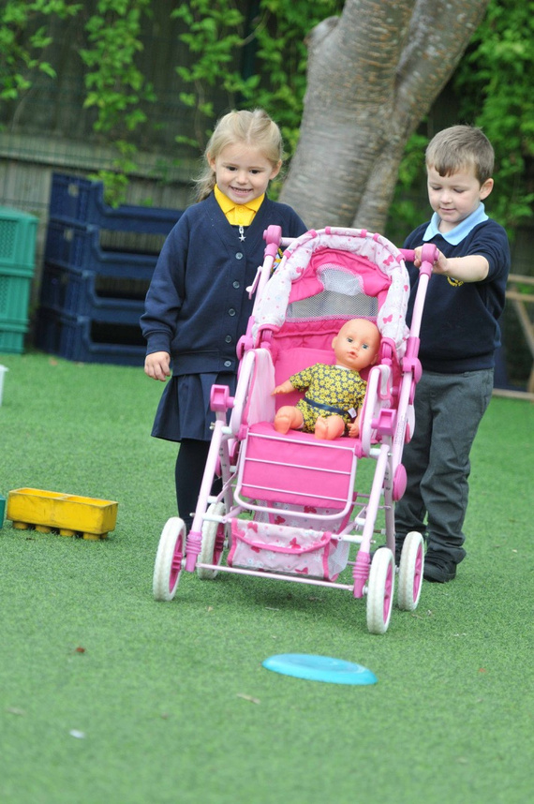

Foundation Stage Curriculum
Communication and Language development gives children opportunities to experience a rich language environment; to develop their confidence and skills in expressing themselves; and to speak and listen in a range of situations.
Physical Development provides opportunities for young children to be active and interactive to develop their co-ordination, control, and movement. Children will be helped to understand the importance of physical activity, and to make healthy choices in relation to food.
Personal, Social & Emotional Development helps children to develop a positive sense of themselves, and others; to form positive relationships and to develop respect for others; to develop social skills and learn how to manage their feelings; to understand appropriate behaviour in groups; and to have confidence in their own abilities

Slide 21




Foundation Stage Curriculum
Literacy provides opportunities for the children to link sounds and
letters and to begin to read and write. Children will be given access to a wide range of reading materials (books, poems, and other written
materials) to ignite their interest.
Mathematics provides children with opportunities to develop and improve their skills in counting, understanding and using numbers, calculating simple addition and subtraction problems; and to describe shapes, spaces, and measures.
Expressive Arts and Design enables children to explore and play with a wide range of media and materials, as well as providing opportunities and encouragement for sharing their thoughts, ideas and feelings through a variety of activities, art, music, movement, dance, role play, design and technology.
Understanding the World helps children to make sense of their physical world and their community through opportunities to explore, observe and find out about people, places, technology and the environment.

Slide 22

Foundation Stage Curriculum
Parents are children’s first educators. Here are some of the ways that you can continue to help your child prepare for school:-
  Encourage your child to be independent for example: going to the toilet, washing and drying hands, putting on jumpers, coats and shoes.
  Encourage your child to count things at home—the number of stairs on the way to bed, how many chairs needed at the table, pairing of socks, reading car registration plates etc.
  Look at books together.
  Talk about favourite stories.
  Let your child see you reading and writing.
  Make lists together, write their own name on birthday cards.
  Letter sounds (play I spy with my little eye).
  Draw pictures together .
  Look out for words and numbers in the environment.
Remember, your child is learning every day just by noticing the things you do and by copying.

Slide 23
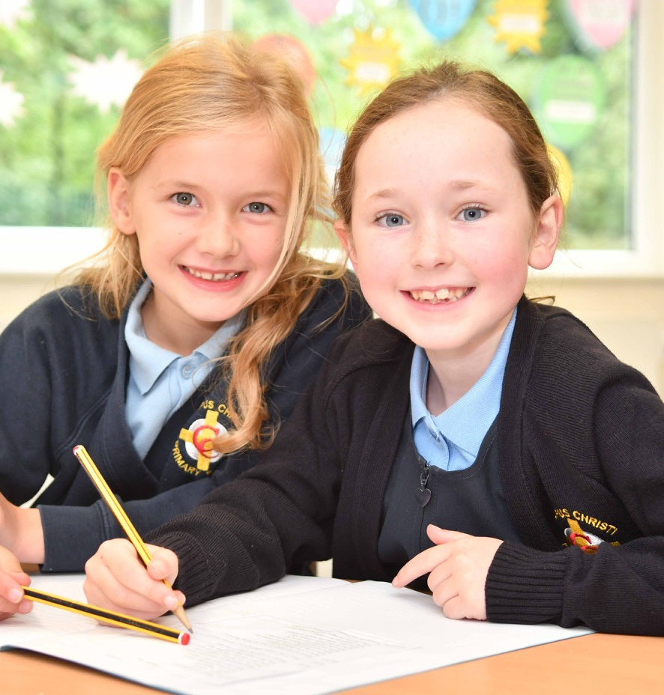
National Curriculum
There are two Key Stages in primary schools, Key Stage One (age 5-7) and Key Stage Two (age 7-11).
The National curriculum requires that all pupils in primary schools study three core subjects:
  English
  Maths
  Science.
  In Catholic schools, Religious Education is also a core subject and is taught following the Liverpool Archdiocese reccomendations.
  RSE is taught through Journey and Love from Nursery to Year 6.
There are nine other subjects to be studied. These are known as the Foundation Subjects:
  Art & Design
  Citizenship
  CoHistory
  Geography
  Music
  History
  Geography
  Music
  Physical Education.

Slide 24



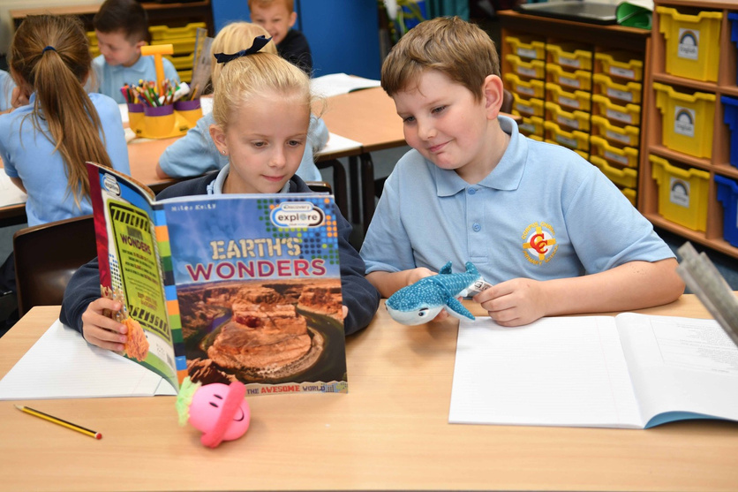



National Curriculum Aims
  Deliver a broad, well-rounded curriculum that meets the needs of all learners, showing progress at an age and stage appropriate standard.
  Build within our children a mixture of skills and knowledge, to develop the whole child in all areas of the curriculum.
  Prepare children for all areas of life, both whilst in education and beyond.
  Experience awe and wonder in all areas of the curriculum, encouraging questions, independent thinking and an inquisitive approach to life.
At Corpus Christi, our mission statement and the teaching of Jesus is at the centre of all we do.
We intend to show this through our curriculum development:
Give opportunities to DISCOVER new facts, skills, talents and experiences, creating well rounded independent learners, well prepared for their journey through life.
Teach children to RESPECT each other, those who are different and the world around them by exposing them to different ideas, cultures and aspects of society, ensuring they recognise that their choices can impact many things.
Provide experiences to ENTHUSE and excite across all subjects, giving the children a chance to explore their interests and build their love of learning and life across all curriculum areas.
Encourage high ASPIRATIONS in both school and beyond, providing a strong foundation for our children to grow from and develop into useful and enhancing members of society and communities.
Show ways our children can MAKE A DIFFERENCE to themselves, each other and outside, in big and small ways.

Slide 25


Religious Education
Corpus Christi is a Catholic School, and the religious education it provides is in conformity with the doctrines of the Catholic Church.
Religious education is provided within the timetable according to the ‘Religious Educations Directory’ and syllabus, ‘To know you more clearly. The aim of the school is to interpret human knowledge to its pupils in the light of the Gospel with the school community contributing to the spiritual and moral formation of the pupils as well as to their intellectual and physical development. As a result, the withdrawal of pupils from religious instruction and worship would not isolate them from the Catholic teaching which the school gives, and no specific arrangements for withdrawal are in operation at present.
Relationships and Sex Education At Corpus Christi, we believe that parents are the prime educators of their children and we, as school, church and family work together to support you in educating your child. Our role is support you, not replace you. Our key objective in all things, including RSE, is the well-being of the child.
RSE is the life long learning about physical, moral and emotional development. It covers all aspects of learning about relationships with people, including family and friends,, and the importance of marriage for family life, stable and loving relationships, respect a, love and care. It is also about the teaching of sex, sexuality and sexual health.
RSE forms a part of PSHE, RE and Science curriculum. RSE plays a part in these subjects and they overlap to ensure the emotion, spiritual and biological aspects are taught together.
Journey in Love We use the Journey in Love scheme to support the teaching of RSE. It has been approved by the Bishops of England and Wales and approved and recommended by the Christian Education Department of Liverpool Archdiocese.
It teaches these main areas:
  Our journey begins at the moment of our conception.
  God is at the heart of love.
Puberty can be extremely confusing time for children, our message will be that even in this confusion, God is there.
The sacrament of marriage publicly declares the commitment of each spouse to the other permanently and that it is Gods-given gift.

Slide 26


English
The development of language is of utmost importance as without language, any development in other areas is limited. Therefore, much emphasis is placed on teaching the following:
  Speaking & listening skills-through discussion across the curriculum, role play, drama, reading aloud, sharing texts and presentations and productions.
  Reading skills-through phonics, individual, group and class work, using a variety of materials, including , class readers, poetry and prose and information texts. A variety of I.T. programs are used to enrich the curriculum.
  Understanding of books-through shared text work teaching: knowledge about books, grammar, sentence construction, comprehension, inference and referencing skills. Read Write Inc is used throughout school and this is a starting point for all children.
  Writing skills –through modelling, guided writing and talk for writing, focus on tasks which have a real purpose. Composition of stories, poems, lists and instructions are some examples and many more opportunities arise through Curriculum 2014. accounts etc. and grammar and spelling exercises.
  · Handwriting skills-through learning, practising and perfecting (a) print script (b) cursive script.

Slide 27


Maths
Corpus Christi follow the National Curriculum and use White Rose Maths to meet all expectations.
Emphasis is given to practical experiences, particularly across Key Stage 1, thus enabling the development of mathematical knowledge. The children are taught to record their work in various formats.
The children are taught the four rules of number, shape, time, money and measurement with emphasis on using correct mathematical language and applying these skills to real life situations in individual, group and whole class situations.
Throughout Key Stage 2 much of the work allows levels of differentiation and we are keen to focus on higher order skills as the children approach year 6.
Before leaving our school we would expect the vast majority of children to have a wide mathematical vocabulary and should have knowledge of money, fractions, decimals, percentages, handling data and geometry. Children are given a range of opportunities to work with mathematical apparatus and investigations requiring logic, reasoning and communication.
All Mathematical work is linked to the Programme of Study and Key Learning Objectives of Curriculum 2014.

Slide 28




Science
Science begins in the Early Years with the children developing their ability to observe, investigate and experiment. They are encouraged to ask questions and discover answers through practical activities. Topics include the environment, plant and animal life, themselves, types and uses of materials, electricity, forces, light and sound. The children are taught to record their findings in various ways including verbal accounts. All the children’s work is related to Curriculum 2014 Programmes of Study for Science.
The emphasis in our teaching of Science is on first-hand experience and we encourage the children to increasingly take control of their own learning. There are four types of practical Science:
  Observation
  Skill development
  Illustrative Science or experiments where the teacher decides what the children are to do
  Investigative Science where the children are given the practice in devising and exploring questions of their own within a given criteria.
The children are encouraged to predict and hypothesise and to gain knowledge and understanding through observation, exploration and investigation. Importance is placed on the children recording their work scientifically, using a wide variety of methods including diagrams, graphs and tables.

Slide 29
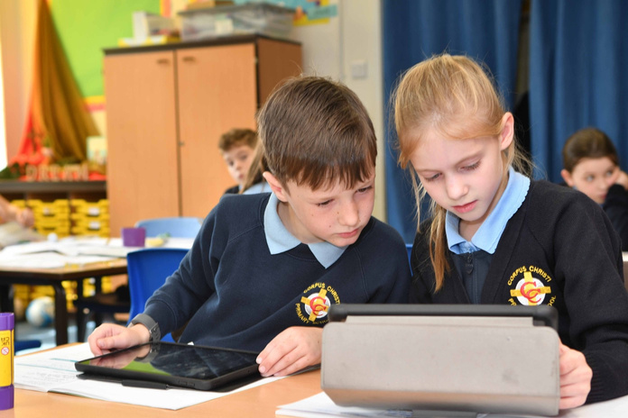

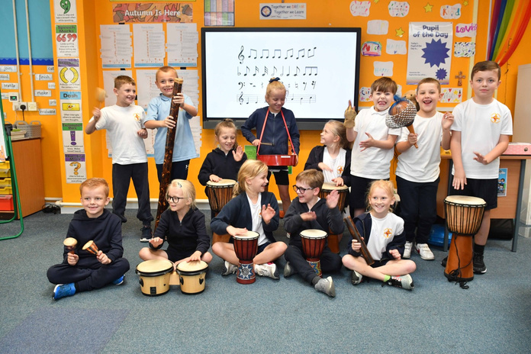
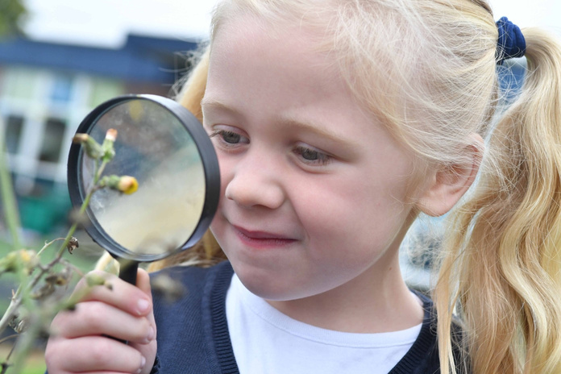
National Curriculum
Foundation Subjects
Throughout Key Stage 1 and 2 we employ a blocked-curricular approach to our Foundation Subjects. History, Geography, Art, Design Technology, Music, computing and Languages are taught using one key theme throughout a half term.
Children are encouraged to be creative problem solvers by designing, making and evaluating technology projects linked to a time of historical importance or a geographical feature.
Drawing, sketching, painting and use of colour are explored so that pupils can express themselves in a variety of dimensions from a range of themes,
cultures and inspirations.
Children are encouraged to ask questions. Our carefully chosen topics are
designed to boost independent thinking skills, creative and practical abilities and self-evaluation skills to develop the children’s enquiring minds.

Slide 30


National Curriculum Foundation Subjects
Computing The knowledge, skills and understanding in the programmes of study
from the teaching of computing identify the three aspects:
  Programming
  Networking
  Safety
Computing provides opportunities for pupils to develop the key skills of communication, application of number, working with others, improving own learning and performance, and problem solving through modelling real situations and developing solutions. ICT prepares pupils to participate in a rapidly changing world in which work and other activities are increasingly transformed by access to varied and developing technology. Children are encouraged to remember the rules of staying safe and being sensible when using online resources.
Corpus Christi has a fully equipped computer suite, bank of laptops and iPads to facilitate the computing curriculum.
Physical Education - The school offers a broad and balanced programme in order to:
  develop competence to excel in a broad range of physical activities
  Provide children with enjoyable experiences that will encourage a lifelong interest in sport
  Provide challenging activities that can be of a competitive or co-operative nature
  Instill in the pupils a sense of fair play and respect for others
  Promote positive attitudes to health and fitness
At Key Stage 1, the children will master basic movements including running, jumping, throwing and catching as well as developing balance, agility and co-ordination, and begin to apply these in a range of activities, By participating in team games using simple tactics for attacking and defending, and perform dances using simple movement and pattern.
At Key Stage 2, the pupils will be taught to use running, jumping, throwing and catching in isolation and in combination, play competitive games, modified where appropriate and apply basic principles suitable for attacking and defending, develop flexibility, strength, technique, control and balance, perform dances using a range of movement patterns and take part in outdoor and adventurous activity challenges both individually and within a team.

Slide 31


National Curriculum Foundation Subjects
Music At Corpus Christi, our main aim is to encourage understanding, enjoyment and sensitivity for music. We offer a wide range of opportunities for the children to:
  Know and understand how sounds are made and then organised into musical structures
  Know how music is made through a variety of instruments
  Know how music is composed and written down
  Know how music is influenced by the time, place and purpose for which it was written
  Develop the interrelated skills of performing, composing and appreciating music
  Music to influence emotions and to develop personal preferences.
Languages The main aim of teaching languages is to develop children’s linguistic
competence. We offer opportunities for children to:
  Become increasingly familiar with written and spoken forms of Spanish
  Understand and communicate in this language
  Make comparisons between Spanish and English
  Increase their cultural awareness by learning about different countries and their people
  Develop positive attitudes towards language teaching
  To express themselves in speech and in writing
  Form a basis for study at Secondary level.

Slide 32

SEND and Inclusion
Inclusion
Admission of Disabled Pupils (Disability Act 2001)
As with all additional needs pupils, any child with a disability will be assessed and his/her need identified. Every effort will be made to provide the necessary support to enable the child to gain the maximum benefit from the curriculum. Disabled children are encouraged to participate fully in the life of the school, as with any other pupil.
At Corpus Christi, each child’s needs are identified as soon as possible.
Tracking systems are kept to monitor the progress of pupils from entry. If a child has additional needs, specialist help is sought and put into practise.
Any child with additional needs is catered for as much as possible in the
mainstream school situation. Individual Education Plans are put in place to meet the needs of each child.
Safeguarding Children
Parents should be aware that the school will take any reasonable action to ensure the safeguard of its pupils. In cases where the school has reason to be concerned that a child may be subject to ill treatment, neglect or any other form of abuse. Staff have no choice but to follow procedures and to inform Social Care section of Children and Young
Peoples' services.

Slide 33
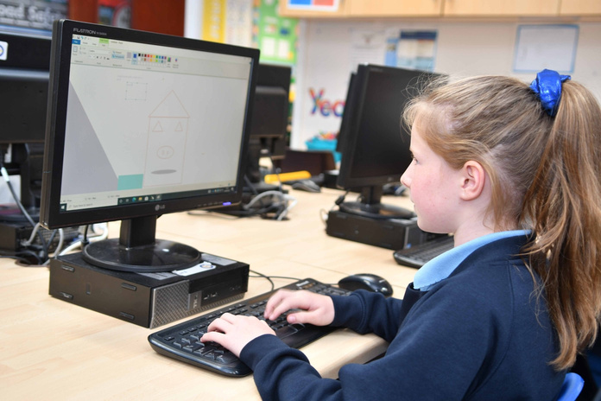
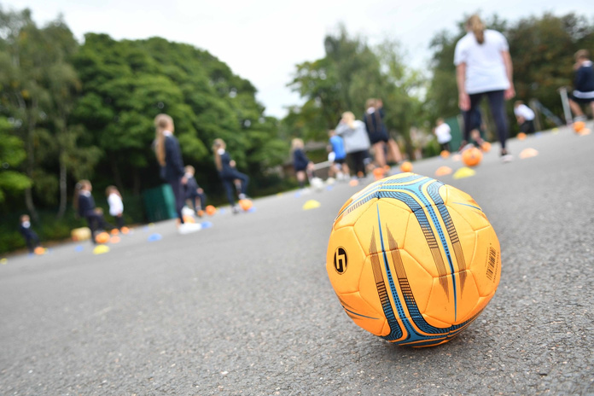
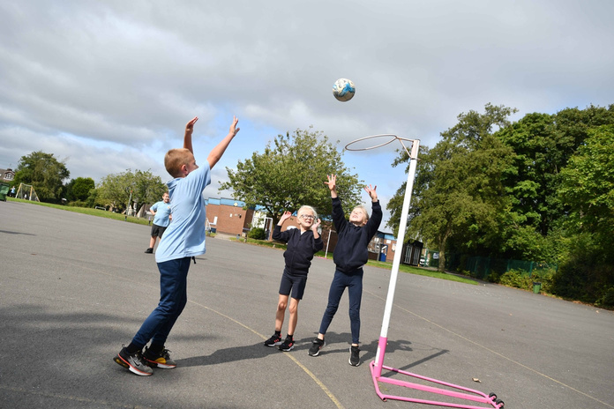

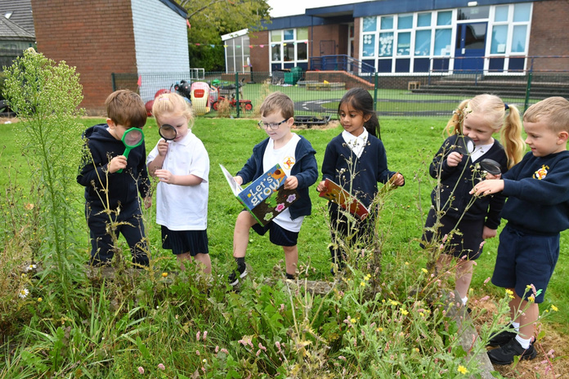




Extra Curricular Clubs
In addition to the many sporting and musical opportunities in school, children/parents are offered access to a wide variety of clubs which may include:
  Football
  Rugby
  Cricket
  Judo
  Fencing
  Tennis
  Yoga
  Gymnastic
  Rounders
  Athletics
  Netball
  Art & Craft
  Recorder/Percussion
  Homework
  Cookery
  Revision
  Eco
  Computing
  Stay and Play

Slide 34
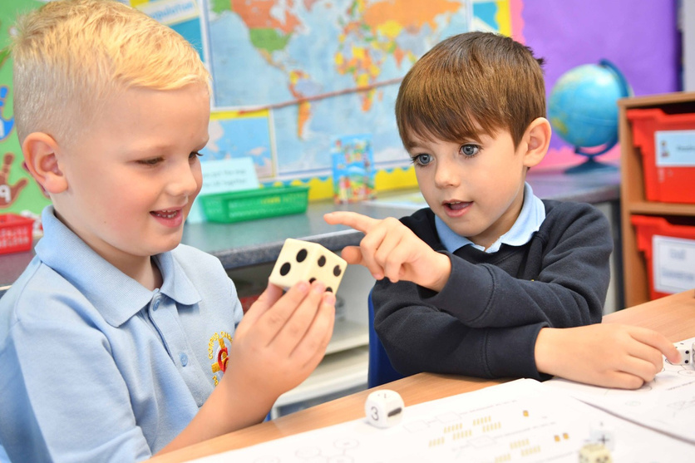
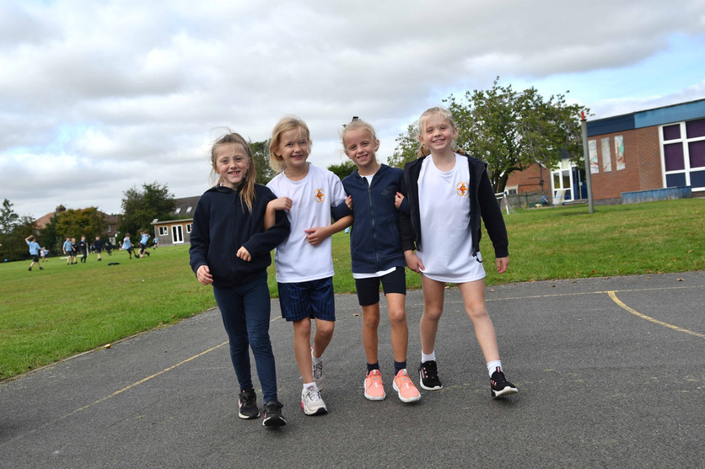
School Holidays
All children are issued with a copy of the Holiday List for the current year. Parents may obtain further copies from the school office. Holiday dates are also found on the school website.
Holiday requests other than the official holidays will only be granted in
exceptional circumstances (up to 10 days). Parents need to apply in writing to the Headteacher a minimum of 4 weeks in advance.
The Headteacher will not authorise absences for holidays during SATs Week (Y6) or during the SATs period for (Y2) or where attendance is low.

Slide 35



Corpus Christi RC Church
According to the Liturgical Calendar, school Mass is celebrated in Corpus Christi Church. Feast Days and Seasonal Liturgies are also celebrated by the school children. We see Church as an extension of the Parish, school and family community. All pupils are encouraged to attend and participate and parents and friends are always welcomed at our celebrations. The sacrament of Holy Communion and Confirmation will be celebrated in Year 4.
Transfer to Secondary School
The school is a designated ‘feeder’ primary to De La Salle High School, in the St Helens Authority.

Slide 36

Holiday dates 2024-2025
Autumn Term 2024
Tuesday 3rd September 2024 First day of term
Friday 25th October 2024 School closes at 3:30pm for half term
Tuesday 5th November 2024 Re-open after half term
Friday 20th December 2024 Closes at 3:30pm for Christmas
Spring Term 2025
Monday 6th January 2025 Re-open after Christmas
Friday 14th February 2025 School closes at 3:30pm for half term
Monday 24th February 2025 Re-open after half term
Friday 4th April 2025 School closes at 3:30pm for Easter
Summer Term 2025
Tuesday 22nd April 2025 Re-open after Easter
Friday 23rd May 2025 School closes at 3:30pm for half term
Tuesday 3rd June 2025 Re-open after half term
Friday 18th July 2025 School closes at 3:30pm for Summer
Bank Holidays
Good Friday 18th April 2025
Easter Monday 21st April 2025
May Day 5th May 2025
Inset Days
Monday 2nd September 2024
Monday 4th November 2024
Monday 2nd June 2025
Monday 21st July 2025
Tuesday 22nd July 2025

Slide 37

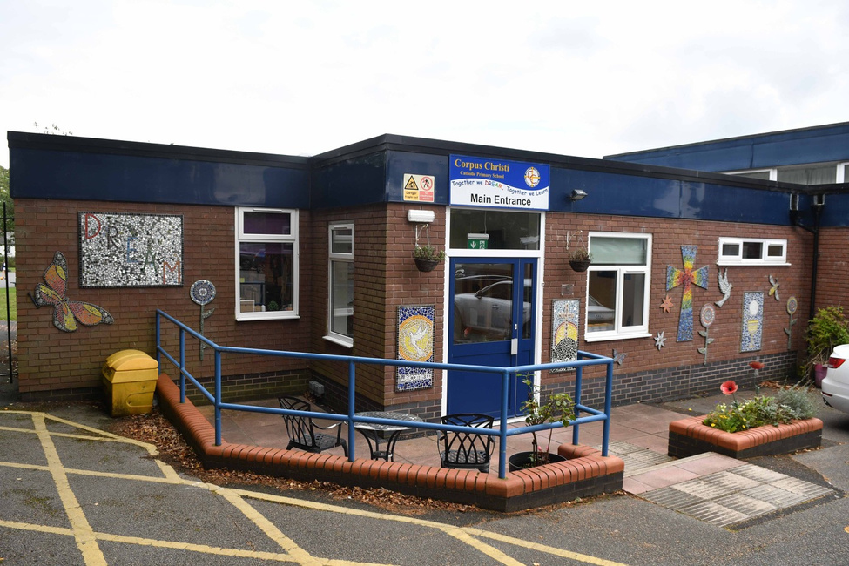


Thank
You!
Contact Us
01744 678102
@corpuschristicp
www.corpuschristirainford.co.uk
corpuschristi@sthelens.org.uk
Old Lane, Rainford, St Helens WA11 8JF

