Slide 1
Long division method

Slide 2
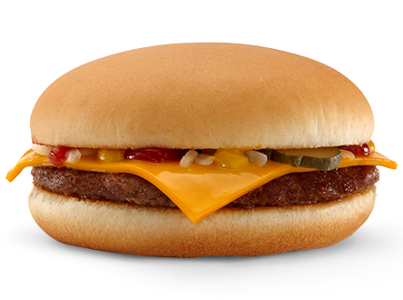

How to divide using long division.
Does
÷ ( Divide)
McDonald’s
X (Multiply)
- (Subtract)
Serve
Burgers
Bring down
Regularly
Repeat

Slide 3
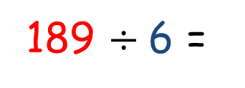
Katy has 189 apples. She wants to put equal amounts into 6 different baskets. How many apples can she put in each basket?
0
3
1
189 $÷$6 =
r 3
6
1 8 9
Answer is 31 remainder 3!
6 baskets have 31 apples in them, with 3 left over!
0
-
How many 6s in 1?
1 8 0
6 x 30
3
How many 6s in 18?
9
1
-
How many 6s in 9?
6
6 x 1
3
Remainder

Slide 4
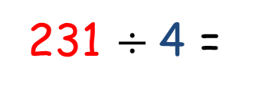
Jan has 231 apples. She wants to put equal amounts into 4 different baskets. How many apples can she put in each basket?
0
5
7
231 $÷$4 =
r 3
Answer is 57 remainder 3!
4 baskets have 57 apples in them, with 3 left over!
4
2 3 1
0
-
How many 4s in 2?
2 0 0
4 x 50
5
How many 4s in 23?
3 1
7
-
How many 4s in 31?
2 8
4 x 7
3
Remainder

Slide 5
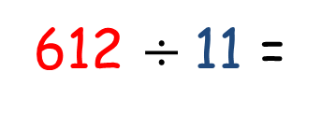
Bob has 612 apples. She wants to put equal amounts into 11 different baskets. How many apples can he put in each basket?
0
5
5
612 $÷$11 =
r 7
11
6 1 2
Answer is 55 remainder 5!
11 baskets have 55 apples in them, with 7 left over!
0
-
How many 11s in 6?
5 5 0
11 x 50
5
How many 11s in 61?
6 2
5
-
How many 11s in 62?
5 5
11 x 5
7
Remainder

Slide 6
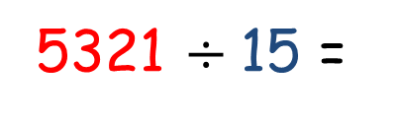
Bob has 5321 apples. She wants to put equal amounts into 15 different baskets. How many apples can he put in each basket?
4
0
3
5
r 11
5321 $÷$15 =
15
5 3 2 1
-
0
4 5 0 0
How many 15s in 5?
15 x 300
Answer is 354 remainder 11!
15 baskets have 354 apples in them, with 11 left over!
3
How many 15s in 53?
0 8 2 1
5
-
0 7 5 0
How many 15s in 82 ?
15 x 50
4
How many 15s in 71 ?
71
-
60
15 x 4
11
Remainder

