Slide 1
Welcome to Year 6
Mrs Galley
Miss Schumacher (Computing, Music and RE)
Mrs McElhinney (French)

Slide 2
Here is our curriculum overview
 | Autumn 1 | Autumn 2 | Spring 1 | Spring 2 | Summer 1 | Summer 2
English | Detective / crime fiction War poems | Narrative poetry – The Lady of Shallot by Alfred Lord Tennyson Playscripts | Darwin On the origin of species (Adventure narrative and explanation text) | The ways of the Wolf (documentary narrative and balanced argument) | Reading skill focus Grammar, punctuation and spelling revision Poetry – free verse | Persuasion – link to geography Novel as theme
Geography History | Crime and punishment | Notable Monarchs of Britain | Rivers | Islamic Civilisations | Countries of the World | Southport and Llandudno
Science | Lifestyles Circulatory system | Electricity | Evolution | Classification | Light | Education for Environmental Responsibility
Art and DT | Brave Colour | Culture and seasonality in food | 2D sketches to 3D sculptures | Pulleys and Gears | Exploring identity | Electrical systems – More complex switches and circuits (including programming, monitoring and control)
RE | Life as a journey | Advent | The Eucharist | The Exodus | Jesus | Ascension and Pentecost
PSHE | How can we keep healthy as we grow? Relationships, drugs, keeping physically healthy |  | How can the media influence people? Media literacy and digital resilience; influences and decision-making; online safety |  | What will change as we become more independent?
French | Phonics lesson 3 and 4 The date | My home | Clothes | Planets | Healthy living | Me in the World
Computing | Communication and collaboration | Webpage creation | Variables in games | Introduction to spreadsheets | 3D modelling | Sensing movement
Music | BBC clips Ravi Shankar Hindustani Music | Musical Styles and instruments | “Music and Me” Rap Charanga Unit | Ukulele | “Happy” Singing Charanga Unit | Music Technology Yustudio Composition

Slide 3
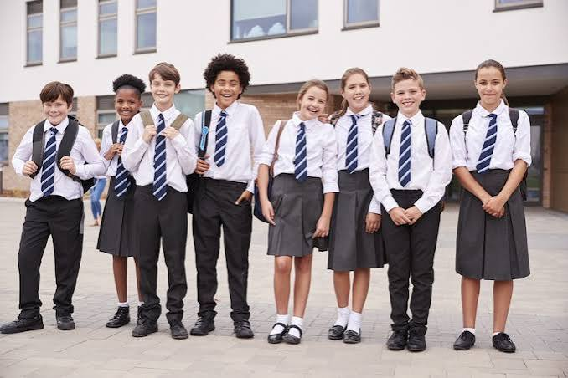
The aim throughout Year 6 is to support the pupils to become more independent and take more responsibility. For example:
Remembering items for the day such as lunch boxes, swimming kits and homework.
Behaviour – they will be reminded that any behaviour choices that they make are their own choice. They may be influenced by others but ultimately they are responsible.
Uniform rules are expected to be followed – plain navy or black PE kit (no large logos), school shoes not trainers.
Please support us in this as we are attempting to develop more independent pupils so that they are prepared for high school.

Slide 4
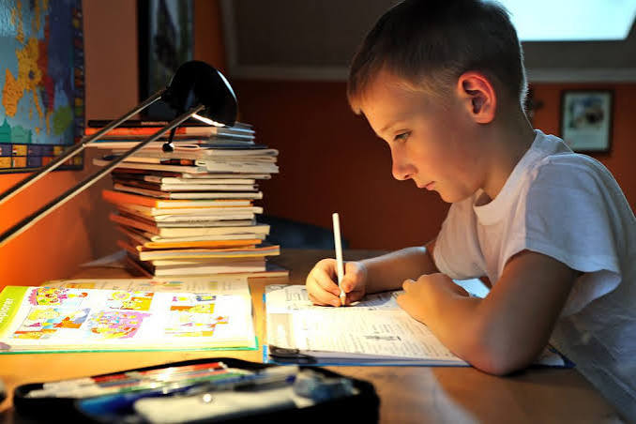
Homework
Homework is set every Monday and collected the following Monday.
It will consist of
A page or 2 from a maths workbook. This will correspond to what we have done in class that week.
Spelling – workbook with all spellings in. One set per week to complete.
A short reading comprehension
3 x reads a week
Absent
If a child is absent on a Monday, any sheets will be put it their tray, but it is their responsibility to ask us or another child which pages to complete.
Non-completion
We spend a whole session on Monday mornings going through the homework, discussing and marking it. If it is not completed, this is further time and learning wasted. As we are working to build responsibility, if homework is not completed or brought in on the Monday, the child will miss a breaktime and receive a negative dojo. The homework will then be expected in the following day but may not be marked.

Slide 5
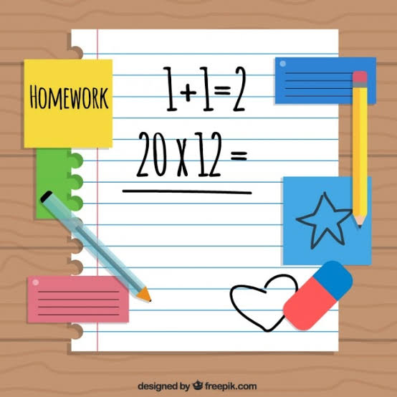
Maths
In the homework book, the answers are in the back. I encourage the children to work like this:
Try to complete the page of work independently.
Use the answers in the back to check their work
If they got any wrong, use the answers to see where they went wrong, but do not change their answers. This is learning!
When we look at it together, we can go over any difficult questions
We do expect the children to show their working out in the books. This proves that they have not just written in the answers.

Slide 6
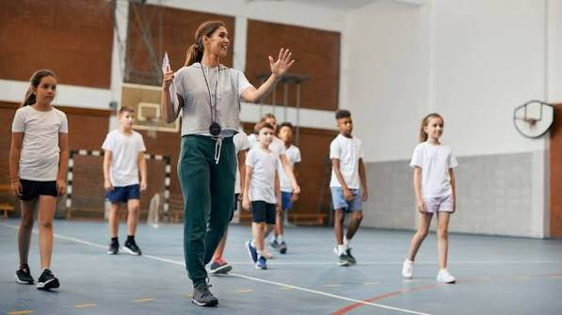
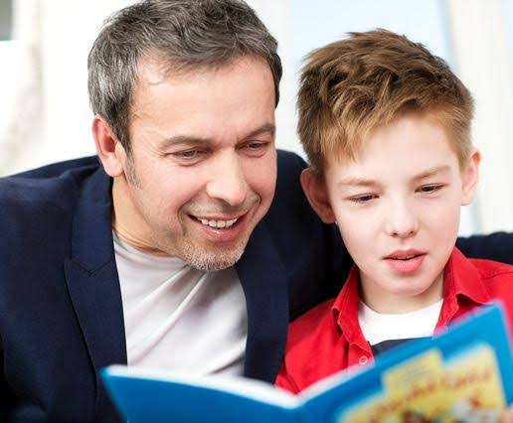
Reading
We still expect parents and carers to interact with their children and their books at least 3 x week.
By Year 6 most children can read fluently. If this is the case, then shorten the time you hear them read and spend time discussing the text : characters, events, unfamiliar words, plot predictions and so on.
If your child particularly struggles with reading, obviously it is in their best interests that you spend more time reading with them.
At this stage, we have to cover so much in such a short amount of time that it is impossible to hear individual readers at school. As parents, you are expected to support your child with this.
PE
PE for Autumn term is on Fridays. Swimming will start next Friday morning ( 18th) and our other curriculum session is Friday afternoon.

Slide 7

Behaviour for learning
We have high expectations of behaviour, both socially and in the classroom for learning.
Pupils will be rewarded using the dojo system. We will have star of the week and team rewards (house teams of St Andrew, David, Patrick and George)
Pupils who disrupt learning for others, don’t complete their homework or who hurt others in some way will receive a negative dojo.
I will manage low level disturbances in the classroom but, if after a first warning or the behaviour is serious enough, I will give a negative dojo. I will also judge if the child should spend a break time reflecting on their behaviour or choice.
I have told the class that if anyone receives 3 negative dojos, they may lose the privilege of attending spooky disco.
I don’t anticipate this will happen to anyone, as we will always look to support the children making poor choices or disrupting learning and will also be working with parents.

Slide 8
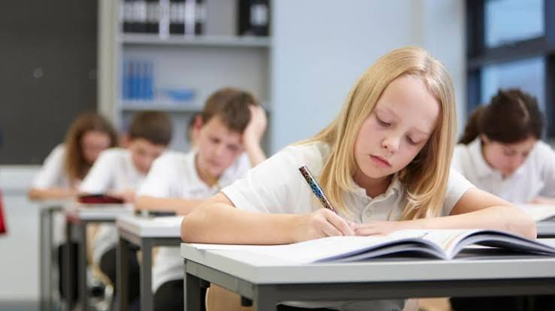
SATs
The SAT’s take place the week beginning 10th – 13th May 2027
They are statutory assessments and all children working within the key stage 2 curriculum level will sit the tests.
They consist of the following:
English – Reading paper
Spelling, punctuation and Grammar paper
Maths – 2 x Reasoning papers
Arithmetic paper
The children take them in the hall, under test conditions. The papers are then collected by a courier, made into a digital copy then an external marker receives them to mark.
I assess and submit teacher assessment in Writing and Science.

Slide 9
What is the purpose of them?
SATs assess whether the child is working at the “Expected” level for the end of key stage 2 based on their scores in the test. It can also be seen as “being High School ready” or being ready to begin their learning in Key Stage 3.
The data is used by the high school to set a pathway towards GCSE grades. They track the progress of the child along this pathway to ensure they make good progress. If their attainment falls below the trajectory, they put measures in place to support the child.
Some high schools use the data to create sets, others don’t.
Obviously, we work hard to make sure every child makes good progress and ideally all would be ready to move on to learn at key stage 3, so they don’t struggle. But every child is different, with different strengths and weaknesses. If a child does not reach “expected level” then measures should be taken by the high school to support them.
We work on covering the curriculum up until Easter. After the Easter holidays, we have 4 weeks until the SAT tests. It is during the morning of these weeks that we prepare for the tests, practicing timings, techniques, etc. We continue with the foundation subjects in the afternoons.
Please do not book holidays during these important times for the children.

Slide 10
Parents’ role
We need to be building independence or High School will be a huge shock!
You can help them take responsibility by giving them opportunities to develop this, such as them packing their own bag the night before, taking responsibility for homework, swimming kits, etc.
Attendance
Year 6 is a full, fast year in school. It absolutely flies by and we pack so much in!
If a child misses just a day, they miss a lesson in English and will potentially find it very difficult to catch up the work. English lessons are in a particular order, building on from each other to create a final piece of writing. Missing just one of these could affect the whole topic.
In Maths, each lesson is a key part of a bigger sequence, building up knowledge. If they miss it, they could struggle to keep up and they may have gaps in understanding, affecting future learning. They could potentially miss an entire topic in Maths as we have to rush through so quickly to be prepared for SAT’s!
It is vital your child attends school in order for them to be successful.
APPLYING FOR A HIGH SCHOOL PLACE – you will need to find the dates of open evenings for the high schools you wish to visit. You apply for a high school place online through the council website. This has a deadline of the end of October. You will be offered a place in March.

Slide 11
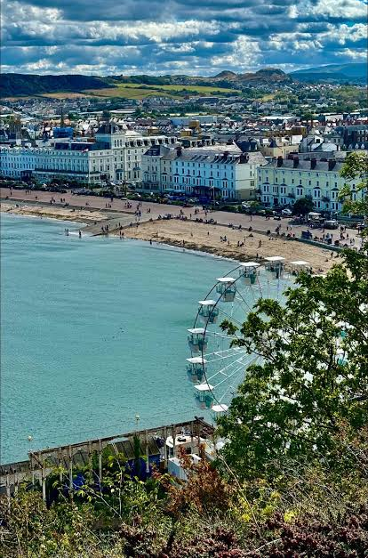
Venture week
We will be taking the children to Llandudno again this year. The accommodation and activities have been finely tuned over the last few visits!
This is a fabulous week in which the children are given the opportunity to spend quality time with their peers, develop further responsibility with regards to money, behaviour, belongings and choices.
This year the date will be June 21st – 25^{Th.}
School spider will be set up soon so payments can be made throughout the year.
Miss Hampson intends to hold a meeting soon to address any concerns

