Slide 1

MTC Parent Meeting
12.03.2026

Slide 2
What is the MTC?
It is an onscreen check consisting of 25 times table questions.
Your child will be able to answer 3 practice questions before taking the actual check.
They will then have 6 seconds to answer each question.
On average, the check should take no longer than 5 minutes to complete.
TTRS soundcheck: https://play.ttrockstars.com/ttrs/online/game/home/list/single

Slide 3
Why?
The purpose of the check is to determine whether your child can fluently recall their times tables up to 12, which is essential for future success in mathematics.
A good knowledge of times tables helps in many areas of maths e.g.
Division
Multiplication
Fractions
Percentages

Slide 4
How will the results be used?
We will have access to all their pupils’ results, to allow us to identify pupils who need additional support.
You will receive their scores.

Slide 5
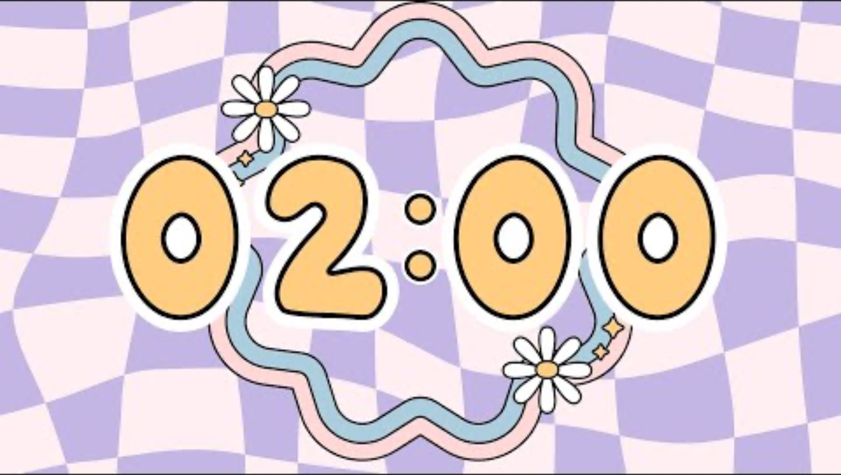
What are we doing?
Daily times tables practice
Weekly sound checks - mock MTC
Times tables booklets that include a mix of multiplication and division facts.
Let’s have a go
You will have 2 minutes to complete one section of the booklet.

Slide 6
What can you do?
Practice, practice, practice!
Here are some useful links:
https://play.ttrockstars.com
https://www.topmarks.co.uk/maths-games/hit-the-button
https://www.timestables.co.uk
https://www.youtube.com/results?search_query=times+tables+songs

