Slide 1
Moving from Year 4 to Year 5

Slide 2
When I come back to school after the summer holidays, I will be in Year 5. I will have a new classroom.

Slide 3
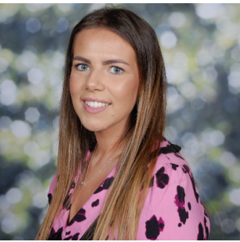
My new teacher is Miss Champion. Miss Flint will be the Teaching Assistant

Slide 4
I will come into school through the Year 5 door. This is next to the entrance to the playground.

Slide 5
A day in Year 5 is just like a day in Year 4.
When I come into the classroom, I will put my coat and bag in my own locker.
I will get out my water bottle and put it on the trolley.

Slide 6
The Timetable
In the mornings
Morning work
English
Math
In the afternoons
All the other subjects – History, Geography, Art, Science, DT, RE PSHE, Music and PE
My teacher has a timetable in class to let me know what is happening that day.
I will go to assembly just like I did in Year 4.

Slide 7
I will use the Year 3, 4 and 5 bathroom.
This is the same bathroom I used in Year 4.
I will use this bathroom at lunchtimes too.

Slide 8
I will have my lunch in the hall at 12.30. I will play outside first.

Slide 9
On Thursday 17th July I visited my new classroom and spend the afternoon with Miss Champion in the Year 5 classroom.

Slide 10
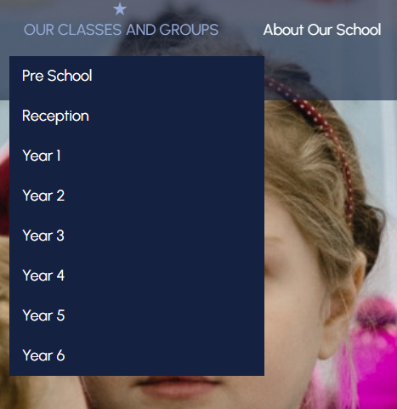
This is the website with all the information about Year 1! Penwortham Primary School: Headteacher Welcome On here you will find a timetable for the week and a curriculum overview for the half term.

