Slide 1

“Happy children who achieve”
Aspire, Belong, Care, Discover
WELCOME TO YEAR 2

Slide 2


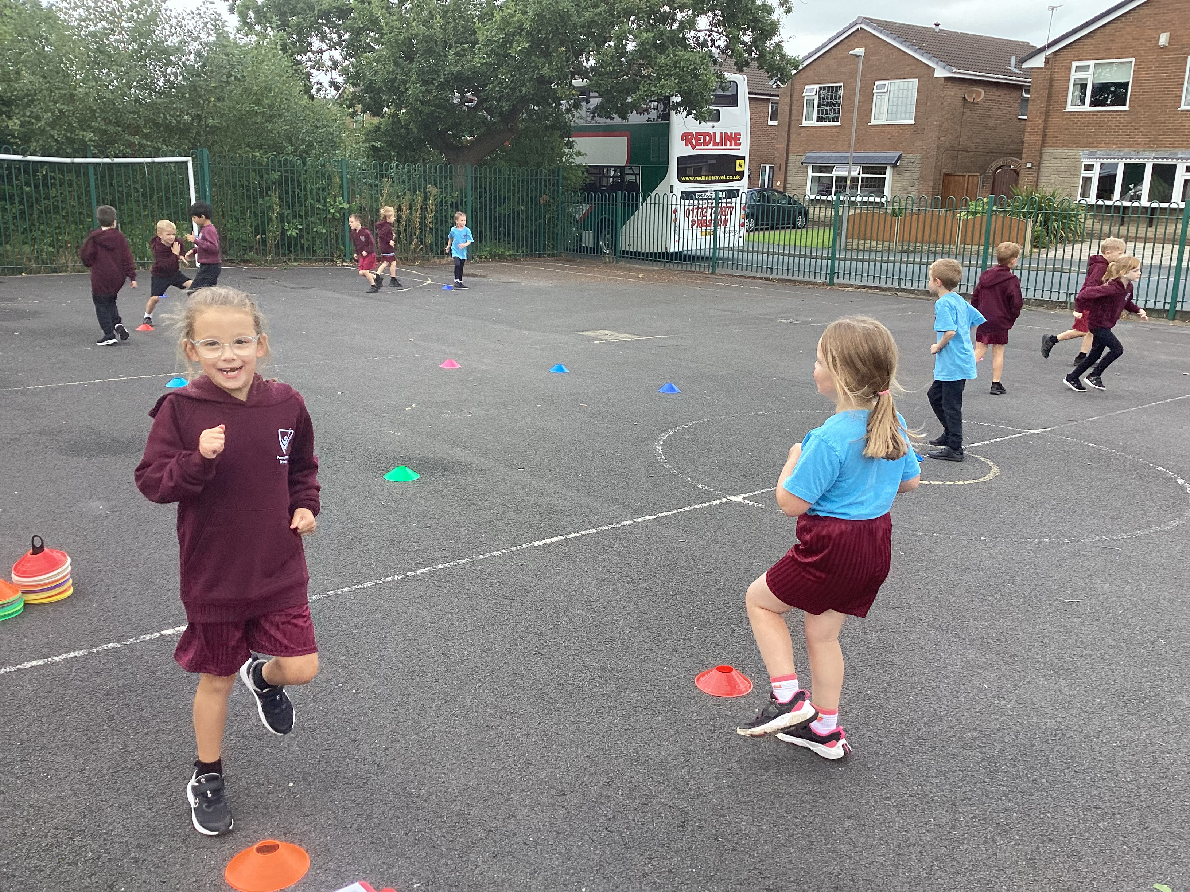
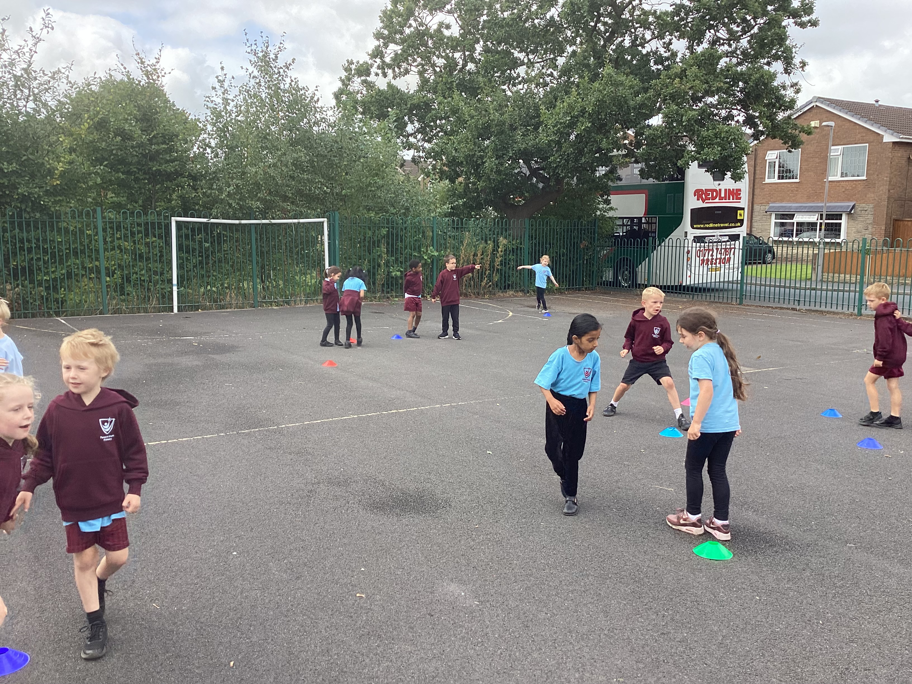


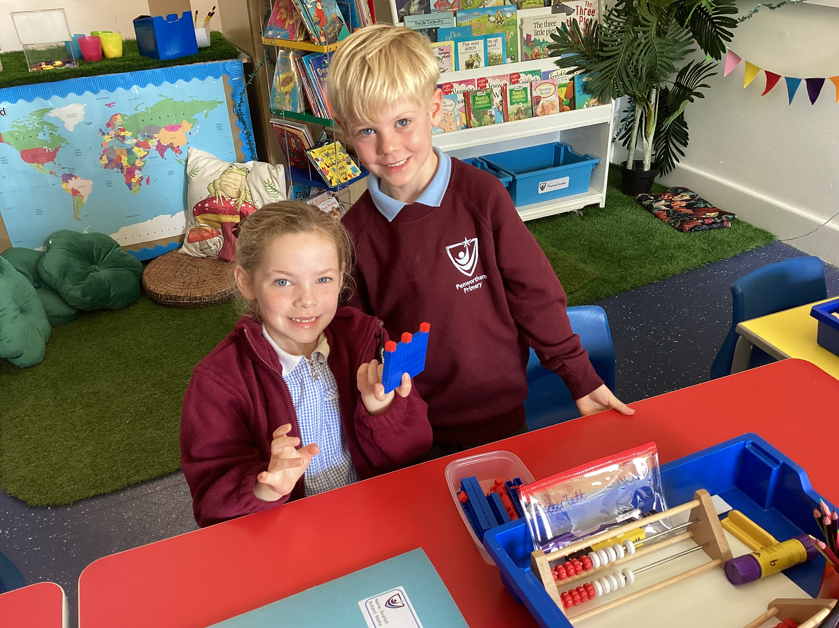
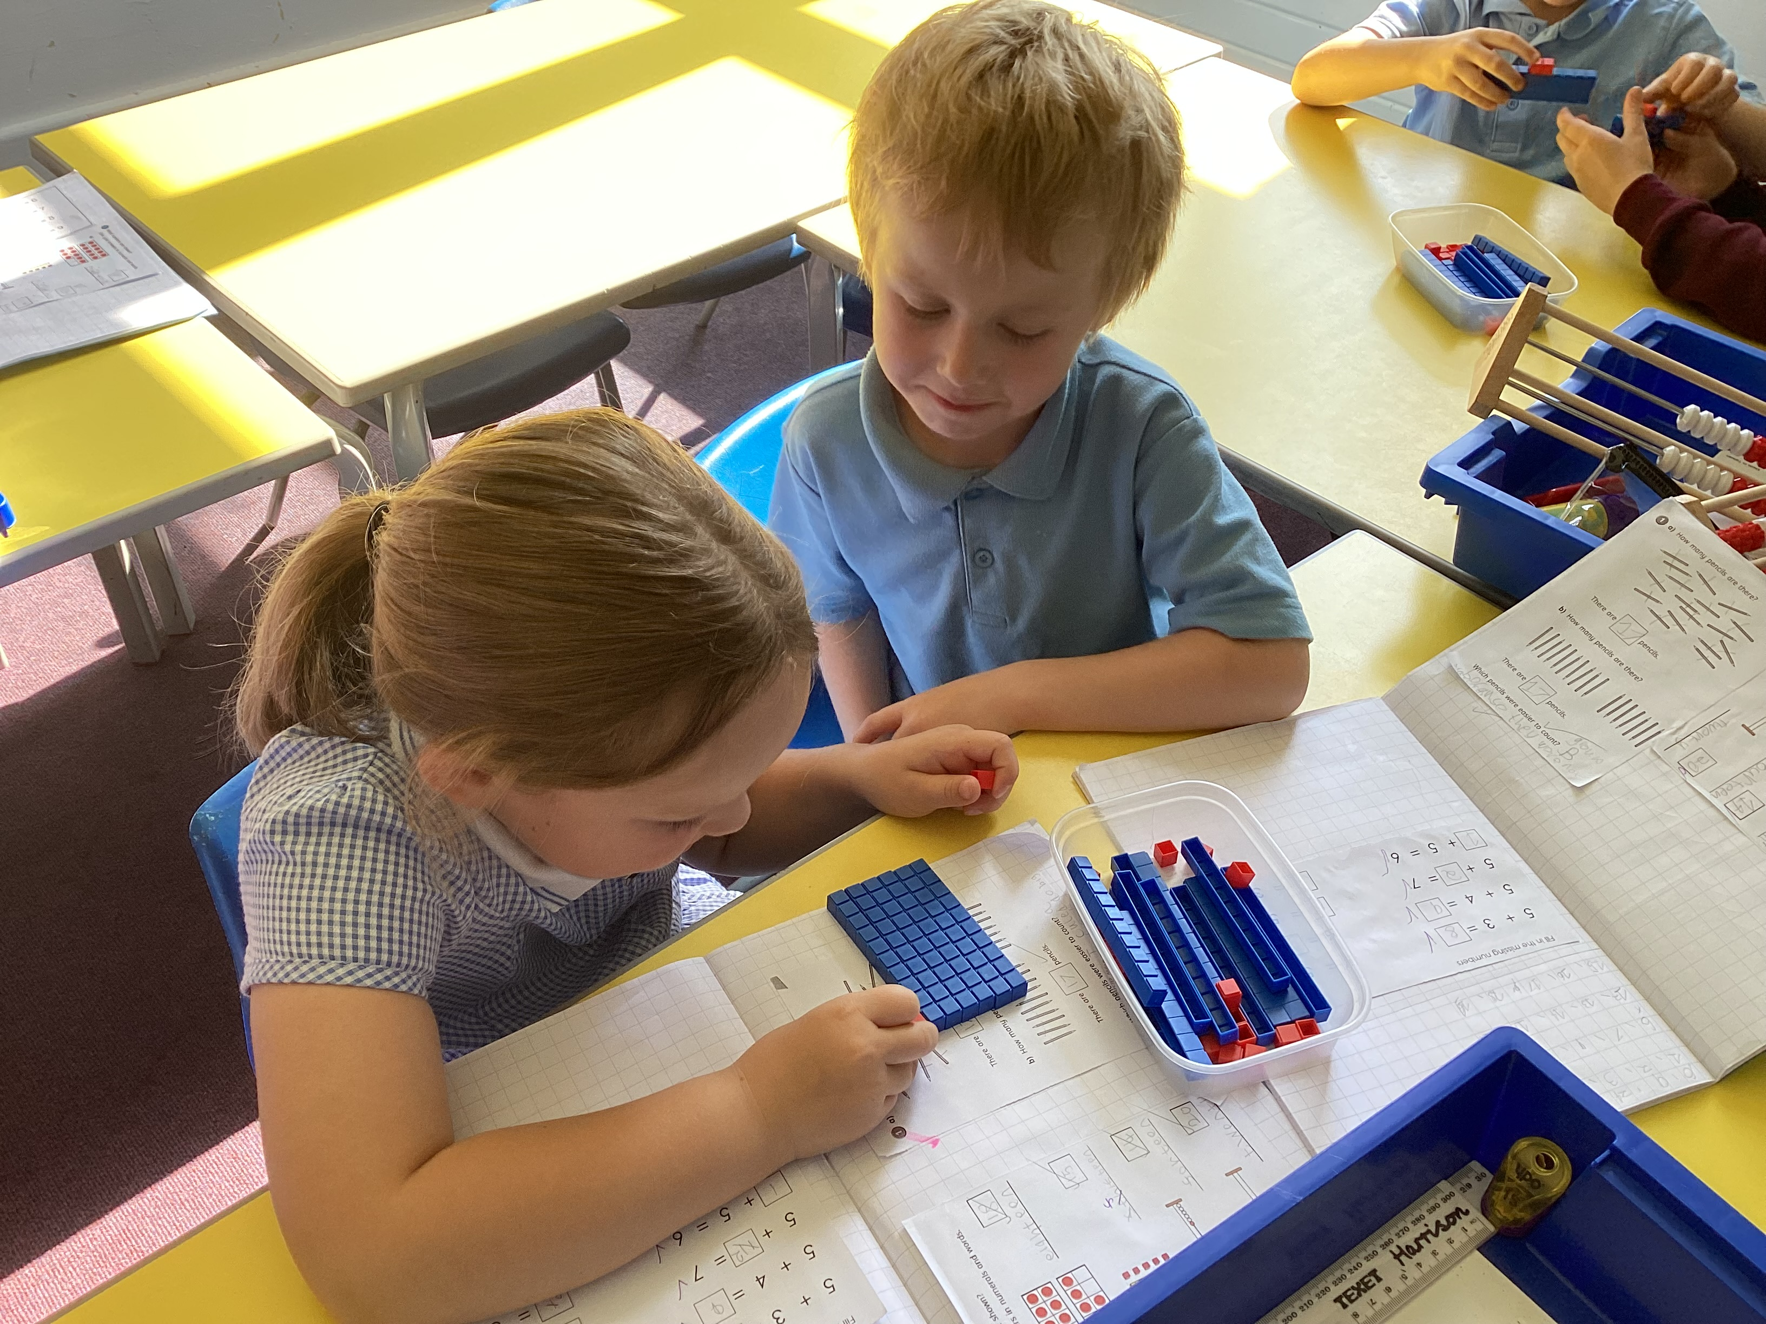
The magic of year 2!

Slide 3
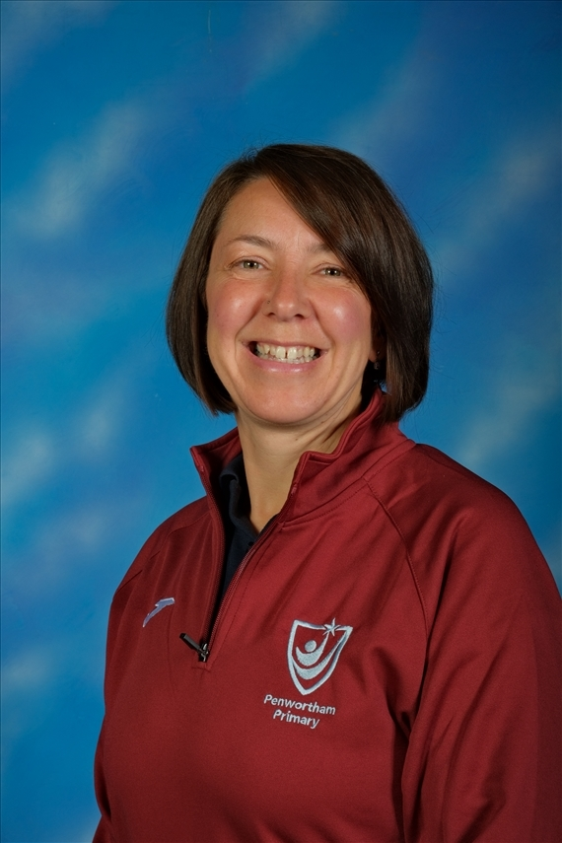

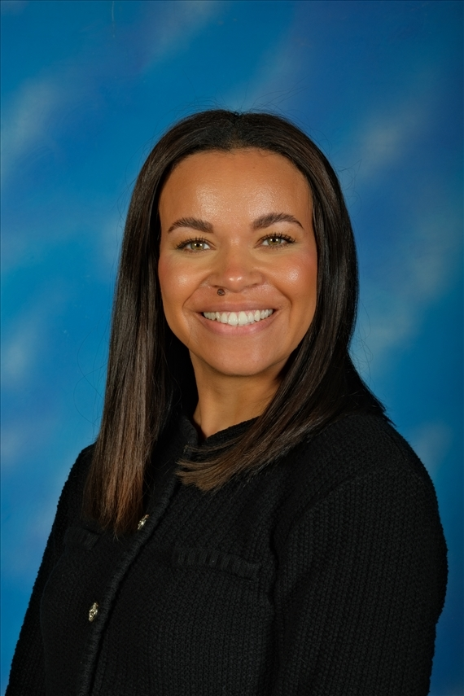
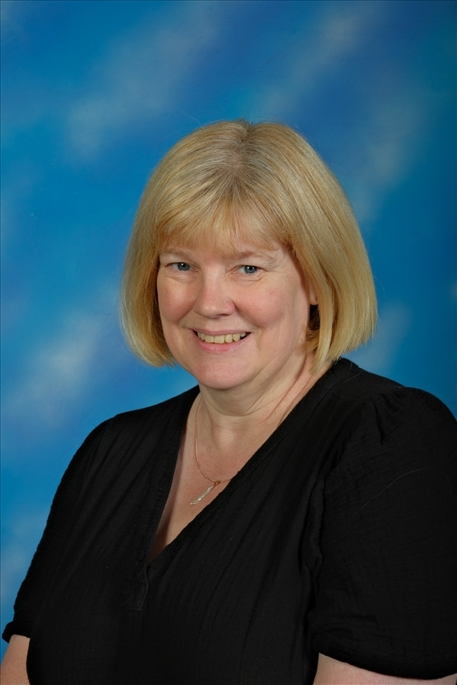
Meet the year 2 team!
Mrs Lambert (Class Teacher)
Mrs Kirkpatrick (PPA Cover)
Miss Flint (Learning Mentor)

Slide 4

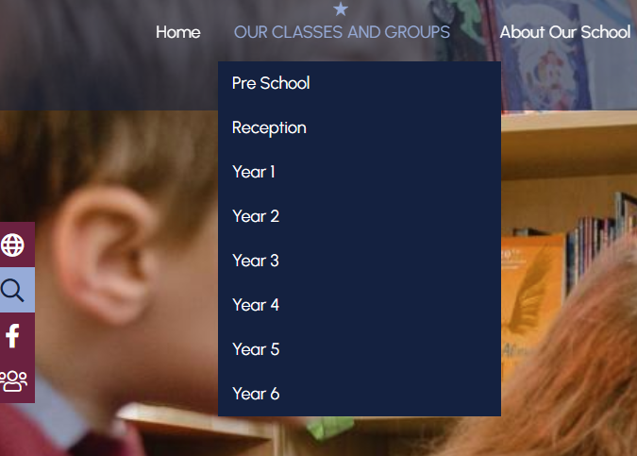
Our website
Penwortham Primary School: HEADTEACHER WELCOME

Slide 5
Life in Year 2
Engaging and active
Exciting curriculum
Timetable
Trips and enrichment
Reading records
Home learning – our new homework grids

Slide 6
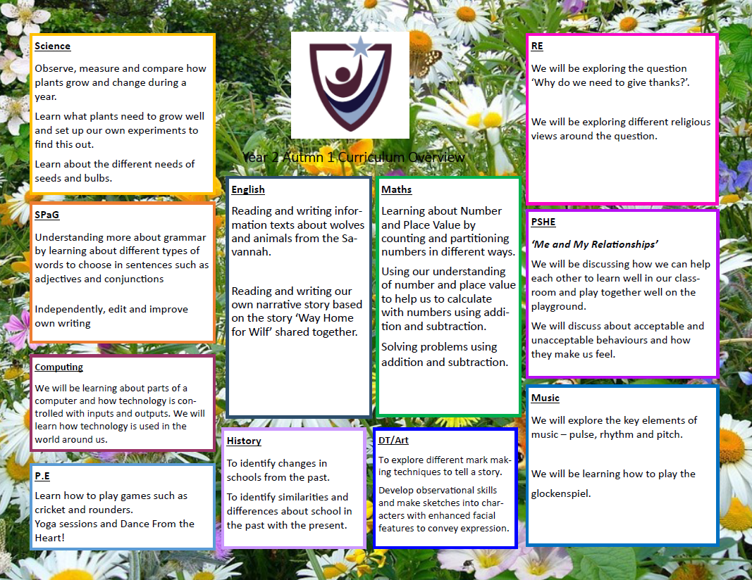
Our curriculum

Slide 7
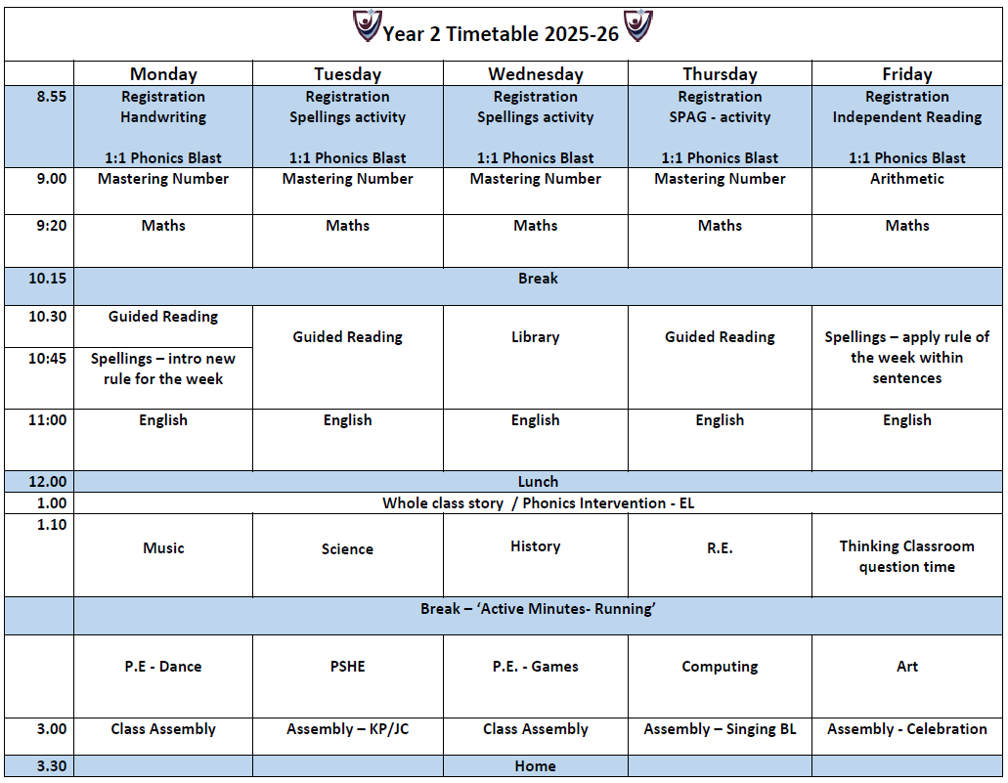
Our day

Slide 8
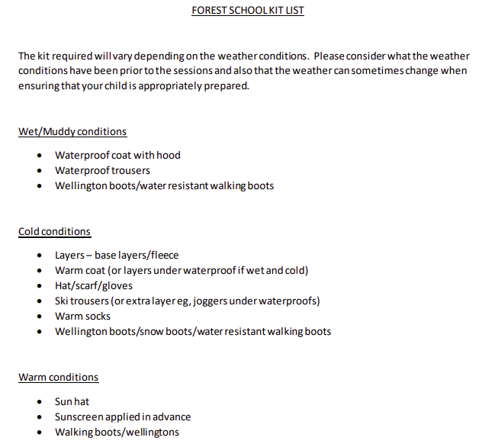
Forest school
Each class has the opportunity to experience Forest School.
Our aim is that every class will experience Forest School for each season during their school life at Penwortham Primary School.
Here is the timetable for 2025 – 2026
Autumn Term | Autumn 1 | Year 1
Autumn Term | Autumn 2 | Year 2
Spring Term | Spring 1 | Year 3
Spring Term | Spring 2 | Year 4
Summer Term | Summer 1 | Year 5
Summer Term | Summer 2 | Year 6
All information for Forest School can be found on our website:

Slide 9

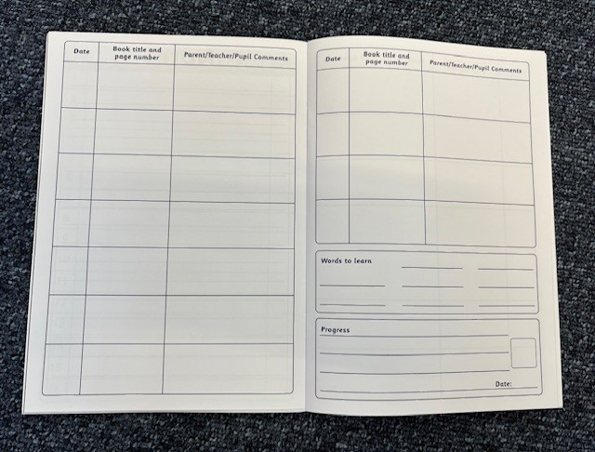
Reading books
Daily
Please make sure your child brings their home reading books in every day.
Read
Please read with your child every night, even if it’s only for 5-10 minutes and record in the reading record book. They should be reading 5 times per week.
Guided Reading
Your child will read in a guided reading session in school. This will be a text at their reading level.
Remind
Remind your child to put their book in the blue box when they have read it. They will be changed weekly.

Slide 10
Home Learning
Reading (daily)
One Maths activity
One English activity
One activity linked to Theme (you choose one from the 'Menu')
All homework set on Friday to be completed by the following Wednesday
Some online activities
One Oracy activity

Slide 11
Uniform
School jumper / cardigan with logo.
Trousers / shorts / skirt / dress.
Blue t-shirt with logo.
School fleece with logo.
Black shoes.
White socks / black / grey socks.
PE
Blue t-shirt with logo
Maroon shorts
School jumper / hoodie with logo.

Slide 12
P.E.
P.E. is on Mondays and Wednesdays
Please ensure your child has their P.E. kit on for school on those days.
Please ensure earrings are removed on P.E. days.
They can wear school jumpers or hoodies and jogging bottoms or leggings (plain black).
No other sportswear should be worn i.e. hoodies or football kits.

Slide 13
Online resources
School Spider – weekly summary of learning is sent every Friday
Sumdog – Maths and SPAG homework
TTRockstars – x tables
Phonics Play
Emile – spelling and grammar

Slide 14
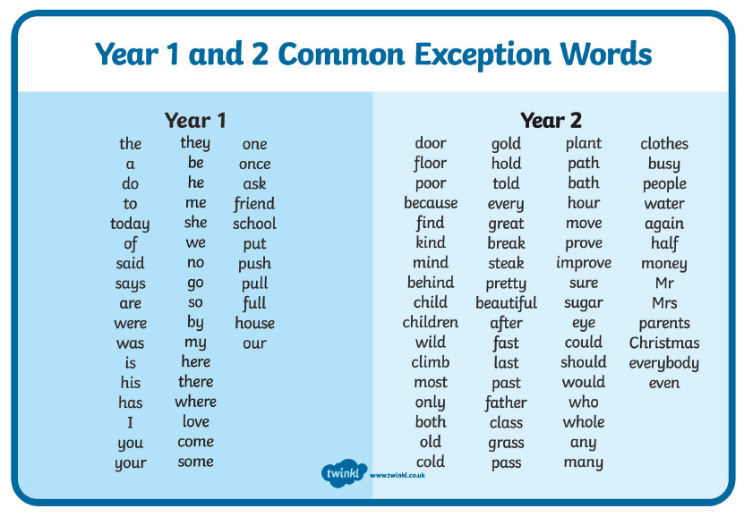
Common exception words

Slide 15

Leadership groups
As a school, we have several leadership groups that the children can apply for at the start of the year
School Council
Reading Ambassadors
ECO Council
STEM Ambassadors
Digital Leaders

Slide 16

Communication
Check our website class page for regular updates and news.
Like our Facebook page and follow our activities weekly.
Messages sent each week with Homework and news.
Email e.lambert@penwortham-pri.lancs.sch.uk with any questions – insert email.

Slide 17
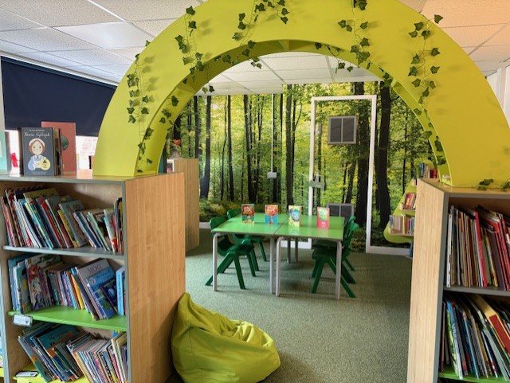
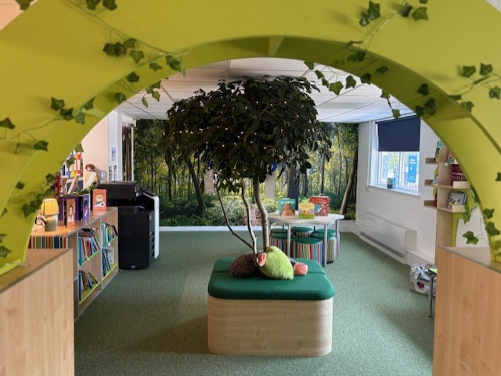
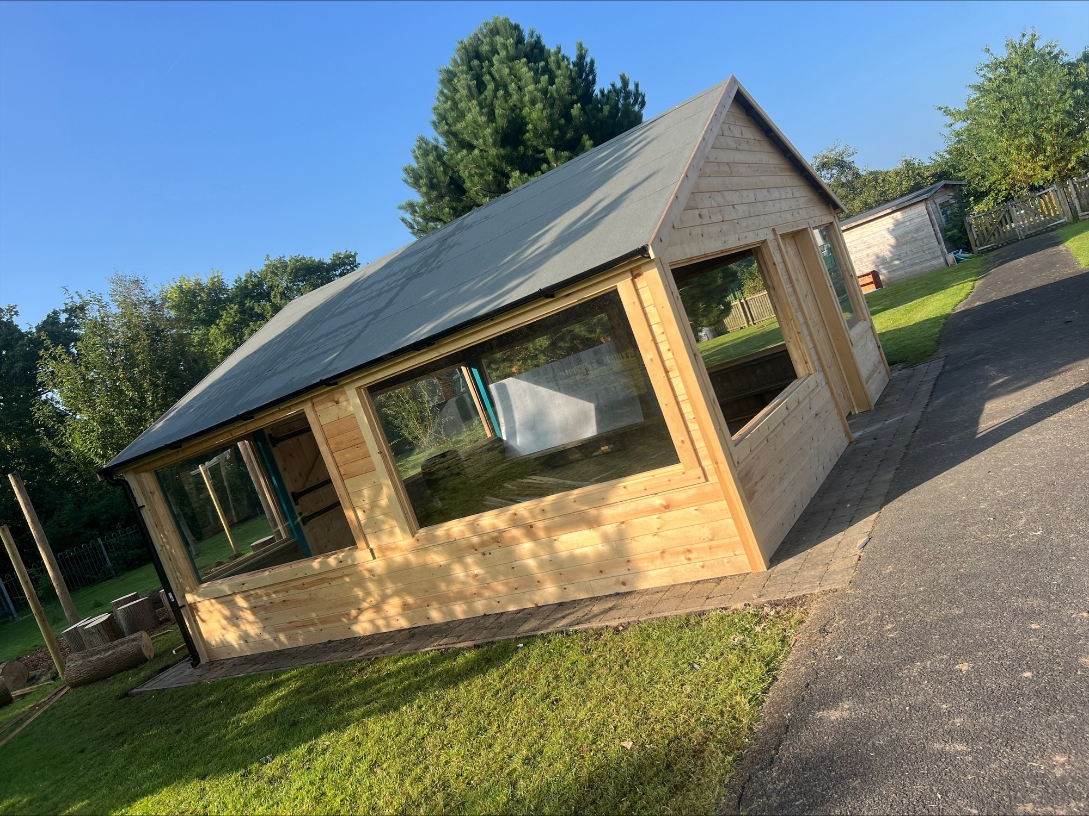
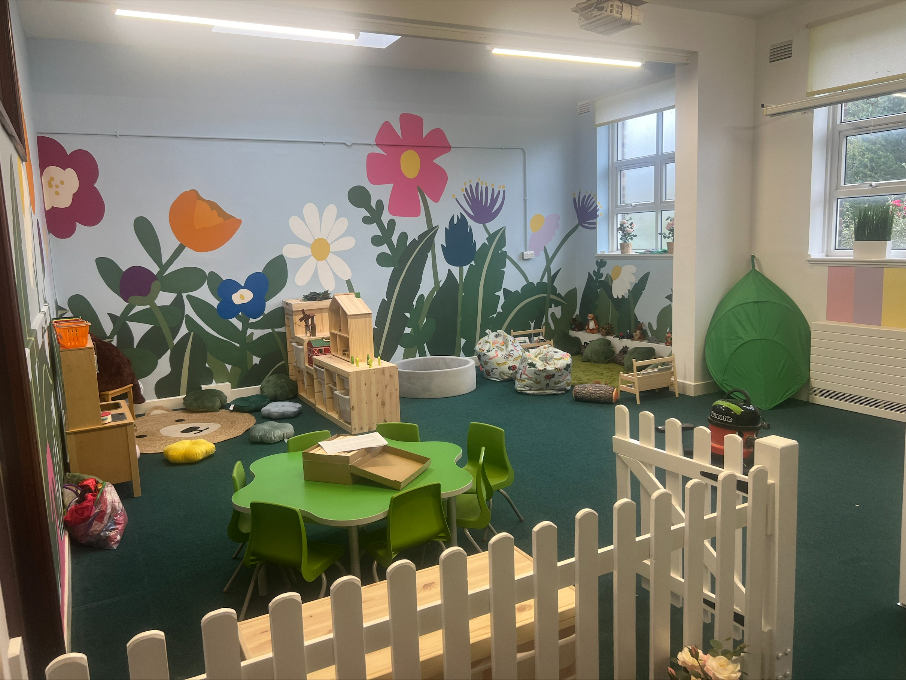
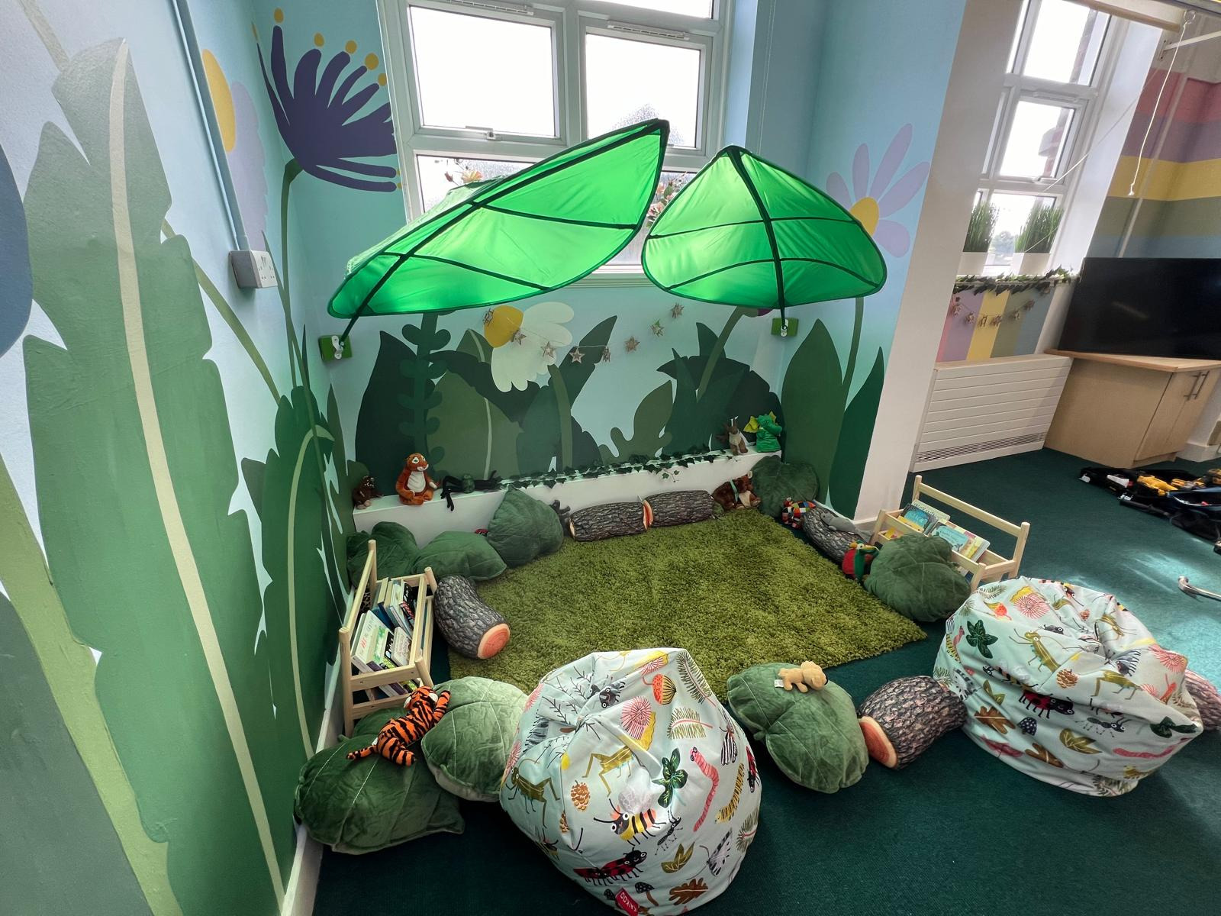
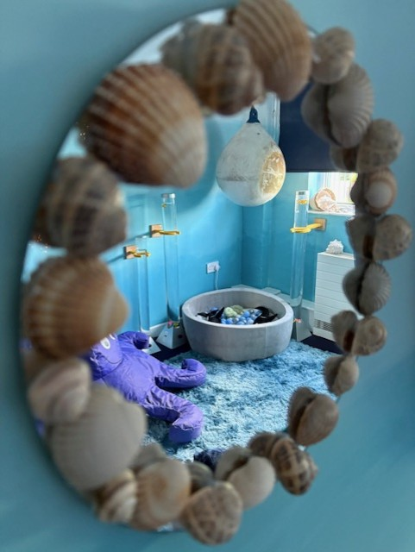
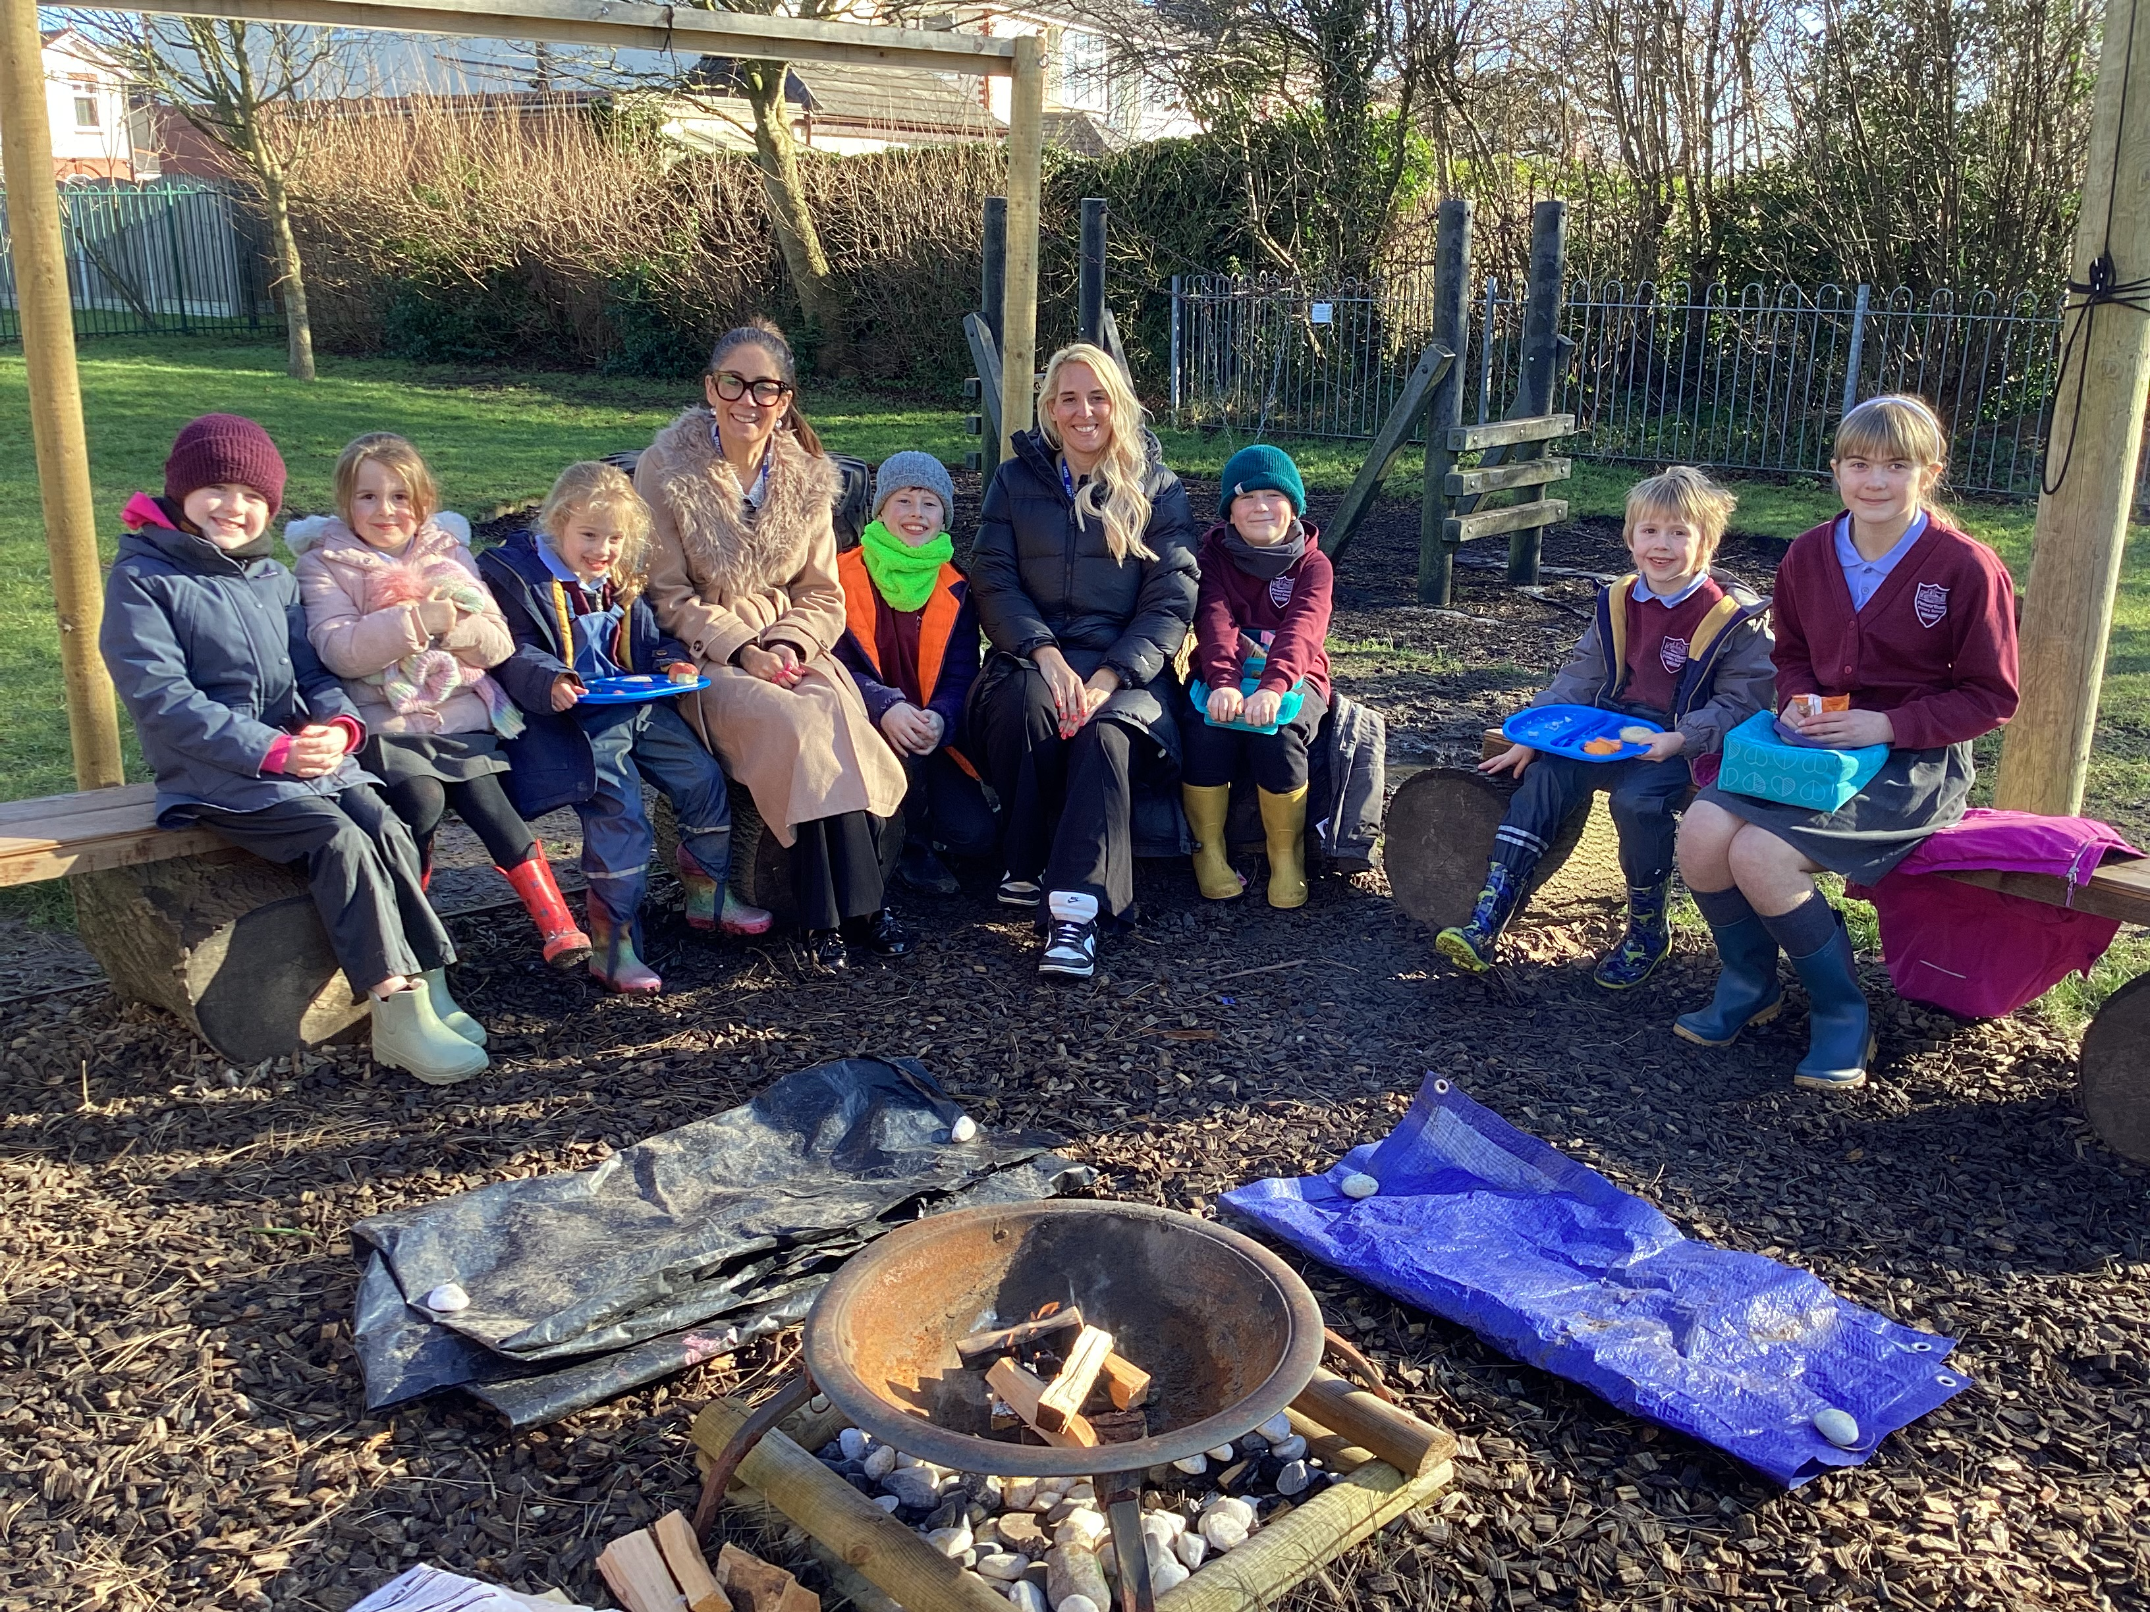
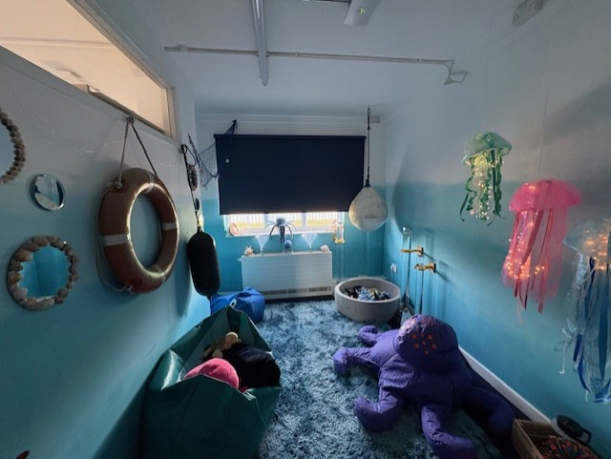
SCHOOL DEVELOPMENTS
School library (Mrs. Watkinson opens the library every Tuesday evening) – Wednesdays -Can you help?
Pre-school – we still have places available in our Penwortham Stars Preschool.
Forest School – more details to follow
Mindfulness suite – our Beach Hut – pastoral support with Miss Flint
PTFA – playground project - can you help?

Slide 18
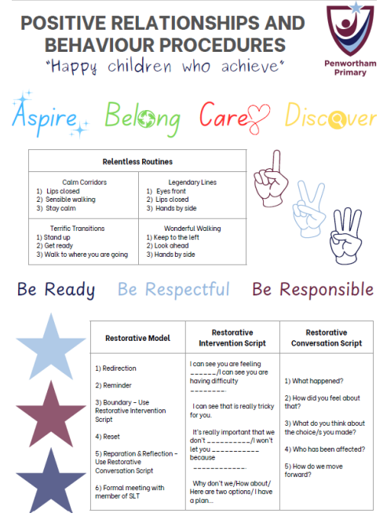
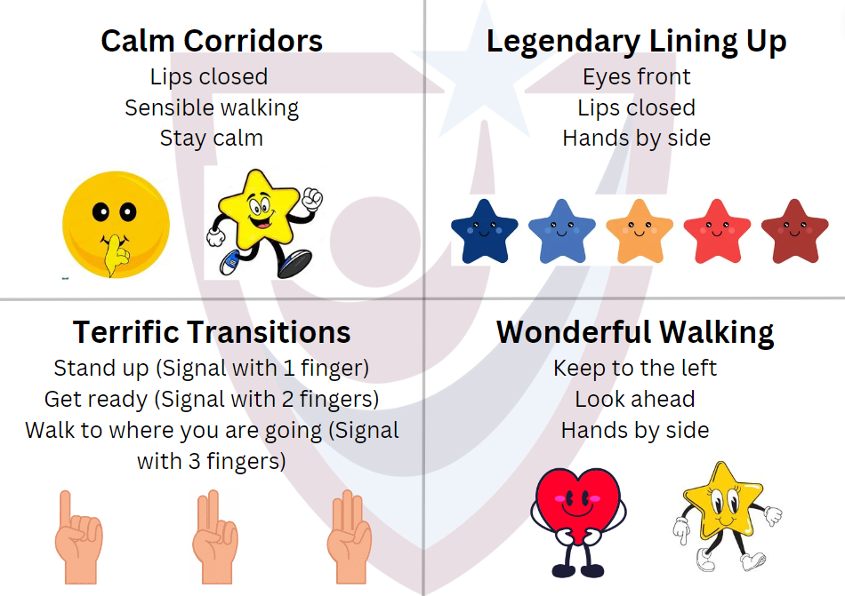
Positive relationships and behaviour policy
At Penwortham Primary, our behaviour approach is built around three clear expectations: Ready, Respectful and Responsible. These are embedded across school life, helping children understand what is expected of them in the classroom, around school and during playtimes.
Ready means being prepared to learn, listening carefully and trying your best.
Respectful means showing kindness to others, using good manners and taking care of our environment.
Responsible means making good choices, being honest and looking after yourself and others.
Our Positive Relationships and Behaviour Policy focuses on encouraging positive behaviour and supporting children to reflect and learn from their choices. We use clear routines, calm and consistent responses, and restorative practice to help children feel safe, supported and ready to succeed

Slide 19
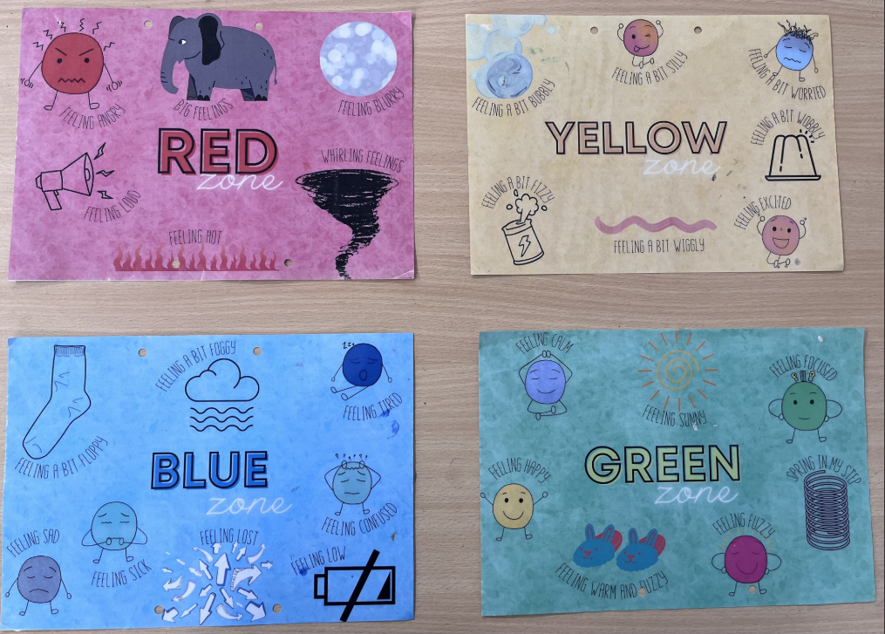
Zones of Regulation
At Penwortham Primary, we use the Zones of Regulation to help children recognise and manage their emotions. The Zones are four colours that represent different feelings – blue (sad, tired, bored), green (happy, calm, ready to learn), yellow (worried, silly, excited) and red (angry, out of control).
Each morning and afternoon, children complete a simple emotions check-in so staff can understand how they’re feeling and offer support if needed. This helps us respond early and support emotional regulation throughout the day. We encourage children to see all feelings as normal and to use strategies, like calm corners and emotions toolkits, to help get back to the green zone.

Slide 20
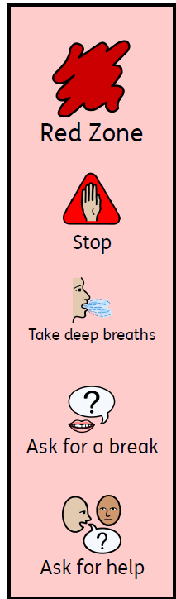







Toolkits
At Penwortham Primary, we support children to manage their own emotions and behaviour using personalised toolkits. These toolkits include a range of strategies and resources that help children calm down, refocus or feel more regulated when needed.
A toolkit might include things like breathing exercises, sensory items, movement breaks or quiet reflection time. Staff work with children to develop these toolkits so they know what works best for them. The aim is to help children build independence, resilience and confidence in managing how they feel.

Slide 21

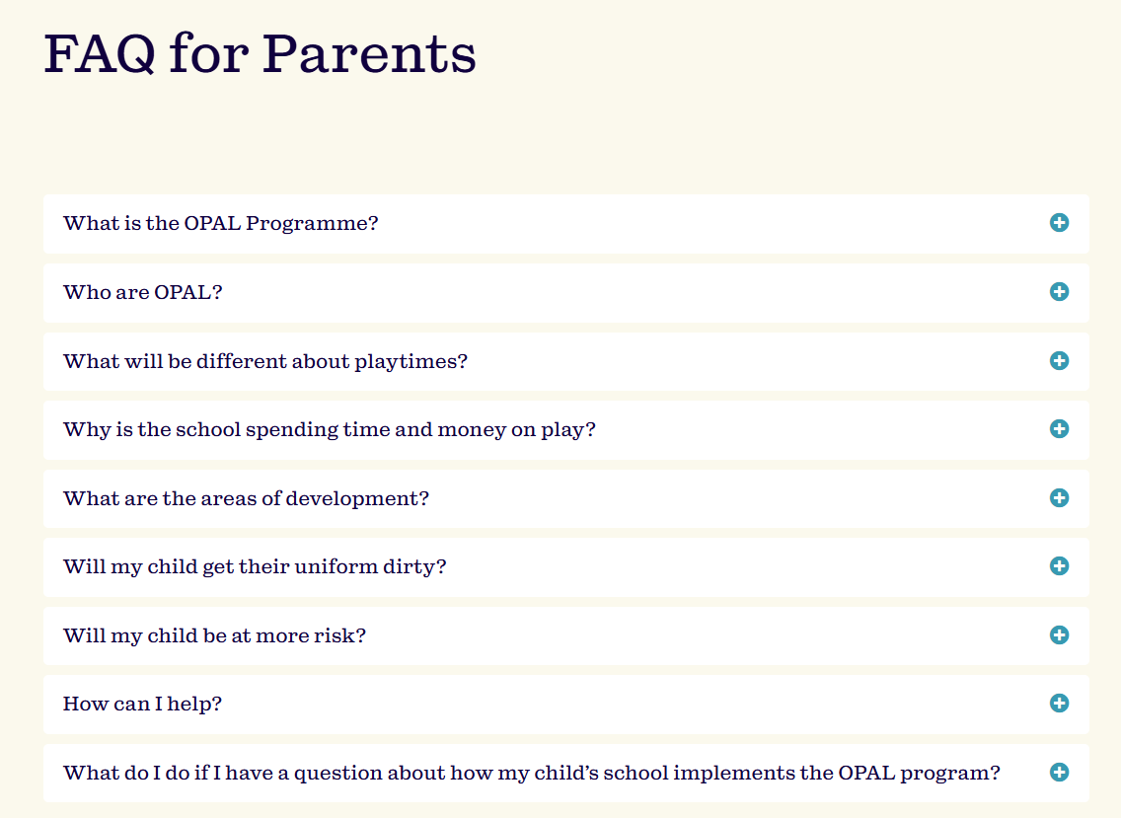

OPAL – a future plan for outdoor play and learning
This is a new project for our school playground that will begin around October time.
More information can be found on the website & we will be asking for donations of wooden pallets, drainpipes and other exciting materials to transform our outdoor space.
Home - Outdoor Play and Learning

Slide 22
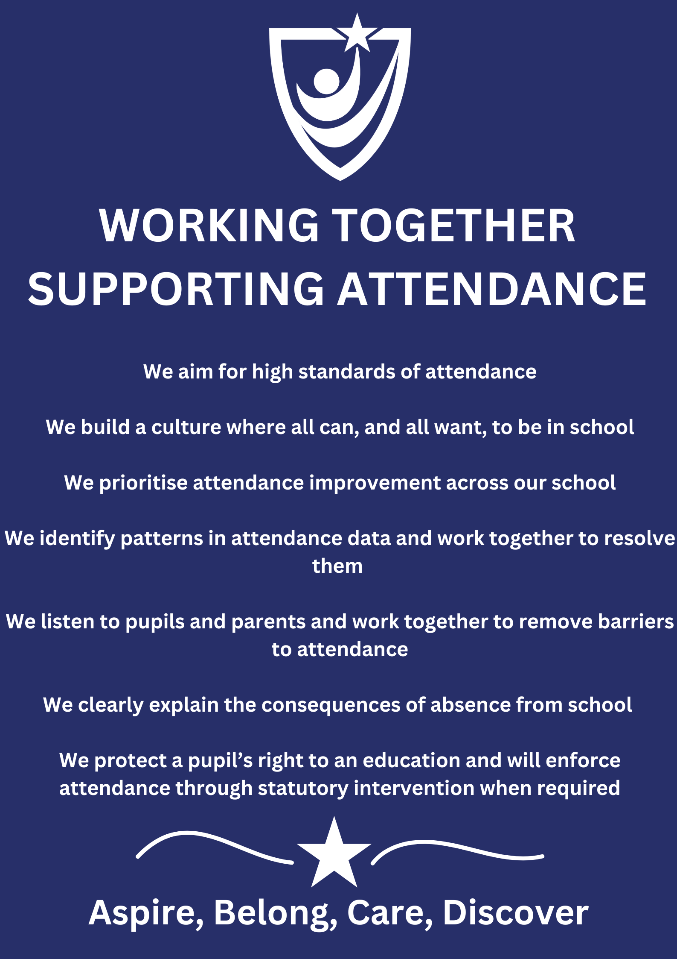



School attendance
At Penwortham primary school, every school day counts.
We ask our children to be an Attendance H.E.R.O.
(Here Every day Ready On time) and help us achieve our school attendance target of 96% or above.
Should your child be too unwell for school, please leave a voicemail on the school phone 01772 743321 or submit an absence request vis School Spider.

Slide 23

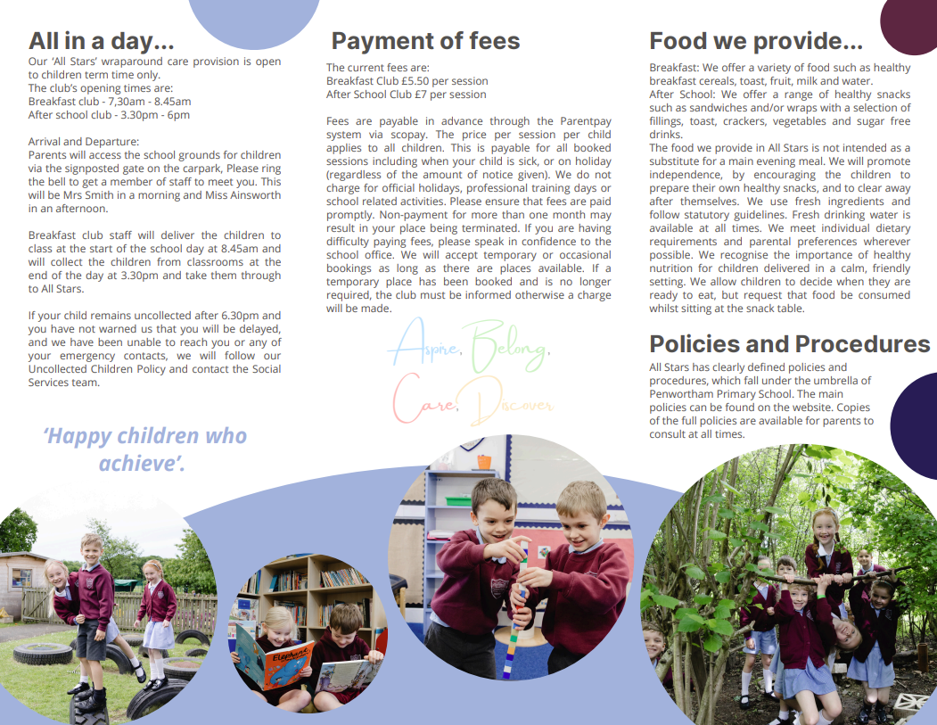
Wraparound care
Breakfast Club – 7.30am - 8.45am
After School Club – 3.30pm - 6pm

Slide 24

Places are available in our Preschool setting for September.

Slide 25
Exhibitions, assemblies and showcases
Every half term you will be invited into class to look through the children's books and see all their fantastic work. This will be a wonderful exhibition of learning and a great opportunity for you to see what we have been getting up to in class.
Alongside the exhibitions, we have class assemblies that happen every year.
And, we also have special 'showcases' that we hold in the school hall every term.
Our goal is to celebrate the children's learning and for you to be a part of the children's learning journey

Slide 26

Thank you for coming!
Any specific questions please email:
e.lambert@penwortham-pri.lancs.sch.uk
Or email/telephone to make an appointment via the school office.

