Slide 1


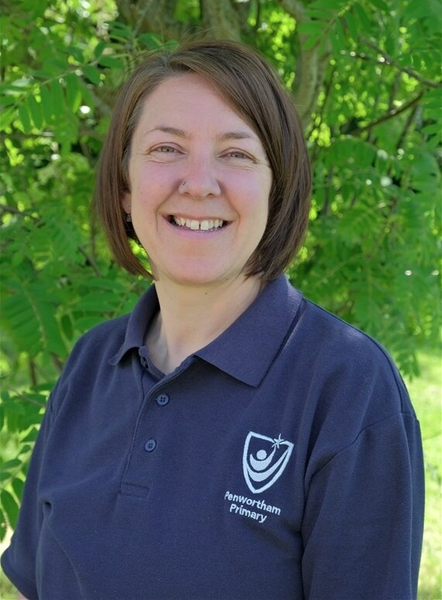

Moving from Year 1 to Year 2

Slide 2
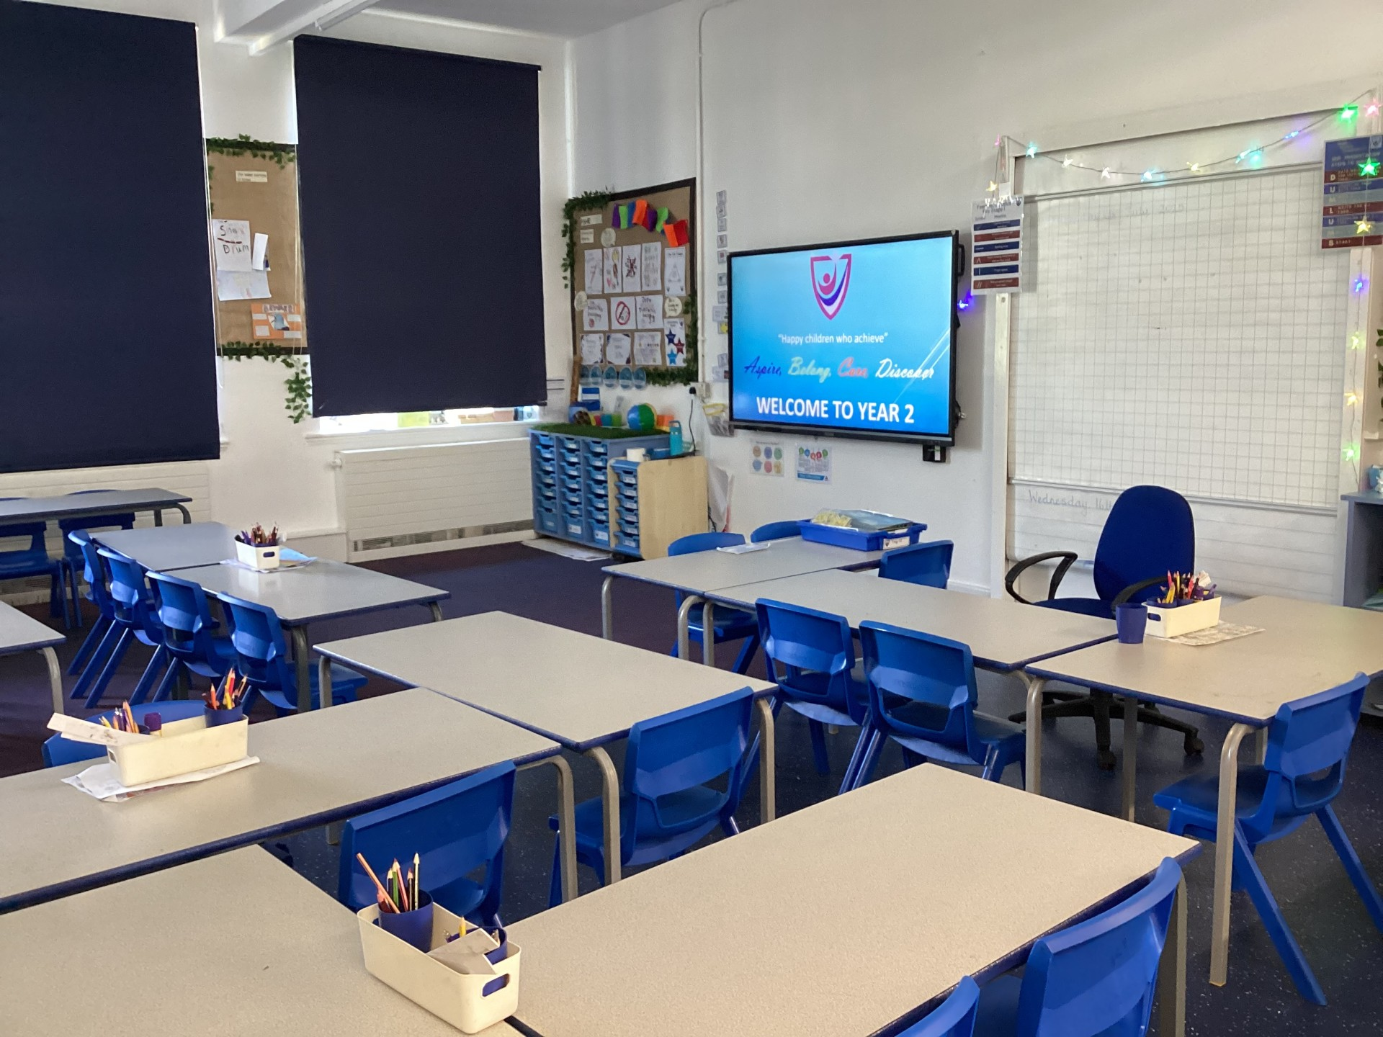
When I come back to school after the summer holidays I will be in Year 2.
I will have a new classroom.

Slide 3
My new teacher is Mrs. Lambert.

Slide 4
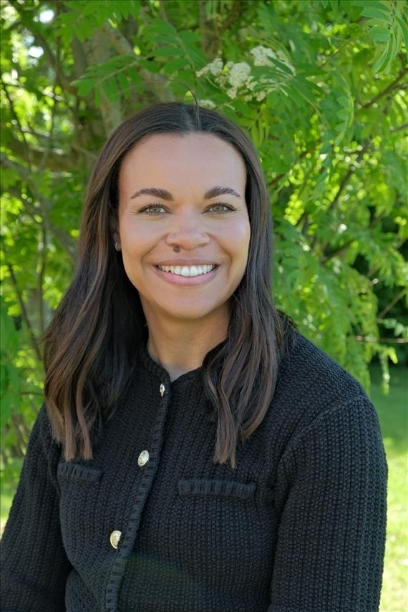
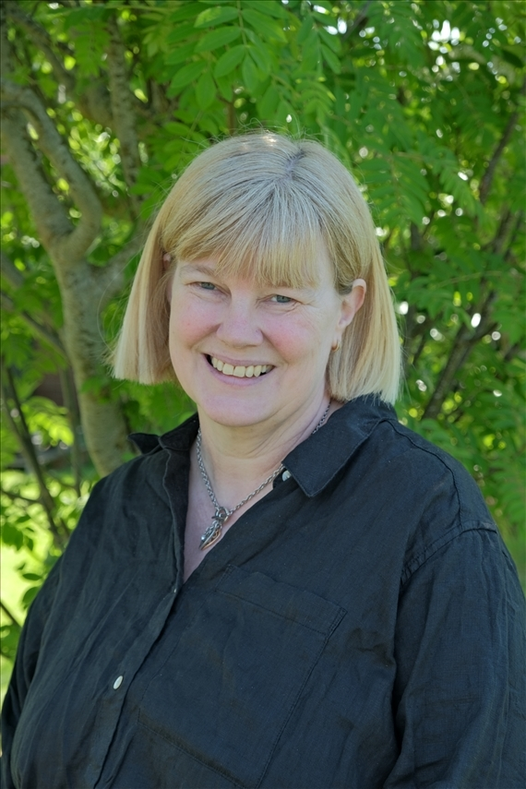
Other people who can help me in Year 2 are:
Mrs Kirkpatrick
Miss Flint

Slide 5
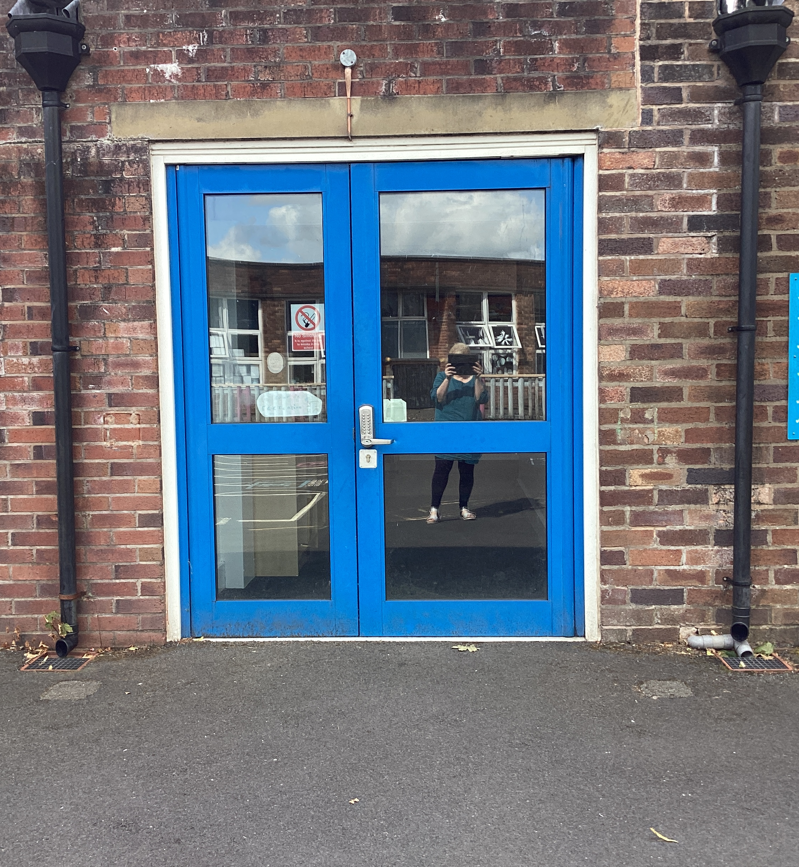
I come into school and leave by a different door.
This is the Year 2 entrance and home time door.

Slide 6
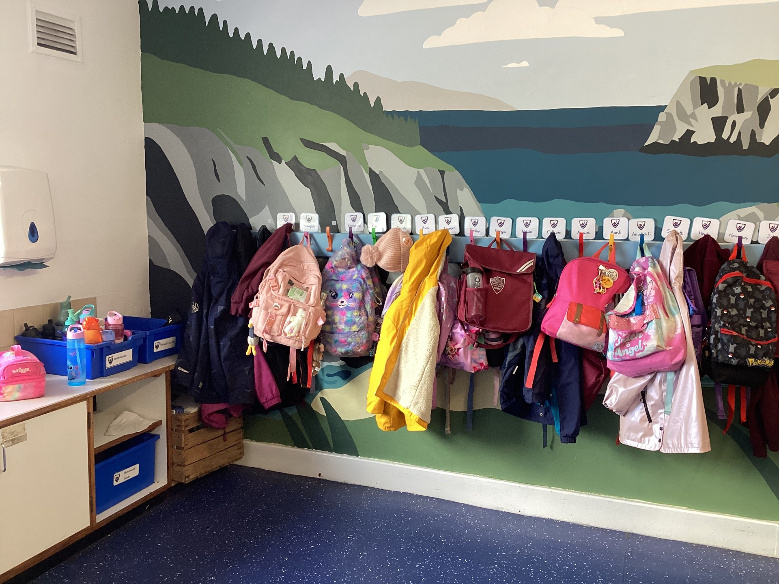
A day in Year 2 is just like a day in Year 1.
When I come into the classroom I will hang up my coat and bag.
I will get out my water bottle and put in the tray.

Slide 7
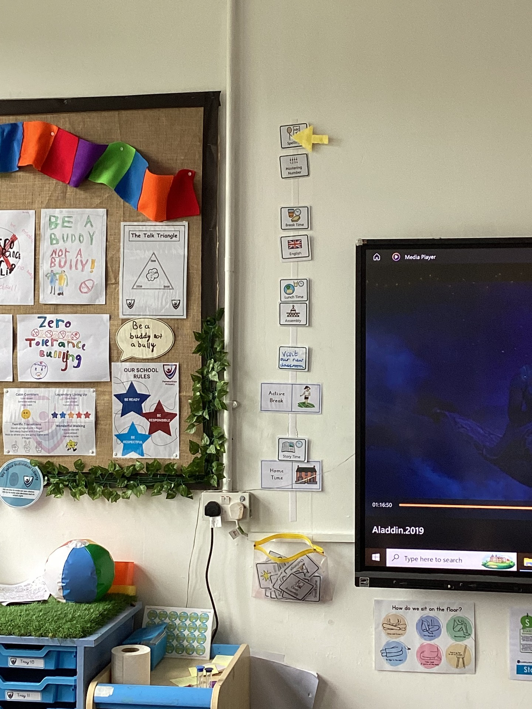
The Timetable
In the mornings
Morning work
English
Math
In the afternoons
All the other subjects – History, Geography, Computing, Art, Science, DT, RE PSHE, Music and PE
My teacher has a timetable in class to let me know what is happening that day – just like the one I had in Year 1.
I will go to assembly just like I did in Year 1.

Slide 8
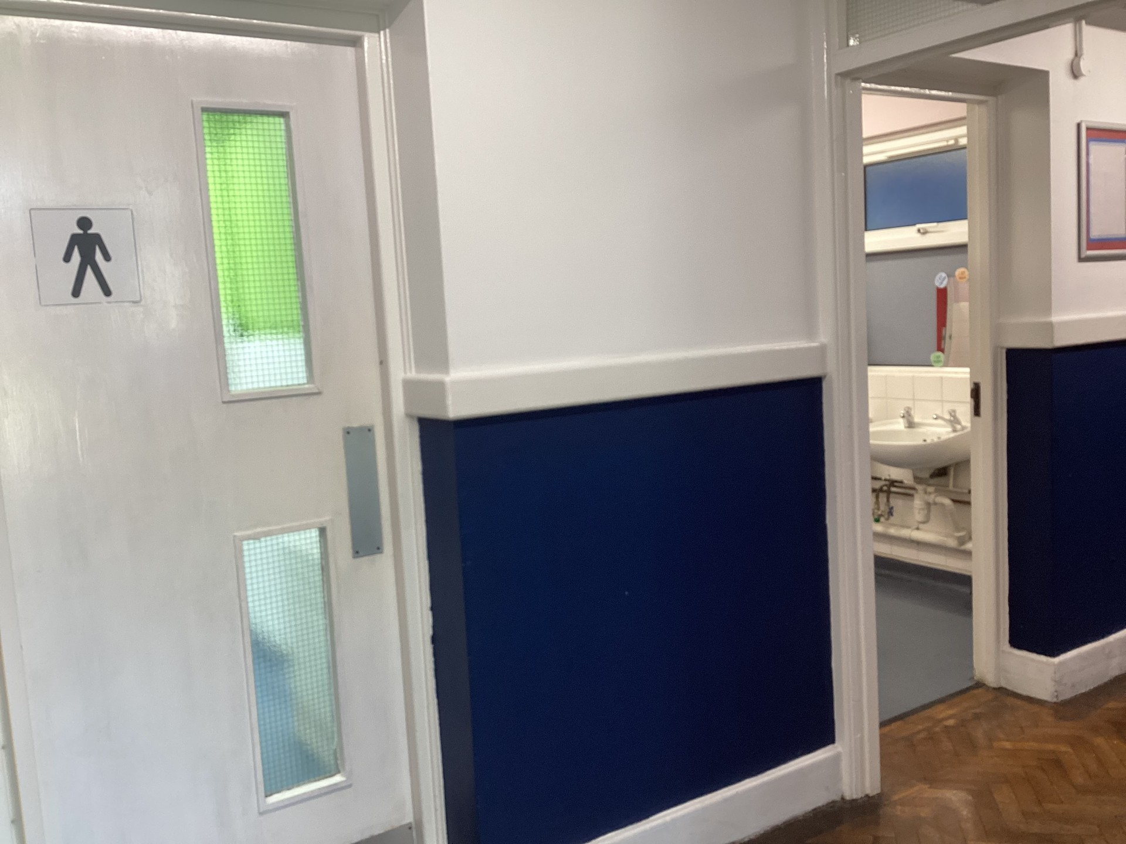
I will use the Year 2 bathroom.
This is the same bathroom I already use at lunchtimes.

Slide 9
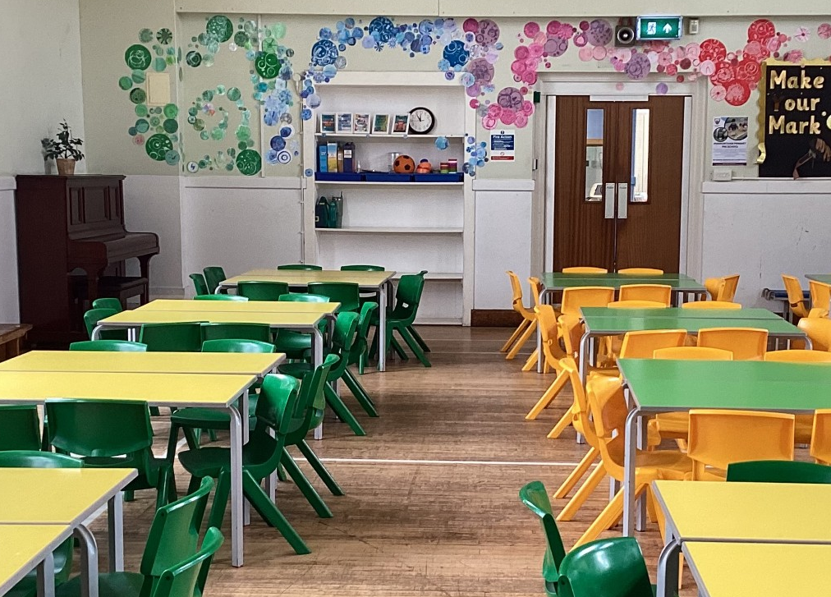
I will have my lunch in the hall.
Year 2 sit on these tables.

Slide 10
On Thursday 17th July, I will go with my friends and spend the afternoon with
Mrs. Lambert in the Year 2 classroom.

Slide 11
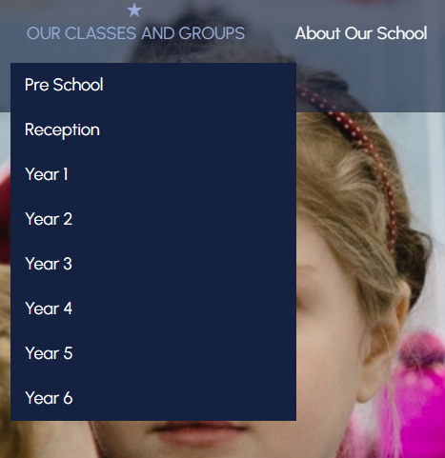
This is the website with all the information about Year 2!
Penwortham Primary School: Headteacher Welcome
On here you will find a timetable for the week and a curriculum overview for the half term.

