Slide 1
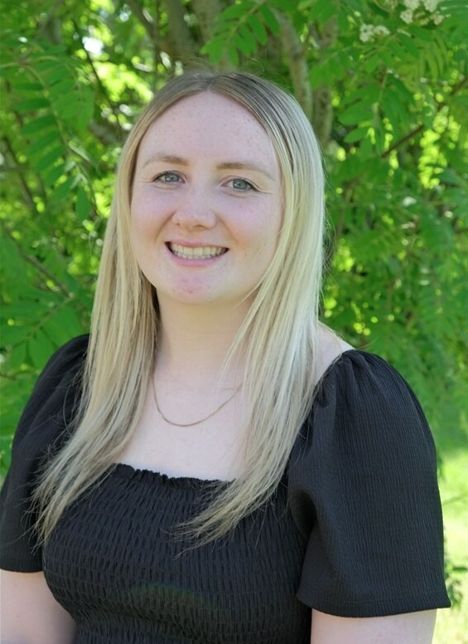
Moving from Reception to Year 1

Slide 2
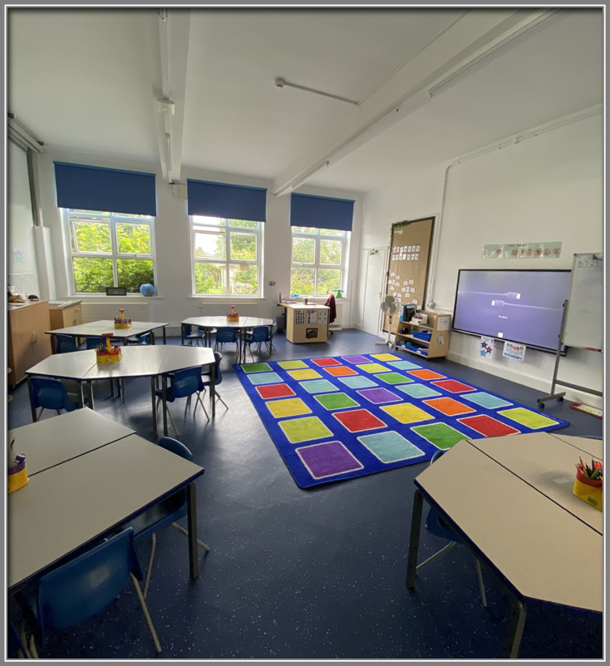
When I come back to school after the summer holiday, I will be in Year 1. I will have a new classroom.

Slide 3
My new teacher is called Miss Lilley.

Slide 4
Other people who can help me in Year 1 are:

Slide 5
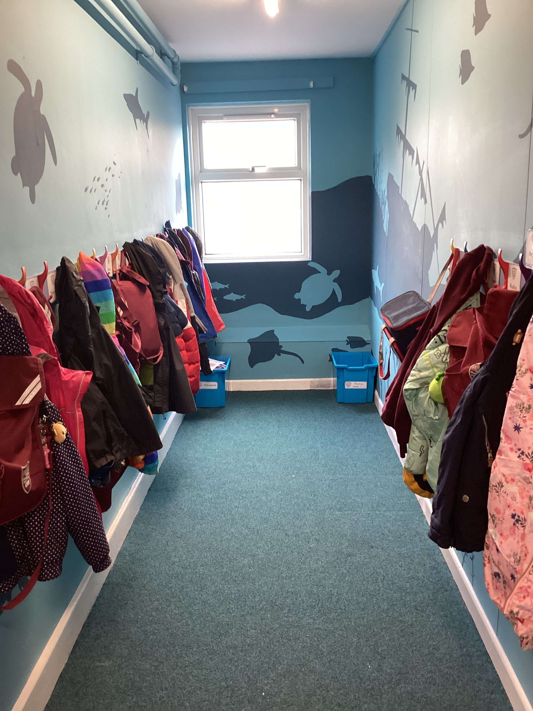
When I come into the classroom, I will hang my coat and bag on my peg.
I will get out my water bottle and put it in the tray.

Slide 6
I come into school and leave by a different door. This is the Year 1 entry/home time door. It is accessed from the main playground

Slide 7
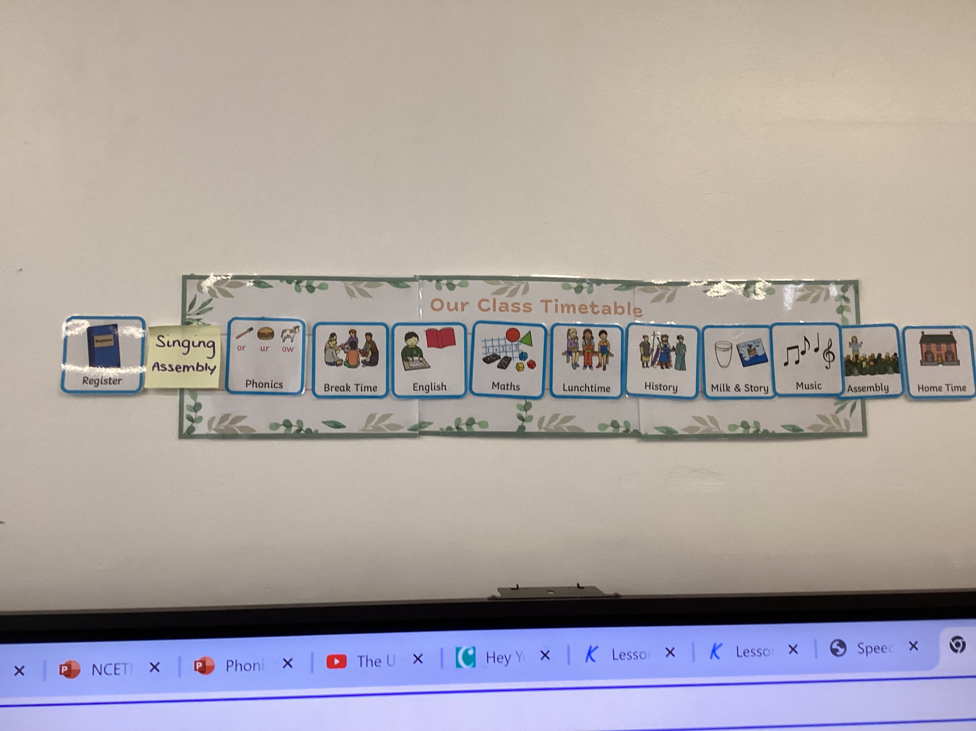
The Timetable
In the mornings
Morning work
English
Math
In the afternoons
All the other subjects – History, Geography, Art, Science, DT, RE PSHE, Music and PE
My teacher has a timetable in class to let me know what is happening that day – just like the one I had in Reception.
I will go to assembly just like I did in Reception.

Slide 8
I will use the Reception/Year 1 bathroom.

Slide 9
I will have my lunch in the hall. Then I will go outside to play.

Slide 10
On Wednesday 17th July I will go with my friends and spend some of the morning with Miss Liley in the Year 1 classroom.

Slide 11
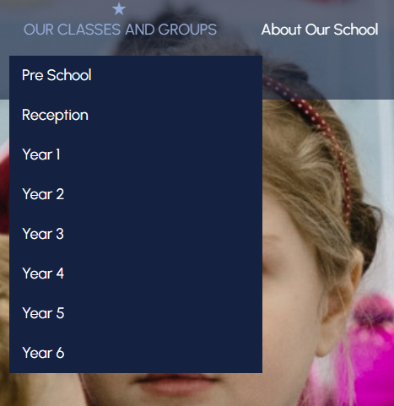
This is the website with all the information about Year 1! Penwortham Primary School: Headteacher Welcome On here you will find a timetable for the week and a curriculum overview for the half term.

