Slide 1

Welcome to

Slide 2
Mersey Vale Primary School is a…
…1 form entry primary school with a nursery
... warm, friendly, diverse family, with inclusion at our core. Like our badge says, we are “working together for a brighter future”
…restorative approaches school. Building, maintaining and repairing relationships is very important to us
…school which communicates via text, email, our website and letters, but has regular communications through Class Dojo
…happy, friendly school!

Slide 3

Mersey Vale’s Values

Slide 4
Welcome to Reception!
Please see the ‘Reception’ section of our school’s website for more information!
www.merseyvale.stockport.sch.uk

Slide 5
Today’s meeting will cover…
Early Years Foundation Stage Curriculum and Assessments
Parent/Carer information
Reading at home and school
Things to remember
Things that will help

Slide 6
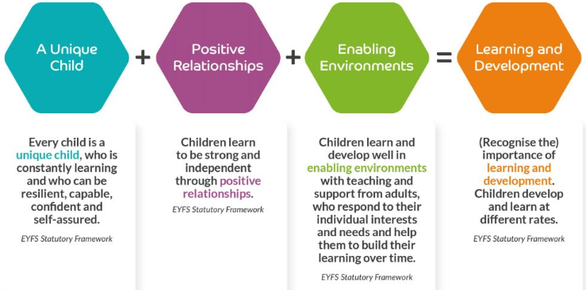
EYFS Themes and Principles

Slide 7
All children develop in different ways and at different rates.
Development is not a linear or automatic process.
Each unique child requires experiences and opportunities that encourage engagement and recognise their strengths and starting points.
All children have agency and curiosity to learn.
Understanding these different ways of knowing about the world is central to understanding who children are and how best to support their development.

Slide 8
‘Play’
“Through play, children learn new physical skills, imagine, pretend, explore, find out, release energy, relax, practice new behaviours, develop social skills, learn to turn-take, cooperate, overcome anxieties and fears, problem-solve, develop language and thinking, communicate thoughts, feelings and begin to understand others’ views.” (EYFS Policy)
“Play is essential for children’s development, building
their confidence as they learn to explore, relate to others,
set their own goals and solve problems.”
“Children learn by leading their own play, and by
taking part in play which is guided by adults.”
(EYFS Framework)

Slide 9
“Play both indoors and outdoors.”
“Opportunities to explore and take risks.”
“Playful teaching” “Multi-sensory and practical approaches”
“Having freedom and time to play in an appropriately stimulating and resourced environments support development and learning across all areas.”
“Experience of a variety of different ‘types of play’: sensory, messy, imaginative, robust, risky, quiet, physical, symbolic, constructive, creative… promotes engagement and enjoyment.”
“Learning environments provide for children operating at
different ‘stages of play and communication’.”

Slide 10
‘Enabling Environments’
“The environment plays a key role in supporting and extending children’s development and learning (Physical and Emotional).”
Continuous Provision carefully matched to ‘ages and stages’ of development:
Offers security, comfort, choice, engagement and opportunity
Allows for movement, action, creativity, imagination, independence and collaboration
Ignites creativity and critical thinking
Provides opportunities for sensory play and learning
Supports learning and development across and within all areas of learning and development (EYFS Curriculum)

Slide 11
Early Years Foundation Stage Profile
(EYFSP)
A continuation of children’s progression, following on from the development made at home and/or nursery setting.
7 - Areas of Learning
17 - Aspects of development

Slide 12
Early Years Foundation Stage Profile
(EYFSP)
The three Prime Areas of Learning make up a crucial part in early
child development and form the foundations upon which all
further learning is built.
PRIME Areas –
Personal, Social and
Emotional development
Physical development
Communication and Language

Slide 13
Personal, Social and Emotional
Development
Building Relationships
Managing Self
Self-Regulation

Slide 14
Communication and Language
Listening, Attention and Understanding
Speaking

Slide 15
Physical Development
Gross Motor Skills
Fine Motor Skills

Slide 16
Early Years Foundation Stage Profile
(EYFSP)
SPECIFIC Areas –
Literacy
Maths
Understanding the World
Expressive Arts and Design
The four Specific Areas of Learning give young children opportunities
to strengthen the prime areas and widen their knowledge of different
curriculum areas.

Slide 17
Literacy
Comprehension
Word Reading
Writing

Slide 18
Maths
Number
Numerical Patterns

Slide 19
Understanding the World
People, Culture and Communities
The Natural World
Past and Present

Slide 20
Expressive Arts and Design
Creating with Materials
Being Imaginative and Expressive

Slide 21
Assessments
Baseline assessment within the first six weeks of starting
On going teacher assessment to show progress throughout the year: using pupil voice, photographic evidence and teacher led planned activities
At the end of Reception, children are assessed against the 17 Early Learning Goals. This is shared with you at the end of the academic year.

Slide 22
Parent and Carer Information
The school day begins with the gate being opened at 8:40. The register is taken at 8:55. Home time is 3:20 and children leave from the same gate
We have a breakfast club and an after school club
EYFS Staff: Miss Bunting (Class Teacher), Miss Lansdale and Mrs Sadik (Teaching Assistants)
We have an open-door policy where staff are available to speak to parents either before or after school for a short period of time. However, if you need a longer conversation an appointment can be made
If your child is absent or late please inform the office with the reason for absence by telephone

Slide 23
Phonics, Reading and Writing
Please try to spend time reading with your child (any type of reading) for a few minutes a day - make it fun!
Once your child has settled in we will start our Read Write Inc phonics sessions daily. We will be following the scheme to learn letter sounds, blending sounds to read words, forming letters correctly and taking part in guided reading and one-to-one reading sessions.
Your child will come home with a reading book weekly, which is suitable and relevant for their stage in the phonics scheme.
It is important to read with your child at home and comment in their book.
More information will be given at our phonics workshop in the Autumn term.

Slide 24
Things to remember
Please ensure all admissions forms are completed and given to the school office.
If the adult collecting your child is different to those named as contacts, please inform the school office.
Each child is different and may take longer than others to settle. The staggered starts are there to support your child to settle in comfortably and happily.
Encourage your child to practice dressing and undressing in time for Autumn Term.
Purchase a book bag: important for reading and writing, homework and letters home. These need to be brought in every day

Slide 25
More things to remember
Please label all your child’s uniform and PE kit including pumps. They all look the same!
PE kit: light blue t-shirt/black or navy shorts and jogging bottoms/black pumps/navy top.
Snacks – children are provided with milk and fruit in the afternoons.
Your child will get messy even though we provide aprons – water/ sand/ paint/ dough/ glue/ gloop – but all products we use wash out.

Slide 26



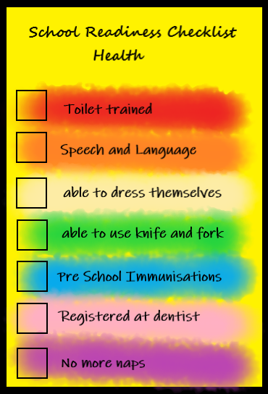
School Readiness

Slide 27
School Readiness
Further websites/resources to help…
https://pathways.org/kids-learn-play-6-stages-play-development
www.startingreception.co.uk
bbc.co.uk/tiny-happy-people
www.booktrust.org.uk
www.wordsforlife.org.uk
https://foundationyears.org.uk/files/2021/09/What-to-expect-in-the-EYFS-complete-FINAL-16.09-compressed.pdf

Slide 28
Welcome!
We look forward to meeting your child at the transition morning next week: Thursday 2nd July, 9:30am – 10:30am and seeing parents at the parent meetings in September.
We look forward to welcoming you all to Mersey Vale.
Miss Bunting and the EYFS Team

