Slide 1

Oracy at Mersey Vale
To learn how to talk and listen effectively and use these improved skills in all lessons to help us learn and achieve more.

Slide 2
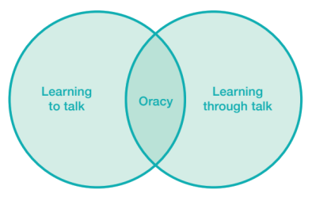
What is oracy?
Oracy is the ability to express yourself fluently, confidently and effectively through spoken language.
Being able to speak well isn’t just about using good grammar or having a rich vocabulary. It’s about knowing when to speak, how to structure ideas so they make sense, how to listen to others and how to respond thoughtfully.
In school, oracy is a powerful tool for learning; by teaching students oracy skills we empower them to better understand themselves, each other and the world around them.
It is also a route to social mobility, empowering all students, not just some, to find their voice to succeed in school and life.

Slide 3
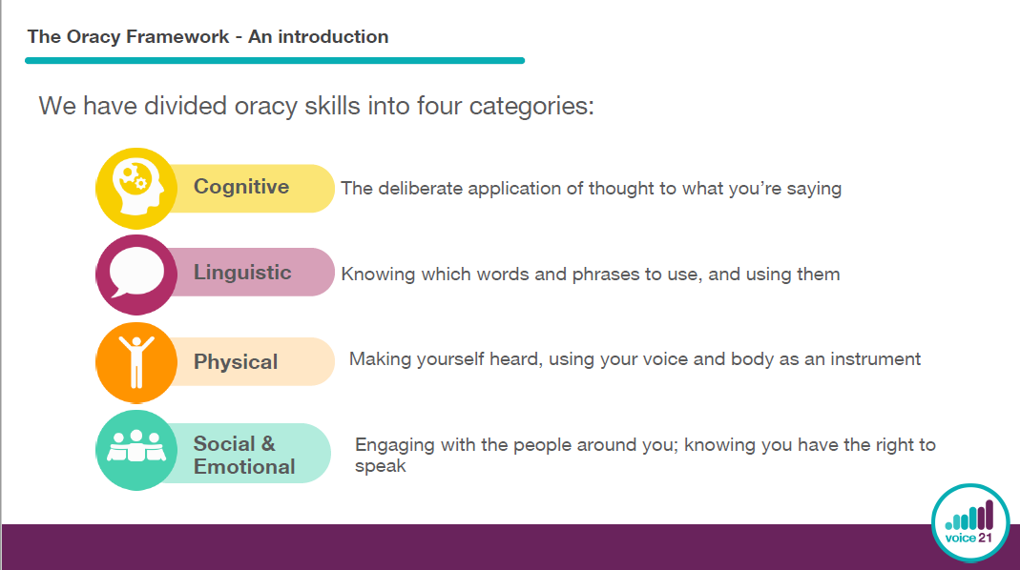
How do we teach oracy?

Slide 4
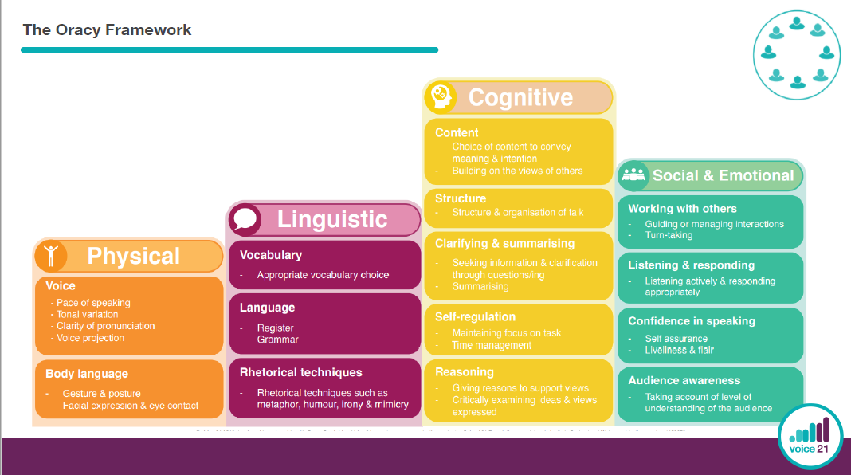

Slide 5
Introducing the Framework to children
If I ruled the world…
Articulate!
Which emotion
1-20 game

Slide 6
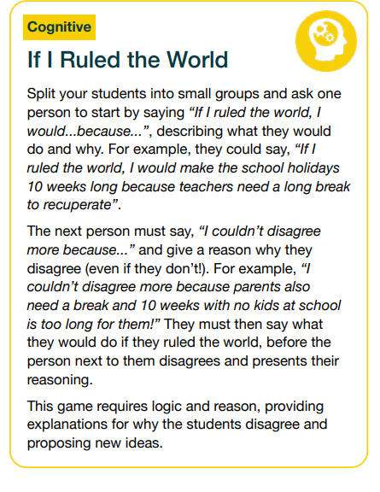
Let’s practise our cognitive oracy skills…
“If I ruled the world I would……because….”
“I couldn’t disagree more because…”

Slide 7

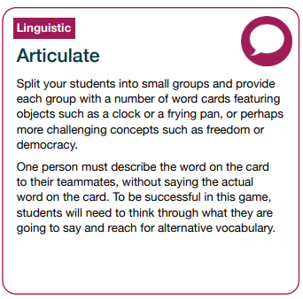
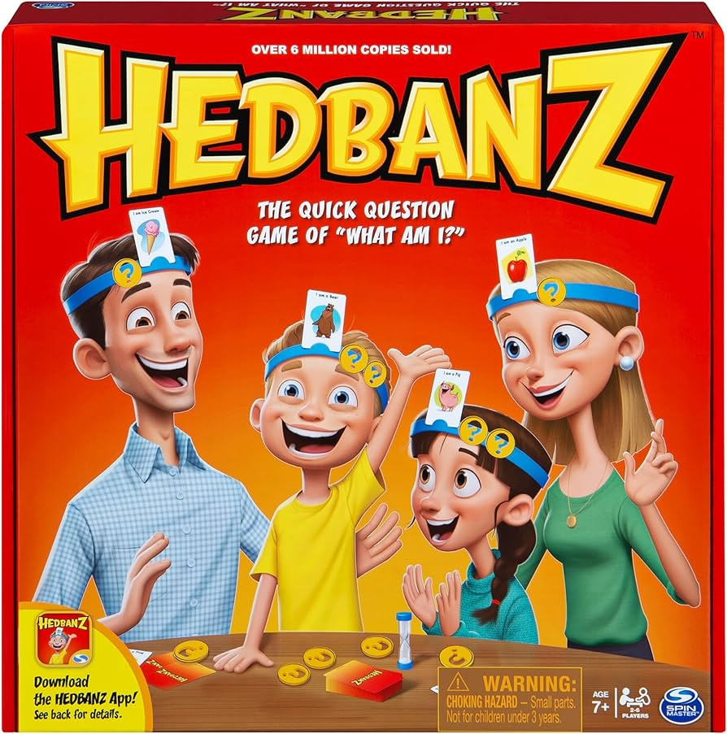
Describe the word to your friends but don’t use the word itself!!
Let’s practise our linguistic oracy skills…
Notes:
7

Slide 8
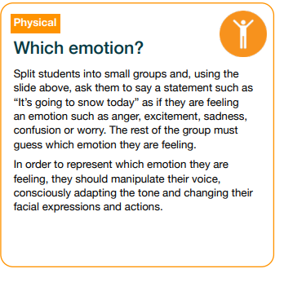
Choose a sentence and use physical oracy skills to say it with an emotion!
Let’s practise our physical oracy skills…
I am having pizza for tea.
It’s going to snow today.
Choose:
Anger/ excitement/ sadness/ confusion/ worry/ fear/ happiness
I've got PPA this afternoon. The photocopier is broken.
Anger/ excitement/ sadness/ confusion/ worry/ fear/ happiness
Notes:
8

Slide 9
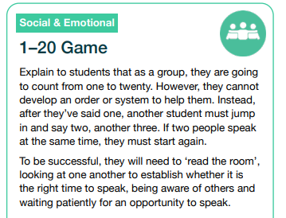
Let’s practise our social and emotional oracy skills…
Count up to 20 in your group.
You can’t go in order or use a system!
Read the room, be aware of others!

Slide 10
Oracy in EYFS
Weekend News, Circle Time - Back and forth conversation
Tales Toolkit – drama, story sessions, puppets
My turn / your turn modelling language – adults in the classroom and children
Sharing books during story time on the carpet
Nursery rhymes – vocab and using Makaton signs
The story voice – teacher led
Show and Tell
Key, well chosen vocabulary in provision / on display, modelled by adults
Carefully chosen texts with repetition to promote children joining in
Taking children’s lead on interests, narrating their play, not asking too many questions!
Thinking time

Slide 11
Our oracy toolkit…what will you see today?
EYFS- Range of provision, activities on tables- adults interacting with children.
Y1-Whole class Read Write Inc .session. My turn/ your turn, partner reading
Y2-The Journey Home English lesson. Vocabulary focus , sentence types-exclamations/ commands/ statements/ questions
Y3- The four strands-oracy games
Y4-Barrier games, Iron Man round robin, Articulate oracy game!
Y5 -Would you rather? Practising oracy skills leading to partner writing
Y6-Oracy in arithmetic

Slide 12
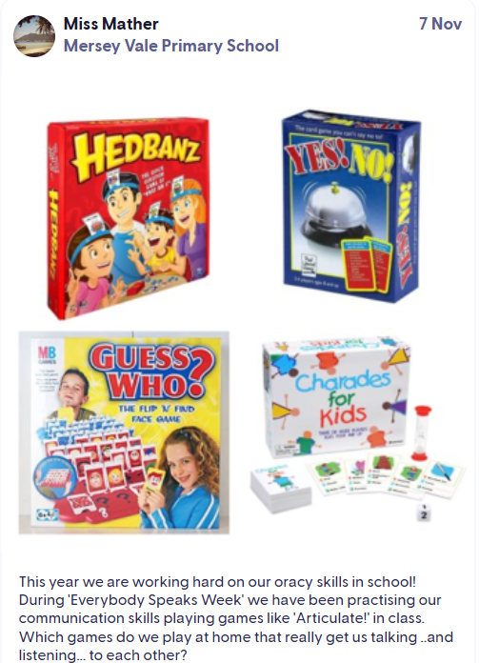
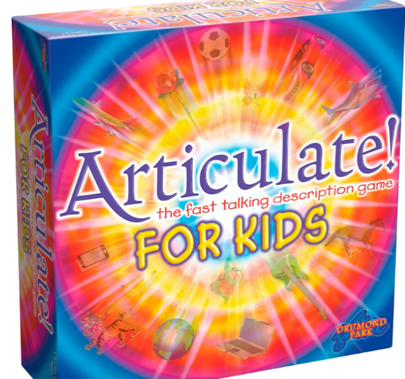
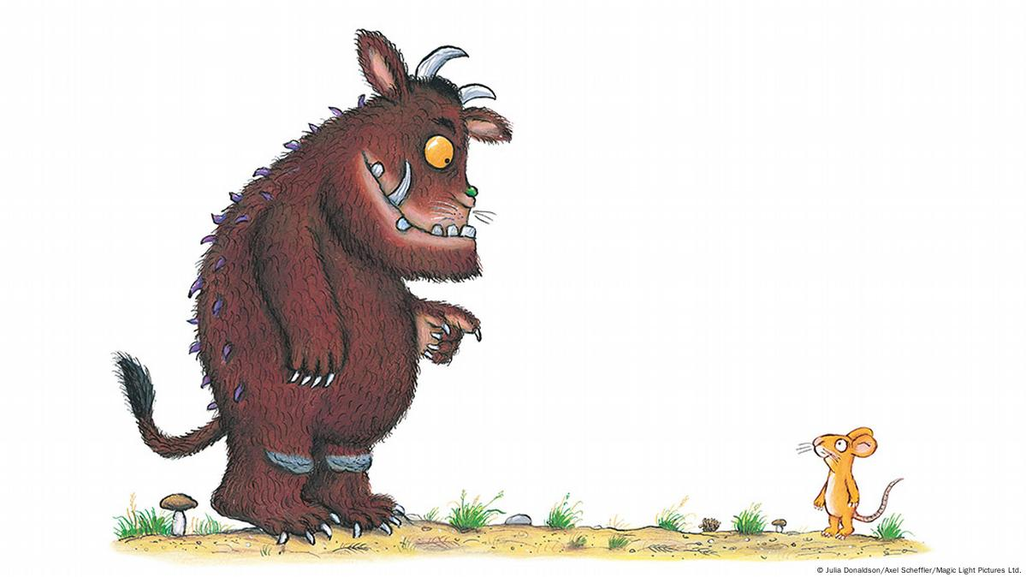

How can we support at home?
Read aloud to your child, beyond the age they can read themselves
Talk about the characters/ events etc. Re-reads are good!
Repeat and extend children’s responses when reading or any time!
Ask the question, “Why?” Encourage curiosity
Play word games
Phone family members
Find ways in to get them to talk about their day
Record video diaries
Talk for ten homework activities
Roleplay

