Slide 1
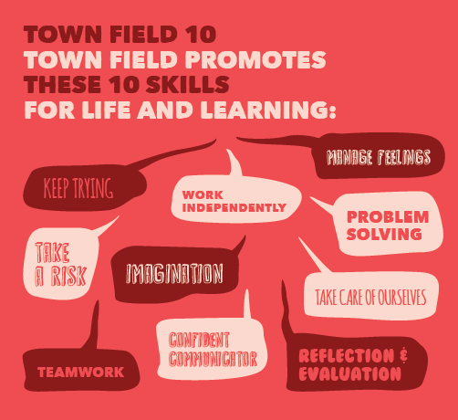


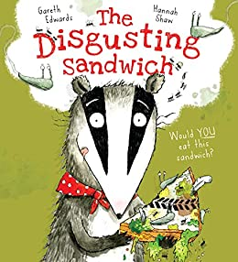
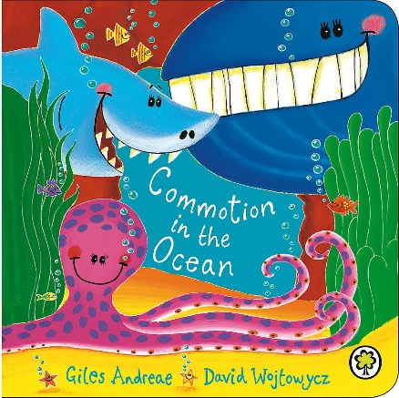
English
In our English lessons this term, we will be reading ‘The disgusting sandwich,’ by Gareth Edwards. We will learn how to identify nouns and imperative verbs in writing and use these words when writing instructions telling someone else how to make a disgusting sandwich! We will explore descriptive language and use adjectives to describe settings. After exploring various settings we will write our own introduction to the story while changing the setting.
During writing meetings we will continue to work on handwriting in the cursive style from letter join including letter shape and size and consolidate basic writing skills.
Maths:
We continue to learn out 2, 5 and 10 times tables. Children can practise online using Times tables rock stars. In our maths lessons, we will be learning how to recognise equal groups using arrays and then forming multiplication equations using the ‘x’ symbol. We will use our knowledge of making equal groups to share and group for division. We will learn to identify and recognise coins and notes. We will count amounts, compare money and find the difference between amounts. Finally, we will calculate change given using two step word problems.
Year 2
Spring Term Learning Project
STEM:
World Around Us:
In Geography we will learn how to identify geographical similarities and differences through studying the human and physical geography of a small area of the United Kingdom, and of a small area in a non-European country. We will compare Doncaster to Mugurameno. Children will locate and name the seven continents and five oceans.
In History, we will use research skills to find out about Sir Nigel Gresley and how he is significant in the history of transport in Doncaster. We will discover the significance of Doncaster in relation to it’s position in the country and transport links.
In Design Technology, we will understand what a healthy diet is and what to eat in order to have a healthy diet. Design and make a healthy meal while understanding where food comes from.
In Science, children will name and identify different animals and understand how they are suited to different habitats. Children will group animals according to what they eat and use simple food chains to describe these relationships.
Sports, Arts and Culture:
We will keep fit and healthy in school and at home using a combination of work outs with Mr Cullen and use resources from the Active fusion website.
Children will investigate and use various techniques to draw lines and create tone. Children will use their pencils to create darker tones using pressure and layering techniques.
Children will use their voices creatively and expressively by singing songs, speaking chants and rhymes. They will experiment with, create, select and combine sounds.
Notes for Parents:
Read every day / listen to a book being read to them by an adult to support with fluency
Make sure you practice your weekly spellings from Spelling Shed (www.spellingshed.com)
Login to bug club, oxford owl and phonics play to support with phonics and reading
Login to www.mathswithparents.com and Times Tables Rockstars
*please contact your class teacher if you need passwords for the above

