Slide 1





PSHE and RSHE OVERVIEW 2026-27

Slide 2










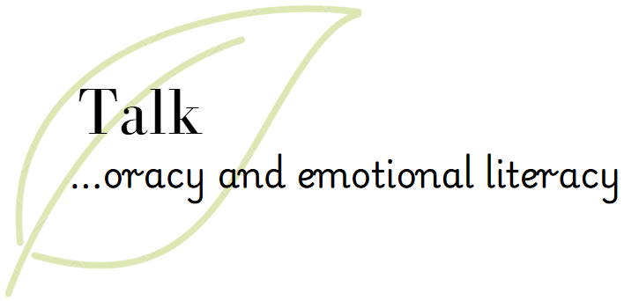



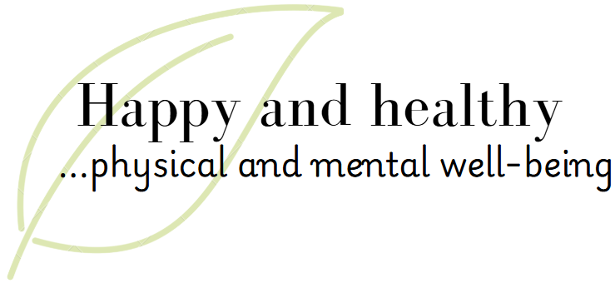
PSHE and RSE
at Town Field Primary School
At Town Field Primary School, we make use of Kapow Primary to inform our PSHE and RSE planning, which is built upon the PSHE Association’s recommended coverage alongside the statutory requirements for Relationships and Sex Education.
Children will build knowledge in the following areas:
While PSHE is taught as a discrete subject, wherever possible, we strive to make links between other curriculum subjects, our over-arching curriculum themes- belonging, motivation and change- and the wider world. PSHE and RSHE also play a key role within our Growth Curriculum for personal development:
My healthy self
Connecting with others
The online world
Health protection
Transition
Citizenship
Growing Up
Staying Safe

Slide 3
PSHE and RSE Overview
My healthy self
Connecting with others
The online world
Health protection
Transition
Citizenship
Growing Up
Staying Safe
 | Autumn Term | Spring Term | Summer Term
Year 1 | Transition to new classes Setting ground rules for PSHE and RSE How can we look after our emotions? How can I help myself and others feel happy and safe? | How do we spend time online? How can I help others and the environment? | How can I protect myself and others in daily life? How can I stay safe? Transition to new classes
Year 2 | Transition to new classes Setting ground rules for PSHE and RSE How can we look after our bodies? How can I build safe, kind and caring relationships with others? | How can we stay safe online? How do people belong to a community and earn money? | How can we look after and respect our bodies as we grow up? How can I make safe choices in different places? Transition to new classes

Slide 4
My healthy self
Connecting with others
The online world
Health protection
Transition
Citizenship
Growing Up
Staying Safe
Key Stage Two | Year 3 | Transition to new classes Setting ground rules for PSHE and RSE How can I look after my mind and body? What helps us feel safe and included? | How should we communicate online? What rights and responsibilities do we have? | How can we prevent illness or injury and respond if they happen? What careers do people choose and why? Transition to new classes
 | Year 4 | Transition to new classes Setting ground rules for PSHE and RSE How can I make healthy choices? How can we respect each other? | How can we decide what to trust online? How can I spend my money wisely? | How will my body and emotions change as I grow up? What signs help me recognise what is safe and unsafe? Transition to new classes
 | Year 5 | Transition to new classes Setting ground rules for PSHE and RSE How can I support my mind and body as I grow? Why are healthy relationships important? | How am I influenced by what I see online? How can we make a difference in our communities and beyond? | How can I manage the changes to my body and emotions as I grow up? How can we be in control of our money? Transition to new classes
 | Year 6 | Transition to new classes Setting ground rules for PSHE and RSE How do my choices today shape my future health? What does it mean to stand up for myself and others? | How do I feel about things I see online? How can we protect everyone’s rights? | How can I stay safe as I grow up? Sex Education Transition to new classes

Slide 5
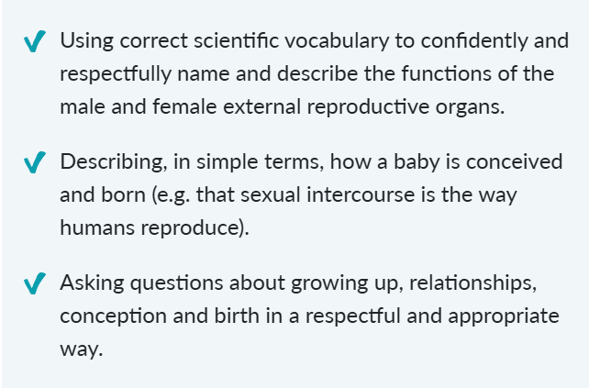
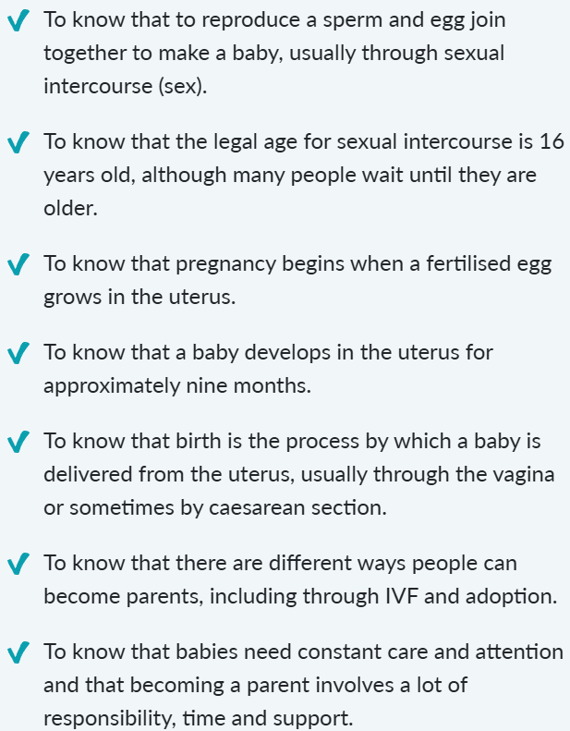
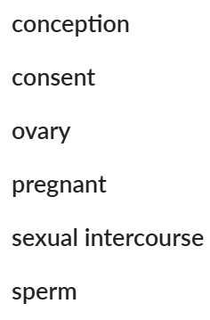
Skills
Knowledge
Growing Up
Year 6
Sex Education
Vocabulary

