Slide 1
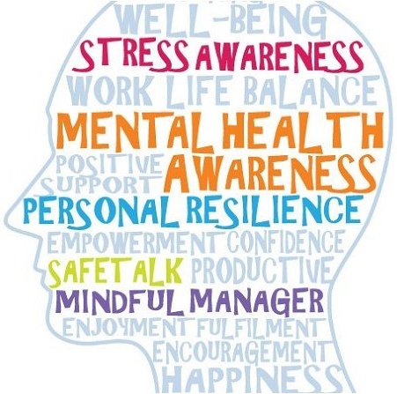
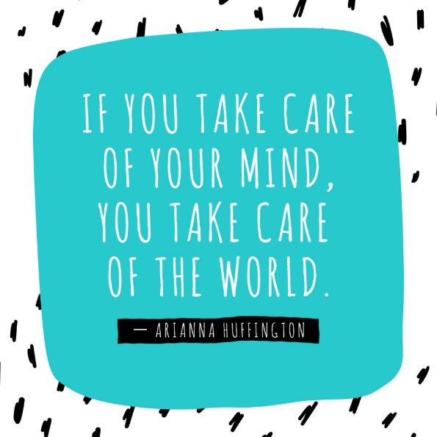



Supporting your child and promoting positive mental health
Wednesday 30th June
10 am

Slide 2
By the end of the session you will:
Have an understanding of what mental health is.
Understand ways to support your child’s mental health and your own mental health.
Have an awareness of services available to support children and parents in Doncaster.
Have a list of resources, contacts and websites which you can go to for more information.

Slide 3
What is mental health?

Slide 4
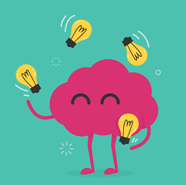

What is mental health?
We all have mental health just like we all have physical health.

Slide 5
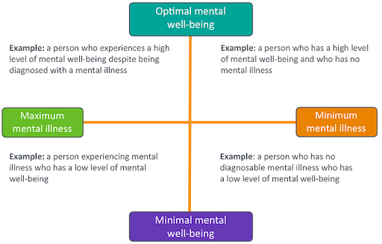
What is mental health?
“Mental health is a state of well-being in which every individual realises his or her own potential, can cope with the normal stresses of life, can work productively and fruitfully, and is able to make a contribution to her or his community.”
(World Health Organization)

Slide 7
Ways to support your child's mental health.

Slide 8

Find the time to talk.
Communication is one of the most powerful tools for mental health.
Socialising and talking to others helps to increase our wellbeing.
Talking about positives and negatives in our day can help us to reflect and put things in to perspective.
If a child is struggling, end each day focusing on the positives. ‘3 good things’.
We need to provide our children with the opportunity to talk about how they are feelings, share their worries and we as adults need to actively listen.
Even simple things like saying hello,
asking how someone is and asking how
there day is can improve wellbeing.
It makes you feel cared for!

Slide 9
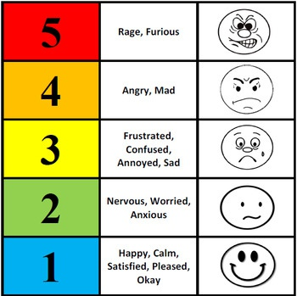
Role model. Be open and honest.
Children learn from watching us. If we talk about how we are feeling it normalises it for children.
It is okay to tell children you have had a hard day. Use language they understand and then look ways to make yourselves feel better if you are struggling.
By doing this children will learn to understand and manage their feelings.

Slide 10

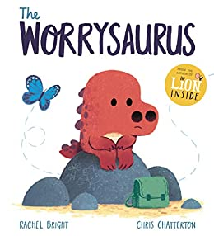




Stories
Stories can help children understand situations.
It can offer relatable characters.
Start conversations with adults and other children.
Help to understand feelings and emotions.

Slide 11
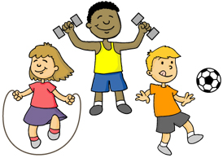
Healthy lifestyle: Diet and exercise
Exercising regularly can improve your mood and self-confidence; it can increase your energy during the day and help you sleep at night.
When you exercise, it releases a chemical in your body called endorphins. This chemical triggers positive feelings and emotions.
Eating a healthy and balanced diet can help to improve our
wellbeing, mood and mind-set. We need to ensure we eat the right food to give our body enough energy to look after itself. Sugar and caffeine can effect our ability to focus and concentrate.
SENDIAS

Slide 12

Technology breaks
It is important to take a break from technology and connect with the world. TV, tables and phones can affect your sleep and mental wellbeing.
The blue light that comes through your screen is similar to daylight, so it makes your body think that it is daytime and want to stay awake longer.
Breaks help us to reconnect with the world around us and each other.
Pressures and expectations from social media can cause stress and anxiety, especially for children and teenagers.

Slide 13
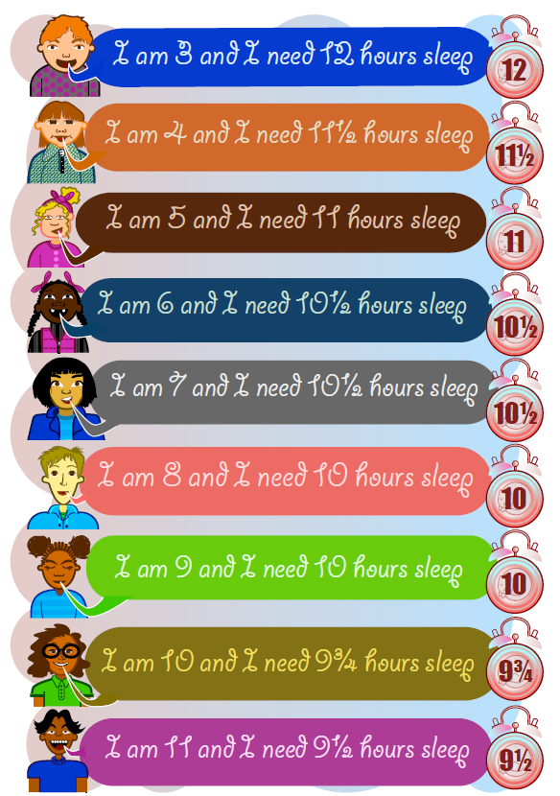

Sleep
Getting good sleep, and enough of it, can help us have more energy, feel more positive, and feel less stressed.
Lack of sleep negatively affects your emotional state. You may feel more impatient or prone to mood swings. It can also compromise decision-making processes and creativity.
To help sleep have clear routines, time before bed away from technology and provide a calming environment.

Slide 14

Nature
Spending time in green space or bringing nature into your everyday life can benefit children mental and physical wellbeing.
Being around nature can help to reduce stress, help children to feel calm and relaxed, improve physical health and help to improve wellbeing.
Nature has a calming impact on children and being outside can often provide them with the space to feel free, to explore and to enjoy themselves.

Slide 15

Relaxation, enjoyment and creativity.
What we do to relax and the things we enjoy are different for all of us. Taking time to relax can give us time to de-stress think and feel calm.
Mindfulness activities can help us to relax and switch our focus from the world around us to a calming activity.
Spending time doing something we enjoy can make us feel happier and more relaxed, have fun, boost relationships with others, and even help develop a skill.
Similar to exercise, doing things we enjoy can reduce stress and release endorphins in our body.

Slide 16
Mental Health and wellbeing services in Doncaster.

Slide 17
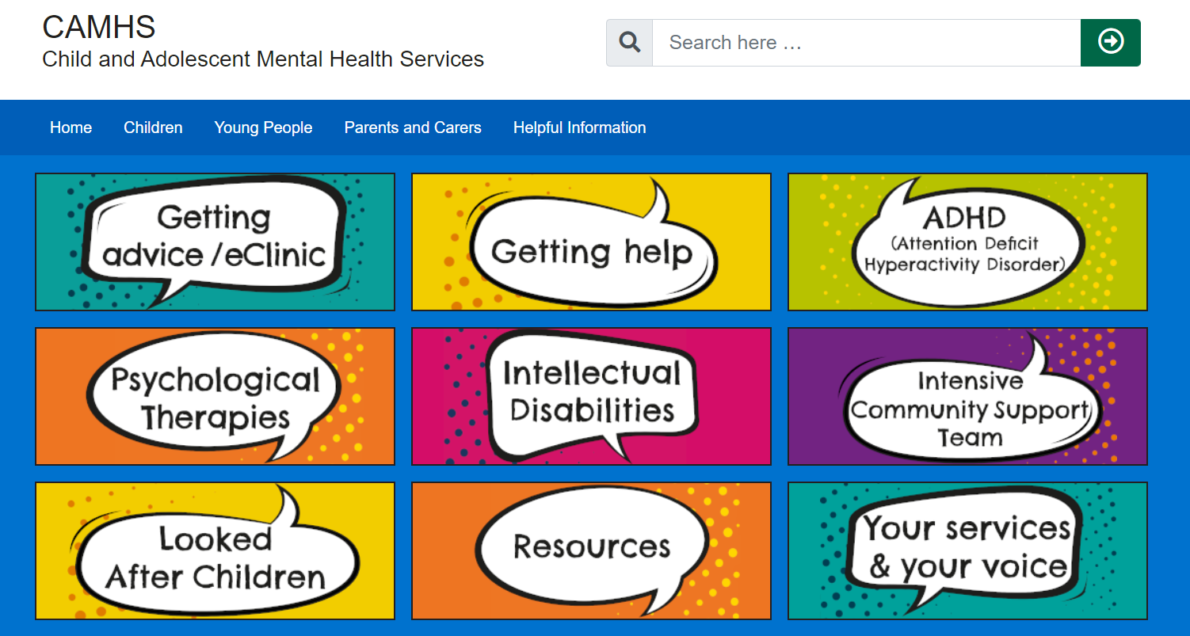
CAMHS
Children and Adult Mental Health Services
https://camhs.rdash.nhs.uk/doncaster/

Slide 18
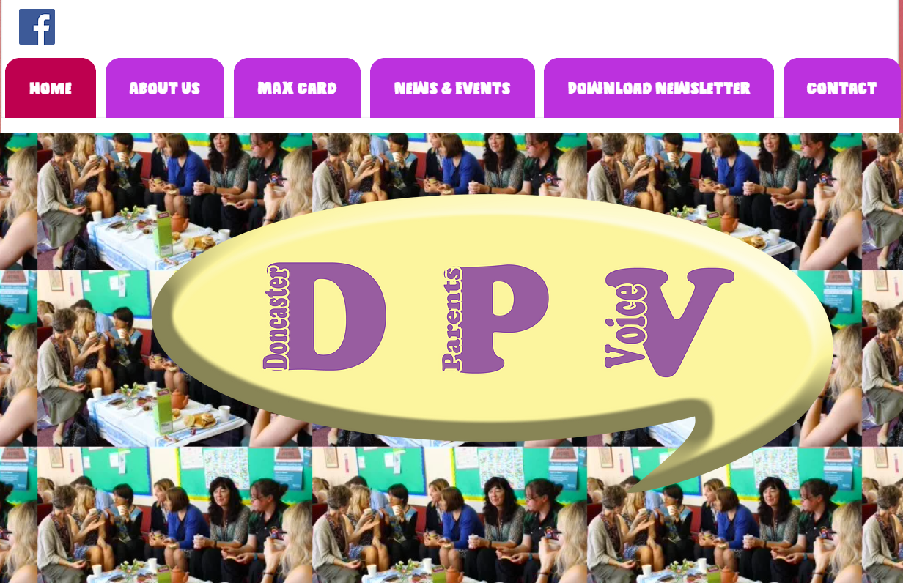
Doncaster Parents Voice
https://www.doncasterparentsvoice.co.uk/

Slide 19
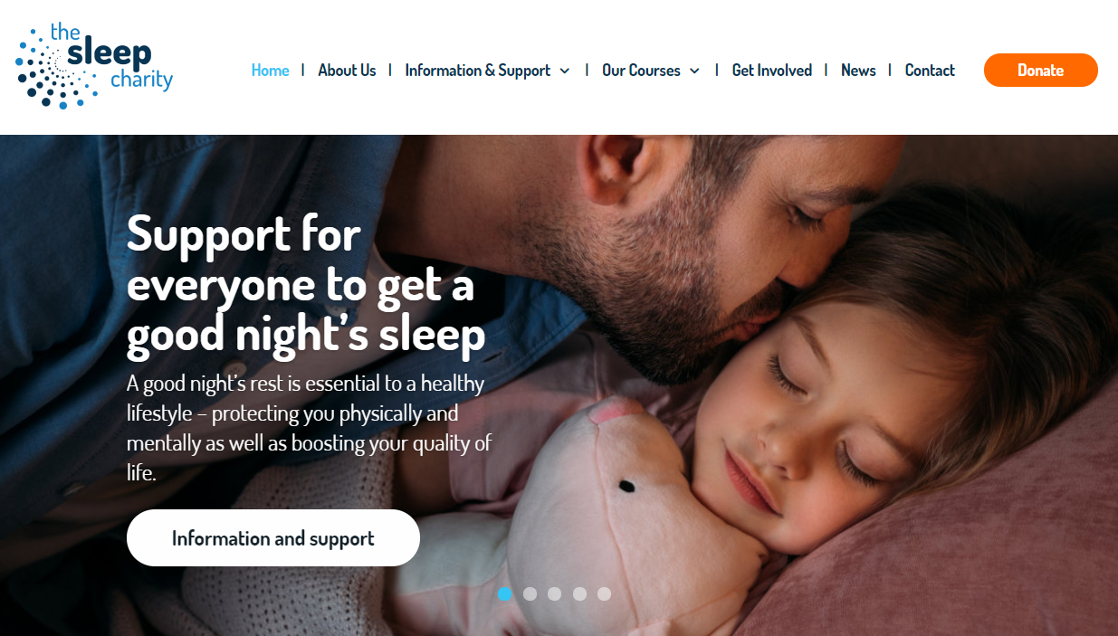
The Sleep Charity
https://thesleepcharity.org.uk/

Slide 20
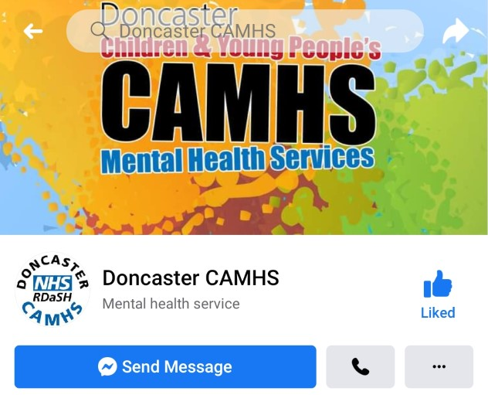
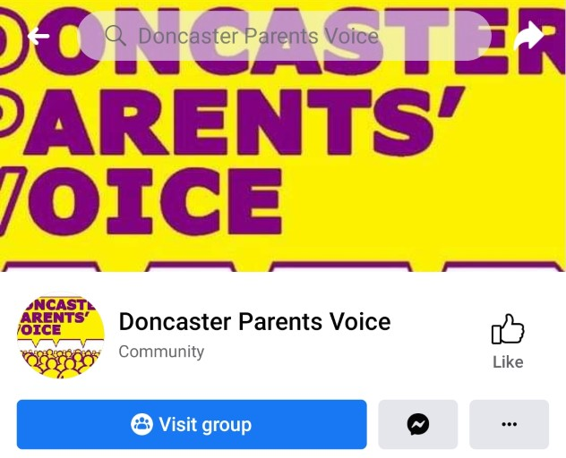
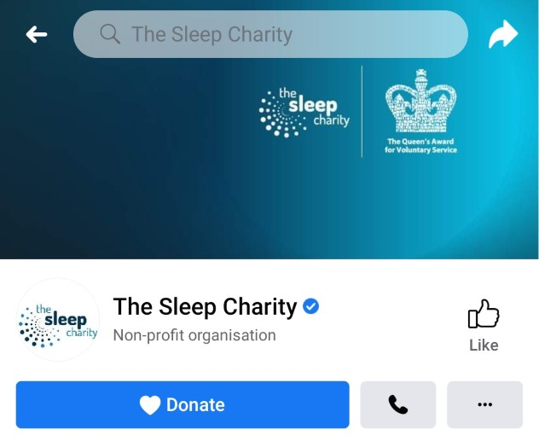
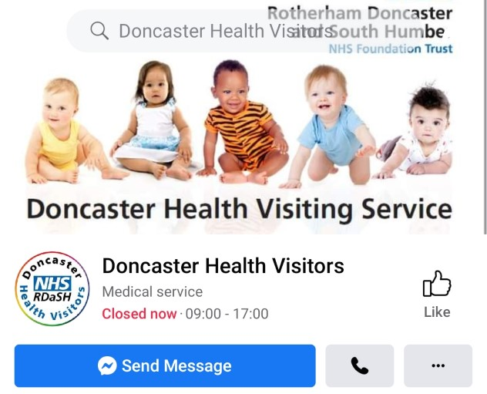
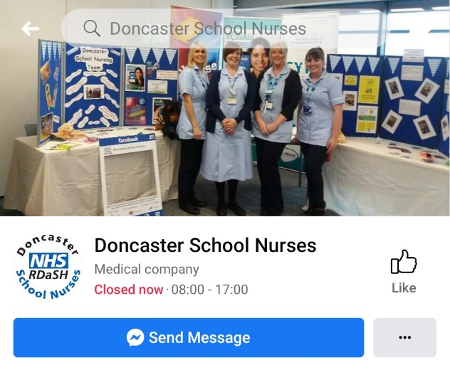
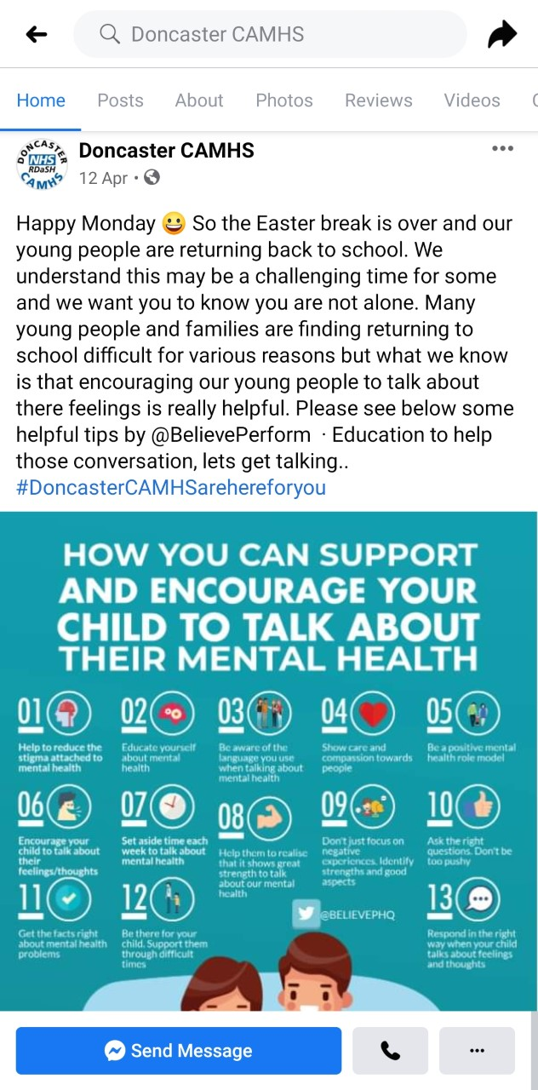
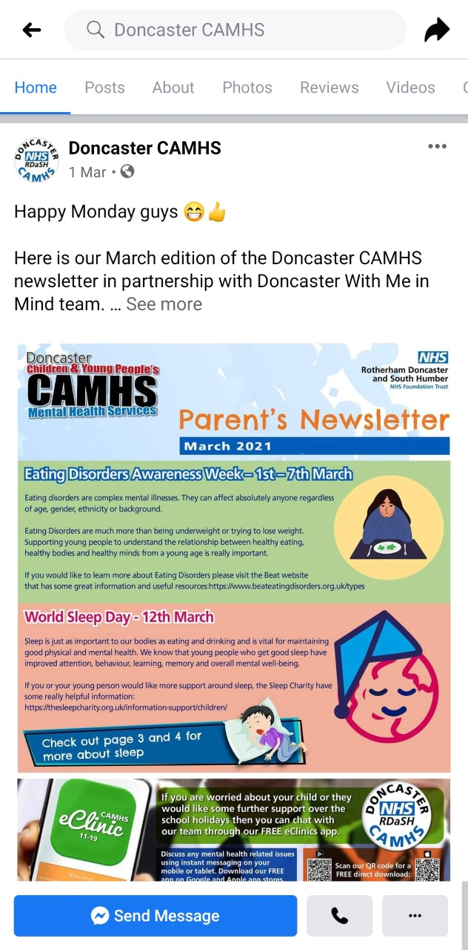
Facebook pages

Slide 21
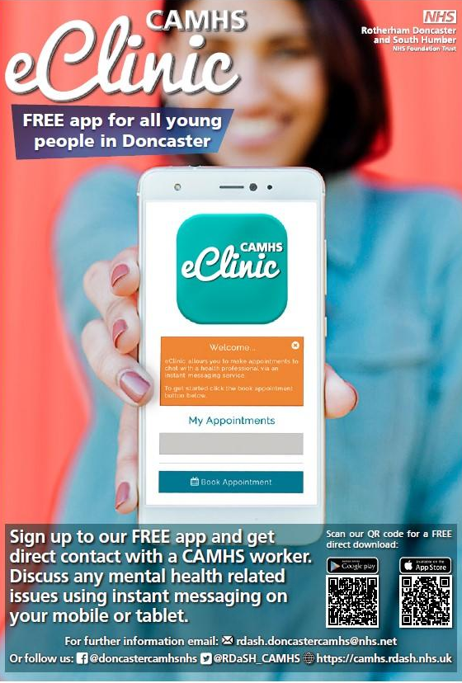
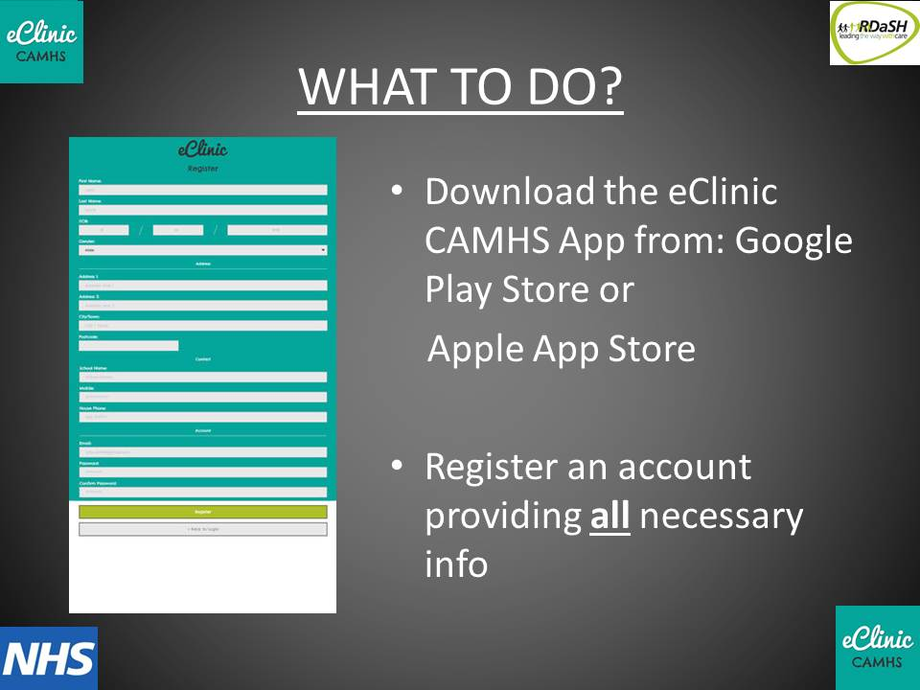
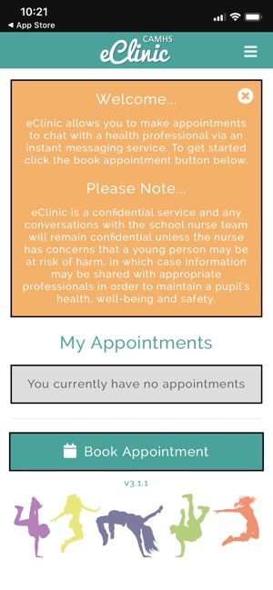
CAMHS eClinic app

Slide 22
Other useful online resources.

Slide 23
Useful websites:
Young minds – Website for mental health aimed at young people up to the age of 25
https://youngminds.org.uk/blog/what-to-do-if-you-re-anxious-about-coronavirus/
Mental Health Foundation – Website for support children and young people’s mental health
https://www.mentalhealth.org.uk/a-to-z/c/children-and-young-people
Children’s society – Advice and resources on how to improve wellbeing and mental health https://www.childrenssociety.org.uk/back-to-school/childrens-well-being-and-mental-health
Action for children – Guide on how to support mental health
https://www.actionforchildren.org.uk/support-for-parents/children-s-mental-health/
NHS – Children and adolescent mental health services
https://www.nhs.uk/using-the-nhs/nhs-services/mental-health-services/camhs-information-for-parents-and-carers/
Place2Be – Website for mental health aimed at young people
https://www.place2be.org.uk/our-services/parents-and-carers/supporting-your-child-s-mental-health/

Slide 24
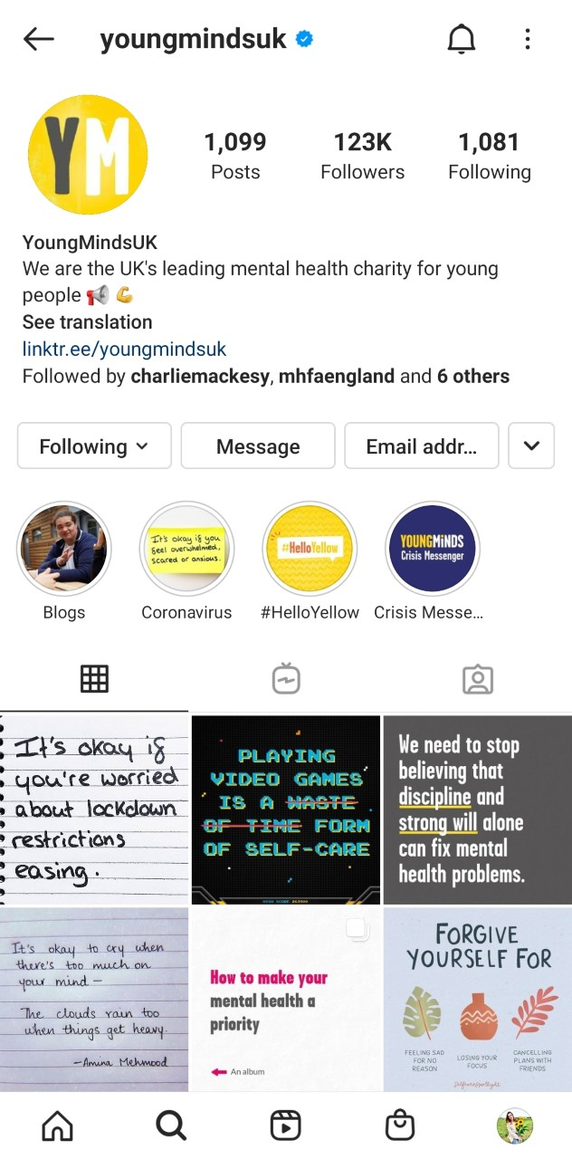
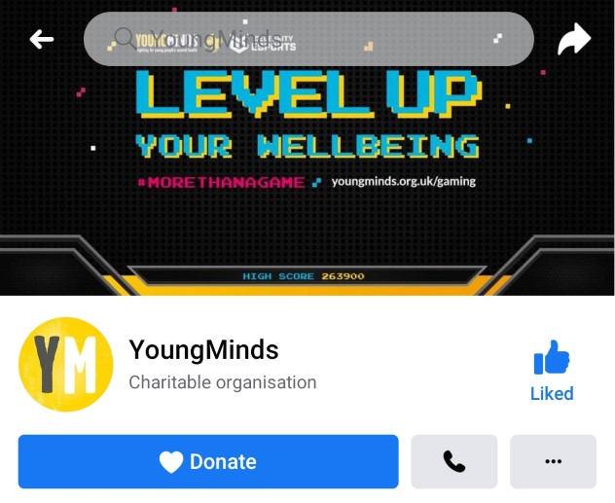
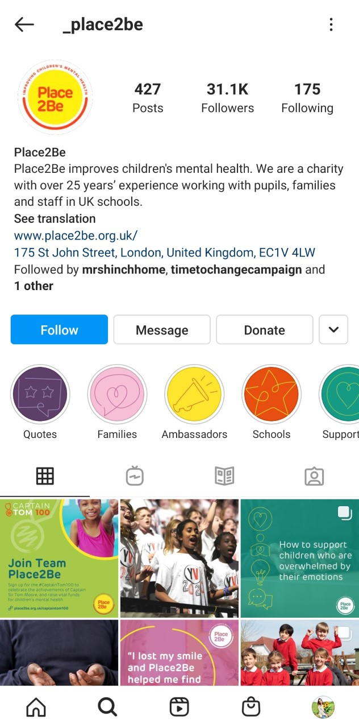
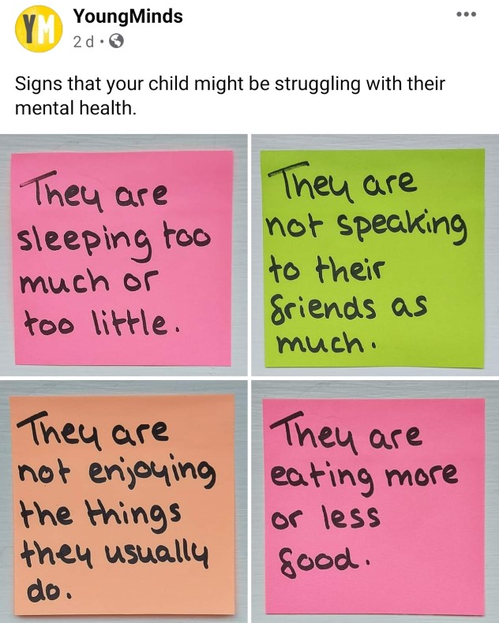
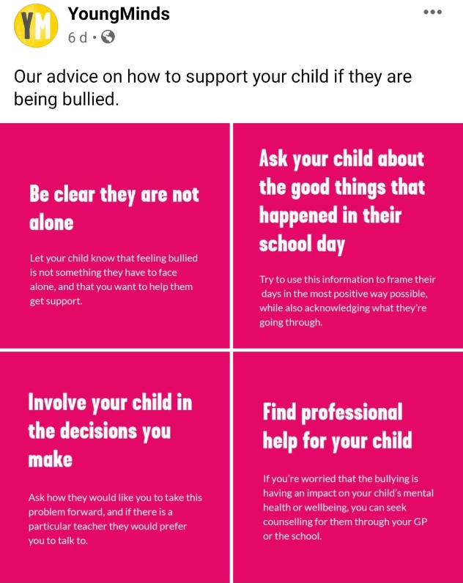
Social Media

Slide 25
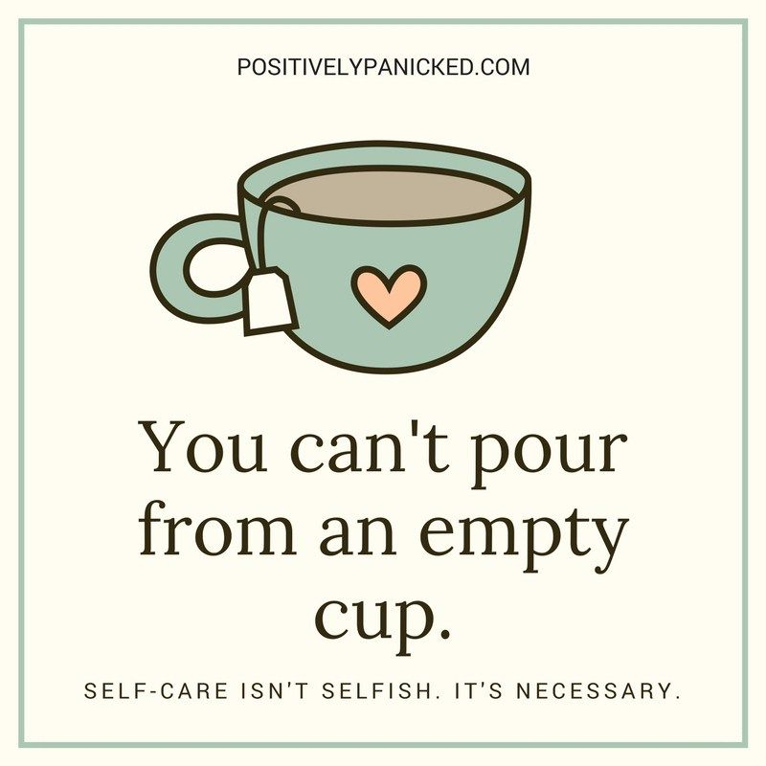

Slide 26
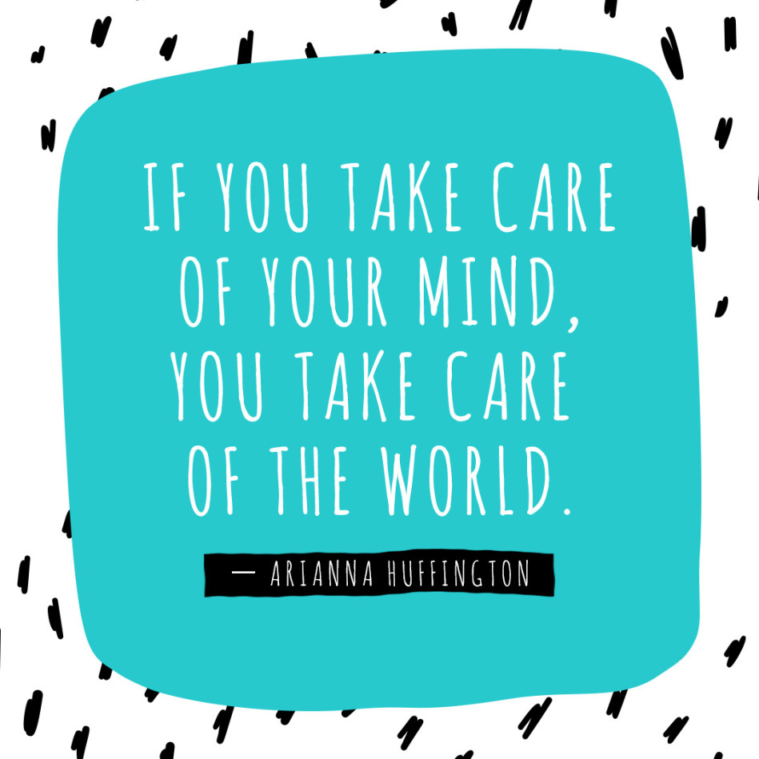

Slide 27
Any Questions?

Slide 28
Resources
Local
National
Websites:
CAMHS Doncaster
https://camhs.rdash.nhs.uk/doncaster/
Doncaster Parent Voice https://www.doncasterparentsvoice.co.uk/
The Sleep Charity
https://thesleepcharity.org.uk/
Facebook:
CAMHS Doncaster
Doncaster Parent Voice
The Sleep Charity
Doncaster Health Visitors
Doncaster School Nurses
App:
eClinc CAMHS
Young minds – Website for mental health aimed at young people up to the age of 25
https://youngminds.org.uk/blog/what-to-do-if-you-re-anxious-about-coronavirus/
Mental Health Foundation – Website for support children and young people’s mental health
https://www.mentalhealth.org.uk/a-to-z/c/children-and-young-people
Children’s society – Advice and resources on how to improve wellbeing and mental health https://www.childrenssociety.org.uk/back-to-school/childrens-well-being-and-mental-health
Action for children – Guide on how to support mental health
https://www.actionforchildren.org.uk/support-for-parents/children-s-mental-health/
NHS – Children and adolescent mental health services
https://www.nhs.uk/using-the-nhs/nhs-services/mental-health-services/camhs-information-for-parents-and-carers/
Place2Be – Website for mental health aimed at young people
https://www.place2be.org.uk/our-services/parents-and-carers/supporting-your-child-s-mental-health/

