Slide 1
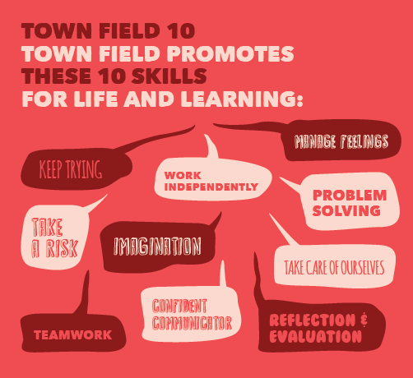



English:
We will be writing for a range of audiences and purposes this term, linked to our text ‘Holes’ and to our geography topic about Iceland. We will be writing persuasively to defend oceans from plastic pollution and to promote tourist destinations in Iceland. We will also be writing to inform about the ‘yellow spotted lizard’ from ‘Holes’. We will write to explain the physical geographical features including volcano and glacier formation and river erosion. We will also continue to build on our fiction writing skills using animations such as ‘Alma’ and ‘Road’s end’.
We will be reading a wide range of fiction, non-fiction and poetry and developing our ability to articulate responses with supportive evidence.
Maths:
During this term we with continue to develop understanding of decimals and percentages following on from our previous Fractions. We will calculate and compare percentages from amounts. Following this we will explore ration and proportion, learning how to express and solve problems. Finally we will learn about statistics, interpreting line graphs and pie charts, analyzing data and interpreting the mean.
We will continue to practice and consolidate arithmetic skills and will apply in problem solving contexts.
Year 6
Spring term
Geography driver
Iceland
STEM:
We will continue to look at how living things are classified, focusing on the classification system devised by Carl Linnaeus. Children will describe how things are classified into broad groups according to common characteristics and give reasons for classifying plants and animals. Following this, we will look at fossils and learn how they provide information about living things that inhabited the Earth millions of years ago and their changes over time. We will find out how living things produce offspring of the same kind that are not identical to their parents and how these small differences may help animals adapt to their environment leading to evolution over time.
Geography
We will be exploring the land of fire and ice – known more formally as Iceland! We will be exploring its global location, topography, physical and human geography. We will investigate why the landscape continually changes; why the population is so small; and how it compares to the UK. We will learn about the foundations of Iceland’s economy, focusing on thermal energy and draw comparisons with the UK.
Notes for Parents:
Both classes will have P.E on a Tuesday and a Wednesday. Please ensure that your child has sensible shoes and that no jewellery is worn, in accordance with school policy.
The homework for this term will take the form of weekly tasks via our online learning platform ‘Seesaw’.
Please encourage your child to read a variety of texts at home. This could be shared with an adult or done independently.
Sports, Arts and Culture:
Pupils will develop attacking, defending and team work skills in a range of invasion games, including basketball. Children will refine their ability to gain possession and develop control of the ball. Pupils will also develop their ability to balance and move using different pieces of gymnastic equipment.
In art lessons, children will explore Icelandic patterns and will knit a pattern of their own design.

