Slide 1
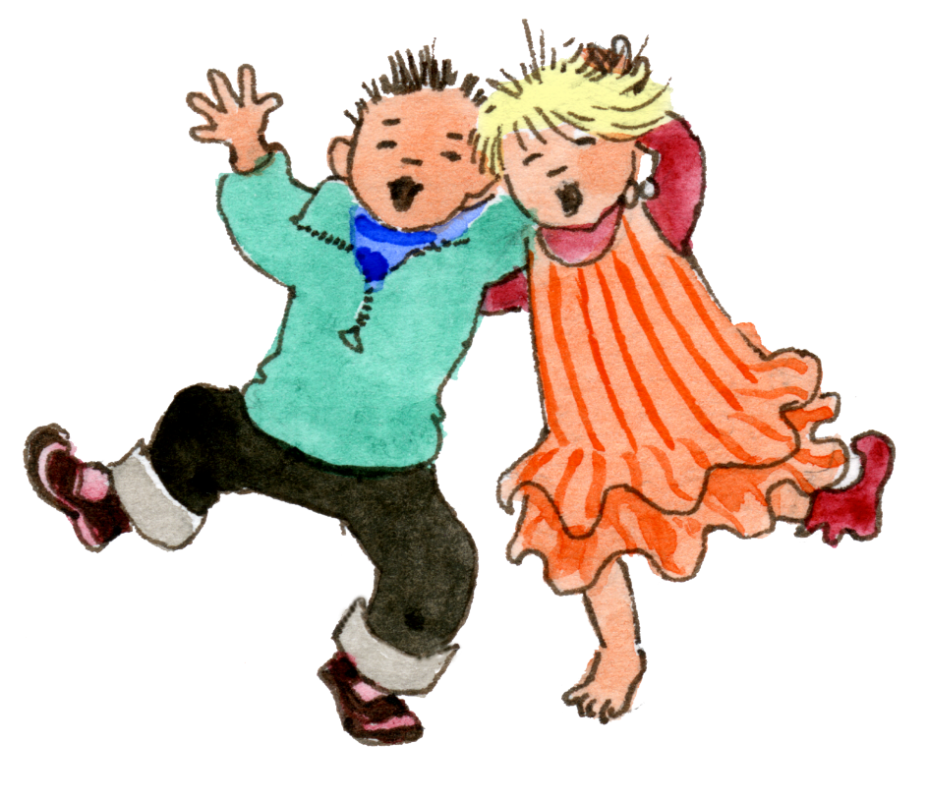
Reception
God loves each of us in
our uniqueness
1 A Journey in Love - Reception

Slide 2
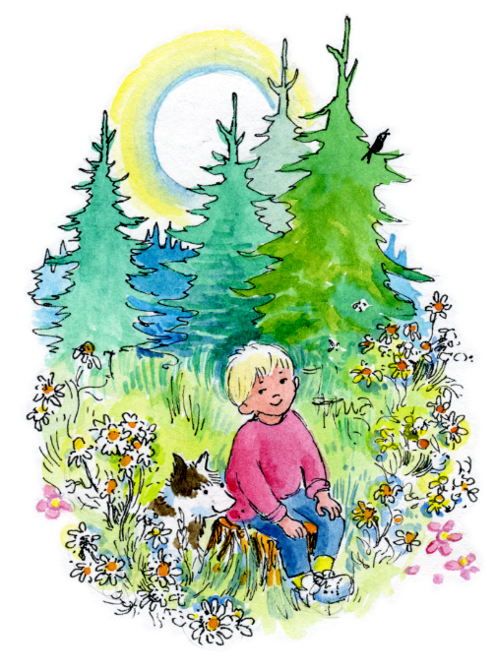
Objective
Know that there
is no one more
special than me.
Know that God
made me and
loves me as I am.
2 A Journey in Love - Reception

Slide 3
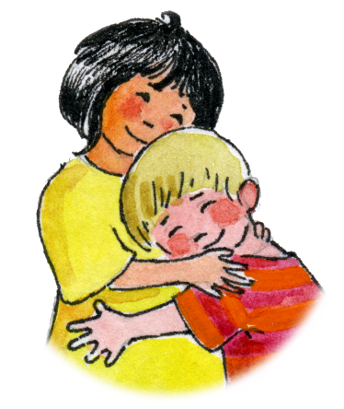
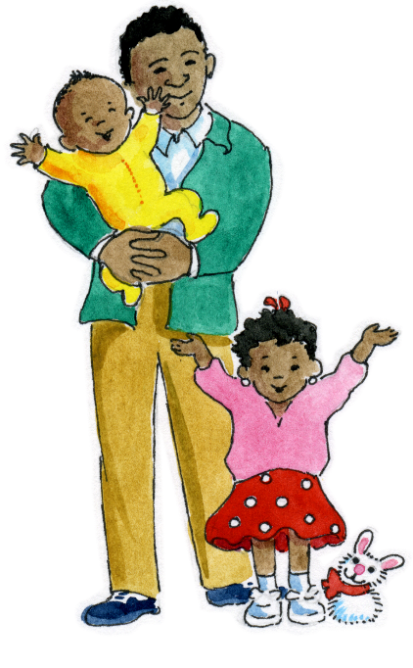
Keywords
God Unique Special Eyes | Hair Boy/Girl Hands Fingers Name | Family Love Womb Describe
3 A Journey in Love - Reception

Slide 4
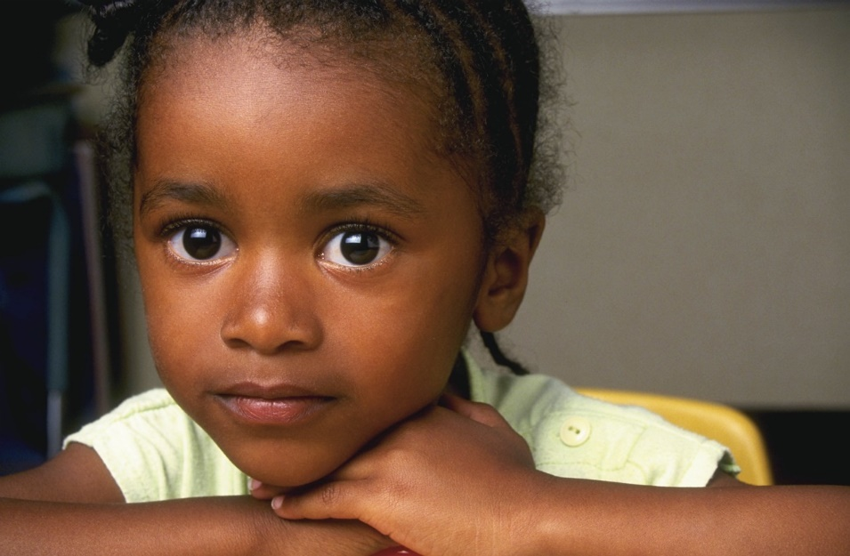
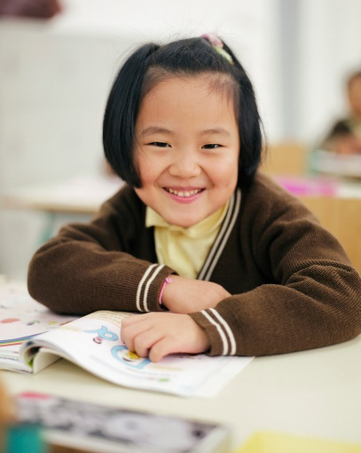
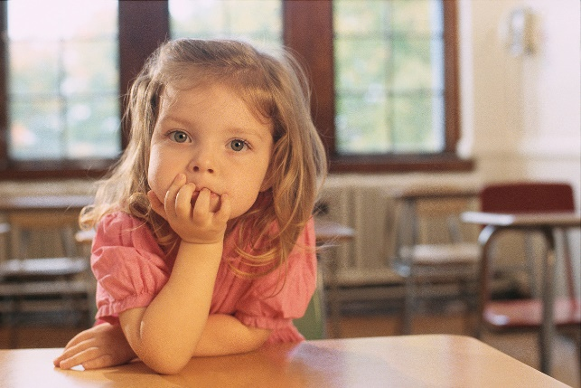
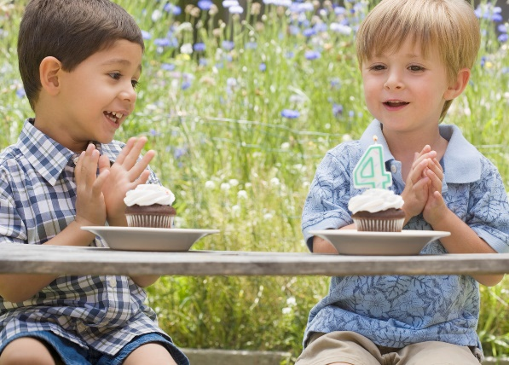
PHYSICAL
We are different
4 A Journey in Love - Reception

Slide 5
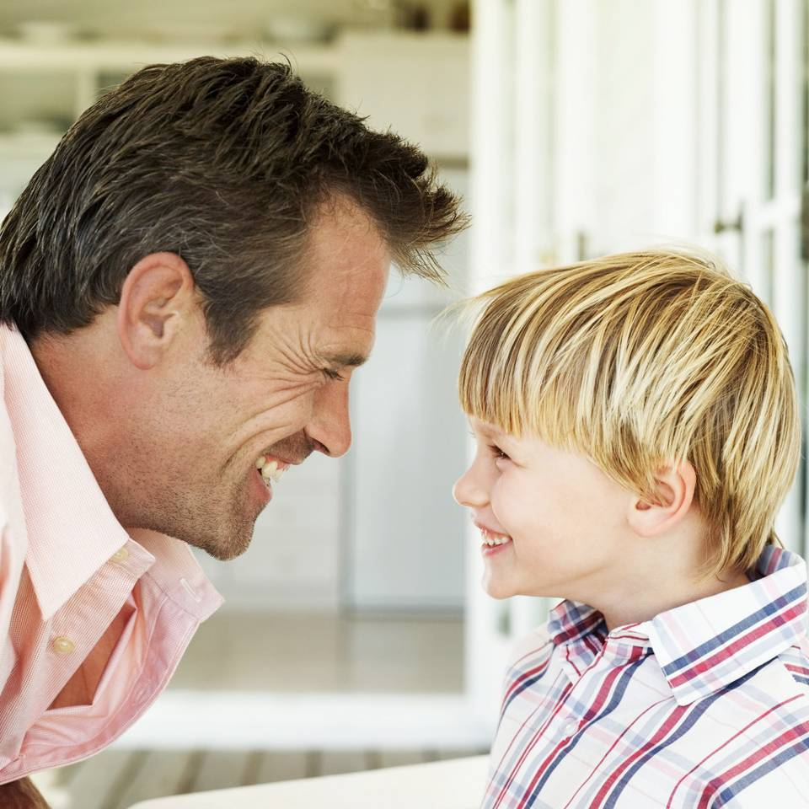
I am Unique
No one else is the same as me
5 A Journey in Love - Reception

Slide 6
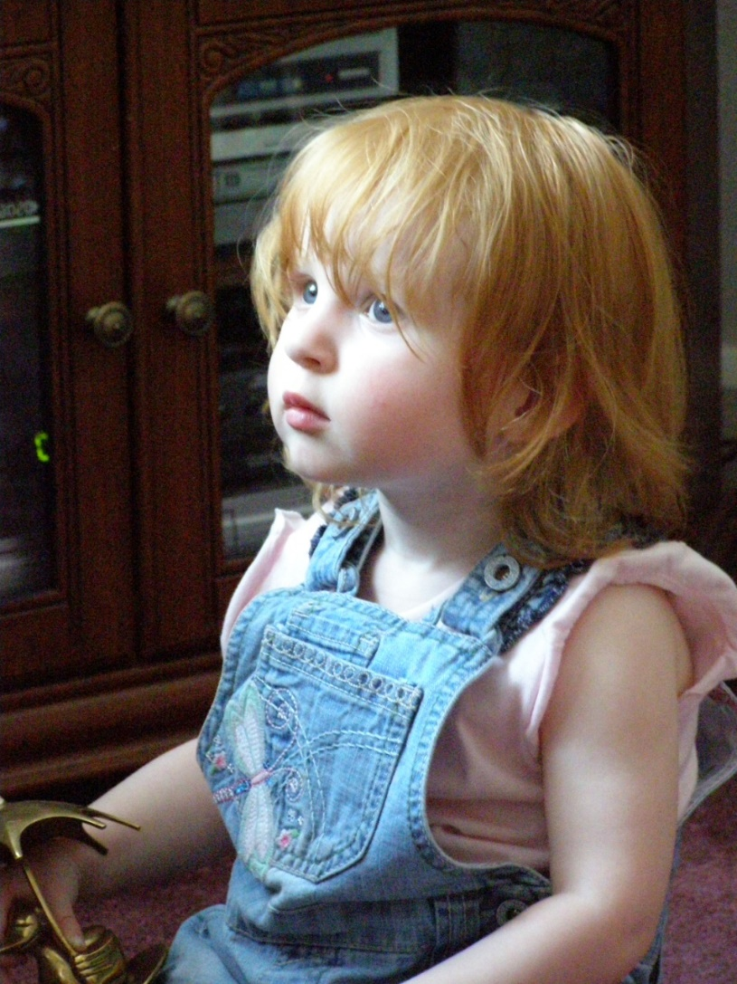
Uniqueness
Describe her…
Hair
Eyes
Lips
Skin
6 A Journey in Love - Reception

Slide 7
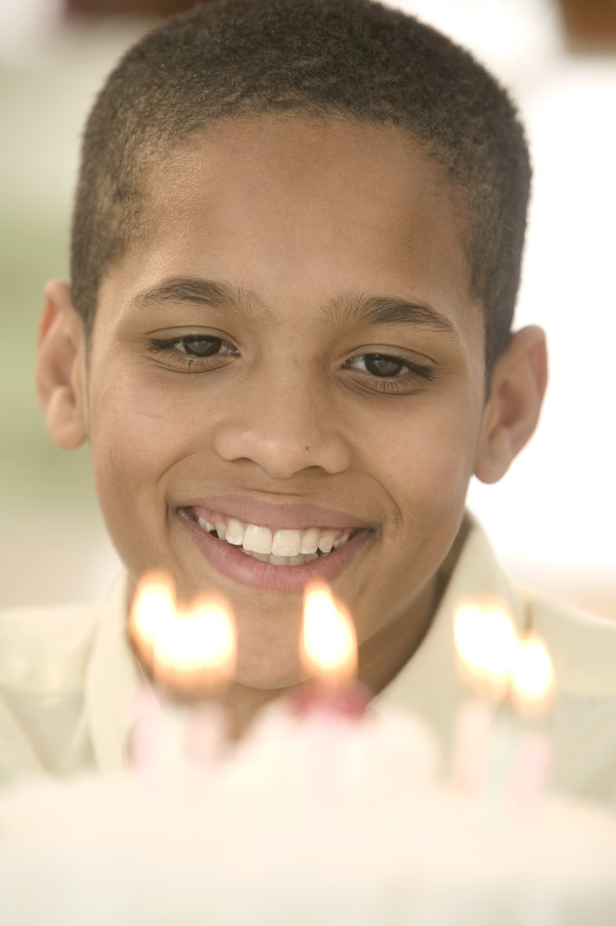
Uniqueness
Describe him…
Hair
Eyes
Lips
Skin
7 A Journey in Love - Reception

Slide 8

How are they…
…different?
8 A Journey in Love - Reception

Slide 9
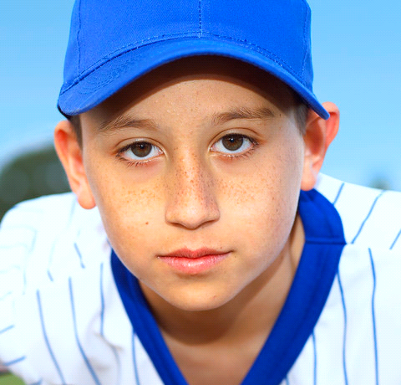
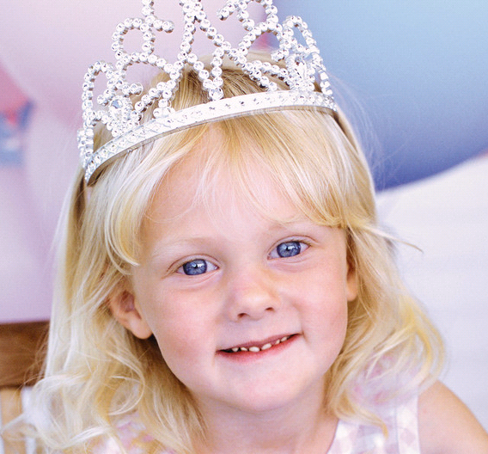
I am different.
I am special.
9 A Journey in Love - Reception

Slide 10
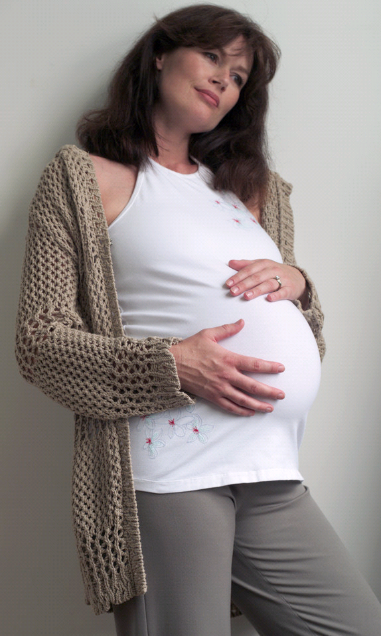
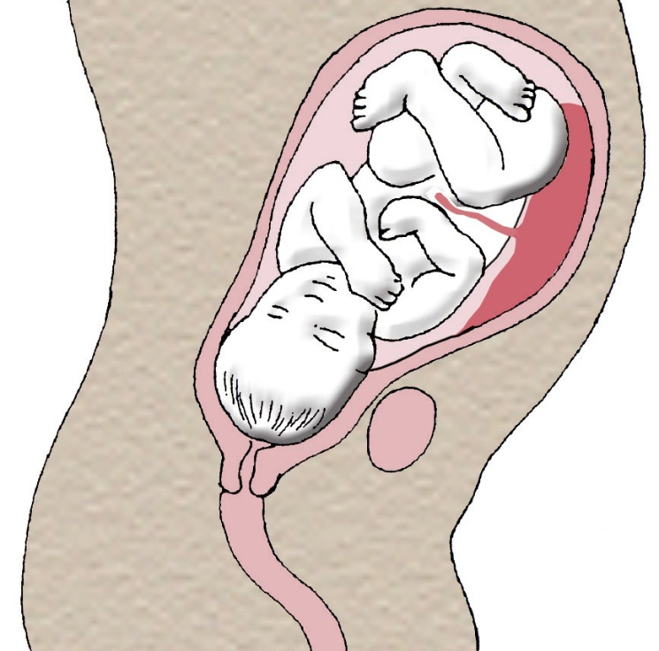
I grew for 9 months in
my mummy’s womb…
10 A Journey in Love - Reception

Slide 11
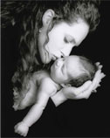
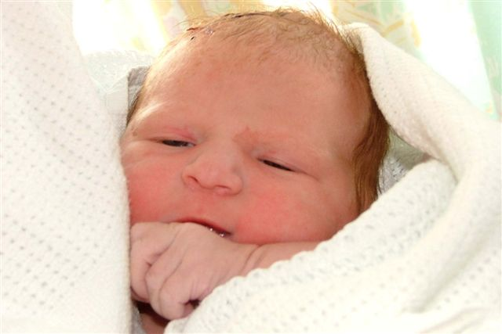
…before I was born.
11 A Journey in Love - Reception

Slide 12
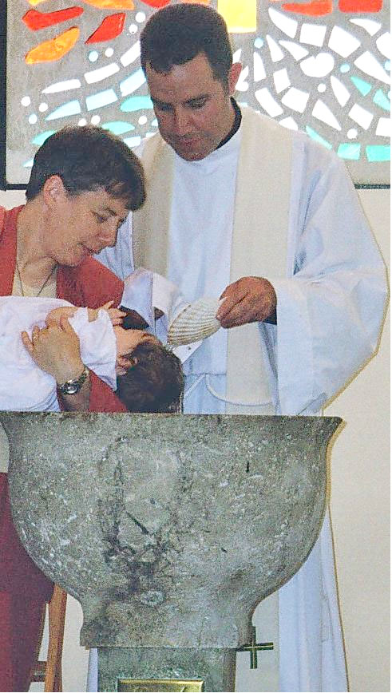
I have a
special name
12 A Journey in Love - Reception

Slide 13
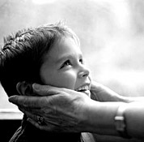
Prayer
Loving God,
Thank you for your gifts
of love and for making
me special with my
own name.
Amen.
13 A Journey in Love - Reception

Slide 14
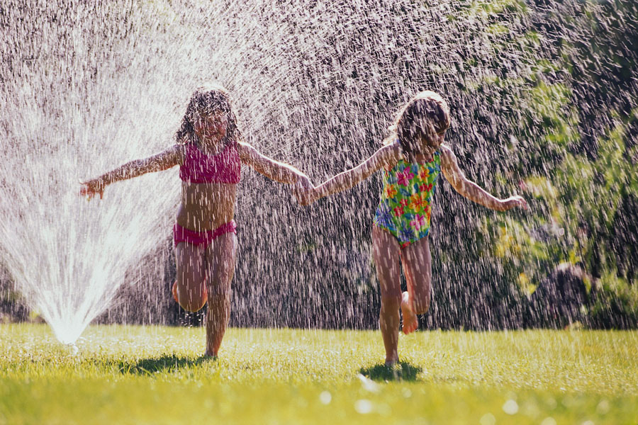
SOCIAL
Who do I play with?
14 A Journey in Love - Reception

Slide 15
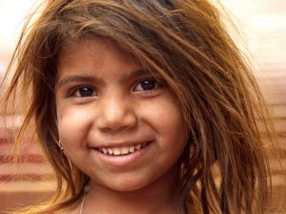
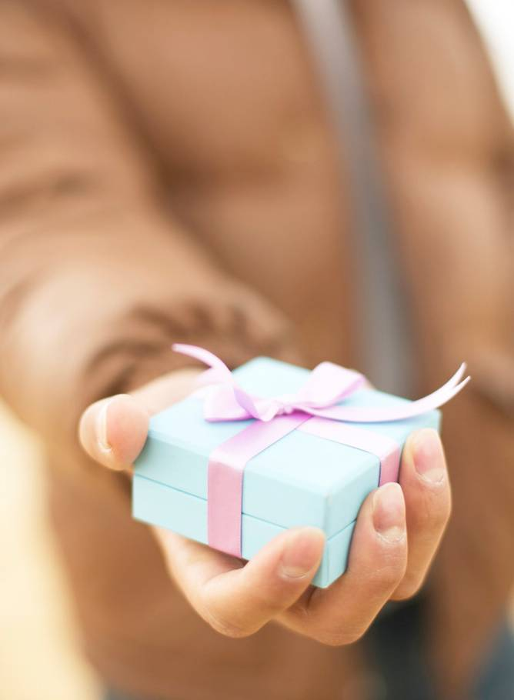
Why do they play with me?
Am I happy?
Generous?
15 A Journey in Love - Reception

Slide 16
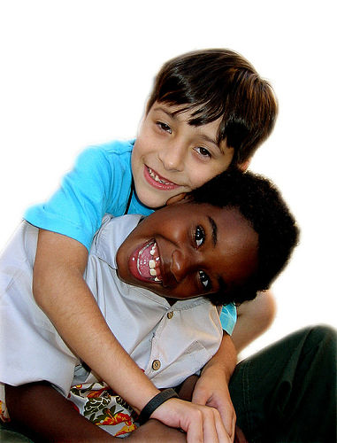
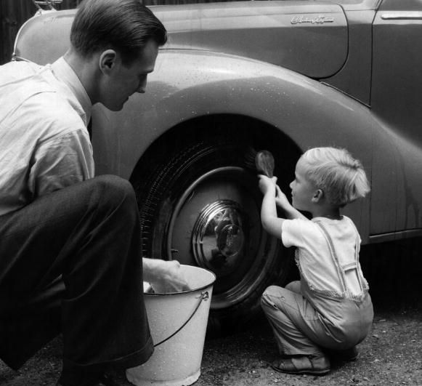
Am I…
Helpful?
Friendly?
16 A Journey in Love - Reception

Slide 17
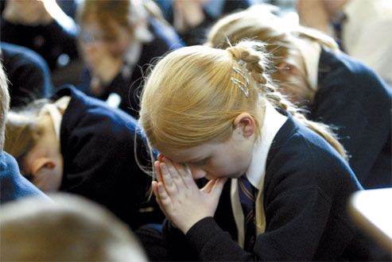

Prayer
Loving God,
Thank you for the gift of
my friends at home
and at school.
Amen.
17 A Journey in Love - Reception

Slide 18
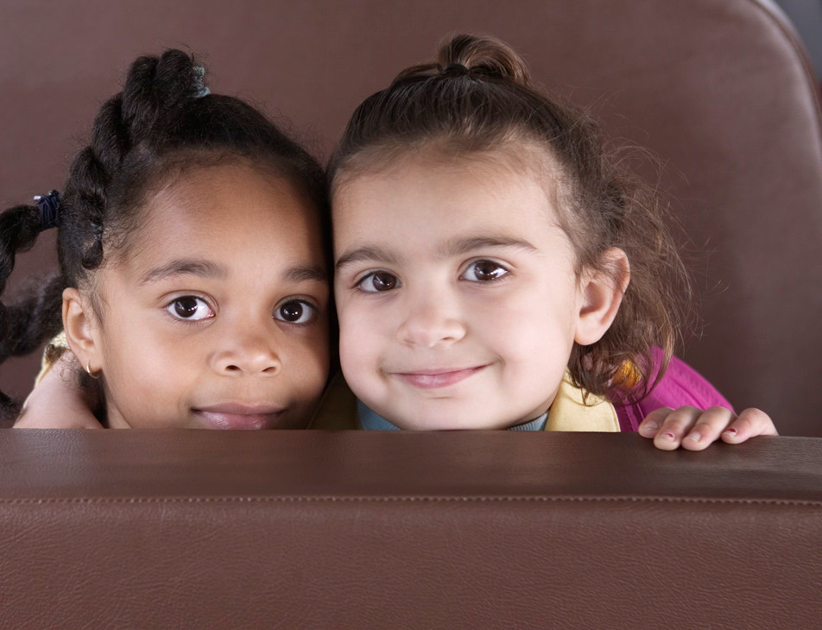
EMOTIONAL
How do I feel about my friends?
18 A Journey in Love - Reception

Slide 19
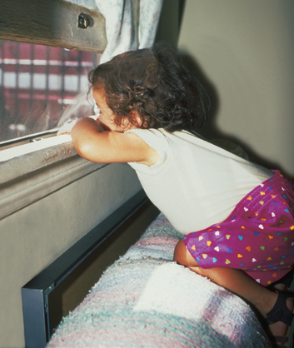
How do I feel when I am left out?
19 A Journey in Love - Reception

Slide 20
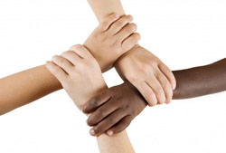
How do I care for people who are not my special friends?
20 A Journey in Love - Reception

Slide 21
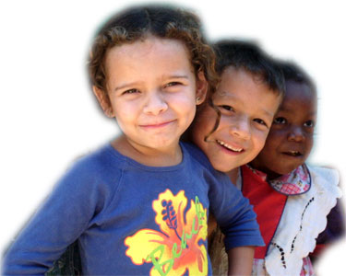
Prayer
Loving God,
Thank you for my friends.
Help me to be a good friend to everyone.
Amen.
21 A Journey in Love - Reception

Slide 22
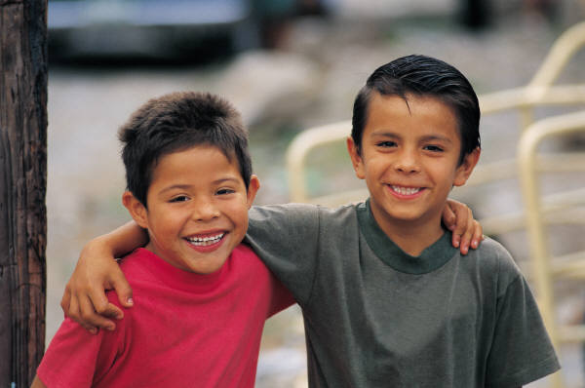
INTELLECTUAL
Is it important to have friends?
22 A Journey in Love - Reception

Slide 23
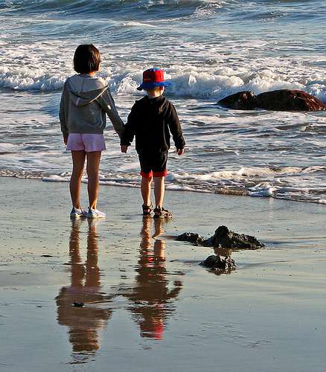
Who is a good friend?
23 A Journey in Love - Reception

Slide 24
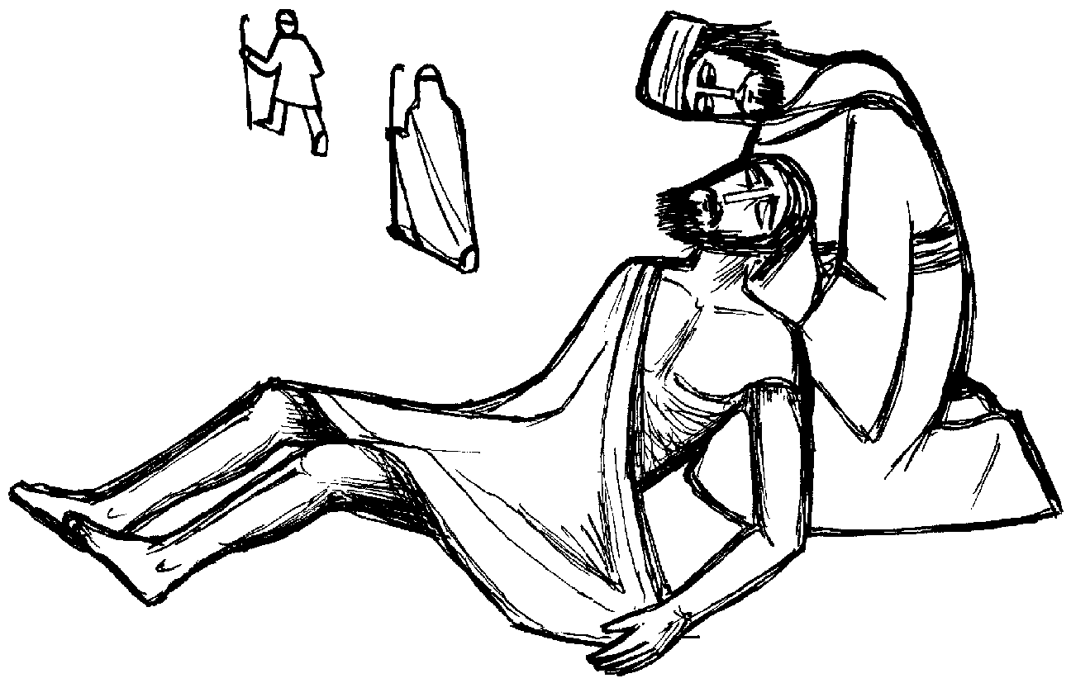
The Good Samaritan
24 A Journey in Love - Reception

Slide 25
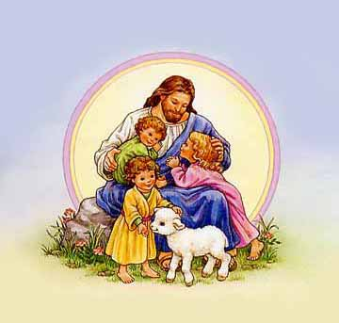
Prayer
Loving God,
Thank you for
being my friend.
Amen.
25 A Journey in Love - Reception

Slide 26
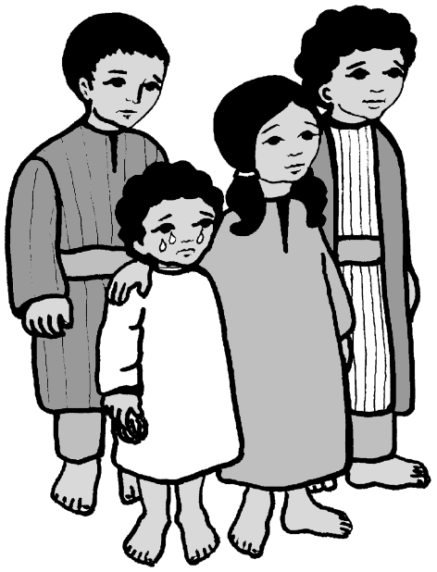
SPIRITUAL
People often used to bring children to
Jesus and when they did, Jesus always
blessed them.
26 A Journey in Love - Reception

Slide 27
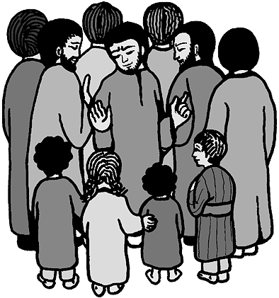
One day, however, some of the friends of Jesus told the children to go away.
27 A Journey in Love - Reception

Slide 28
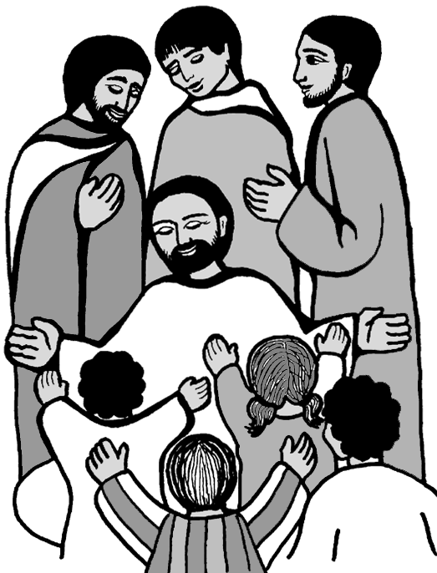
Jesus was angry when
he saw this happening,
and he said:
“Don’t stop the children
from coming to me.
Don’t send them away
like that!
Bring them back.”
28 A Journey in Love - Reception

Slide 29
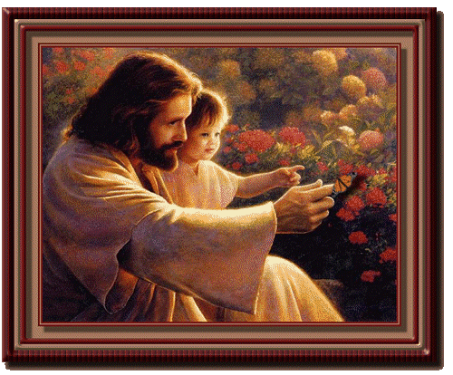
Then he put his arms round them and he blessed them.
29 A Journey in Love - Reception

Slide 30
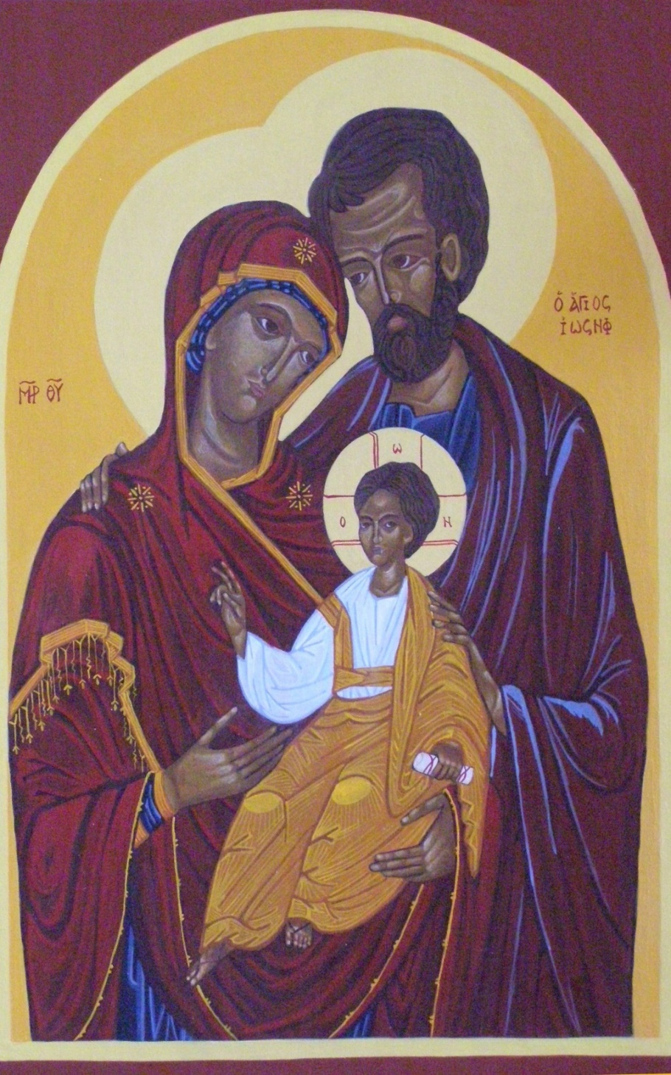
Jesus grew up
in a family
30 A Journey in Love - Reception

Slide 31
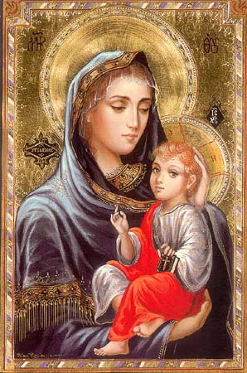
Who was the mother of Jesus?
Why is she special?
Jesus grew for
nine months in
Mary’s womb.
31 A Journey in Love - Reception

Slide 32
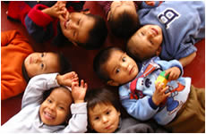
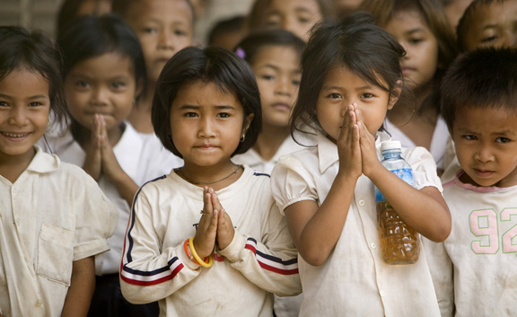
Prayer
Loving God,
We know that we are unique.
Although we are different from one another
we are all special to you.
Amen.
32 A Journey in Love - Reception
End of presentation

