Slide 1
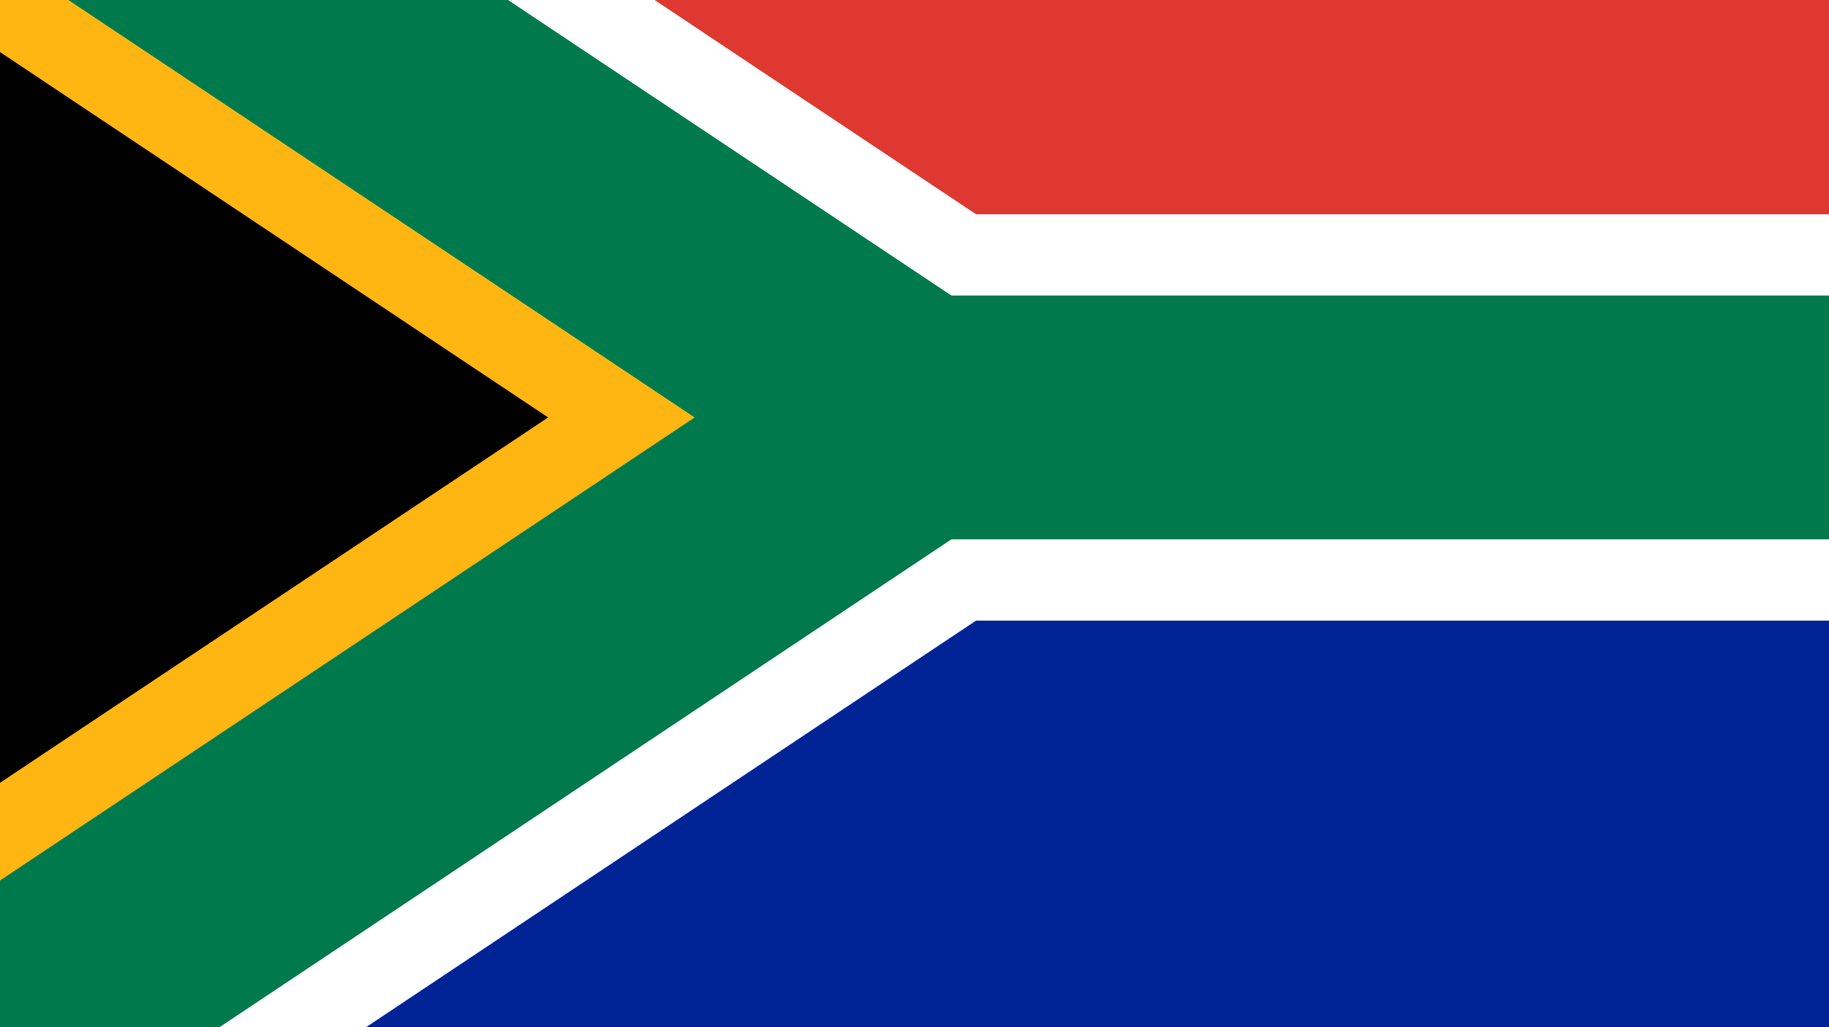
Nelson Mandela

Slide 2
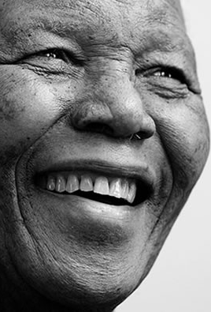
Who is Nelson Mandela
Nelson Mandela was a campaigner for equality and justice
Nelson Mandela was born in July 1918 in Mvezo.
When Nelson Mandela was born his name was Rolihlahla Mandela
Nelson Mandela was president of South Africa from 1994-1999

Slide 3
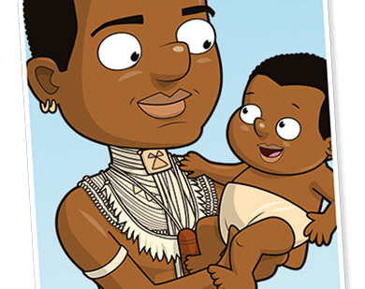
Early life
Nelson Mandela was born on 18 July 1918 in a village of Mvezo in Umtata. He was named Rolihlahla but one day a teacher gave him the name Nelson and that is how he became Nelson Mandela .Also Nelson Mandela was born into royalty his farther Henry was chief of a tribe called the Tembu .His great grandfather was the king of the tribe however Nelsons farther passed away when he was just 9 years old .

Slide 4
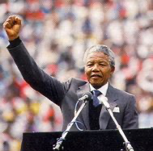
Political Life
Nelson Mandela joined the African National Congress in 1944 and Formed the ANC Youth League. He rose through the ranks of the ANCYL and through his work the ANC adopted in 1949 a more radical policy, the Programme of Action. The ANC and the Pan African Congress were banned on 8 April 1960.Nelson Mandela was among thousands detained during this period.
On 2nd February 1990 the African National Congress was unbanned and on the 11th, Mandela was released from prison.
On 2nd March 1990, Mandela was elected as ANC deputy. On 9th May 1994, he was elected by parliament as the first president of South Africa. This came from the first free elections where black people could vote.
Mandela was inaugurated as the first black President of South Africa in May 1994 and formed a racially mixed government.

Slide 5
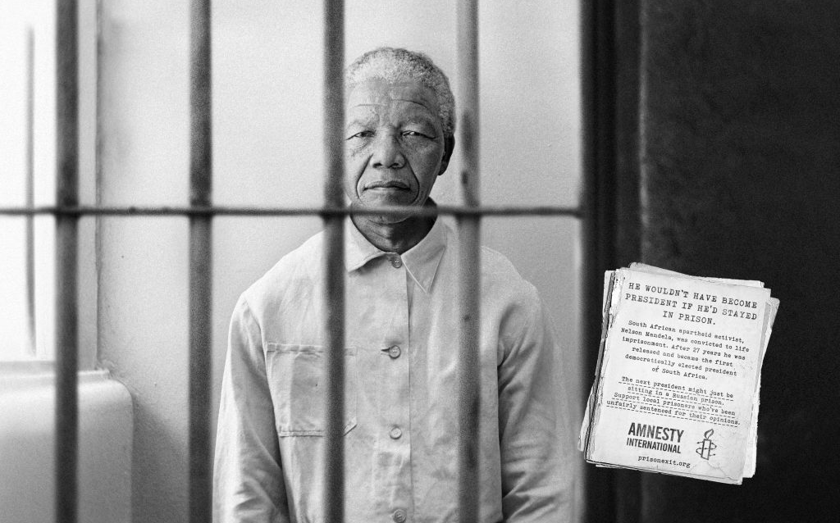
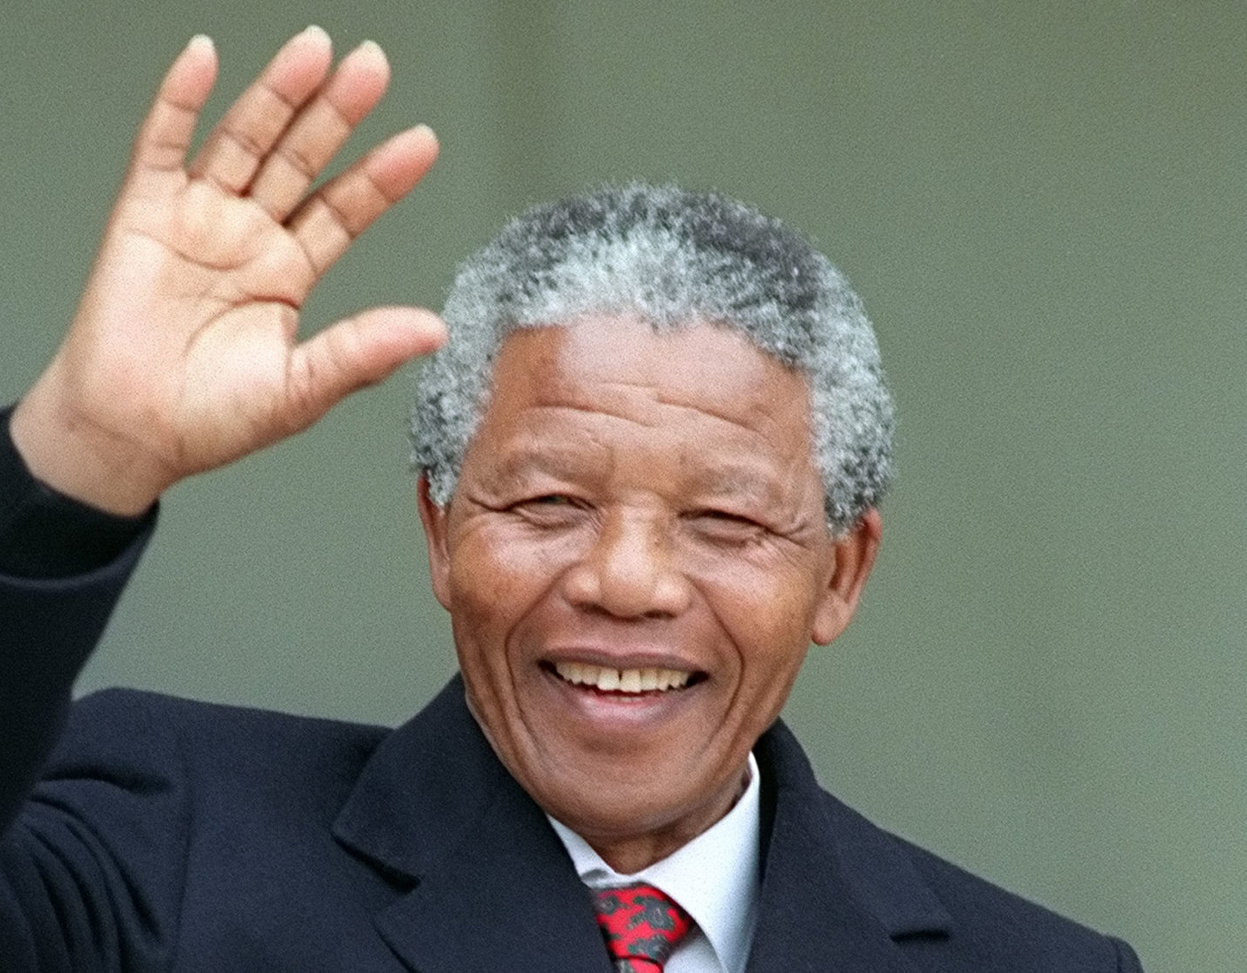
Prison
Nelson Mandela was arrested and imprisoned in 1962 and subsequently sentenced to life imprisonment for conspiring to overthrow the state following the Rivonia Trial.Mandela served 27 years in prison split between Robben Island Pollsmoor Prison and Victor Verster Prison. He was released in 1990

Slide 6
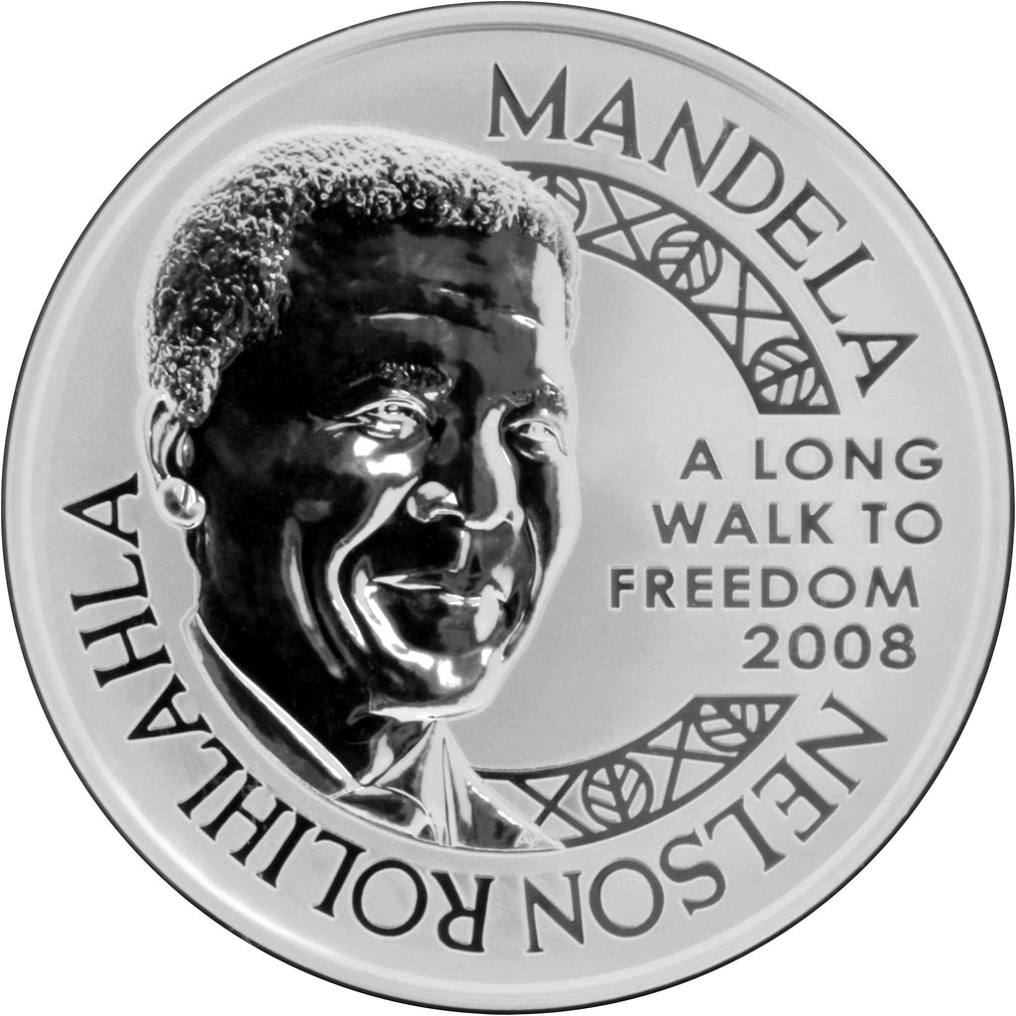
Nobel peace award
The Nobel Peace Prize 1993 was awarded jointly to Nelson Mandela and Frederik Willem de Klerk for their work for the peaceful termination of the apartheid regime and for laying the foundations for a new democratic South Africa .Nelson Mandela is an anti apartheid champion and the first black South African President (1994-1999)

Slide 7
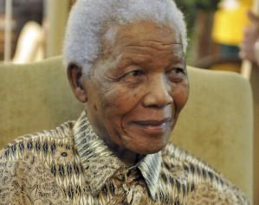
Nelson Mandela announced his retirement from public life in 2004 due to ill health. Nelson Mandela Foundation discouraged invitations to public events but the legend continued to earnestly world for his Nelson Mandela Foundation. In 2009, the United Nations declared his birthday, 18 July as Nelson Mandela International Day.

Slide 8

My thoughts on Nelson Mandela are that he is a great person that we will always remember even if we were not even alive when he did his great deed because he is known by everybody especially South Africans that love him for helping there county to be a better place that everybody would like to visit and look around .South Africans and the rest of the world praise him and enjoy learning about his amazing life and how he became and a brilliant person to South Africa because he stoped apartheid which was were black and white people were separated from each other however white people got it a lot better then black people. Black people were slaves to white people and Nelson Mandela stuck up to the president and built a group to stop this apartheid system. Also he went to prison yet he still managed to make a difference to South Africa .
My thoughts on Nelson Mandela

