Slide 1
The life of Nelson Mandela
By Joanna D

Slide 2
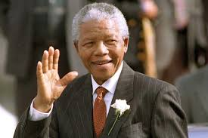
Who was Nelson Mandela?
Nelson Mandela was a South African man who stood up for the rights of black people during apartheid. Because of what he did Mandela and Frederick Willem de Klerk won the Nobel peace prize in 1993 for eventually bringing apartheid to an end. Mandela was imprisoned for 27 years in 3 different prisons. Shortly after his release from prison Mandela became the president of South Africa.

Slide 3
Info
Born: 18th July 1918, Mvezo, South Africa
Died: 5th December 2013, Houghton Estate, Johannesburg, South Africa
Spouse: Graca Machel (m. 1998–2013), Winnie Mandela (m. 1958–1996), Evelyn Mase (m. 1944–1958)
Children: Zindziswa Mandela, Zenani Mandela, More

Slide 4
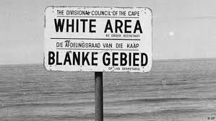
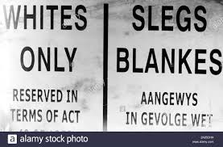
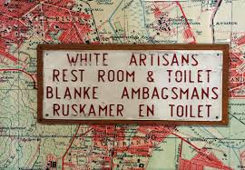
What was apartheid?
Apartheid (Afrikaans for apartness) was where anyone who was a certain religion or black were treated unfairly. If say you were a black child you couldn’t live with your mum. She would have to go and work as a servant for a white family. Also you wouldn’t be able to go on the same buses as white people and even not live in the same towns and cities as white people. As well as that you couldn’t even go in the same building as white people (unless you’re a servant) and you couldn’t sit on the same bench as white people. How horrible would that be!

Slide 5

Political life
The logo for the ANC
Nelson had taken a large interest in politics for most of his life. In 1944 he became a part of the ANC (African National Congress) as this party was against apartheid just like Mandela. Because of what the ANC did it was banned on 8th April 1960 shortly after a peaceful protest to end the apartheid lead by members of the ANC. The party was allowed again in 1990 although almost all of the members had been imprisoned and forced abroad just like Nelson. Not long after being released from prison Mandela became the leader of the ANC and then leader of the country.

Slide 6
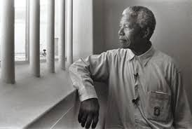
Mandela Imprisoned
Mandela was arrested and imprisoned in 1962. Consequently, he was sentenced to life imprisonment for planning to overthrow the government following the Rivonia trial. Nelson served 27 years in prison divided between Robben island, Pollsmoor prison, and Victor Verster prison.

Slide 7
Free Again
In December 1988, Mandela was moved from Pollsmoor prison to Victor Verster prison. Whilst in Pollsmoor prison people were making protests to free Nelson. A band even made a song called ‘Free Nelson Mandela’
https://www.youtube.com/watch?v=AgcTvoWjZJU
Whilst in prison Nelson became extremely famous. On the 11th February 1990 Mandela was freed by F.W. de Klerk and in countries all around the world, people celebrated his release.

Slide 8
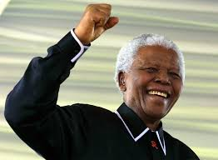
End Apartheid!
When out of prison Mandela continued his campaign against apartheid. Just because he had been put in prison before, did that mean he would settle down and stay home when everyone else was out protesting? No way! Eventually F.W de Klerk and Mandela ended apartheid. For this they earned the Nobel peace prize in 1993.

Slide 9
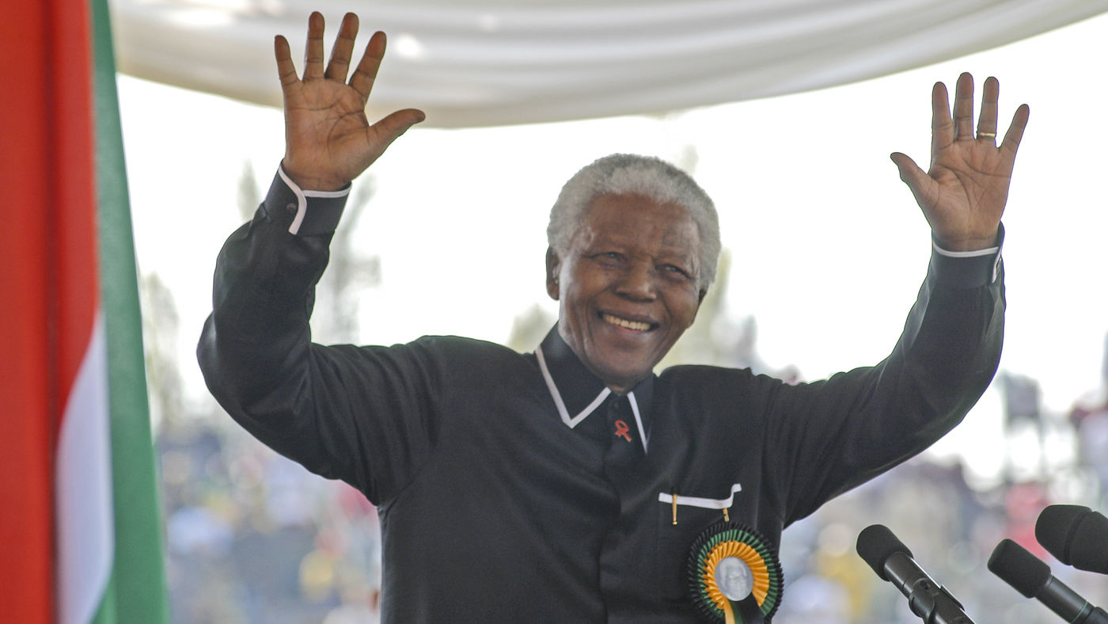
Presidency
On the 10th May 1994 Mandela was elected president of the Republic of South Africa. At the age of 76 Mandela entertained people like Michel Jackson, the Spice Girls and Whoopi Goldberg. He had become world famous. Mandela was president for 5 years. During that time he actually met with Queen Elizabeth II and befriended ultra-rich businessmen, like Harry Oppenheimer of Anglo-American.

Slide 10
Truth and Reconciliation
In other countries, when white rule came to an end there was fighting and trouble.
Mandela was determined to stop the black majority from seeking revenge for all the awful things that had been done to them, by the whites during Apartheid.
Instead of war and bloodshed, when Mandela became president he said that there would be none of that, no war, no fights just truth and reconciliation.
Mandela introduced these courts that were same as the old ones except that there would be not punishment instead you had to tell the judge what you had done and who you had done it to. Then you would be free and the families who had lost their loved ones would find out the truth, finally.

Slide 11
Retirement
In 1994 Mandela retired from being president. He intended to lead a quiet family life, split between Johannesburg and Qunu. He was going to write a follow-up to his first autobiography, but he abandoned this idea.
Mandela found it hard to get any privacy and in the end he had to return from retirement.
He continued to meet with world leaders and celebrities.
When in Johannesburg, he worked with the Nelson Mandela foundation that was founded in 1999 to help develop better housing and schools and to battle against, HIV/AIDS.
Although Mandela had been criticised for failing to do enough to fight the HIV/AIDS disease during his time as president, after he stepped down he spent a lot time fighting it, saying it was ‘a war’ that had killed more than ‘all previous wars.’
Meanwhile, Mandela was fighting his own war against cancer because he was treated for prostate cancer in July 2001.

Slide 12
Last years
After suffering from extended breathing problems. Nelson Mandela died on 5 December 2013 at the age of 95, surrounded by his family.
There were ten days of nationwide grieving for him and a national day of prayer and reflection on 8th December, followed by a memorial service at Johannesburg's FNB Stadium on 10 December 2013
90 representatives of foreign states travelled to South Africa to attend memorial events.
Mandela has been remembered to this day and still people across the world are devastated by his death.

Slide 13
Mandela’s Timeline
1918 18th July: Mandela is born
1943: Mandela starts his journey to ending apartheid
1944: Mandela joins the ANC
1962: Mandela is arrested
1964: Mandela is put in Robben Island prison
1982: Mandela is moved to Pollsmoor prison
1988: Mandela is moved to Victor Vestor prison
1990 11th February: Mandela is freed from prison
1994 10th May: Mandela becomes president
2013 5th December: Mandela dies

Slide 14
The End!
Produced by Joanna Dougan Entertainment Ltd.
This is a has been a Joanna Dougan production.
Thanks for watching/reading.

