Slide 1

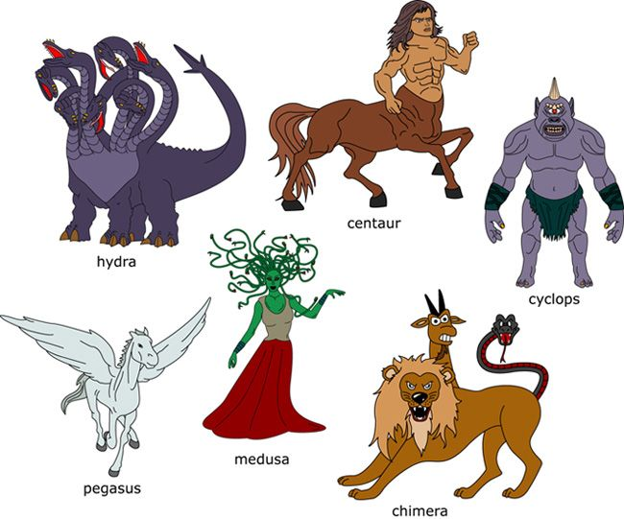



GREEK MONSTERS
BY EMMA WALMSLEY

Slide 2
GREEK MONSTERS
The HEROES are probably the best-known part of GREEK MYTHOLOGY, but what makes a hero?
Having monsters to fight, that's what. Luckily for the heroes, the Ancient Greeks had the strangest, coolest, most terrifying creatures & monsters mythology had to offer ranging from Dragons, Giants, Demons and Ghosts, to multi-formed creatures such as the Sphinx, MINOTAUR, CENTAURS, Manticores & CHIMAERA.
There were also many fabulous animals such as the Nemean Lion, golden-fleeced Ram and the winged horse PEGASUS, not to mention the creatures of legend such as the Phoenix, the Griffin and Unicorns.
In this section, you'll learn interesting facts and information about the many creatures and monsters of ancient Greek mythology

Slide 3
Typhon
Many of the great Greek monsters were descendants of TYPHON, the most deadly monster of Greek mythology.
Typhon was the last son of GAIA, fathered by Tartarus, he was known as the “Father of All Monsters”. Instead of a human head, a hundred dragon heads erupted from Typhon's neck and shoulders. His wife ECHIDNA, half woman half snake, was likewise the “Mother of All Monsters.”
Together, Echidna and Typhon raised some of the most well known monsters and creatures in all mythology.

Slide 4
CHILDREN OF TYPHON
Orthrus. A fearsome two-headed hound that lived with giants
Sphinx. A half human, half lion who would slay anybody who did not answer her riddles. When Oedipus was able to answer a riddle correctly, she jumped into the ocean in a fit of rage and drowned.
Nemean Lion. A gigantic lion with impenetrable skin that eventually became the star constellation Leo.
Cerberus. This well-known monster was a three-headed dog that guarded the entrance to Hades.
Ladon. A serpentine dragon (drakon) that guarded the golden apples in the Garden of the Hesperides.
Lernaean Hydra. An ancient serpent-like water monster with reptilian traits and many heads that multiplied if they were cut off.
Caucasian Eagle. An eagle that every day ate the liver of Prometheus.
Chimera. A monstrous fire-breathing hybrid creature with the body of a lion, the head of a goat, and a tail with a snake’s head.

Slide 5
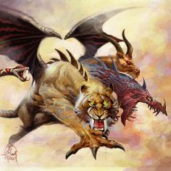
Sphera
The Sphera is a mix of the Sphinx and chimera put together.

Slide 6
THE END

