Slide 1


The slave trade!
By Emma Walmsley

Slide 2
Why did the slave trade end?
In economic terms the slave trade had become less important. There was no longer a need for large numbers of slaves to be imported to the British colonies. There was a world over-supply of sugar and British merchants had difficulties re-exporting it. Sugar could be sourced at a lower cost and without the use of slavery from Britain’s other colonies eg India.
The Industrial Revolution and advances and improvements in agriculture were benefiting the British economy. Since profits were the main cause of starting a trade, it has been suggested, a decline of profits must have brought about abolition because:
The slave trade ceased to be profitable
Plantations ceased to be profitable
The slave trade was overtaken by a more profitable use of ships
Wage labour became more profitable than slave labour
At various times plantations that provided the market for slave ships struggled to make profits. Prices and costs went up and down as war interrupted trade.

Slide 3
Why did the slave trade end?
In 1807, the British government passed an Act of Parliament abolishing the slave trade throughout the British Empire. Slavery itself would persist in the British colonies until its final abolition in 1838. However, abolitionists would continue campaigning against the international trade of slaves after this date.
Those who supported the slave trade argued that it made important contributions to the country's economy and to the rise of consumerism in Britain. Despite this, towards the end of the eighteenth century, people began to campaign against slavery. However, since trading was so profitable for those involved, the 'Abolitionists' (those who campaigned for the abolition of the slave trade) were fiercely opposed by a pro-slavery West Indian lobby. Those who still supported slavery used persuasive arguments, or 'propaganda', to indicate the necessity of the slave trade though the abolitionists also used propaganda to further their cause.
The role of many slaves themselves in bringing slavery to an end is often overlooked. Resistance among slaves in the Caribbean was not uncommon. Indeed, slaves in the French colony of St Domingue seized control of the island and it was eventually declared to be the republic of Haiti. Figures such as Olaudah Equiano and Mary Prince, by adding their eye witness accounts to abolitionist literature, also made a major contribution to the abolition campaign.

Slide 4
Which people were key figures in ending the slave trade?
Thomas Grandville Sharp was against slave trading since his time at Cambridge University. As a student he wrote a prize winning essay on slavery, which was later published and brought him into contact with other anti-slavery campaigners.
In 1787, he helped form the first Abolitionist Committee. He was a crucial person to the anti-slavery campaign because of his tireless energy, his hatred of injustice and his persuasiveness in getting witnesses on board. However, more conservative campaigners like William Wilberforce thought Clarkson was a hot head.
He travelled hundreds of miles to interview people involved in the slave trade. He talked to ships' captains and crew, doctors, ex-seamen, merchants and traders for evidence. This was sometimes at great personal risk but he was able to persuade some of them to be witnesses. He also collected equipment found on slave ships.
He wrote 'The History, Rise, Progress and Accomplishment of the Abolition of the African Slave Trade by the British Parliament' in 1808 chronicling what he saw as his role in the campaign.
as Clarkson was one of the most prominent eighteenth century anti-slavery campaigners. Described by one contemporary as a 'moral steam-engine', he was an Anglican clergyman who had had a passionate interest in the abolition of the

Slide 5
Which people were key figures in ending the slave trade?
William Cowper, the poet, wrote a number of anti-slavery poems. He was friends with the anti-slavery campaigner John Newton who asked him to write in support of the Abolitionist campaign. Cowper wrote a poem called 'The Negro's Complaint' (1788) which rapidly became very famous. He also wrote several other less well known poems on slavery in the 1780s, many of which attacked the idea that slavery was economically viable.

Slide 6
Which people were key figures in ending the slave trade?
Equiano was one of the most prominent black campaigners in the anti-slavery campaign. He was an ex-slave who, by the 1780s, lived as a free man in London. He is mostly remembered for his 1789 autobiography. It tells of his kidnap in Nigeria, his being sold into slavery, his journey to the West Indies, his life as a slave and his struggle to buy his freedom. Between 1789 and 1794, there were nine editions of the book and it was translated into many languages. Although not the first account of slavery from an African point of view, his book became the most popular and widely read.

Slide 7
Which people were key figures in ending the slave trade?
Alexander Falconbridge was a ship's surgeon from Bristol and a friend of John Newton. He experienced life aboard ship during four crossings of the Atlantic before quitting the slave trade on principle. The abolitionist campaigner Thomas Clarkson realised he would make an excellent witness and Falconbridge was interviewed by Richard Philips, a member of the Abolitionist Committee who used his information to publish a detailed, gritty, memorable account of conditions on board a slave ship. His book was published in 1788 and was widely read. He also gave evidence at a parliamentary hearing.

Slide 8
Which people were key figures in ending the slave trade?
Elizabeth Heyrick was one of the most prominent female campaigners against slavery in the 1820s and 1830s. She was a Quaker from Leicester with progressive political views, who devoted her life to social reform. She helped set up a Ladies Association in Birmingham and organised a sugar boycott in Leicester. She had very radical views, favouring the immediate emancipation of slaves while the Anti-Slavery Society preferred gradual emancipation.

Slide 9
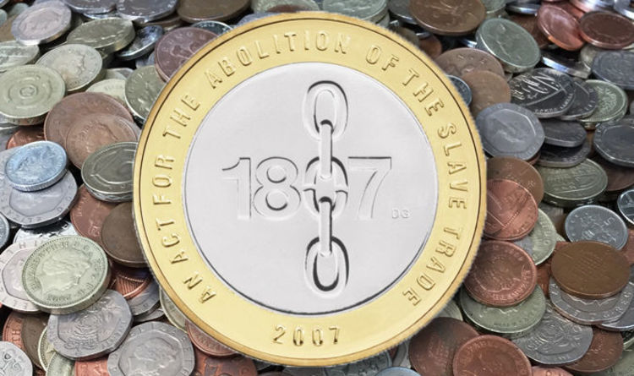
Coins to commemorate the end of the slave trade!
This £2 coin was made in 2007 it is very rare now. Because it is so very rare some people will pay up to £400 to collect this.

