Slide 1
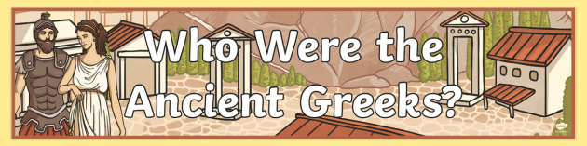
By Joanna Dougan

Slide 2
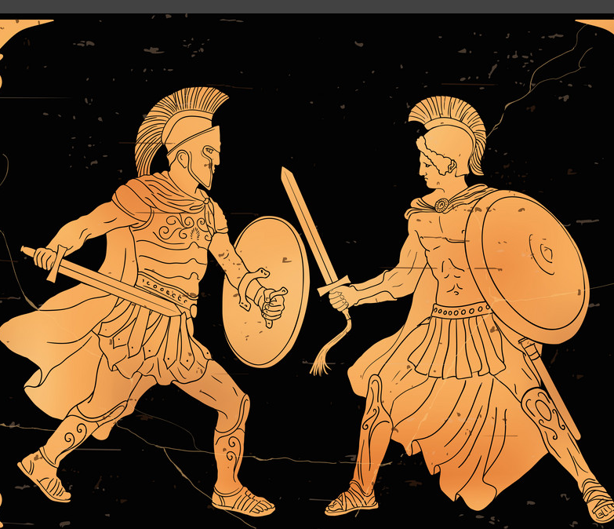
The Ancient Greeks
The Ancient Greeks were people who lived in Greece from around 3,500 B.C.
They also lived in the north and east, in the lands that we now called Romania and Turkey.
Greece become one of the most important places in the ancient world.

Slide 3
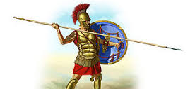
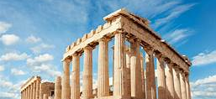
Why were the Ancient Greeks important?
The Greeks were great thinkers, warriors, writers, actors, athletes, artists, architects and politicians.

Slide 4
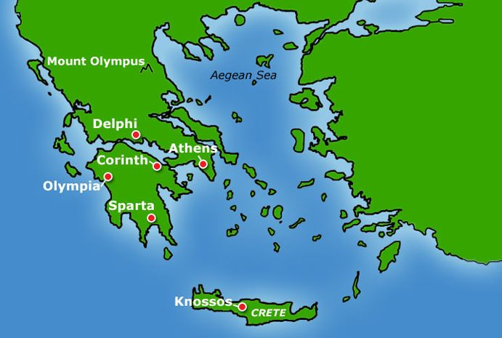
This is a map of Ancient Greece

Slide 5
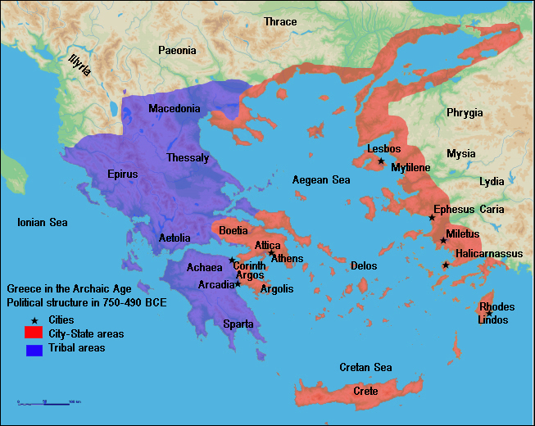
How was Greece ruled?
There was not one country called ‘Ancient Greece’ because Greece was divided up into small city-states
The most important city-states were Athens, Sparta, Corinth and Olympia.
Each city-state ruled itself.
They had their own governments, laws and army.
The city-states didn’t always get on very well and often fought each another.
Sometimes they joined together, to fight against a bigger enemy, like the Persian empire.

Slide 6
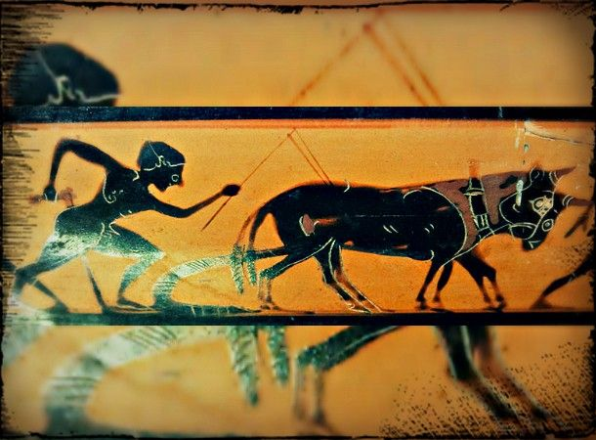
What was Ancient Greek like?
This is picture of an ancient Greek farmer at work, which was painted onto a Greek vase.
Ancient Greece had a warm, dry climate, like Greece does today.
Most people were farmers and fishermen, but many were also involved in trade. Some were soldiers, scholars, scientists and artists.
Greek cities had beautiful temples with stone columns and statues, and open-air theatres where people sat to watch plays.
Most people lived in villages or in the countryside.
Many Greeks were poor, and life was hard, because farmland, water and timber for building were scarce.
That's why many Greeks sailed off to find new lands to settle.

Slide 7
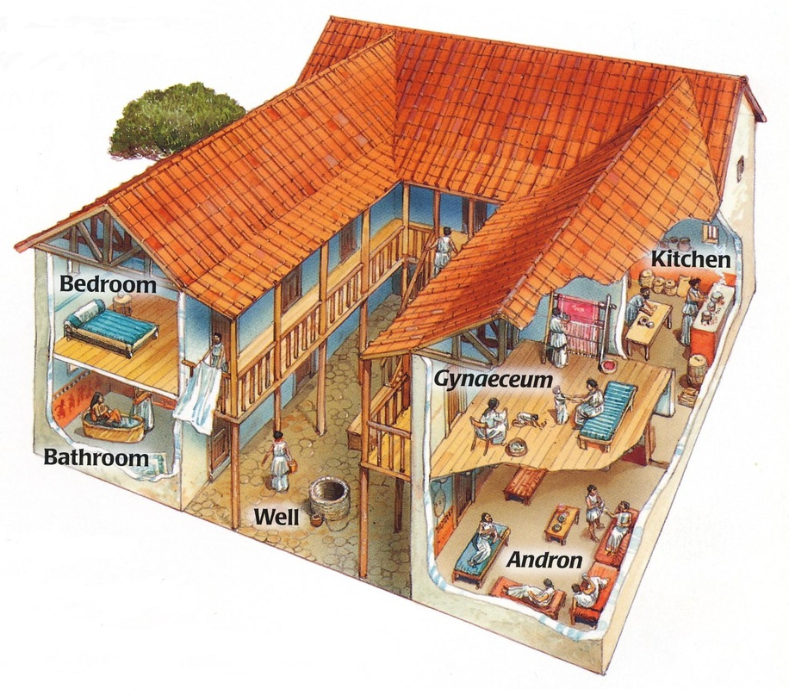
What were Greek homes like?
The homes of rich Ancient Greeks were built around a courtyard or garden. The walls were made from wood. They had small windows with no glass, but wooden shutters to keep out the hot sun.
Rich people decorated the walls and floors with colourful tiles and paintings.
Rich people (with slaves to carry the water) enjoyed baths at home. Afterwards they rubbed their bodies with perfumed oil to keep their skin soft.
At night, rich Greeks slept on beds stuffed with wool and feathers.

Slide 8
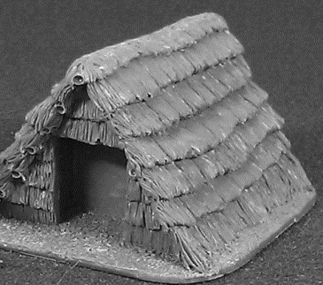
Homes of the poor
The walls were often made from mud bricks. They had small windows with no glass.
They didn't have much furniture inside. People sat on wooden chairs or stools
There was no bathroom. In the cities there were public baths, but most people washed using a small bucket or in a nearby stream.
At night, poor Greeks slept on beds stuffed with dry grass.
Most poor people went to bed as soon as it got dark because they had no oil lamps or candles.

Slide 9
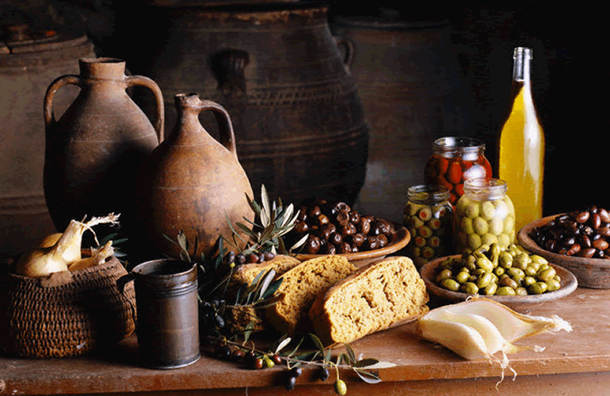
What were Greek meal-times like?
Men and women usually ate separately in Ancient Greece.
Rich people always ate at home - only slaves and poor people would eat in public.
Everyone ate with their fingers, so food was cut up in the kitchen first.
For breakfast, rich Greeks ate fruit with bread dipped in wine. For the poor it might be bread and cheese.
For dinner, people ate porridge made from barley, the rich ate it with cheese, fish, vegetables, eggs and fruit. For pudding people who could afford it ate nuts, figs and cakes sweetened with honey.
Everyone ate olives at most meals.
Only rich people ate a lot of meat. They would eat hares, deer and wild boar killed by hunters. Octopus was a favourite seafood.

Slide 10
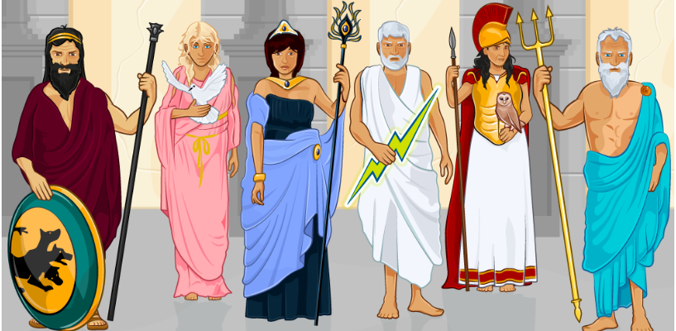
The Greeks believed that gods and goddesses watched over them.
The Greeks believed in many powerful gods and goddesses.
They believed these gods felt human emotions, like love, anger and jealousy, and they did not always behave themselves.

Slide 11
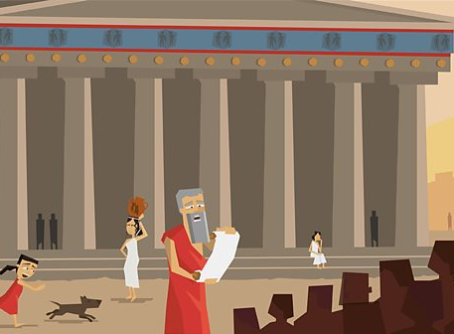
A Greek temple to the gods

Slide 12
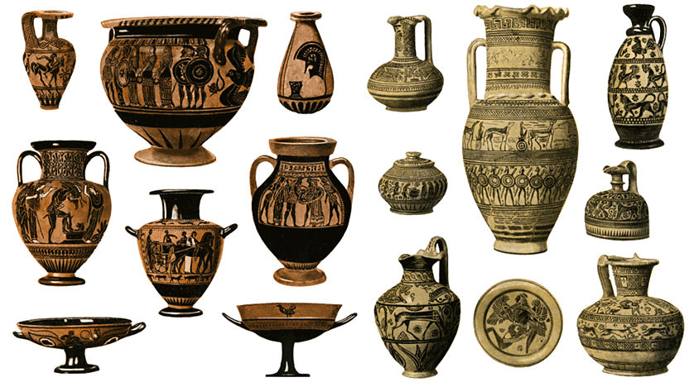
Greek culture: pottery
The Greeks had a trademark red and black pottery which was bought and sold all over the Mediterranean and even parts of Asia.

Slide 13
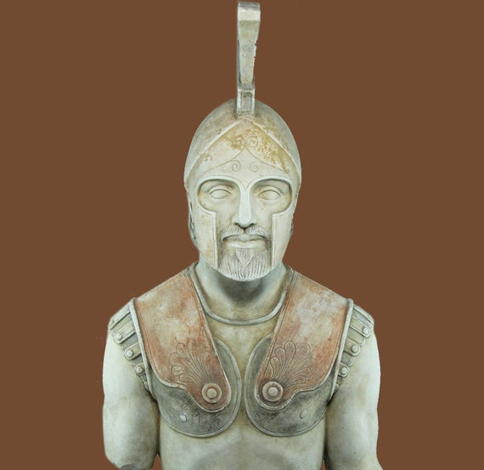
Greek culture: sculptures
The Greeks built grand temples to their gods and superb sculptures of brave heroes.
This is a statue of Achilles, one of the most famous of all the Greek heroes.

Slide 14
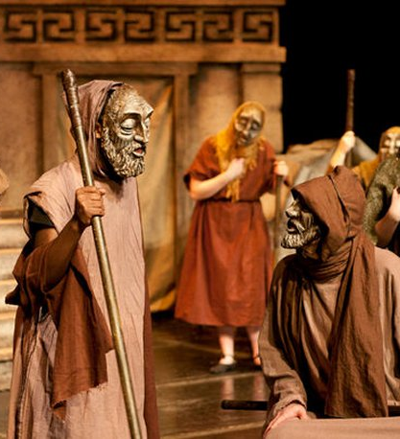
Greek culture: theatre
The Greeks also invented the theatre.
Thousands of people packed the hillside arena of ancient Athens to watch plays by famous writers like Sophocles, Euripides and Aeschylus.
The actors all wore masks.

Slide 15
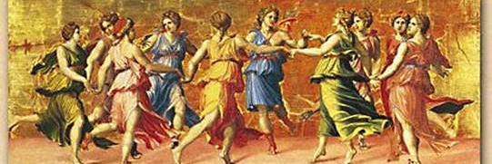
Greek culture: festivals
The Greeks also celebrated the arts with big festivals.
There was always music, dancing and feasting in honour of their gods.

Slide 16
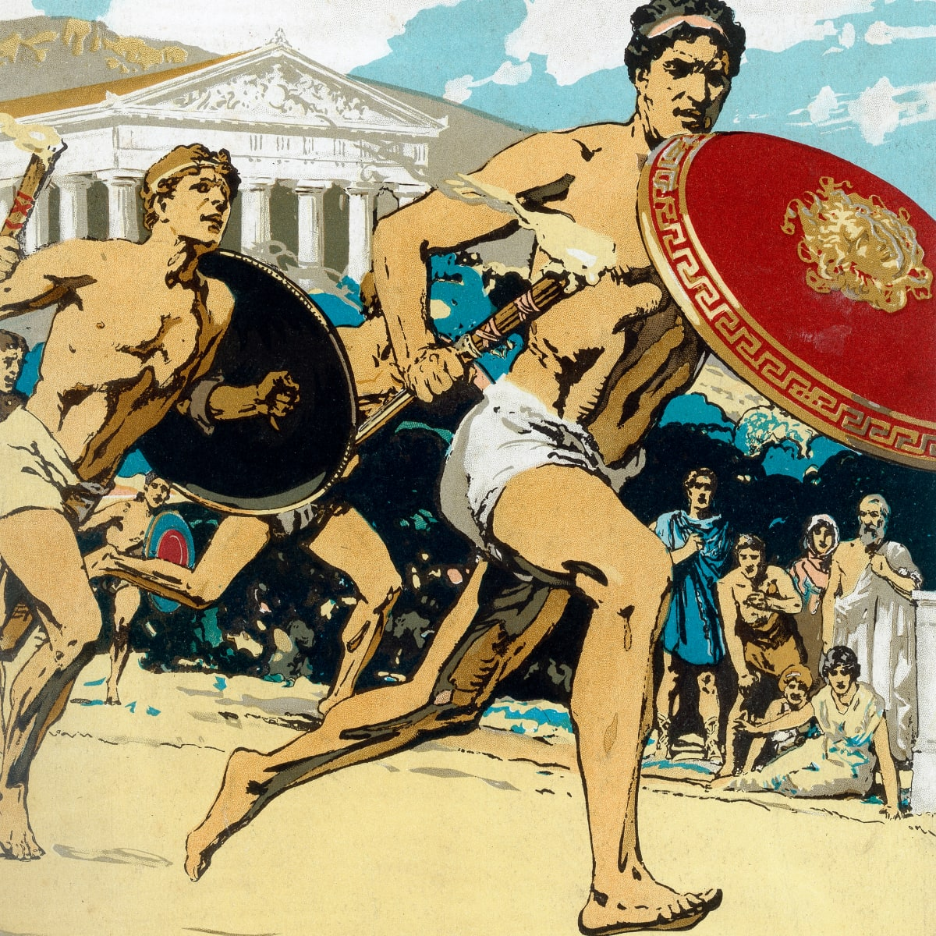
The Olympic games
The Greeks loved sport and the Olympic games were the biggest sporting event they had.
The Olympic games began over 2,700 years ago in Olympia, in south west Greece.
Every four years, around 50,000 people came from all over the Greek world to watch and take part.
The ancient games were also a religious festival, held in honour of Zeus , the king of the gods.

Slide 17
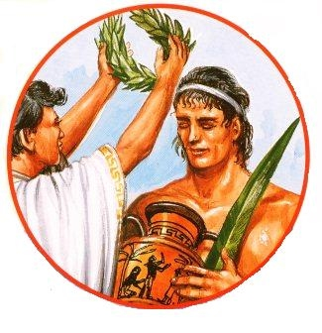
The winners
There were no gold, silver and bronze medals.
Winners were given a wreath of leaves and a hero's welcome back home.
Athletes competed for the glory of their city and winners were seen as being touched by the gods.

Slide 18
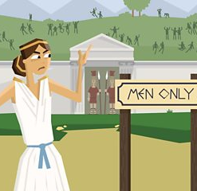
The Olympic games were for men only
Only men could compete in the Olympic games
Married women were not even allowed to watch the Olympic games.
However, one story tells of a mother so keen to see her son compete that she broke the no-women rule and got in disguised as a man.

Slide 19
The End!
Hope you liked it.
Hope you liked it.
Thanks for watching/reading!

