Slide 1
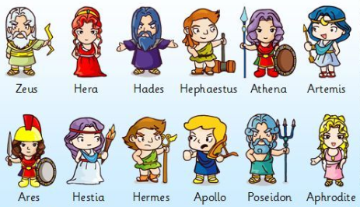

Ancient Greek
By Emma Walmsley

Slide 2
Zeus
Is my favourite god because, Zeus was the king of the gods, and the most powerful. He was the god of the sky and thunder, and controlled the weather. He had different powers, his most famous being the ability to hurl lightning bolts at those who displeased him! He hated dishonesty, and would punish those who lied or broke promises. Zeus was also a fearless leader, and would try a protect everyone.
In Greek mythology Sisyphus was the king of Ephyra (now known as Corinth). He was punished for his self-aggrandizing craftiness and deceitfulness by being forced to roll an immense boulder up a hill only for it to roll down every time it neared the top, repeating this action for eternity. Through the classical influence on modern culture, tasks that are both laborious and futile are therefore described as Sisyphean

Slide 3
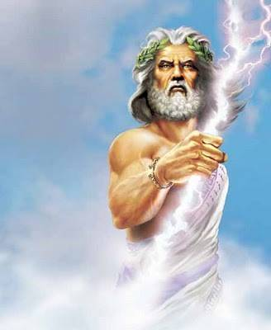
Zeus
Zeus wasn’t always king of the gods. When he was still young, he had to take power from his father, Cronus. Since then, he reigns all-powerful over the skies and Olympus, and he arbitrates any disputes that may arise between the gods. As god of nature, he has power over the human world, and sees that promises are and kept laws adhered to. He is, according to the author Homer, the ‘father of gods and men’, with men frequently invoking his protection. Once their father, Cronus, had been defeated, the Cyclopes gave each god a gift representing their divine futures. They gave Hades a helmet of invisibility, joining him forever to the kingdom of the dead. They gave Zeus thunder and lightning. To get what he wants, this womaniser is capable of many tricks. He charmed Europa by turning himself into a white bull, into a swan to entice Leda and into a shower of gold to conquer Danae. But his wife, Hera, is sometimes suspicious and comes down to earth. Occasionally, Zeus needs to change his lovers’ forms – he changed Io into a heifer!

